Slide 1






Guidance for Video/Audio in PowerPoints
1. Open the folder and copy all the files.
2. Paste the copied files into a new folder.
3. Open the PowerPoint file, enable editing and enter presentation mode (start the slide show).
Please note the embedded audio may not be compatible with early versions of PowerPoint.
You may wish to delete this slide before beginning the presentation.

Slide 3



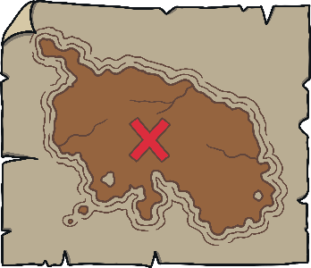








Revisit and Review
Let’s practise Sam’s Sounds and Tricky Words!
v
j
y
x
qu
ch
w
zz
z
th
th
sh
be
me
she
we
he

Slide 4
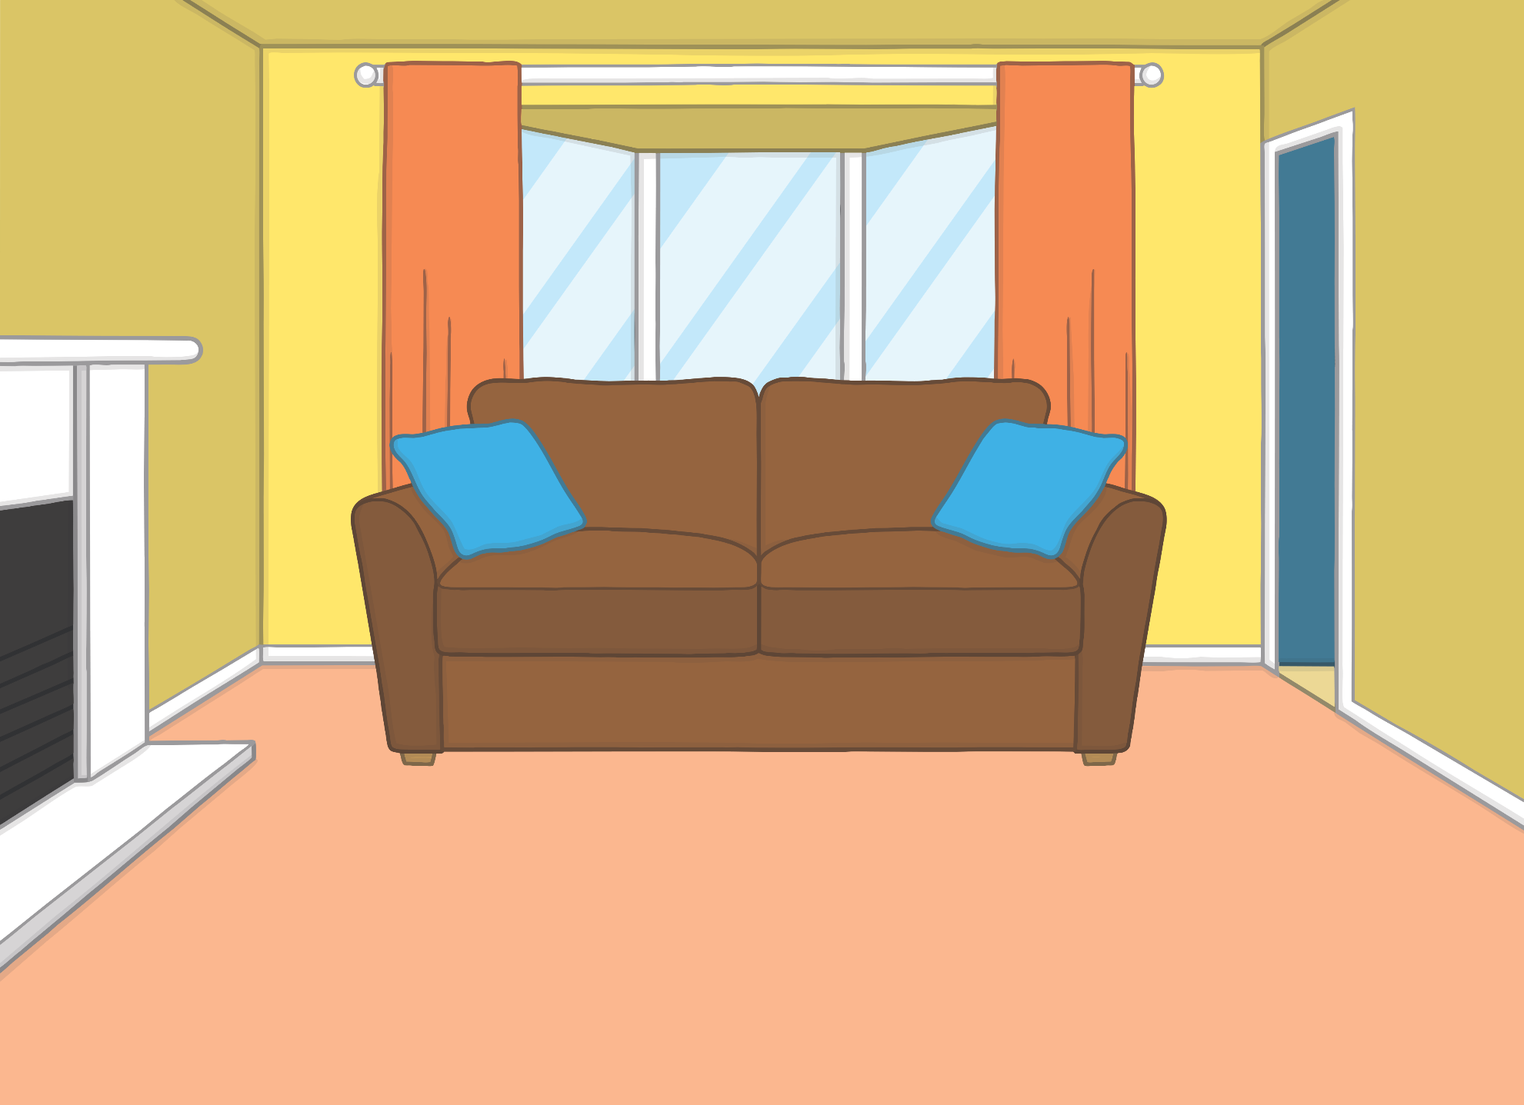



Teach
One day, Mum was upset. “Are you okay, Mum?” asked Kit.
“I’ve lost my ring!” said Mum.
“Don’t worry,” said Kit. “I’ll help you to look for it.”

Slide 5
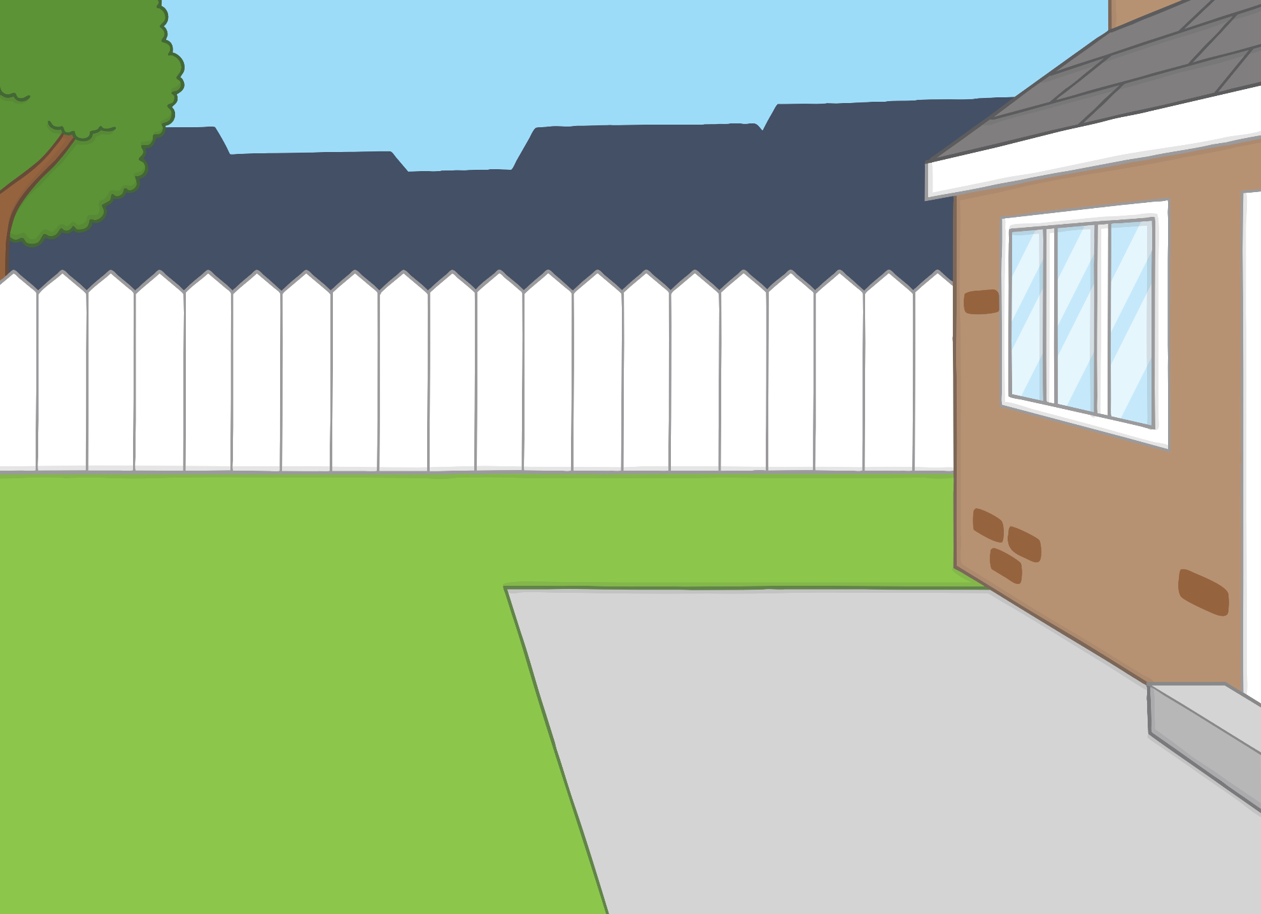
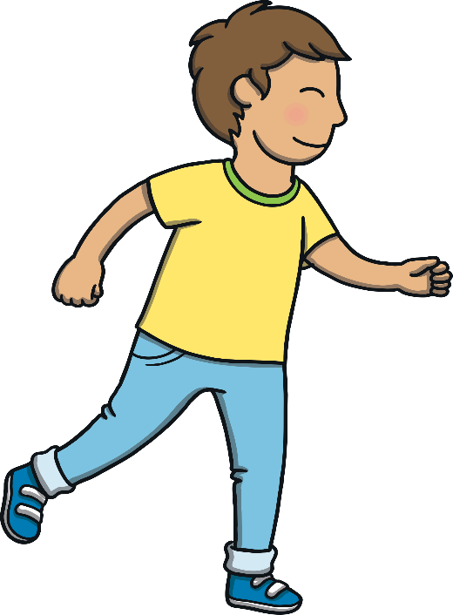
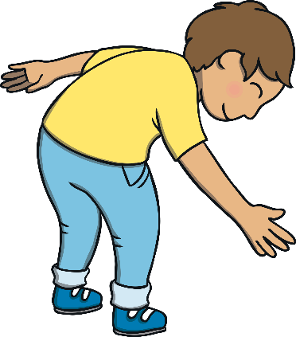



Teach
Kit thought hard about all the places the ring could be. Then, he remembered that Mum had been gardening that morning. He ran outside as quick as he could to check in the garden.

Slide 6

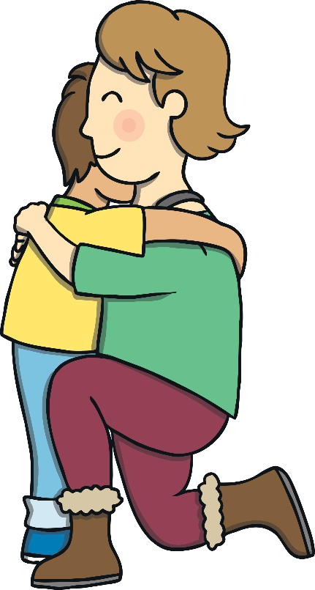
Teach
“The ring was inside your gardening glove!” he said to Mum, handing the ring back.
“Thank you, Kit,” said Mum, as she gave him a big hug. “You’d make a great detective!”

Slide 7


n
g
Teach
n and g are partners. They say ng.

Slide 8

Teach
ng

Slide 9



Detective Kit
Practise
Kit is playing detective and has found lots of things! Can you help him to write down what he has found in his detective notes?

Slide 10

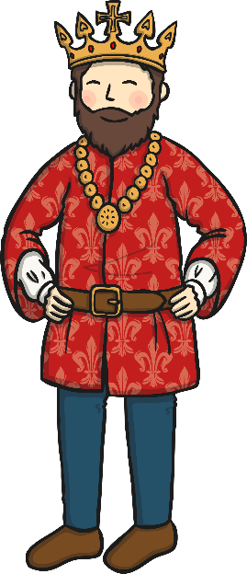


Practise
king
Show Suggestion

Slide 11
Practise
wings
Show Suggestion

Slide 12

Practise
ring
Show Suggestion

Slide 13
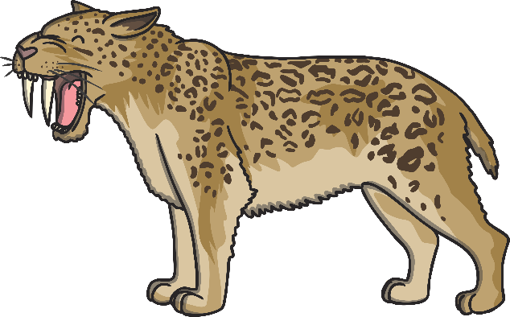
Practise
fang
Show Suggestion

Slide 14

Practise
gong
Show Suggestion

Slide 15
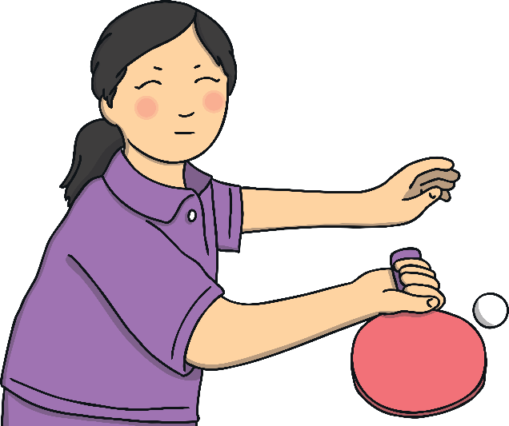
Practise
ping pong bat
Show Suggestion

Slide 16
Apply
Kit decided to carry on being a detective with his magnifying glass. He went to investigate in his bedroom. “Hmm. What do we have here?” he said, as he pulled something out from under his bed.

Slide 17

Sentence Time
Apply
What did Kit find under his bed? Look at the picture and write a caption or sentence to match.
X
Click ‘Sound Buttons On/Off’ to select whether you want to show sound buttons under the caption.
Click me for Kit’s teaching tips!

Slide 18

Apply
Kit got a long sock.
Sound Buttons On/Off
Show

Slide 19

Apply
“Look what else I found!” said Kit.
“Well done!” said Mum.
“The case of the missing long football sock is closed,” said Kit.
“I think we should give it a wash and hang it out to dry now!” said Mum.

Slide 20

Today, we have learnt…
ng

