Slide 1






Guidance for Video/Audio in PowerPoints
1. Open the folder and copy all the files.
2. Paste the copied files into a new folder.
3. Open the PowerPoint file, enable editing and enter presentation mode (start the slide show).
Please note the embedded audio may not be compatible with early versions of PowerPoint.
You may wish to delete this slide before beginning the presentation.

Slide 3




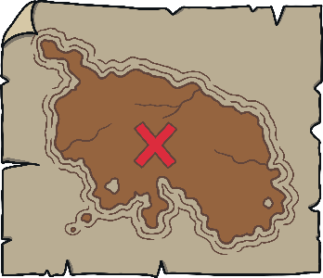




Revisit and Review
Let’s practise Sam’s Sounds and Tricky Words!
w
v
j
y
qu
zz
z
ch
x
she
he

Slide 4

Revisit and Review
This week, we meet our next tricky words –
we, me and be.
Tricky words are words that can’t be sounded out. We just have to learn them off by heart!

Slide 5


Tricky Aeroplanes
Teach
Shout out the tricky words on the aeroplanes. Watch out for tricky words we, me and be!
X
Remember, tricky words from this level are shown in red in the story and decodable or familiar words are in purple. Digraphs and trigraphs are underlined.
Click me for Kit’s teaching tips!

Slide 6
Teach
he
me
she
we
we
me
he
she
me
he
we
she

Slide 7
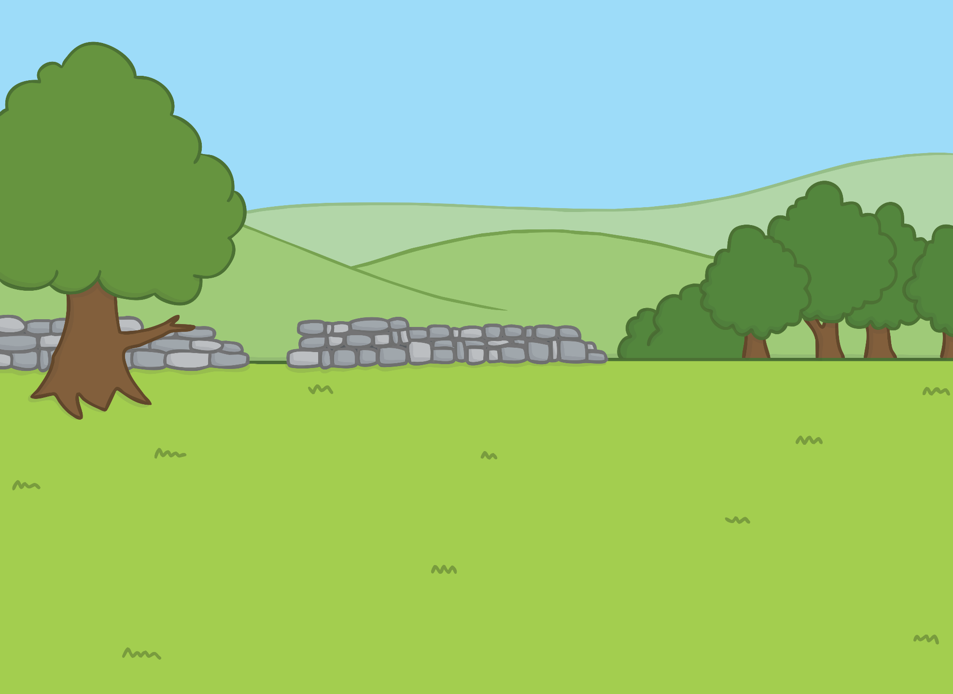
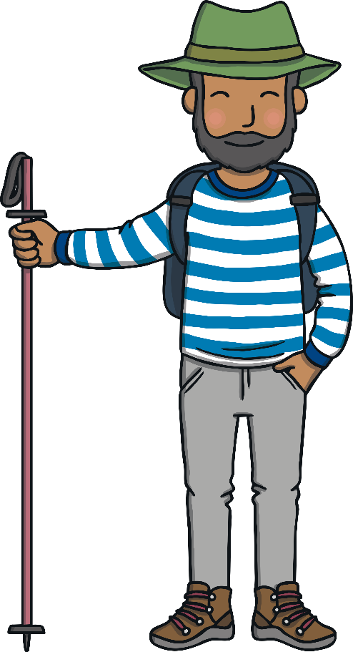



Teach
It was a lovely day so the family went for a long ramble in the countryside. Kit and Sam were wearing their shiny new wellies.

Slide 8
Teach
They climbed over a stile and into a field of sheep. The sheep were dozing in the sun.
“Look!” said Sam. “The sheep are sleeping!”

Slide 9

Teach
“Sh!” said Kit, putting his finger to his lips. “Let’s not wake the sleepy sheep.”

Slide 10


Teach
s
h
s and h are partners. They say sh.

Slide 11

Teach
sh

Slide 12


Action
Teach
Put a finger to your lips.
Say ‘shhh’.

Slide 13



Let’s Sing!
Teach
(To the tune of ‘’Rock-a-Bye-Baby)
sh - the sheep lying still in the grass,
We will make no noise as we walk past.
sh - they are peaceful, calm as can be,
Snuggled together under a tree.
Play Song

Slide 14

Signposts
Practice
At the edge of the field, there are signposts. Can you help Kit and Sam to read the signs?

Slide 15
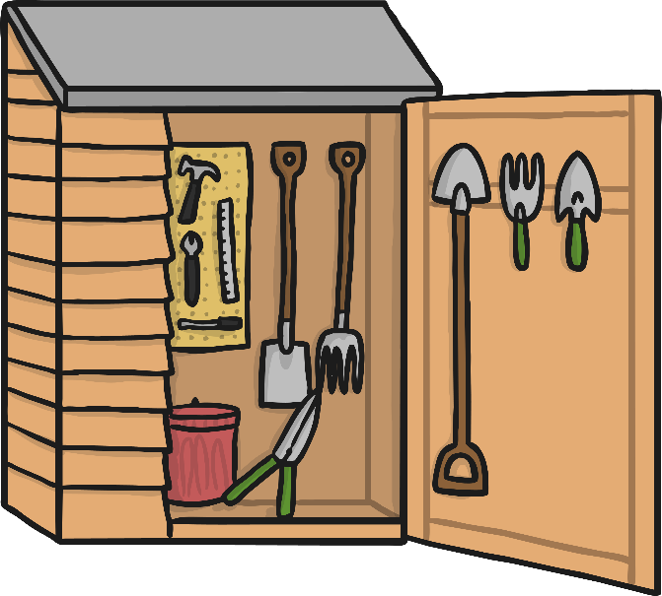
Practice
shed
Check

Slide 16

Practice
shop
Check

Slide 17

Practice
ship
Check

Slide 18
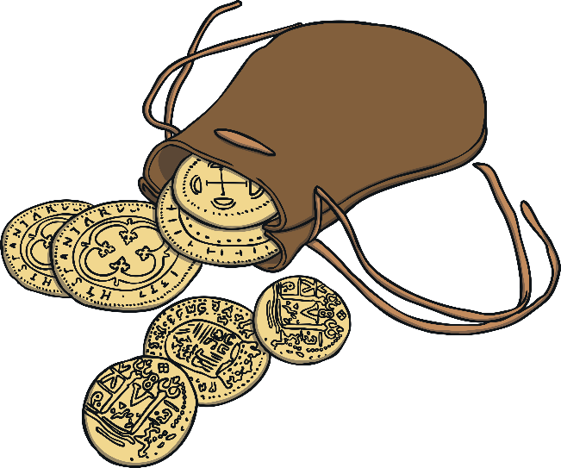
Practice
cash
Check

Slide 19

Practice
fish
Check

Slide 20

Practice
shell
Check

Slide 21

Apply
“Which way shall we go?” said Sam.
“Let’s head towards the shop,” said Dad. “We can get an ice cream to cool us down.”

Slide 22

Sentence Time
Apply
What happened when Kit and Sam got to the shop? Read the sentence, then click ‘Show’ to reveal the answer!
X
Click ‘Sound Buttons On/Off’ to select whether you want to show sound buttons under the caption.
Click me for Kit’s teaching tips!

Slide 23
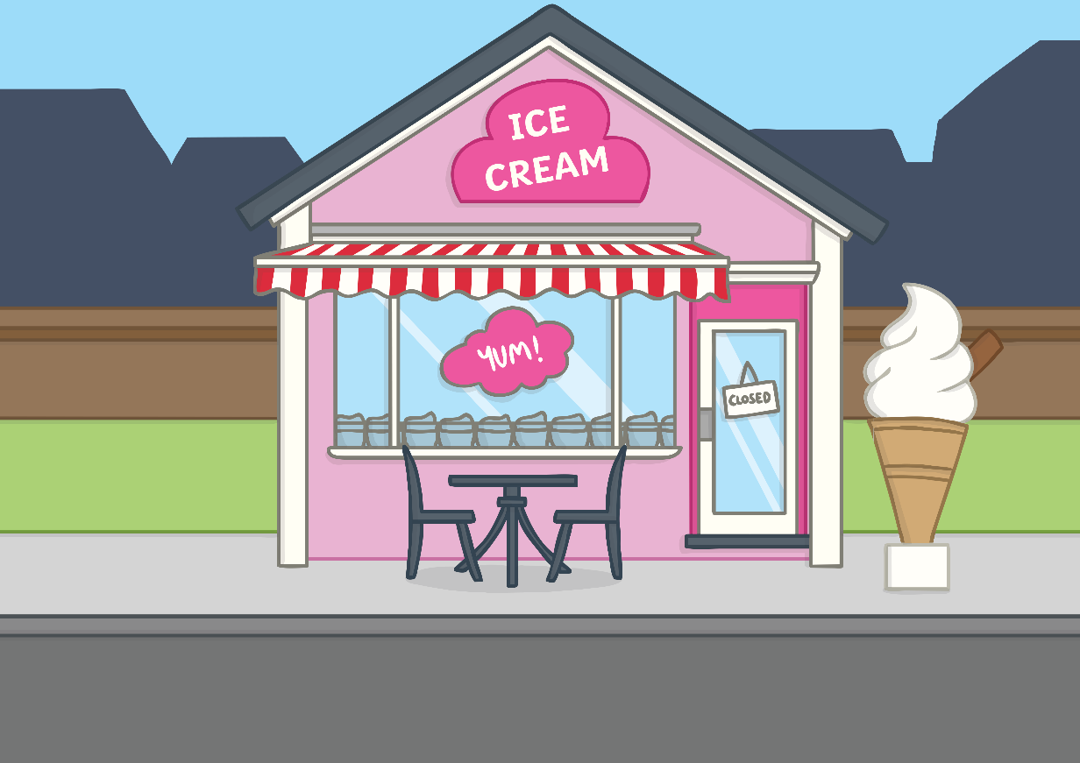
Apply
The shop is shut.
Sound Buttons On/Off
Show

Slide 24





Apply
Hooray!
Hush!
“What a shock!” said Dad.
“Oh, well,” said Mum, “let’s head back.”
Just as they turned around, the shop door opened!
“Hooray!” shouted Kit and Sam but all their shouting woke up the sheep!

Slide 25
Today, we have learnt…
sh

