Slide 1
Week 1: Lesson 5
Growing 6, 7, 8

Slide 2
Lesson 5:
1 More and Less

Slide 3

Lesson 5
One More and Less
In today’s lesson, we are going to be learning to find one more and one less than a number of objects.
3

Slide 4
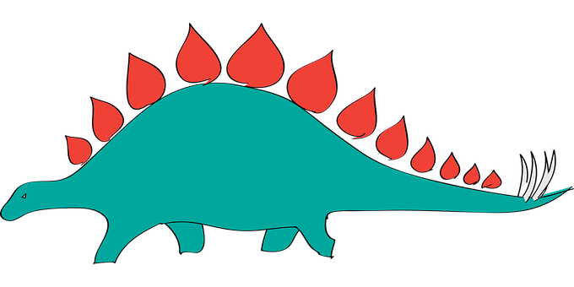

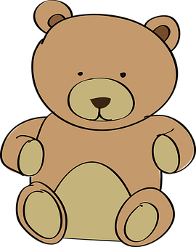
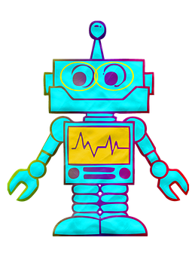
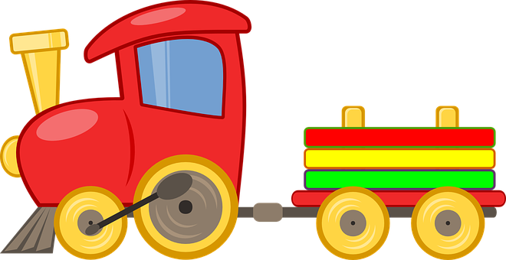
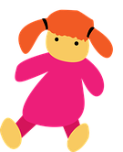
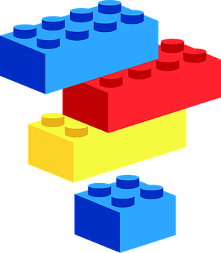
Activity 1
Which Toy is Missing?
Here are some toys. There is a dinosaur, a ball, a teddy, a train, a doll, some bricks and a robot.
4

Slide 5
Activity 1
Which Toy is Missing?
Look really carefully at the toys.
One of the toys will disappear.
Can you spot which toy goes missing?
5

Slide 6
Activity 1
Which Toy is Missing?
Which toy has gone missing?
6

Slide 7
Activity 1
Which Toy is Missing?
Well spotted, it was the ball!
7

Slide 8
Activity 1
Which Toy is Missing?
Look carefully at the toys again.
8

Slide 9
Activity 1
Which Toy is Missing?
Which toy is missing this time?
9

Slide 10
Activity 1
Which Toy is Missing?
Yes, it was the train.
10

Slide 11
Activity 1
Which Toy is Missing?
Look carefully at the toys again.
11

Slide 12
Activity 1
Which Toy is Missing?
Which toy is missing this time?
12

Slide 13
Activity 1
Which Toy is Missing?
Yes, the dinosaur was missing.
13

Slide 14
Activity 1
Which Toy is Missing?
Look carefully at the toys again.
14

Slide 15
Activity 1
Which Toy is Missing?
Which toy is missing this time?
15

Slide 16
Activity 1
Which Toy is Missing?
Yes! The doll was missing.
16

Slide 17
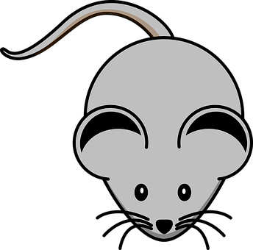
Activity 2
One More and One Less
Here are some mice.
How many mice can you see here?
17

Slide 18
Activity 2
One More and One Less
There are 7 mice altogether.
7
18

Slide 19


Activity 2
One More and One Less
The mice are covered with a blanket. 1 mouse runs away.
There aren’t 7 mice under the blanket anymore. There is 1 less than 7.
How many mice are left under the blanket?
19

Slide 20
Activity 2
One More and One Less
Yes, there are 6 mice left under the blanket.
6
20

Slide 21
Activity 2
One More and One Less
So, now we have 6 mice underneath the blanket. 1 mouse
runs away. Now there is 1 less than 6 mice under the blanket.
How many mice are left under the blanket?
21

Slide 22
Activity 2
One More and One Less
Yes, now there are 5 mice left underneath the blanket.
5 is one less than 6.
5
22

Slide 23
Activity 2
One More and One Less
Now there are 5 mice underneath the blanket. This time, 1 mouse runs underneath the blanket. There is 1 more than 5.
How many mice are underneath the blanket?
23

Slide 24
Activity 2
One More and One Less
Yes, now there are 6 mice underneath the blanket.
One more than 5 is 6.
6
24

Slide 25
Activity 2
One More and One Less
There are 6 mice underneath the blanket. This time 2 mice run underneath the blanket. There is 2 more than 6.
How many mice are underneath the blanket?
25

Slide 26
Activity 2
One More and One Less
Yes, now there are 8 mice underneath the blanket.
8 is 2 more than 6.
6
26

Slide 27
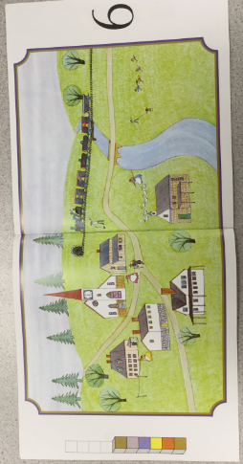

Slide 28
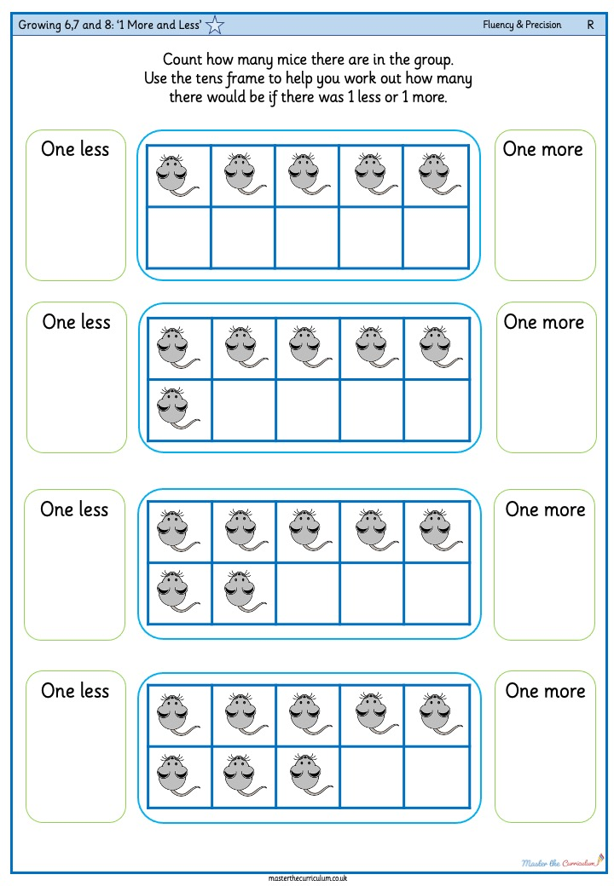
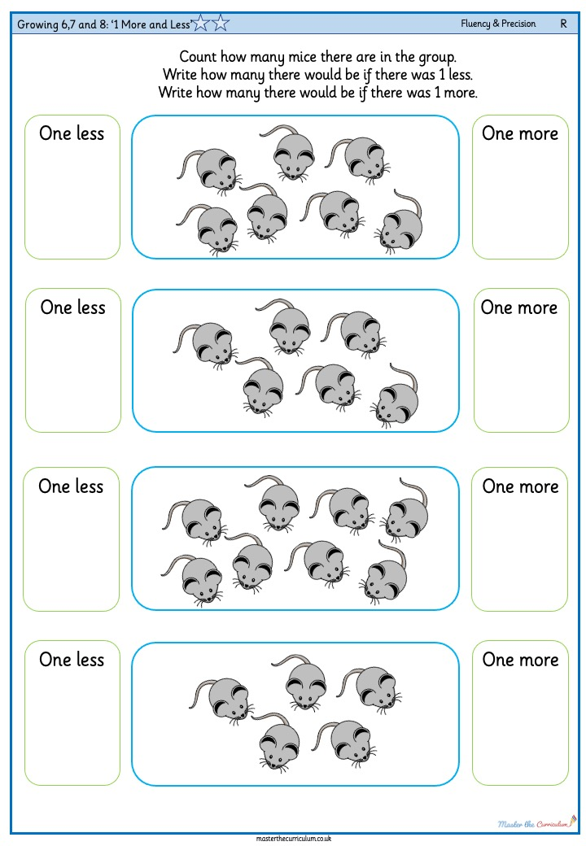
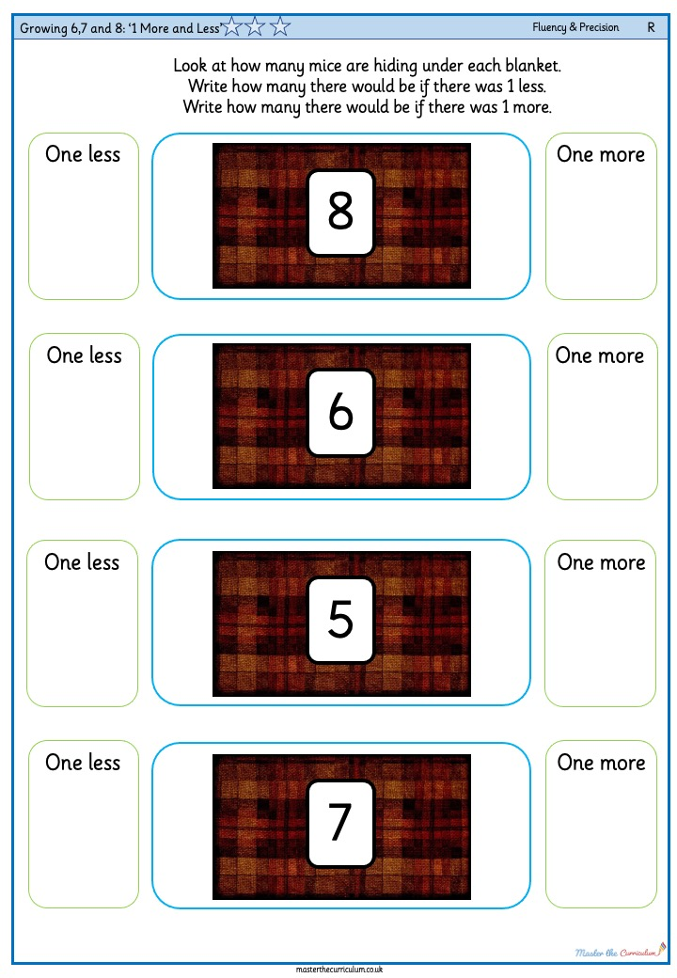
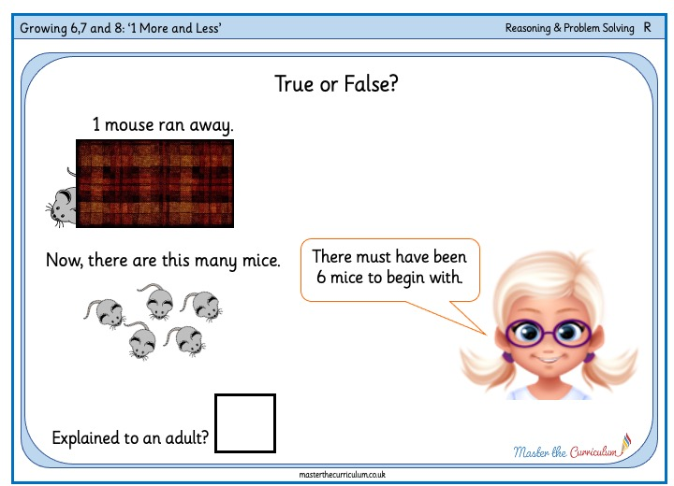
Your turn!
Matching 6, 7 and 8
These are the activities that you can do.
Use a box of toys.
Count the toys in the toy box.
Then take one toy out or put another toy in and say how many toys are in the toy box now.
Differentiated worksheets
28

