Slide 1
Week 1: Lesson 2
Alive in 5!

Slide 2
Lesson 2:
How Many?
Representing Zero

Slide 3

Lesson 2
Representing Zero
In today’s lesson we are going to be learning about 0.
3

Slide 4
Lesson 2
Representing Zero
First, we are going to see if we can recognise how many objects there are in a set.
4

Slide 5
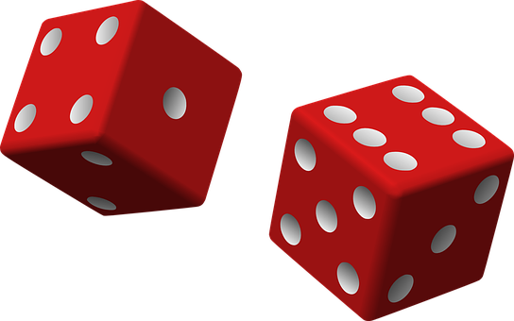
Activity 1
Dots
You are going to see some dots on the screen.
Some of the dots will be red and some of them will be black.
Can you tell me, as quickly as you can, how many
dots there are altogether?
5

Slide 6
Activity 1
Dots
How many dots are there altogether?
R – Alive in 5! – Week 1: L1
6

Slide 7
Activity 1
Dots
Yes, well done, there are 5 dots altogether.
There are 4 red dots and 1 black dot.
Altogether there are 5 dots.
5
7

Slide 8
Activity 1
Dots
How many dots are there now?
8

Slide 9
Activity 1
Dots
Yes, there are 3 dots.
There are 2 black dots and 1 red dot.
So there are 3 dots altogether.
3
R – Alive in 5! – Week 1: L1
9

Slide 10
Activity 1
Dots
How many dots are there this time?
R – Alive in 5! – Week 1: L1
10

Slide 11
Activity 1
Dots
Yes, there is 2 dots altogether.
They are both black.
2
R – Alive in 5! – Week 1: L1
11

Slide 12
Activity 1
Dots
How many dots are there now?
12

Slide 13
Activity 1
Dots
That’s right there is just 1 black dot.
1
13

Slide 14
Activity 1
Dots
How many dots are there this time?
14

Slide 15
Activity 1
Dots
Yes, there are 4 dots .
There are 2 black dots and 2 red dots.
So, there are 4 dots altogether.
4
15

Slide 16

Activity 2
Representing Zero
We have 0 if there is nothing there or if all of our objects have been taken away.
16

Slide 17


Activity 2
Representing Zero
Have a look at these two pictures.
What do you notice?
17

Slide 18
Activity 2
Representing Zero
What did you notice?
This plate has 3 strawberries on it.
This plate doesn’t have any strawberries.
It has 0 strawberries.
18

Slide 19

Activity 2
Representing Zero
Here is another picture.
What do you notice?
19

Slide 20
Activity 2
Representing Zero
There are 3 apples on the plate.
Watch what happens to the apples.
20

Slide 21
Activity 2
Representing Zero
All of the apples have been taken away.
They have all gone.
So, now we’re left with 0 apples.
21

Slide 22
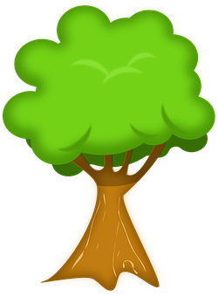
Activity 2
Representing Zero
Here are two different pictures.
What do you notice this time?
22

Slide 23
Activity 2
Representing Zero
The first tree has some apples on it.
Let’s count them.
3
1
4
2
23

Slide 24
Activity 2
Representing Zero
The are 4 apples on this tree.
Let’s show this on our 5 frame.
24

Slide 25
Activity 2
Representing Zero
Here is the numeral 4.
4
25

Slide 26
Activity 2
Representing Zero
What do you notice about the other tree?
4
26

Slide 27
Activity 2
Representing Zero
There aren’t any apples on this tree.
It has 0 apples.
4
27

Slide 28
Activity 2
Representing Zero
We can show zero on the 5 frame like this.
We don’t have any counters because there aren’t any apples.
4
28

Slide 29
Activity 2
Representing Zero
Here is the numeral.
4
0
29

Slide 30
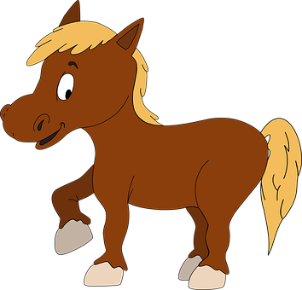
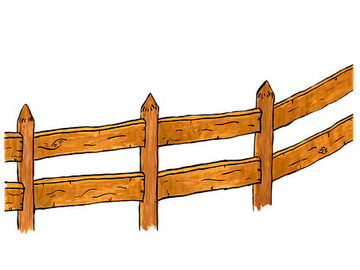
Activity 2
Representing Zero
Here are two different pictures.
Which picture shows 0?
30

Slide 31
Activity 2
Representing Zero
Yes, the first picture shows 0 because there aren’t any horses in this field.
31

Slide 32
Activity 2
Representing Zero
We can show zero on a 5 frame like this.
There are 5 empty spaces on the 5 frame. We haven’t got any counters because there are 0 horses.
32

Slide 33
Activity 2
Representing Zero
Here is the numeral.
0
33

Slide 34
Activity 2
Representing Zero
How many horses are there in the other field?
0
34

Slide 35
Activity 2
Representing Zero
There are 2 horses in the other field.
We can show this on a 5 frame with 2 counters.
0
35

Slide 36
Activity 2
Representing Zero
Here is the numeral.
0
2
36

Slide 37
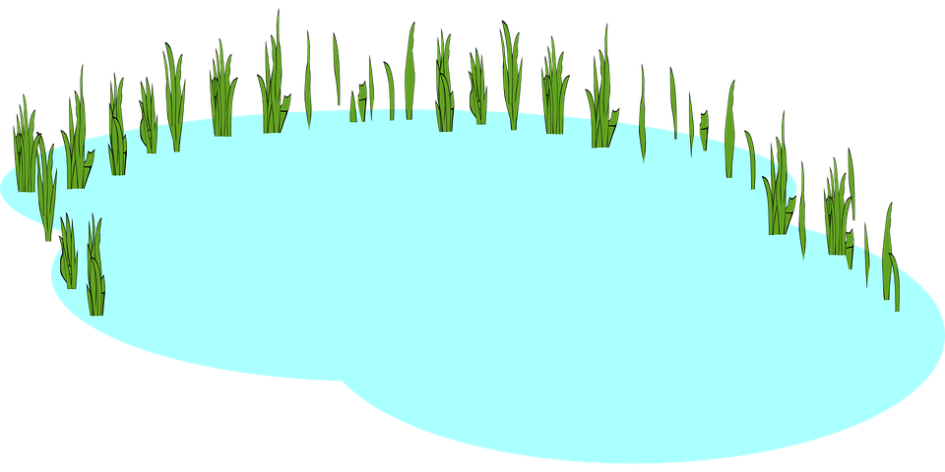

Activity 2
Representing Zero
Here are two different pictures.
What do you notice this time?
Which one shows 0?
37

Slide 38
Activity 2
Representing Zero
Well spotted! The second pond shows 0 because it doesn’t have any frogs in.
38

Slide 39
Activity 2
Representing Zero
Let’s show 0 on our 5 frame.
There is nothing on our 5 frame because there are 0 frogs.
39

Slide 40
Activity 2
Representing Zero
Here is the numeral.
0
40

Slide 41
Activity 2
Representing Zero
The other pond has 3 frogs in it.
We can show 3 on a 5 frame.
0
41

Slide 42
Activity 2
Representing Zero
Here is the numeral.
3
0
42

Slide 43






Activity 2
Representing Zero
Here are two different pictures.
What do you notice this time?
Which one shows 0?
43

Slide 44
Activity 2
Representing Zero
The second picture shows 0 because there aren’t any children on the bus.
The bus is empty.
44

Slide 45
Activity 2
Representing Zero
We can show 0 on a 5 frame like this.
45

Slide 46
Activity 2
Representing Zero
Here is the numeral 0.
0
46

Slide 47
Activity 2
Representing Zero
How many children are on the other bus?
0
47

Slide 48
Activity 2
Representing Zero
Yes, there are 5 children on the other bus.
We can show this on a 5 frame like this.
0
48

Slide 49
Activity 2
Representing Zero
Here is the numeral.
5
0
49

Slide 50
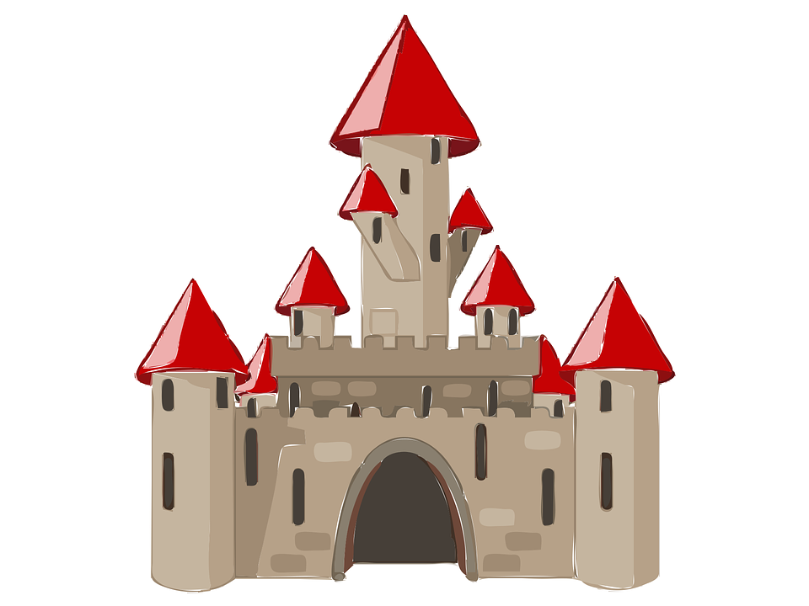

Activity 2
Representing Zero
Here is one last set of pictures.
What do you notice this time?
Which one shows 0?
50

Slide 51
Activity 2
Representing Zero
The first picture shows 0 because there isn’t anyone at the castle.
51

Slide 52
Activity 2
Representing Zero
We can show that on a 5 frame like this.
Our 5 frame is empty because there is nobody in the castle.
52

Slide 53
Activity 2
Representing Zero
Here is the numeral.
0
53

Slide 54
Activity 2
Representing Zero
How many people are in the other castle?
0
54

Slide 55
Activity 2
Representing Zero
There is 1.
We can show that on our 5 frame.
0
55

Slide 56
Activity 2
Representing Zero
Here is the numeral.
0
1
56

Slide 57
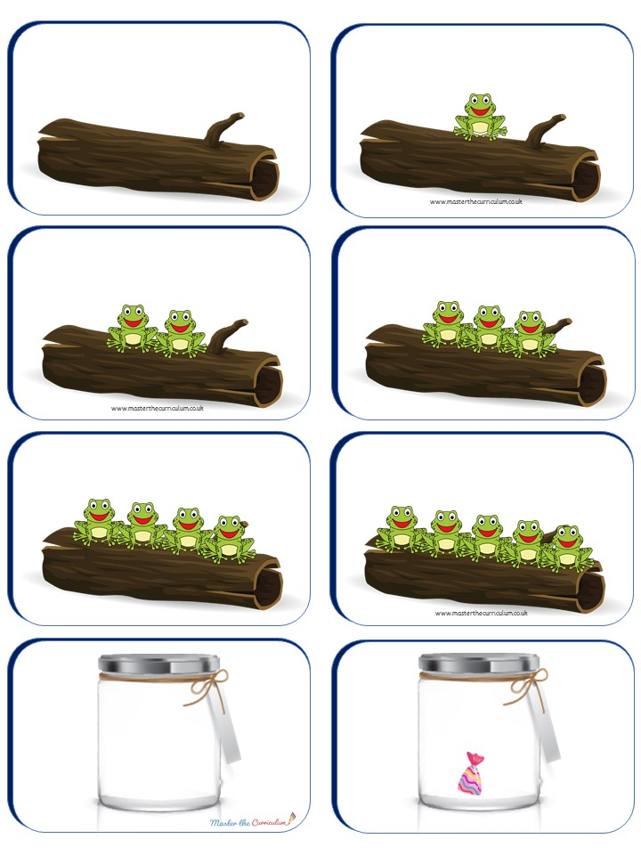
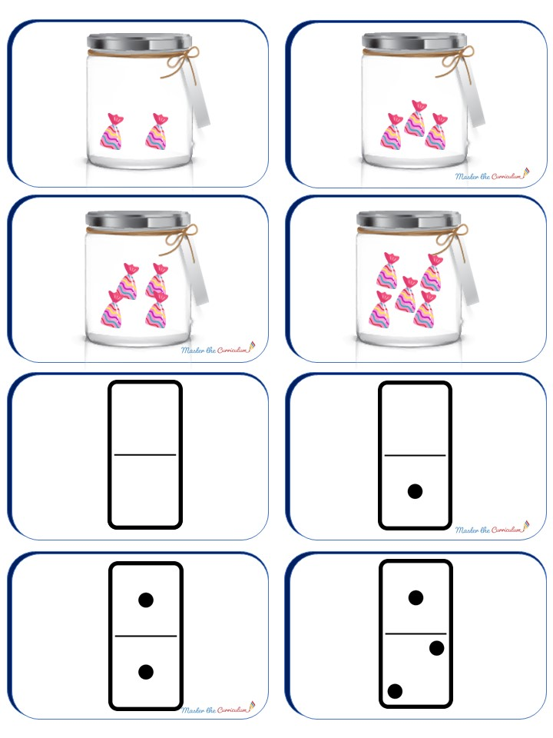
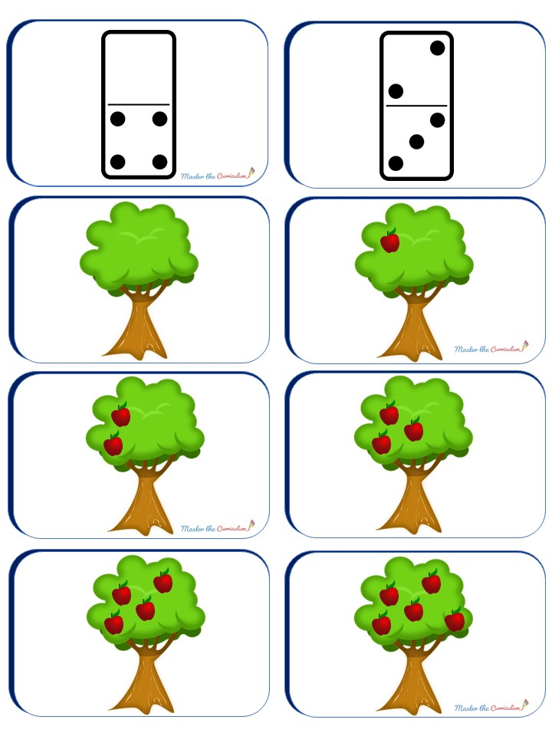
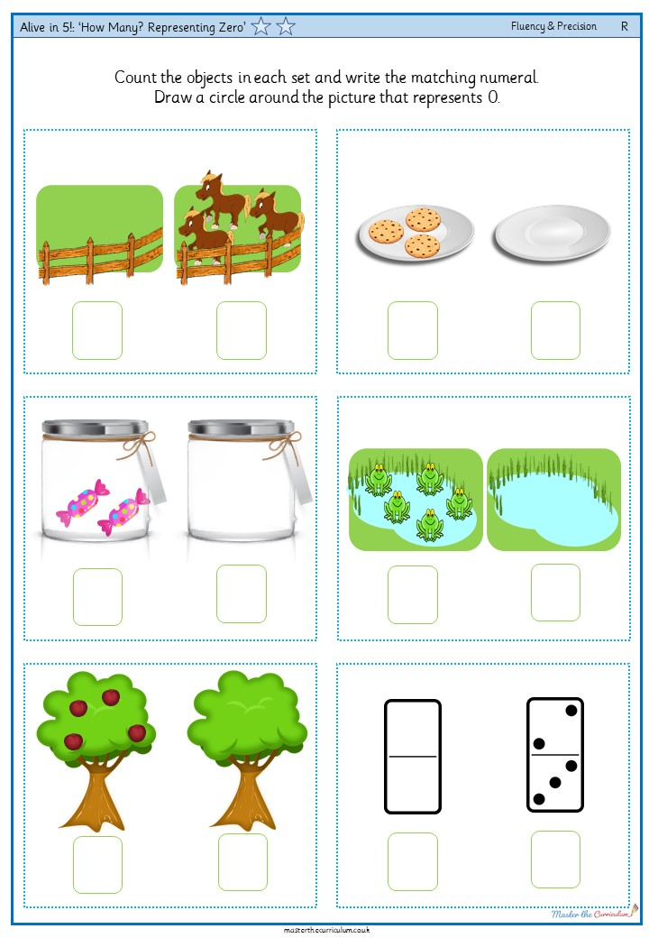
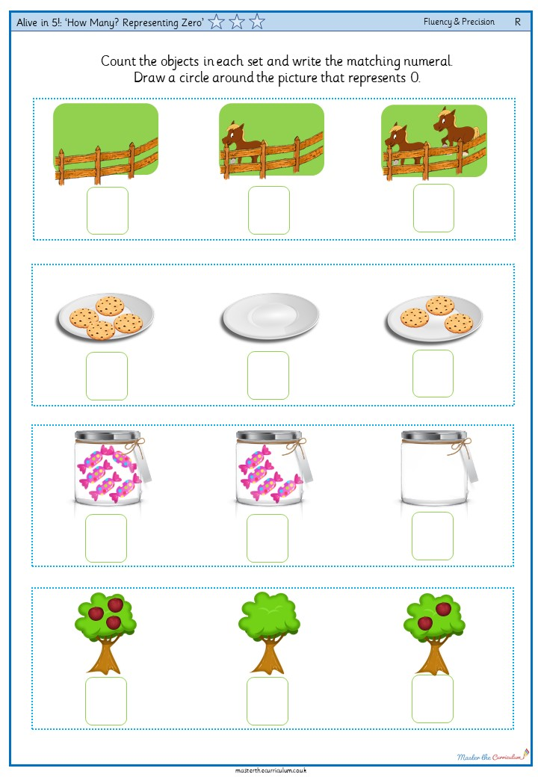
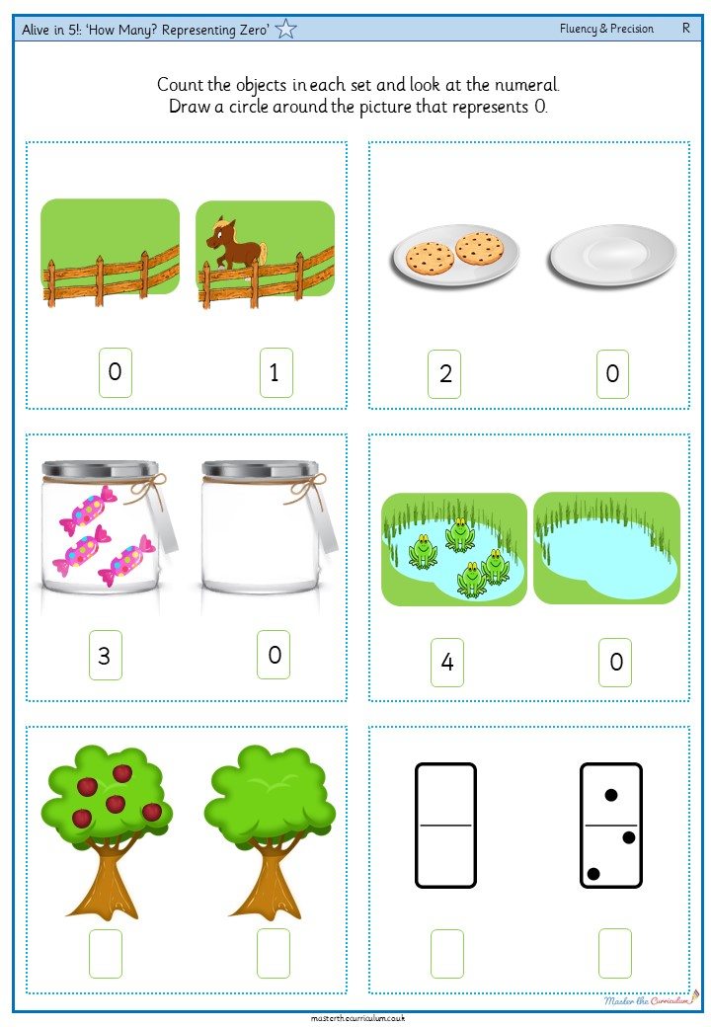
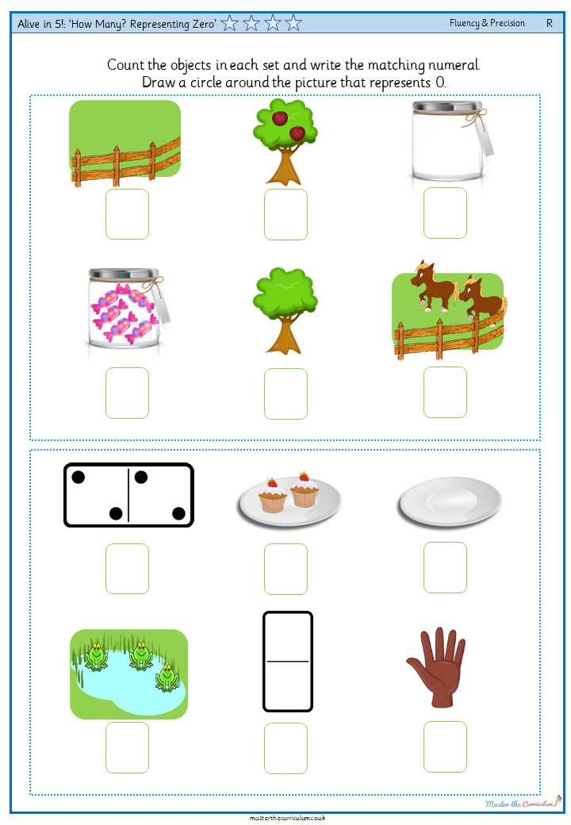
Your turn!
Representing Zero
These are the activities that you can do.
Can you sort the cards into those that show 0 and those that show more than 0?
Look at the pictures on your sheet and count how many objects are in each set.
Circle the pictures that show 0.
57

