Slide 1
Week 1: Lesson 1
Alive in 5!

Slide 2
Lesson 1:
One Less

Slide 3
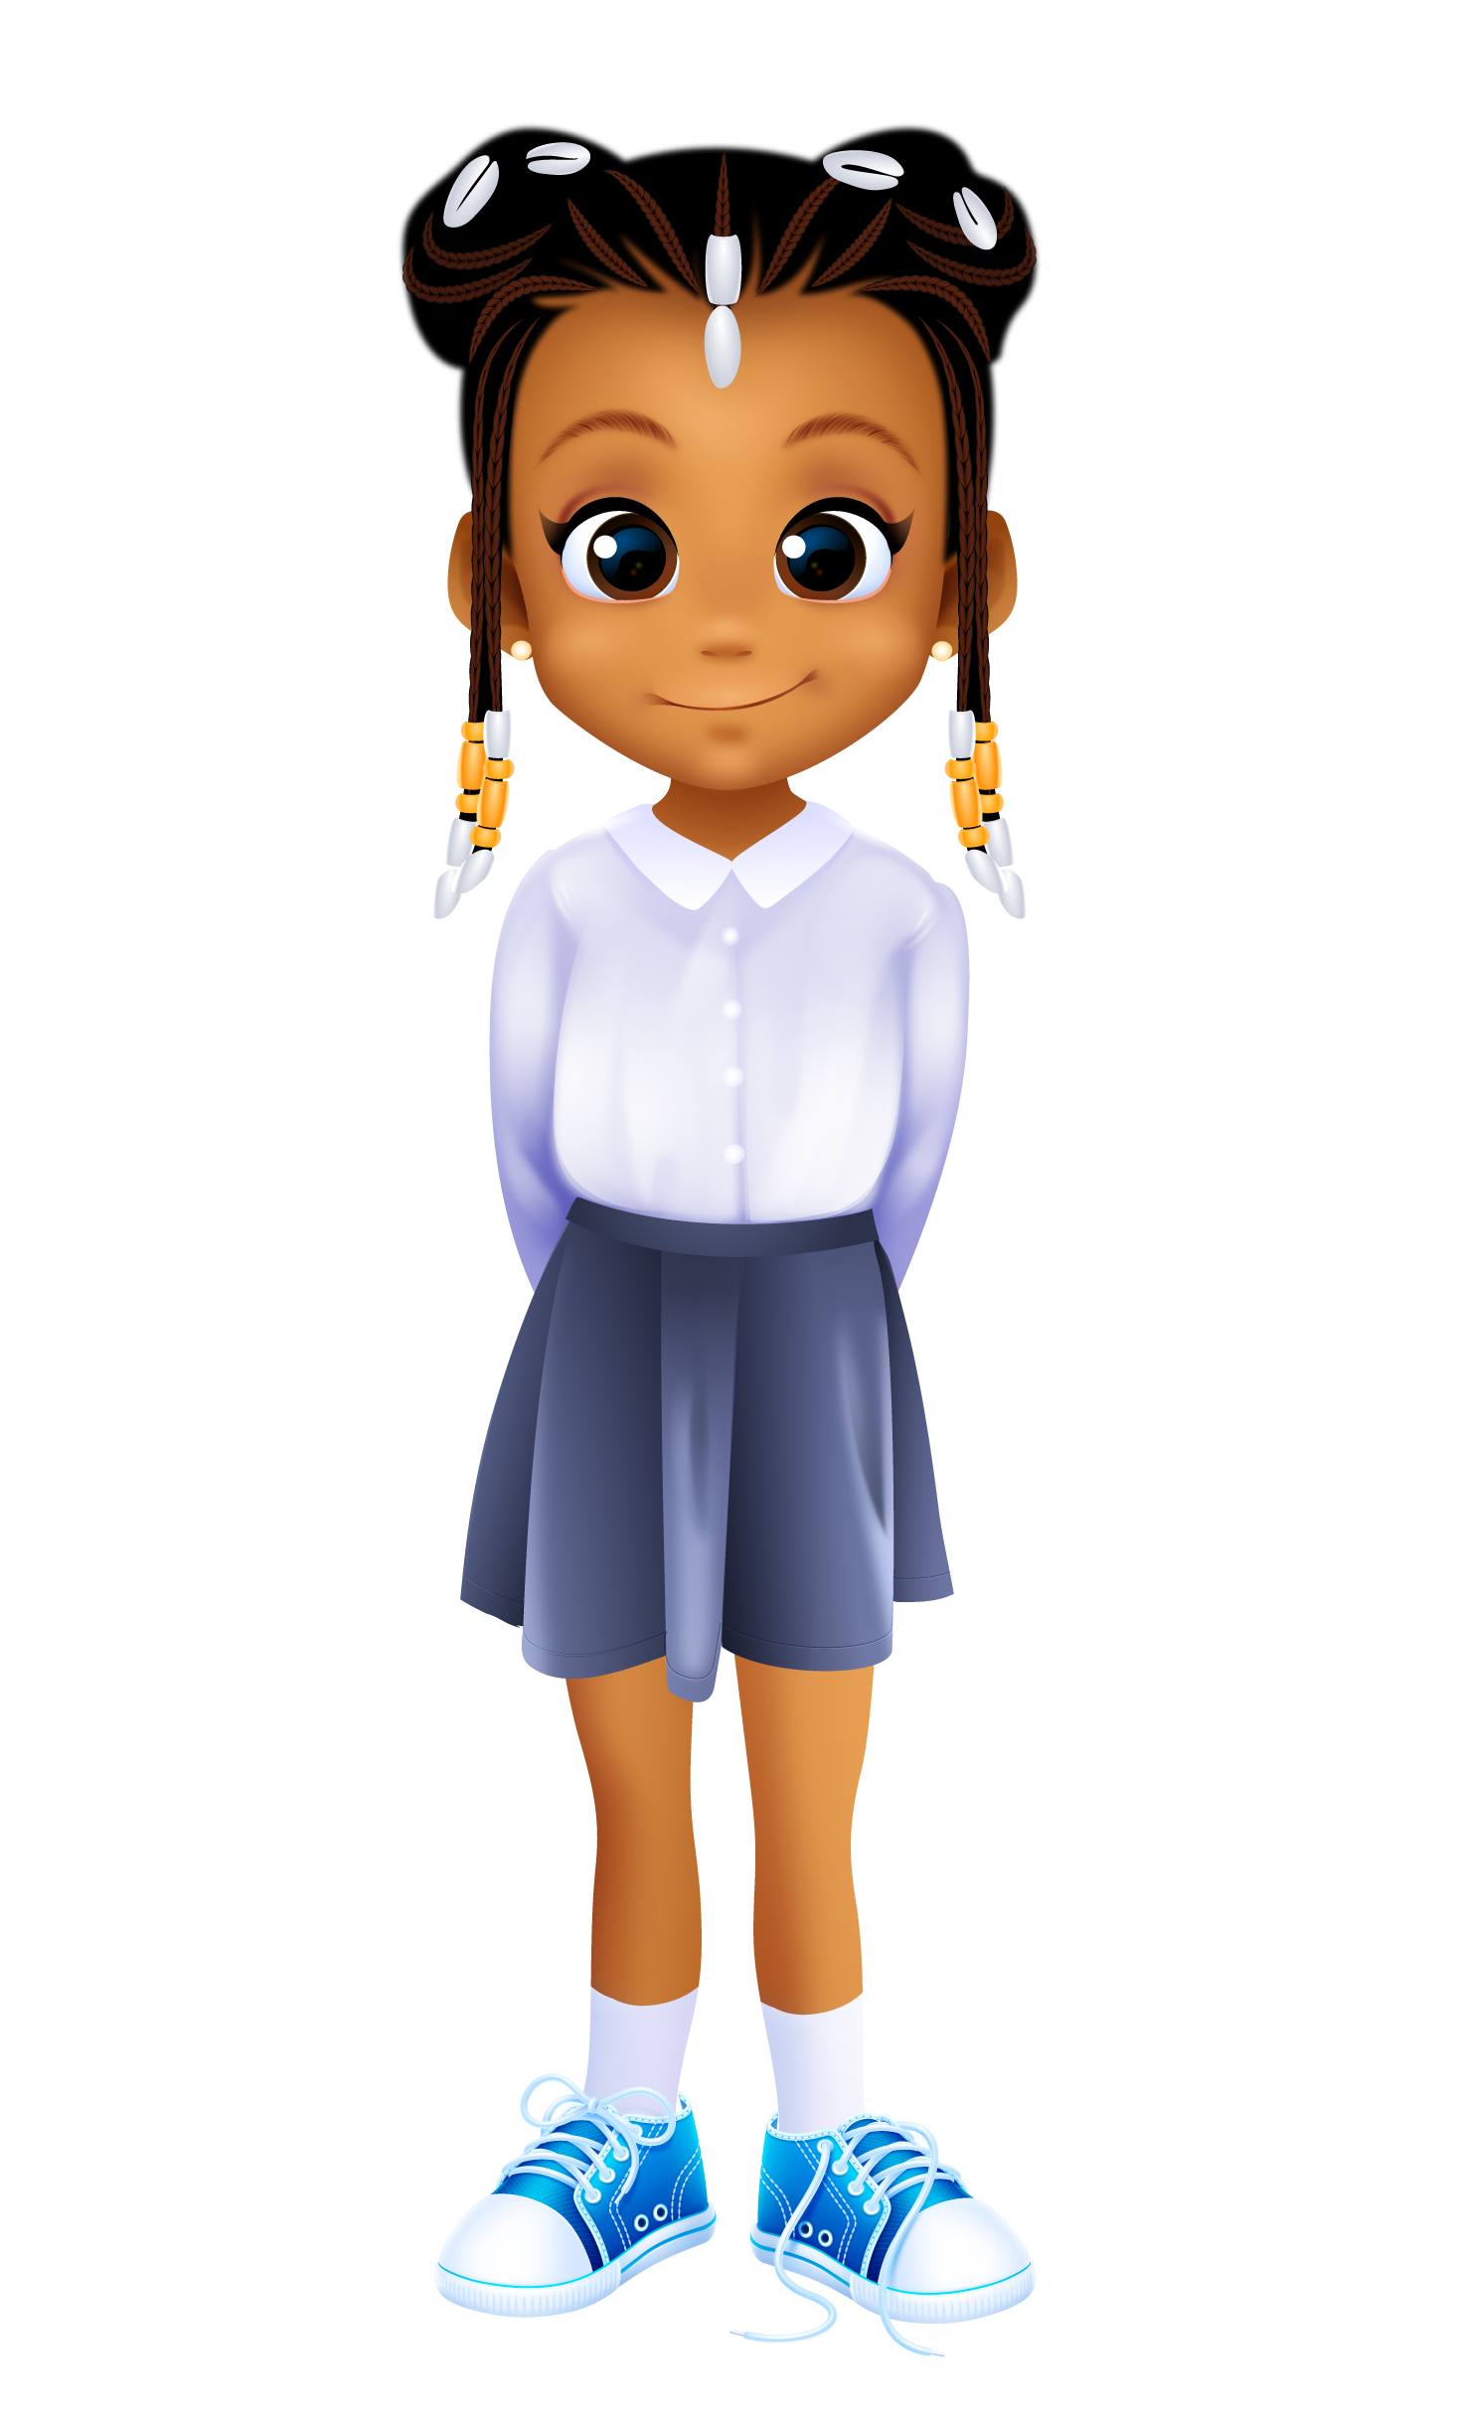
Lesson 4
One Less
In today’s lesson we will be reciting counting rhymes and finding one less than a number.
3
3

Slide 4
Lesson 4
One Less
First, we are going to look at some dots on the screen.
4
4

Slide 5
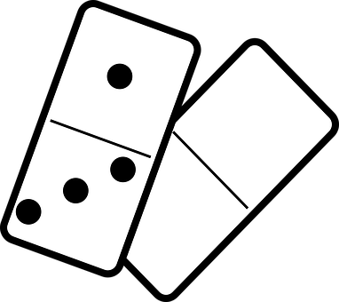
Activity 1
Dots
You will see some dots on the screen.
Some of the dots will be red and some of them will be black.
Can you say how many dots there are altogether?
Can you show how many dots there are with your fingers?
5

Slide 6
Activity 1
Dots
How many dots are there altogether?
R – Alive in 5! – Week 1: L1
6

Slide 7
Activity 1
Dots
That’s right there are 4 dots.
There are 3 black dots and 1 red dot.
Altogether there are 4 dots.
4
7

Slide 8
Activity 1
Dots
How many dots are there now?
8

Slide 9
Activity 1
Dots
Yes, there are 2 dots.
There is 1 black dot and 1 red dot.
So there are two dots altogether.
2
R – Alive in 5! – Week 1: L1
9

Slide 10
Activity 1
Dots
How many dots are there this time?
R – Alive in 5! – Week 1: L1
10

Slide 11
Activity 1
Dots
Yes, there is 1 dot .
We have only got 1 red dot this time.
1
R – Alive in 5! – Week 1: L1
11

Slide 12
Activity 1
Dots
How many dots are there now?
12

Slide 13
Activity 1
Dots
That’s right there are 3 dots.
There is 1 black dot and 2 red dots.
So there are 3 dots altogether.
3
R – Alive in 5! – Week 1: L1
13

Slide 14
Activity 1
Dots
How many dots are there this time?
R – Alive in 5! – Week 1: L1
14

Slide 15
Activity 1
Dots
Yes, there are 5 dots .
There are 3 black dots and 2 red dots.
So, there are 5 dots altogether.
5
R – Alive in 5! – Week 1: L1
15

Slide 16

Activity 2
One Less
We are going to be learning a rhyme today.
How many currant buns are there here?
16

Slide 17
Activity 2
One Less
There are 5 currant buns.
1
2
3
4
5
17

Slide 18
Activity 2
One Less
We can show this on our 5 frame.
There are 5 counters to represent the 5 currant buns.
The 5 frame is full.
18

Slide 19
Activity 2
One Less
Here is the numeral 5.
5
19

Slide 20
Activity 2
One Less
Five currant buns in a baker’s shop.
Round and fat with a cherry on the top.
Along came a boy with a penny one day,
Bought a currant bun and took it away.
20

Slide 21
Activity 2
One Less
We don’t have 5 currant buns anymore.
1 currant bun has been taken away.
How many have we got left?
21

Slide 22
Activity 2
One Less
Yes, now there are 4 currant buns left.
1
2
3
4
22

Slide 23
Activity 2
One Less
Let’s show this on our 5 frame.
Can you see we have 4 counters in our 5 frame?
There is 1 space because 1 currant bun has been taken away.
23

Slide 24
Activity 2
One Less
Here is the numeral 4.
4
24

Slide 25
Activity 2
One Less
Four currant buns in a baker’s shop.
Round and fat with a cherry on the top.
Along came a girl with a penny one day,
Bought a currant bun and took it away.
25

Slide 26
Activity 2
One Less
We don’t have 4 currant buns anymore.
1 currant bun has been taken away.
How many have we got left?
26

Slide 27
Activity 2
One Less
Yes, now there are 3 currant buns left.
1
2
3
27

Slide 28
Activity 2
One Less
Let’s show that on our 5 frame.
Can you see we have 3 counters in our 5 frame?
There are 2 spaces on our 5 frame.
28

Slide 29
Activity 2
One Less
Here is the numeral 3.
3
29

Slide 30
Activity 2
One Less
Three currant buns in a baker’s shop.
Round and fat with a cherry on the top.
Along came a boy with a penny one day,
Bought a currant bun and took it away.
30

Slide 31
Activity 2
One Less
We don’t have 3 currant buns anymore.
1 currant bun has been taken away.
How many have we got left?
31

Slide 32
Activity 2
One Less
Yes, now there are 2 currant buns.
1
2
32

Slide 33
Activity 2
One Less
Let’s show that on our 5 frame.
Now we have 2 counters in our 5 frame.
There are 3 empty spaces on our 5 frame now.
33

Slide 34
Activity 2
One Less
Here is the numeral 2.
2
34

Slide 35
Activity 2
One Less
Two currant buns in a baker’s shop.
Round and fat with a cherry on the top.
Along came a girl with a penny one day,
Bought a currant bun and took it away.
35

Slide 36
Activity 2
One Less
We don’t have 2 currant buns anymore.
We have got 1 less than 2.
How many currant buns do we have left now?
36

Slide 37
Activity 2
One Less
Yes, there is 1 currant bun left.
1
37

Slide 38
Activity 2
Five Currant Buns
Let’s show that on our 5 frame.
Here we have 1 counter for our 1 currant bun.
There are 4 empty spaces on our 5 frame.
38

Slide 39
Activity 2
One Less
Here is the numeral 1.
1
39

Slide 40
Activity 2
One Less
One currant bun in a baker’s shop.
Round and fat with a cherry on the top.
Along came a boy with a penny one day,
Bought a currant bun and took it away.
40

Slide 41
Activity 2
One Less
We haven’t got 1 left now.
We have got 1 less than 1.
How many currant buns do we have left now?
41

Slide 42
Activity 2
One Less
Yes, there are 0 currant buns in the baker’s shop.
There aren’t any left
42

Slide 43
Activity 2
One Less
Let’s show 0 on our 5 frame.
There are 0 counters.
There are 5 empty spaces on our 5 frame.
43

Slide 44
Activity 2
One Less
Here is the numeral 0.
0
44

Slide 45
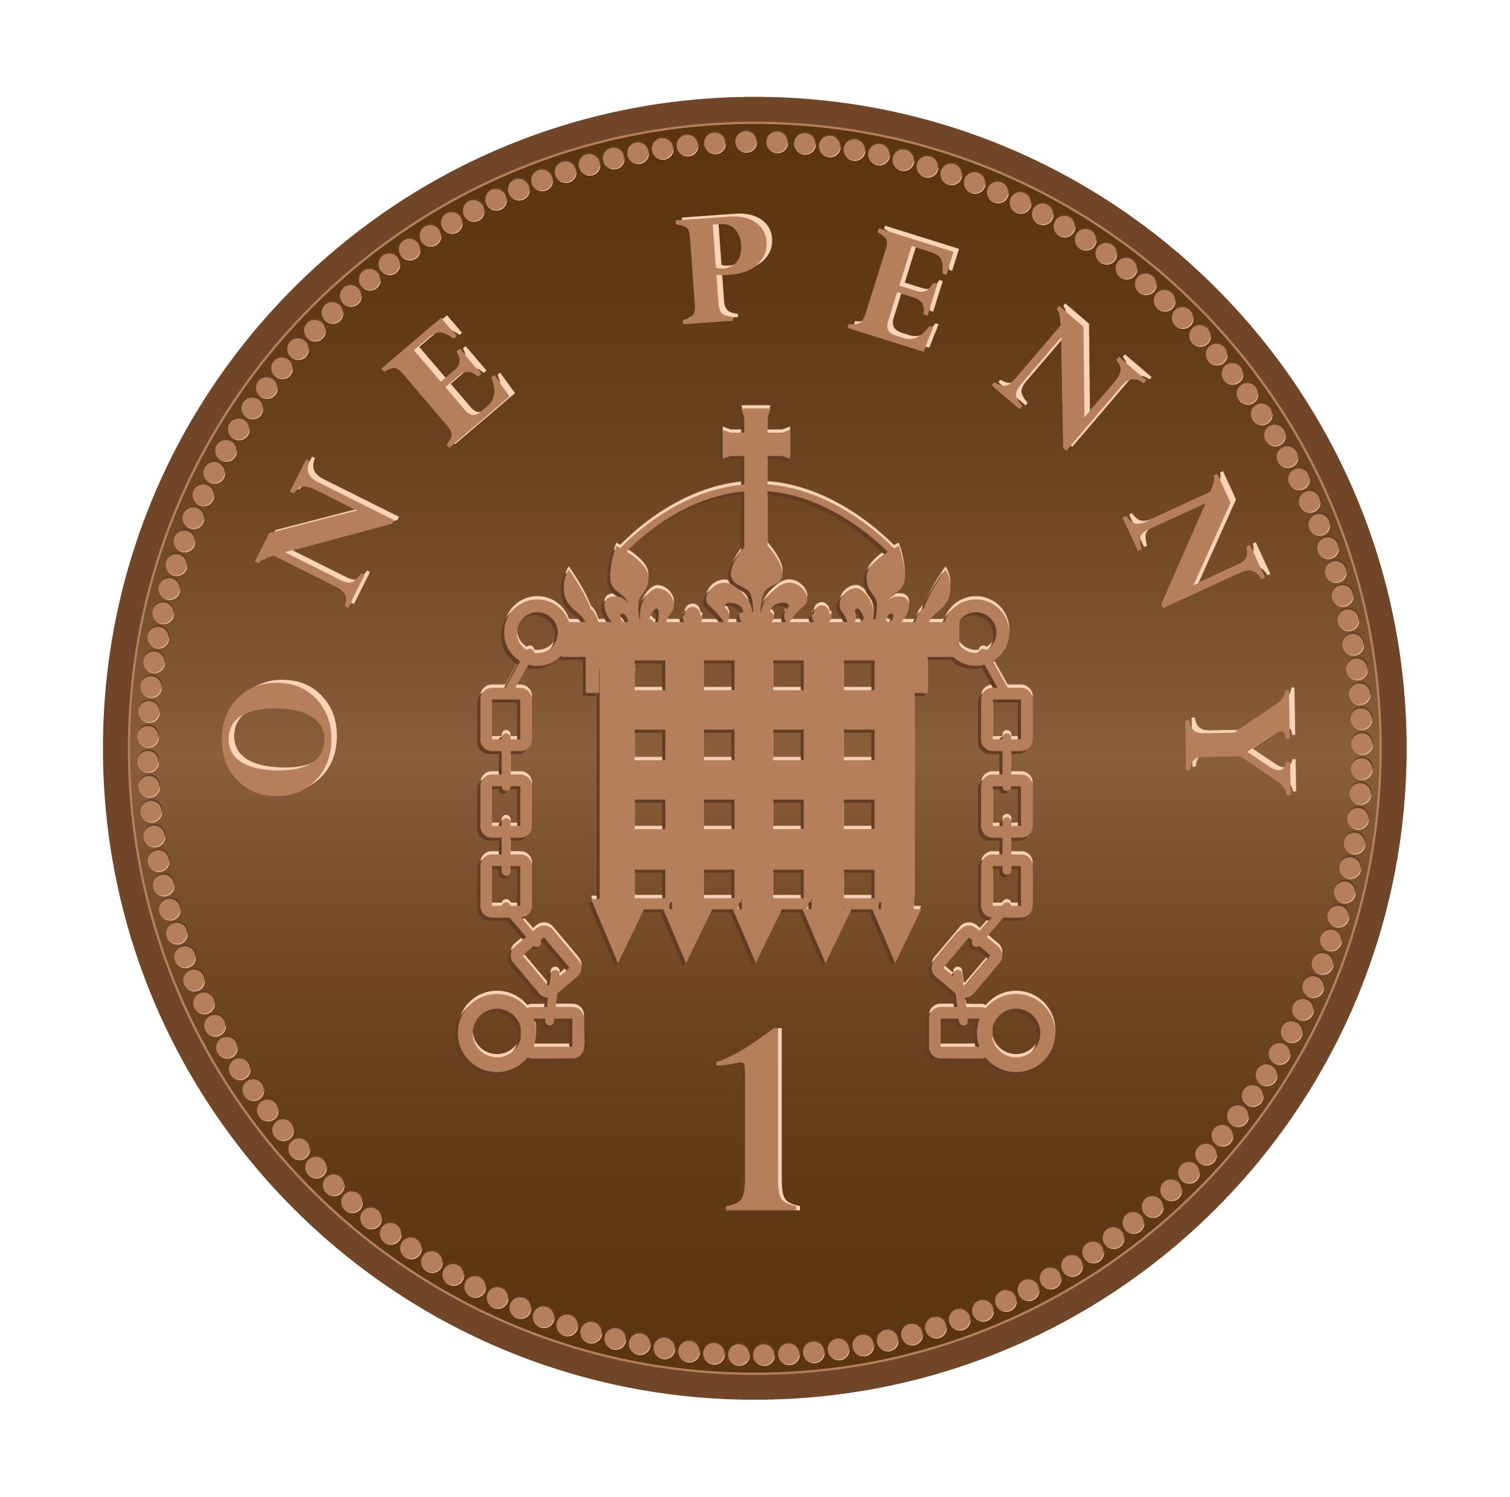
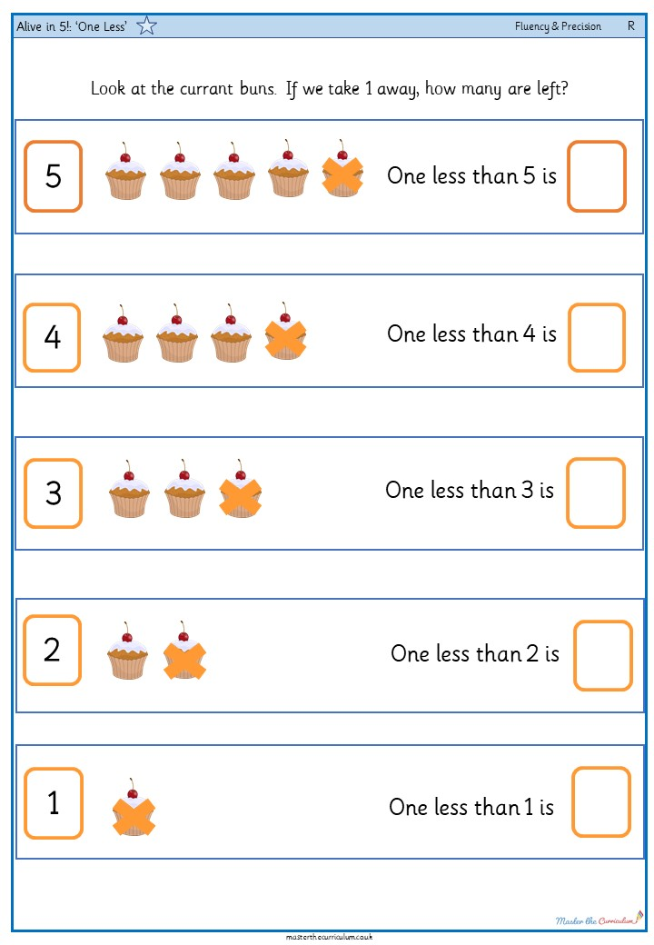
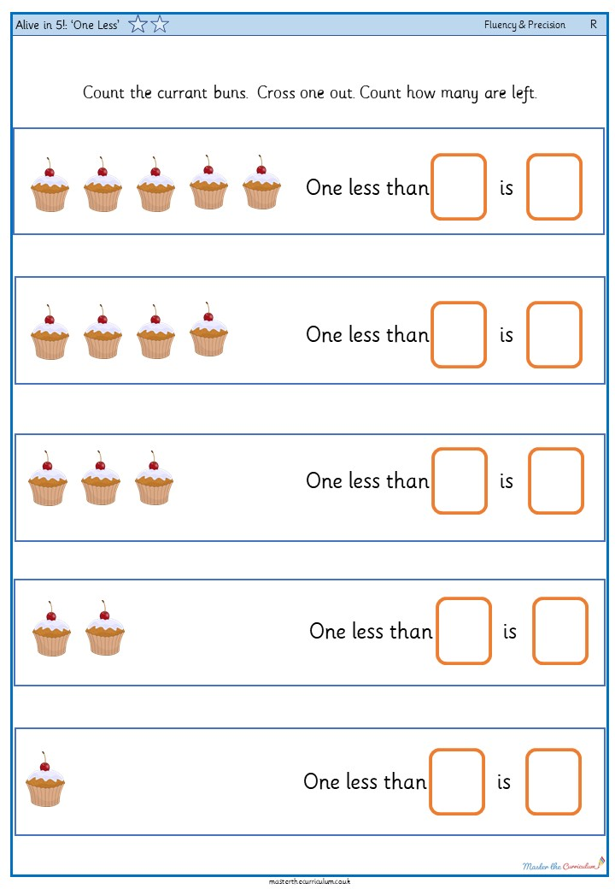
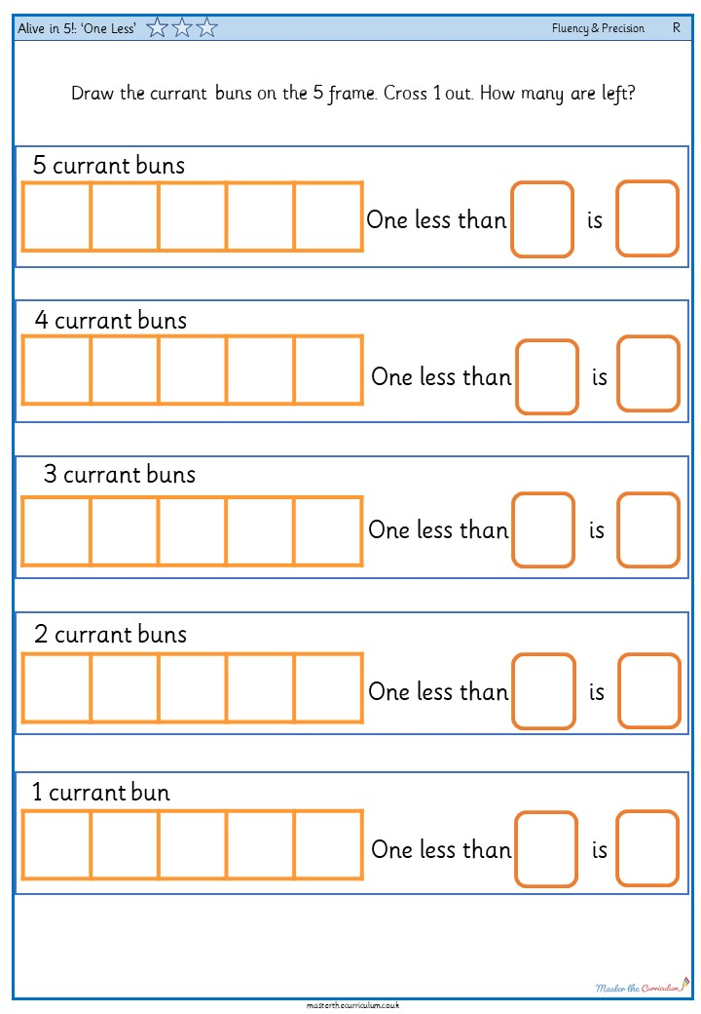
One Less
Your turn!
These are the activities that you can do.
Act out the counting rhymes using the props. Can you say how many is one less?
Count the currant buns. Cross one out. Count how many are left.
45

