Slide 1
Disclaimer/s
We hope you find the information on our website and resources useful.
Animations
This resource has been designed with animations to make it as fun and engaging as possible. To view the content in the correct formatting, please view the PowerPoint in ‘slide show mode’. This takes you from desktop to presentation mode. If you view the slides out of ‘slide show mode’, you may find that some of the text and images overlap each other and/or are difficult to read.
To enter slide show mode, go to the slide show menu tab and select either from beginning or from current slide.
You may wish to delete this slide before beginning the presentation.

Slide 3
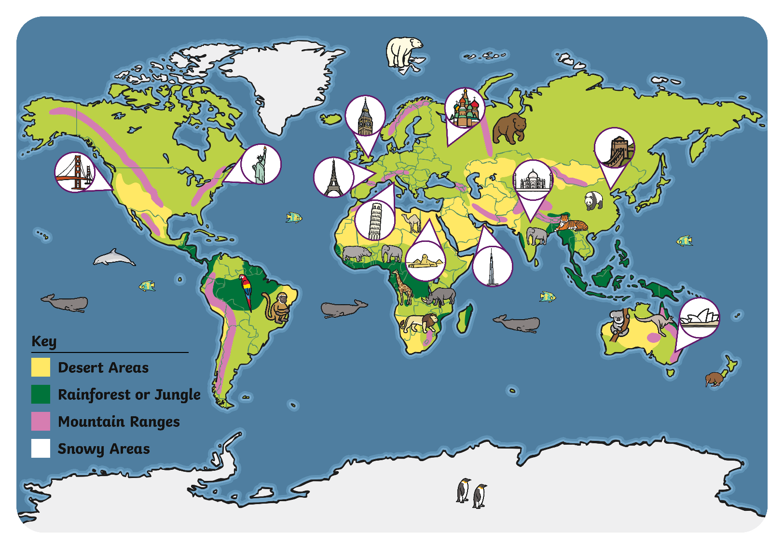


Oh! I think I know what that is – it’s a map of the world! Shall we have a look at some maps together?
Hello everyone. My name is Tomasin. I spotted this poster on the wall of our classroom. Do you know what it is Phil?

Slide 4
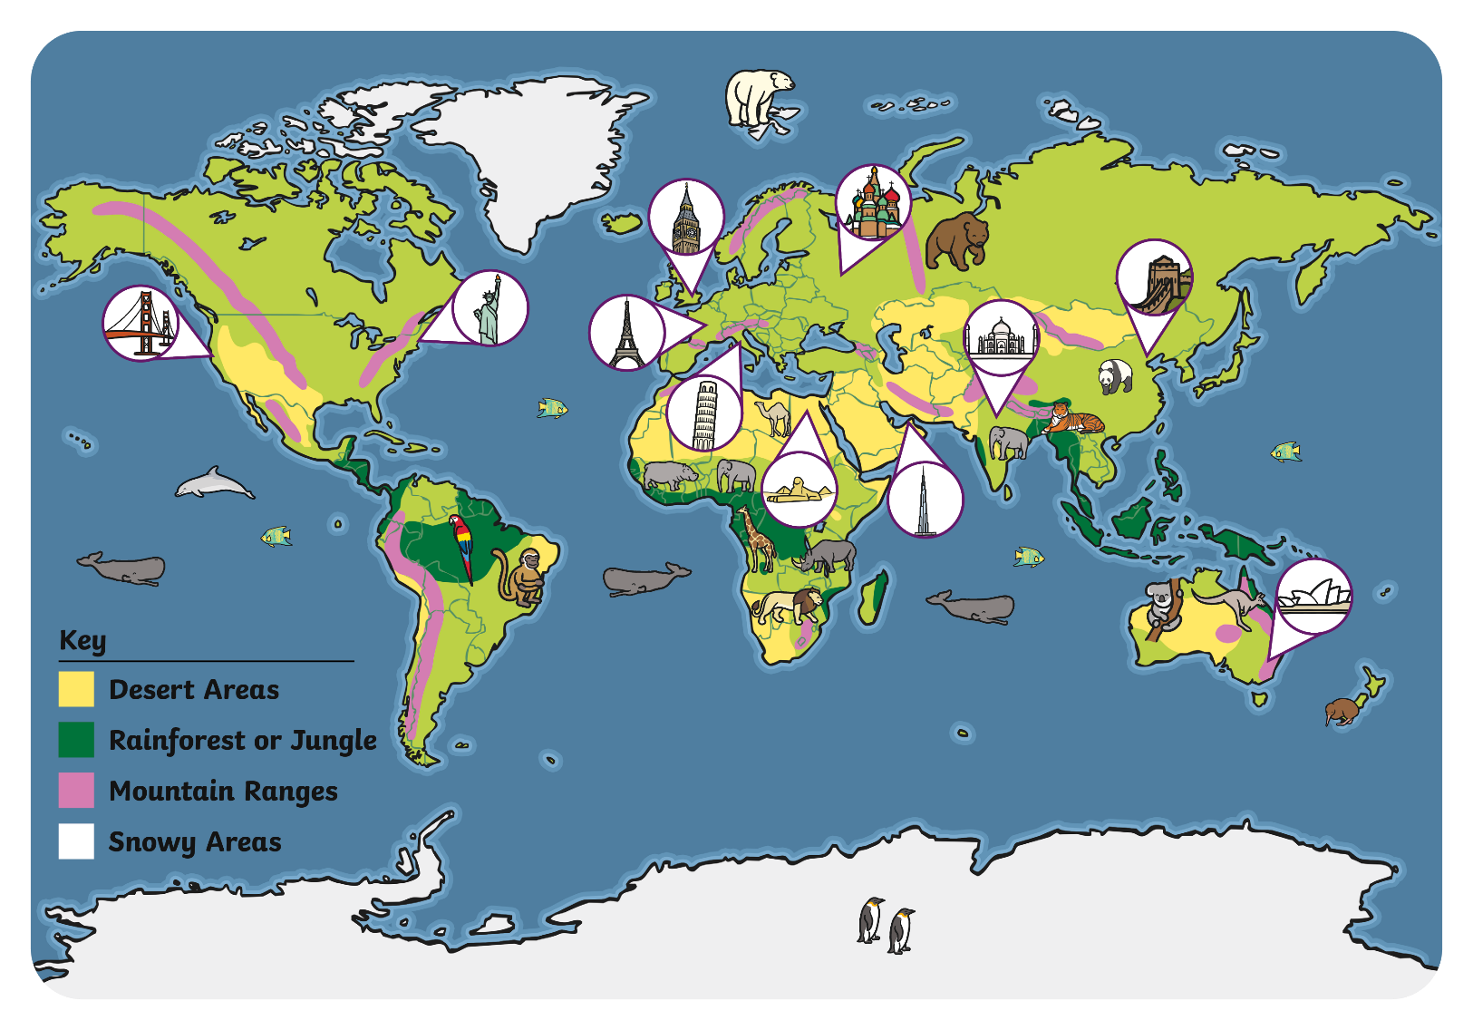


Oh yes! It’s a map. It shows lots of different places around the world. I can see where I went on holiday.
I can see where my favourite animal lives. Can you see the snowy land where polar bears live?
This is a map of the world. The different colours show different areas of land, such as white for snowy places. The key on this map explains the different colours. This map shows where some animals live in the wild and also some famous landmarks.

Slide 5
Let’s see what other maps we can find. Have you used a map before?
I used a little map when I went to the zoo. It showed me where to find the different animals and the cafe.
Maps show information about a place. They can show large places, such as the world, or smaller places, such as a town or zoo. They often use small pictures or symbols to show where things are. There is a key to explain the pictures or symbols. What symbols can you see on this map of the zoo? Can you see the cafe? Where are the lions?

Slide 6
Have you seen a weather map before?
Weather forecasters often use maps to show what the weather is like in different places. They use symbols to show different types of weather.

Slide 7
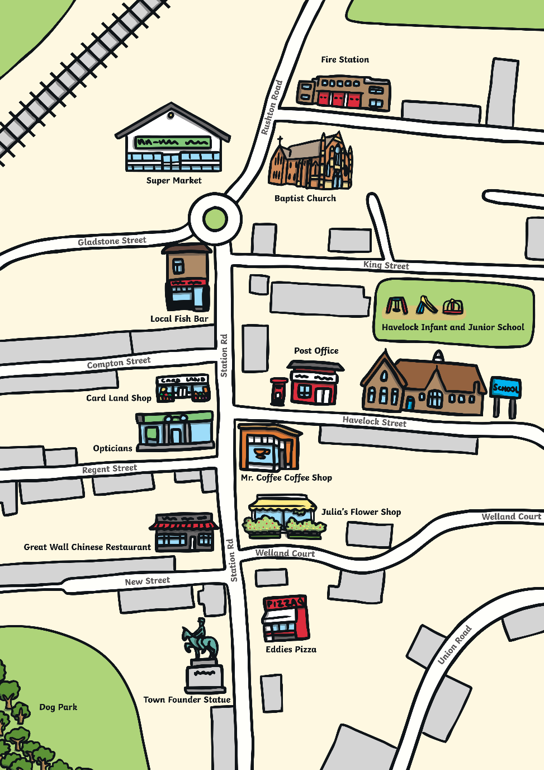
Maps can help us to find our way around. This map shows a town. It shows roads, a railway line, buildings and a park. The roads and railway line are shown from above. Pretend you are flying over the town, like a bird – the roads would look they do on the map. This is sometimes called bird’s-eye view.
This is a map of my local area. I can see my school!
What can you see on this map?

Slide 8
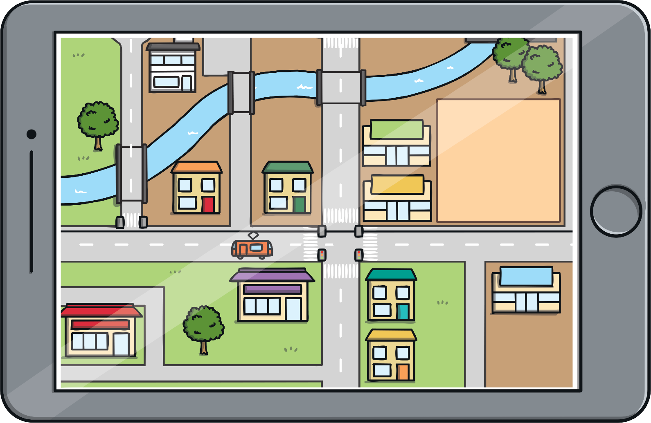
Sometimes, my Daddy uses a map on his phone. These maps can show you the directions of how to get to a place.
That’s clever! I can see how to get from my house to the library.
Sometimes, maps can be used on a phone, tablet or computer. They can give you directions about how to get somewhere. They show you which roads to follow to get from one place to another.

Slide 9
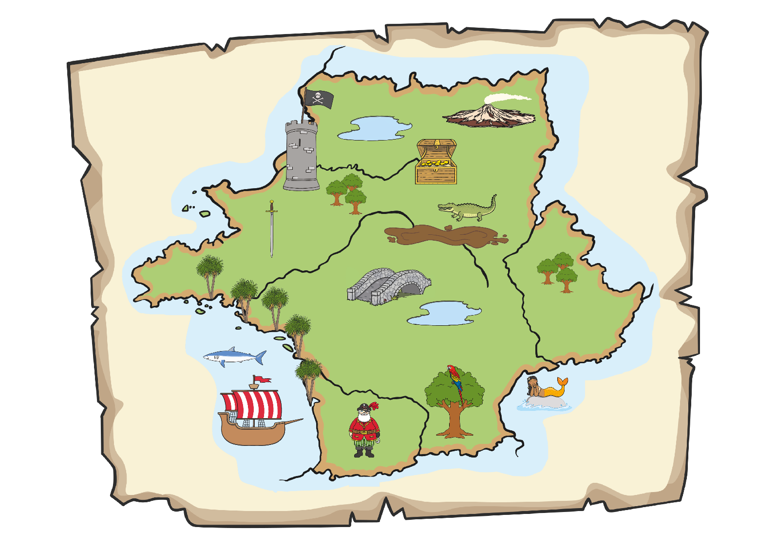
X
Oh look, a treasure map! A pirate must have buried some treasure and used this map so that they could find it again.
Can you see an X on the map? That’s where the treasure is.
Sometimes, people draw maps to help find places and things. What can you see on this map? What has the pirate drawn on their map to help them find the buried treasure?

Slide 10
Teddy is making a map to show how to get to his house.
What can you see on Teddy’s map?
Can you tell a friend about Teddy’s map? What do you see on your way to school or on your way to the park or shops? You could draw your own map and tell a friend about it.

Slide 11
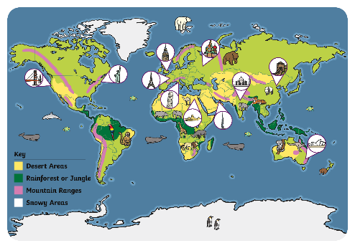
What a lot of maps we saw today! Which one was your favourite?
You could try making your own map. It could be a treasure map, a weather map, a map of how you get to school or a map of places you like to visit.

