Slide 1

The Iron Man
By Ted Hughes
Illustrated by Tom Gauld
Published by Faber and Faber

Slide 2
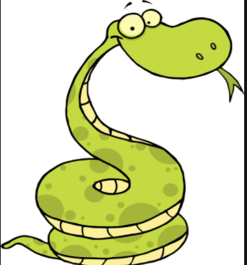
VIPERS
V is for Vocabulary in Chapter 3:
unfurled
hillock
stove
jolt
sagging
groping
draped
dense
deceive
delicacies

Slide 3
VIPERS
I is for Infer and V is for Vocabulary in Chapter 3:
Today you are going to make inferences and show understanding of vocabulary from what the author has written. Your answers should be in full sentences.
What does infer or inference mean?

Slide 4
Infer:
How did the farmers feel when they realised the Iron Man had freed himself? (p.31)
Why do you think Hogarth wanted to help the Iron Man rather than letting the army destroy him?
Do you think the local people were scared of the Iron Man when Hogarth led him through the villages? Why do you think this? (p.33)
Why was the scrap yard the ‘Iron Man’s heaven’? (p.34)

Slide 5
Over to you… 8.2.21
Date and title your work.
Answer the questions on the sheet either directly onto the Word document or straight into your blue exercise books/onto paper.
Answer the questions in full sentences – no one word answers please.
Begin each sentence with a capital letter and finish it with a full stop.

