Slide 1
Girl and Robot
Thursday 13th January 2022

Slide 2
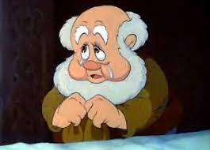
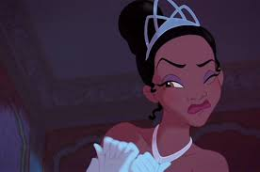
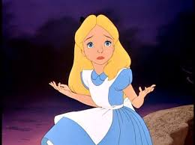
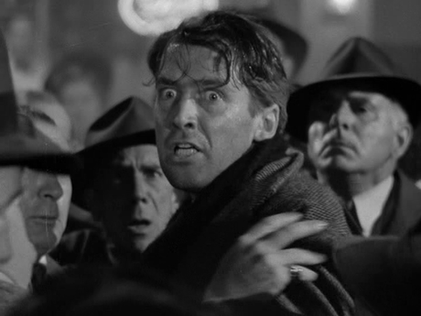
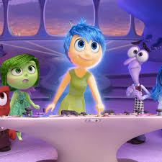
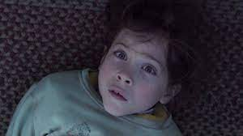

Slide 3
Watch the film from yesterday again until 1 minute.
Focus on the girl’s face and her expressions and emotions.
How is she feeling?
How do you know?
Be precise in your choice of words e.g. is she happy or excited?
Explain why you think she is feeling this way.

Slide 4
Continue watching and pause at 1 min 22 seconds
How is the girl feeling now?
How do you know?
What has changed?
Can you name the emotion?
Now try to complete Resource Sheets 2a and 2b.
☺

