Slide 1
Creating an adjective poem
25.1.22

Slide 2
What is an adjective?
Describes a noun.
What is a noun?
Can you think of any adjectives? Write down as many as you can think of in your journals.
Share.

Slide 3
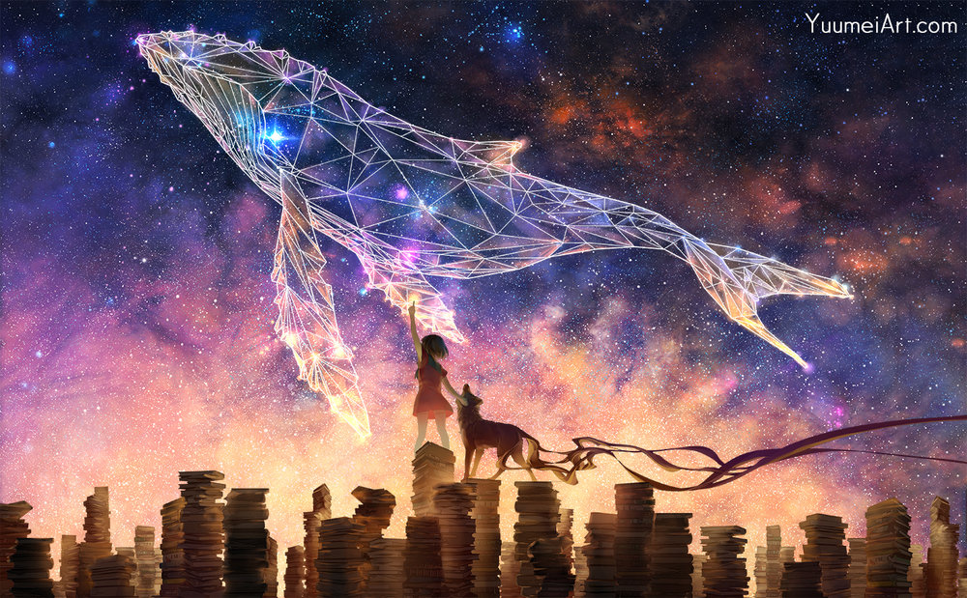
What’s your first impression of this picture?
What adjectives can you think of to describe EVERYTHING in the picture?
Write as many adjectives as you can around the outside of the picture.
Use a thesaurus to improve your word choices.

Slide 4
What is a poem?
What do poems look like?
How are they different from the writing we normally look at and read in our books?
In your journals, write down all the things that you’d expect to see in a poem:
  Verses
  Rhyme
  Rhythm
  Adjectives (imagery)
  No sentences

Slide 5
Can you turn your ideas and adjectives into a poem?
Try to create a 4 line verse listing 3 adjectives per line:
Here’s an example:
Shiny, bright, sharp,
Crystal-white, smooth, sparkling,
High, floating, swooping,
Starry, glittering, huge.

Slide 6
Can you improve your verse?
Shiny, bright, sharp, bright
Crystal-white, Ssmooth, sparkling, crystal-white,
High, floating, swooping,
Starry, glittering, huge, glittering.
I’ve changed the word order to make the last word of each pair of lines rhyme e.g. bright and white, and swooping and glittering.
What can you do to improve your verse?
Change the word order?
Rhyming?
Up-levelling your words?
Include alliteration?

