Slide 1
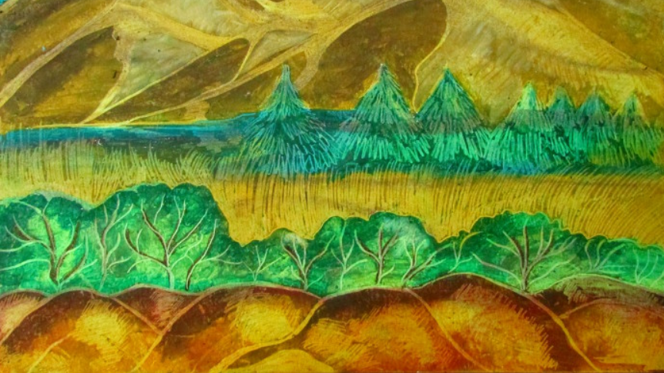
Geogria O’Keeffe style artwork option 1: Follow the simple steps on the following slides

Slide 2
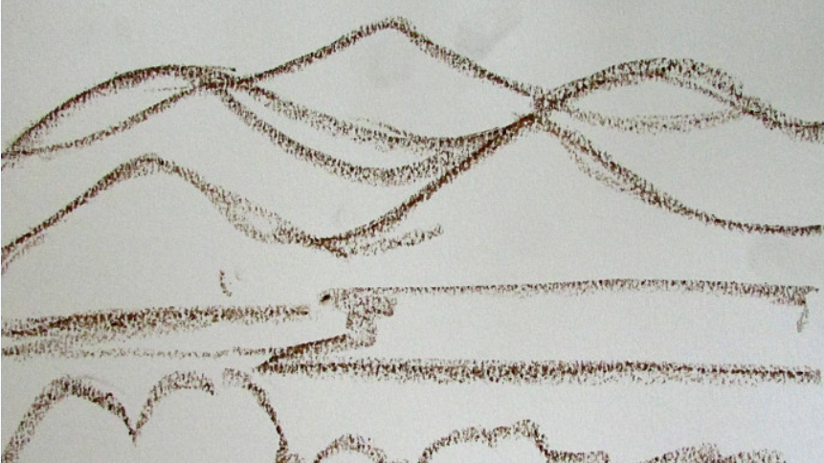

Slide 3
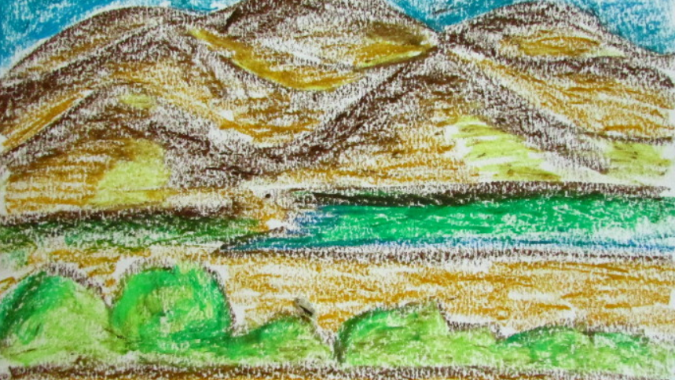

Slide 4
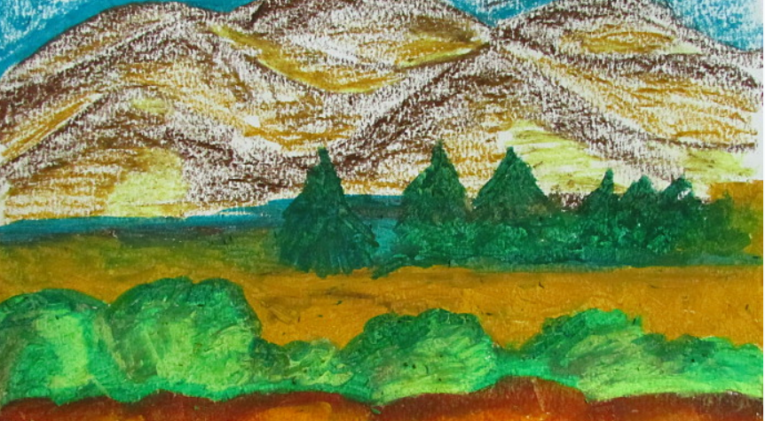

Slide 5
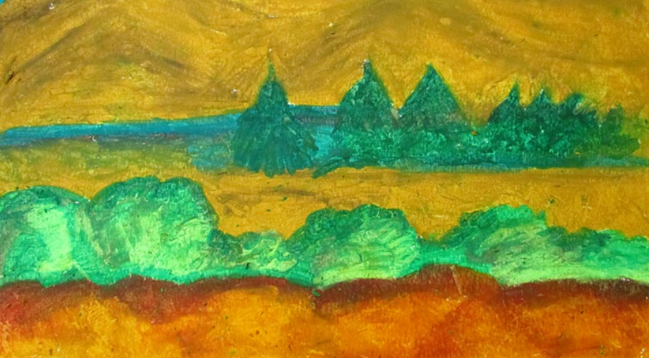

Slide 6
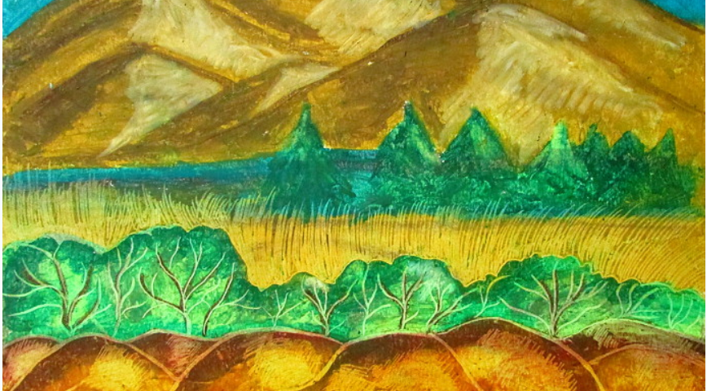

Slide 7
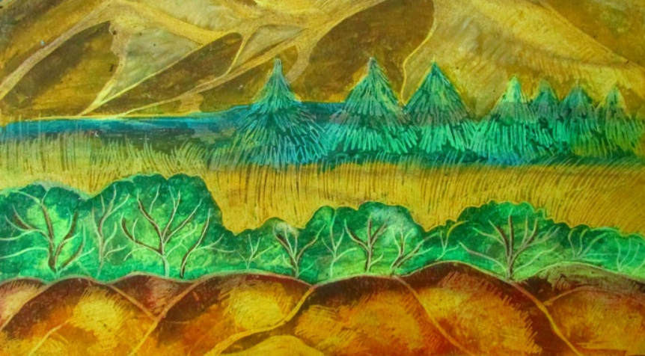

Slide 8
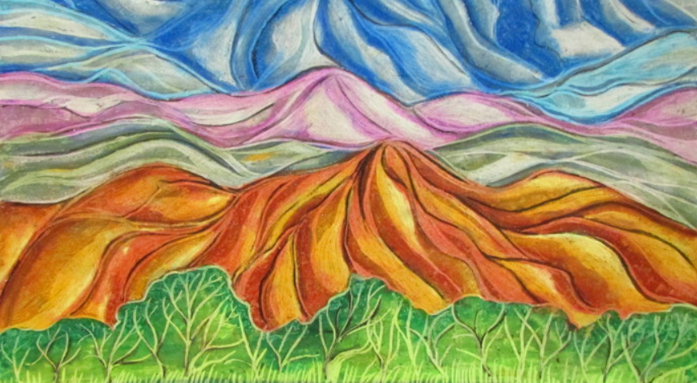
Geogria O’Keeffe style artwork option 2:
Follow the simple steps on the following slides

Slide 9
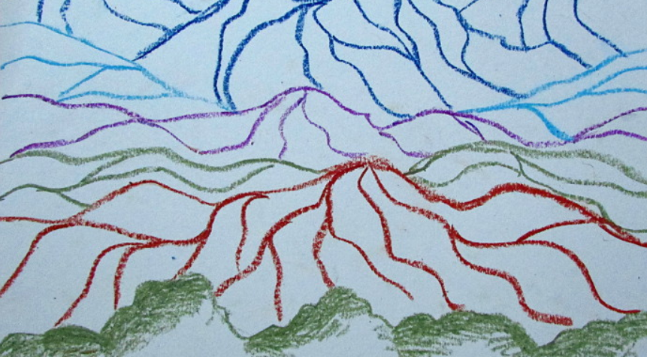

Slide 10
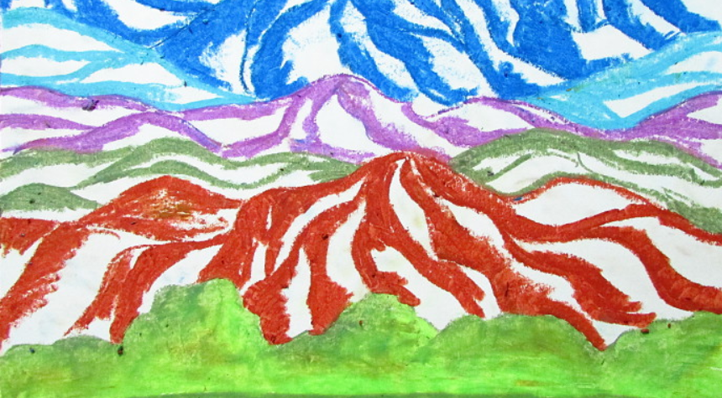

Slide 11
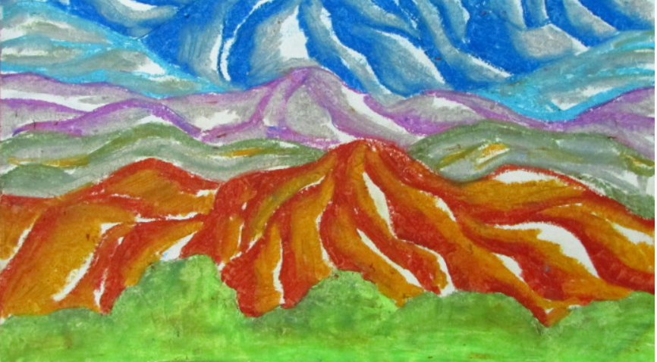

Slide 12
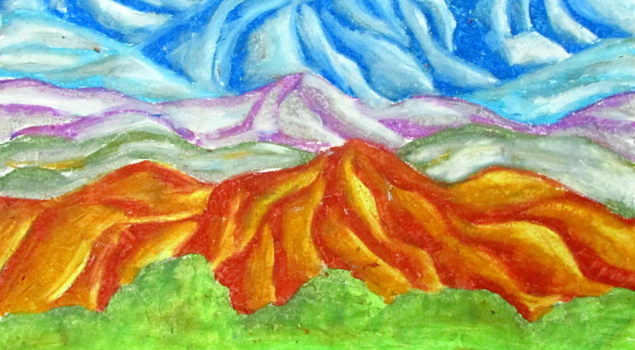

Slide 13
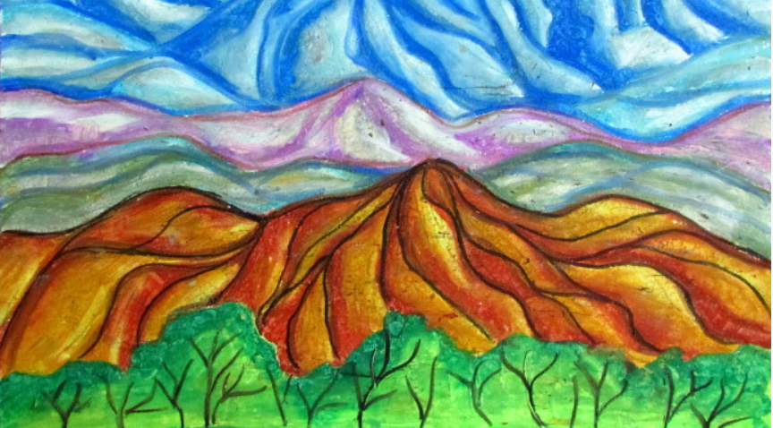

Slide 14
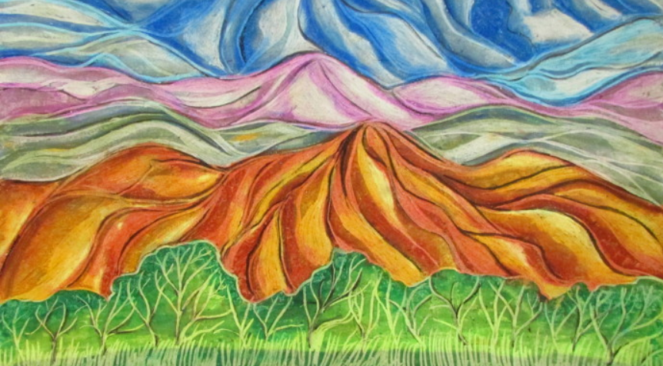

Slide 15
I am very excited to see your completed art work year 4!
Please bring in your completed pieces after half term or take a photo for me to see!

