Slide 1
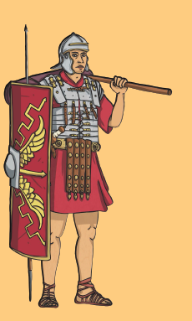
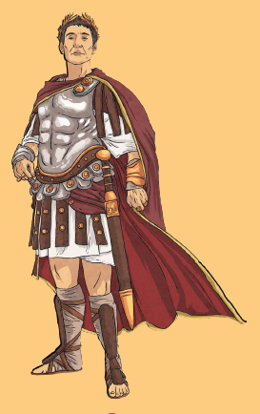
Art/DT
Roman Mosaics
Roman Shields
Roman Cooking
French
Les vetements
Quel temps fait-il?
RE
What is the best way for a Jew to show commitment to God?
Do people need to go to church to show they are Christians?
Science
Living Things and their Habitats
Recognise that living things can be grouped in a variety of ways
Explore and use classification keys to help group, identify and name a variety of living things in their local and wider environment
Recognise that environments can change and that this can sometimes pose dangers to living things
Animals including Humans – Digestion
Describe the simple functions of the basic parts of the digestive system in humans
Identify the different types of teeth in humans and their simple functions
Construct and interpret a variety of food chains, identifying producers, predators and prey.
Blood,
English​
Reading ​
This is Judaism​
Poetry​
Writing ​
Persuasive letter based on The Day the Crayons Quit​
Biography of a Roman soldier​
SPAG
Clauses & conjunctions
Conjunctions for subordination
Tenses
Guts
&
Music
Body percussion
Film music
Glory!
Maths
Decimals
Money
Time
Statistics
Shape
Position and direction
Computing
To understand and use variables in 2Code
To use and build procedures in Logo
PSHE
Compassion
Transformation
Growth mind set
History & Geography
Reasons for invasion
Significant figures: Claudius & Boudicca
Success of the Roman Army
Comparison of Britain and Italy

