Slide 1
28th January 2021
Literacy lesson – I can use the joining word ‘and’

Slide 2
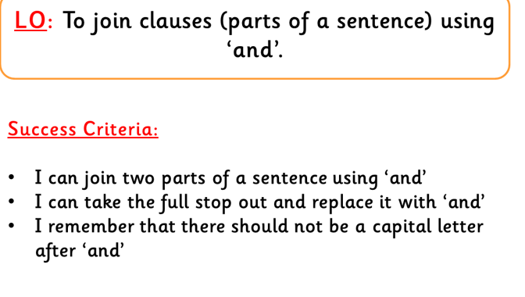

Slide 3
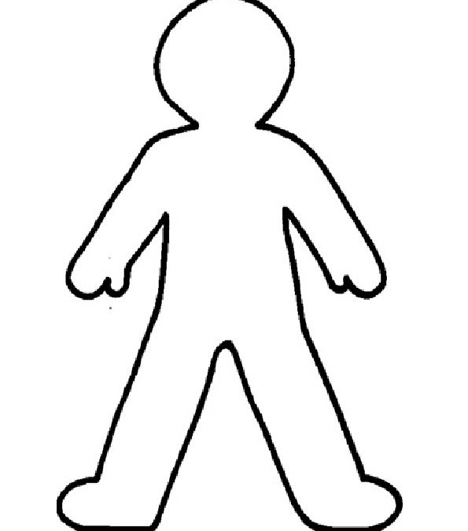
Roll on the wall activity
Can you tell me everything you know about Tammy went to the Arctic – any quotes you can remember?

Slide 4
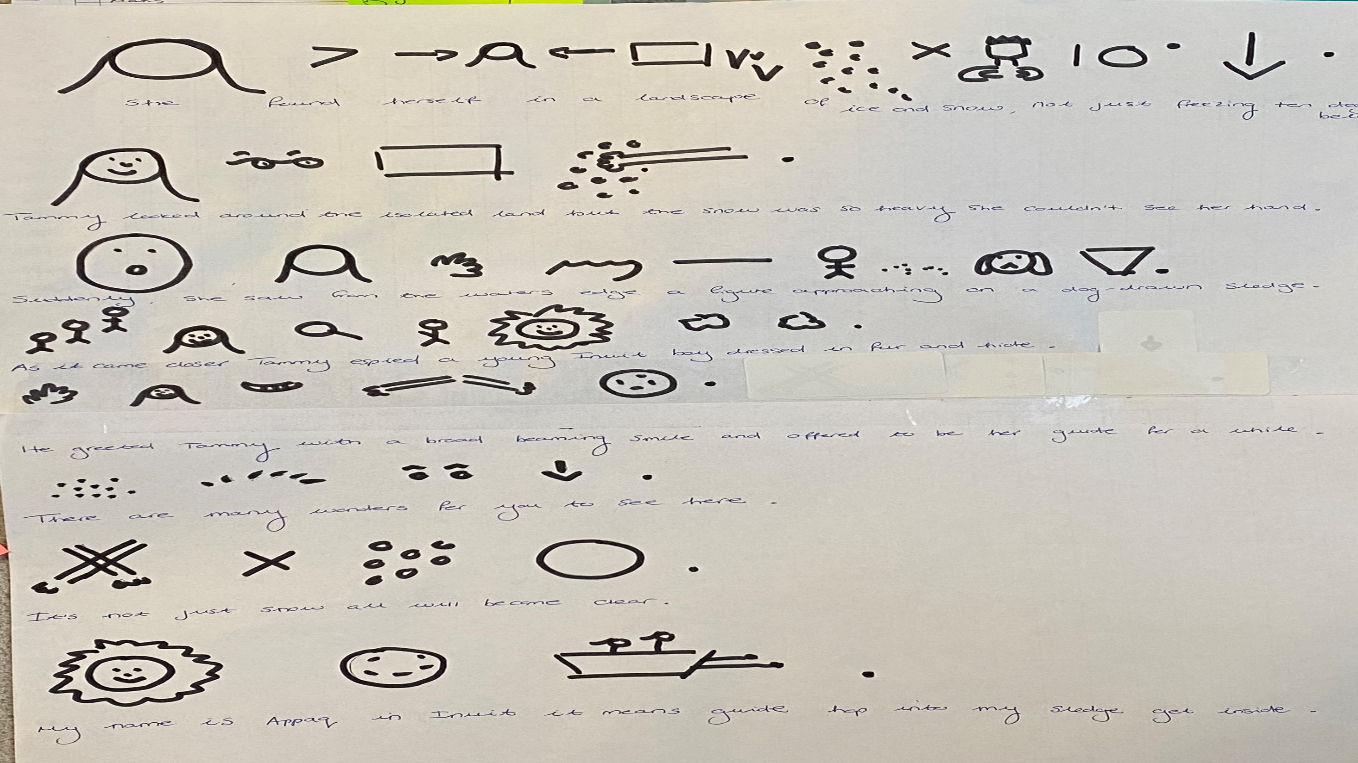

Slide 5
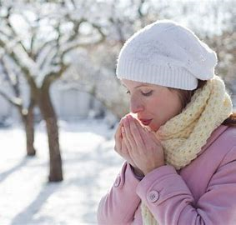
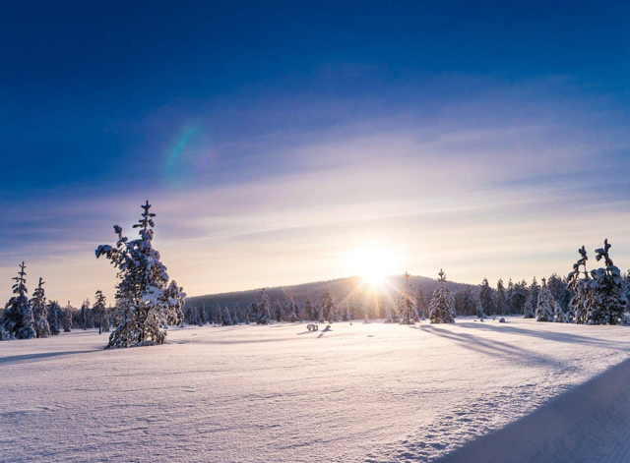
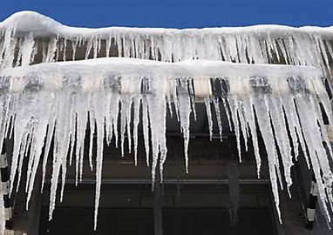
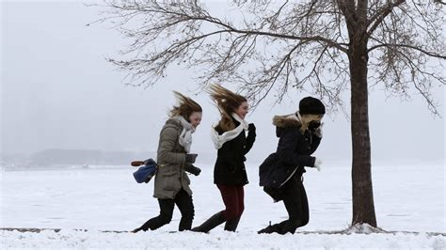
Can you pick two pictures and using the word ‘and’ tell me what the weather is like?
ie stormy and freezing

Slide 6
Lets try and put these weather description into sentences
We could write:
It is cold. The wind blows.
These are lovely simple sentences… lets make them a bit more exciting and use ‘and’ to join them.
Ready….

Slide 7
Using the word ‘and’ to join our sentences.
Take the full stop out of the first sentence.
It is cold The wind blows.
2. We can’t have capital letters in the middle of our sentence so we need to change the capital letter to a lower-case.
It is cold the wind blows.

Slide 8
Finally….
3. We can now use our ‘magic glue’ ‘and’ to join the sentences.
(bit like using glue to stick two things together)
It is cold and the wind blows.
So… first we take the full stop out, then we change the capital letter, finally we join the sentences with our ‘magic glue’ using ‘and’

Slide 9
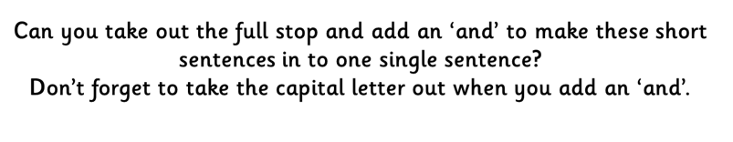
Have a go on your WB – I’ll give you a couple of minutes….
It is snowy. The trees are icy.

Slide 10
It is snowy and the trees are icy.

Slide 11
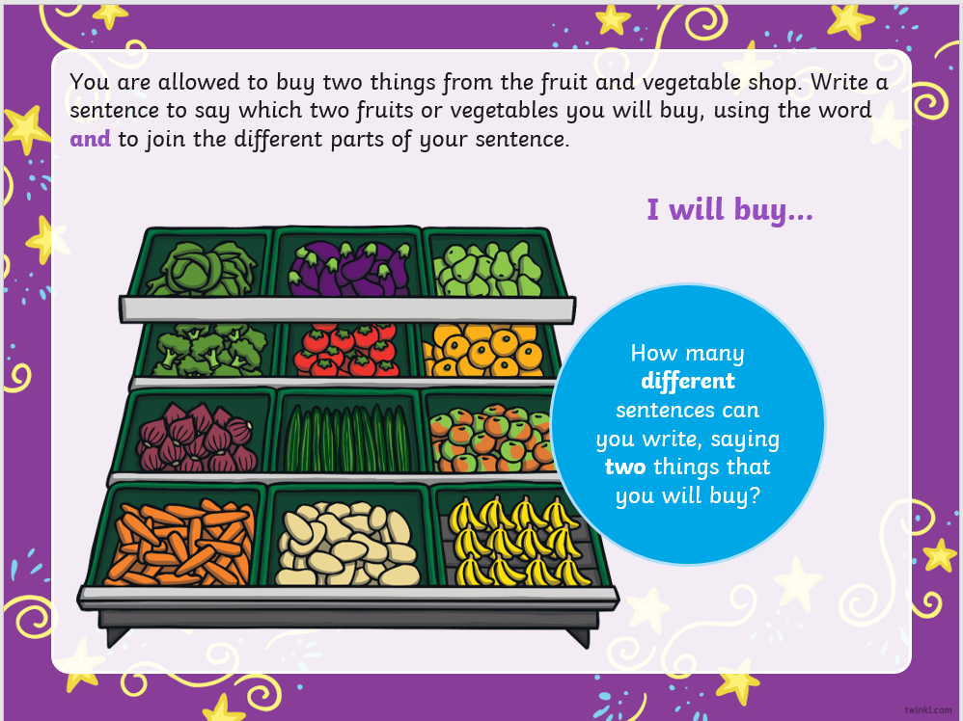
Plenary

Slide 12
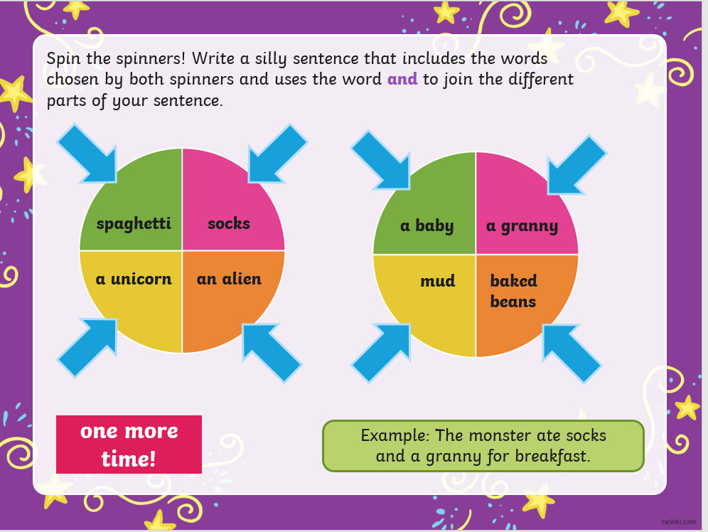
Option 1: Task is to spin the spinner and join some silly sentences using the word ‘and’
You can write these into your literacy books or on your WB and take a picture. Minimum of 2.
(if your struggling today with your writing do it verbally with your parent/adult)
Bubble – leave this slide up and spin the spinner – minimum of 2 sentences -
I’ve posted this PP onto Teams for you to follow again if you need to.

Slide 13
https://www.bbc.co.uk/bitesize/articles/zmqtnrd
Task 2 - option – click onto the above link – BBC Bitesize – Nelly the monster sitter – watch the lady read ‘Nelly the monster sitter’ then….
Imagine you are teaching someone how to be a Monster Sitter.
Write a list of equipment a Monster Sitter will need and then write some instructions outlining what they must do.
You'll need to:
Make sure your instructions are clear by numbering them.
Use capital letters at the start of each sentence and a full stop at the end.
Use the joining word and in your instructions.
For example: The monster is grumpy and very hungry.

