Slide 2
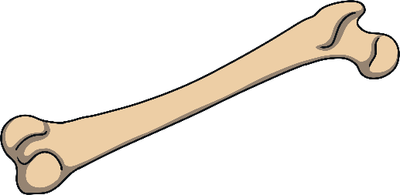

bone
Start Timer
Start Timer
Use Timer
Show Answer
Next

Slide 3
pode
Use Timer
Show Answer
Start Timer
Start Timer
Next

Slide 4
gome
Use Timer
Show Answer
Start Timer
Start Timer
Next

Slide 5
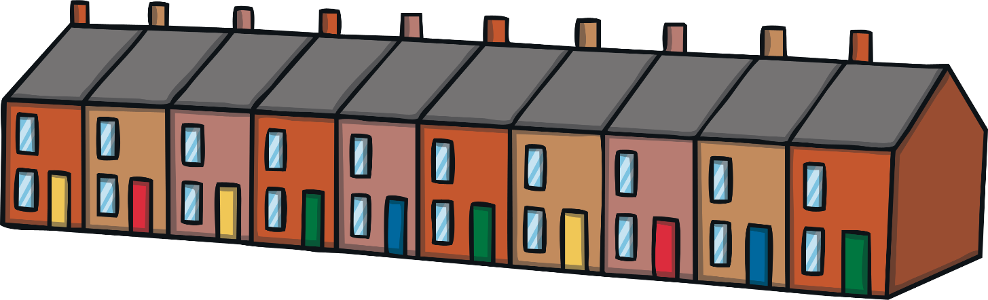
home
Start Timer
Start Timer
Use Timer
Show Answer
Next

Slide 6
quobe
Use Timer
Show Answer
Start Timer
Start Timer
Next

Slide 7
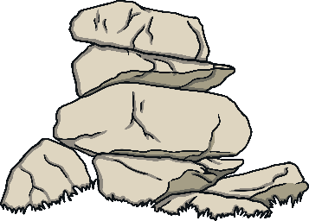
stone
Start Timer
Start Timer
Use Timer
Show Answer
Next

Slide 8
trone
Use Timer
Show Answer
Start Timer
Start Timer
Next

Slide 9
droke
Use Timer
Show Answer
Start Timer
Start Timer
Next

Slide 10

note
Start Timer
Start Timer
Use Timer
Show Answer
Next

Slide 11
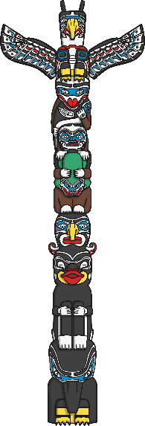
pole
Start Timer
Start Timer
Use Timer
Show Answer
Next

Slide 12
trofe
Use Timer
Show Answer
Start Timer
Start Timer
Next

Slide 13
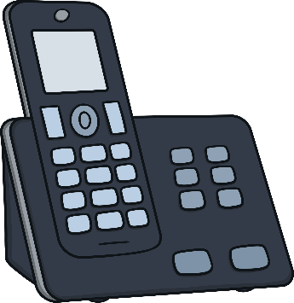
phone
Start Timer
Start Timer
Use Timer
Show Answer
Next

Slide 14
glone
Use Timer
Show Answer
Start Timer
Start Timer
Next

Slide 15

explode
Start Timer
Start Timer
Use Timer
Show Answer
Next

Slide 16

envelope
Start Timer
Start Timer
Use Timer
Show Answer
Next

Slide 17
krote
Use Timer
Show Answer
Start Timer
Start Timer
Next

