Slide 1
26th January 2021
Literacy lesson – Tammy went to the Arctic – Story Map -

Slide 2
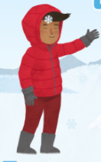
Wanderings – If you could ask Tammy a question what would it be?

Slide 3
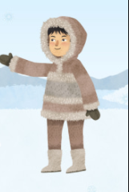
If you could ask Apak a question what would it be?

Slide 4
We are now going to learn the story of Tammy went to the Arctic by making it into a story text map – Just like we did for Handa’s Surprise – we are going to learn the symbols and the actions – I will teach you the actions once you are back at school -

Slide 5
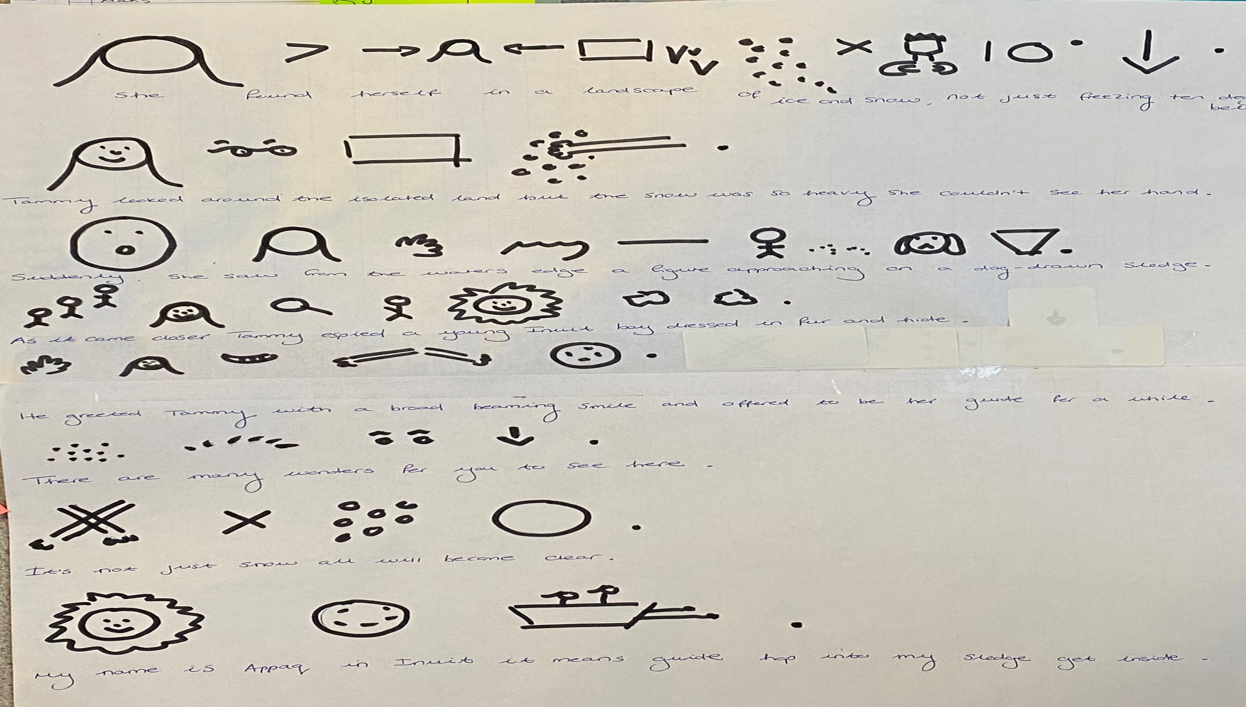

Slide 6
Task
– re-write the story text map into your English books or on piece of paper and bring to your literacy lesson once you are back – You can print off the 5th slide and copy from the printed copy -
- Have a go at the set cold task – re-write the story – do your best – parents let it be independent – even if they can only manage a couple of sentences – thank you -

