Slide 1


Slide 3
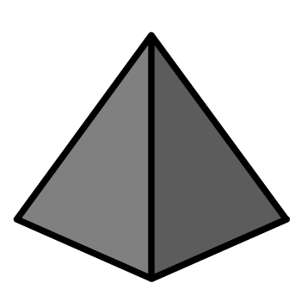
1) What number comes next? 7, 8, 9, ?
2) What number comes next? 6, 5, 4, ?
3) How do spell the number 5?
4) How many pyramids?

Slide 4
1) What number comes next? 7, 8, 9, ?
2) What number comes next? 6, 5, 4, ?
3) How do spell the number 5?
4) How many pyramids?
10
3
five
7

Slide 6



Counting on from 10
11
12
13
14
15
16
17
18
19
20
10
I think I need to practise this!

Slide 7
Counting on from 10
1 | 2 | 3 | 4 | 5 | 6 | 7 | 8 | 9 | 10
1 | 2 | 3 | 4 | 5 | 6 | 7 | 8 | 9 | 10
11 | 12 | 13 | 14 | 15 | 16 | 17 | 18 | 19 | 20
11 | 12 | 13 | 14 | 15 | 16 | 17 | 18 | 19 | 20
What is the same?

Slide 8
Counting back from 20
1 | 2 | 3 | 4 | 5 | 6 | 7 | 8 | 9 | 10
1 | 2 | 3 | 4 | 5 | 6 | 7 | 8 | 9 | 10
11 | 12 | 13 | 14 | 15 | 16 | 17 | 18 | 19 | 20
11 | 12 | 13 | 14 | 15 | 16 | 17 | 18 | 19 | 20
What is different?

Slide 9




Have a think
How many?
10
10
11
12
13
14
15
11
12
13
14
16
17
18
19
I can count on from 10 to see how many!

Slide 10
Have a go at questions 1 - 2 on the worksheet

Slide 11
Counting on from 10
eleven,
twelve,
thirteen,
fourteen,
fifteen,
sixteen,
seventeen,
eighteen,
nineteen,
twenty

Slide 12
Have a think
Say the numbers from 11 to 20
Circle all of the numbers
that end in “teen”.
13
15
14
12
17
18
16
11
19
20

Slide 13
Have a go at question 3 on the worksheet

Slide 14

I see
some mistakes!
Have a think
8 | 9 | 10 | 11 | 12 | 13 | 14 | 15 | 16 | 71
8 | 9 | 10 | 11 | 12 | 13 | 14 | 15 | 16 | 17
19 | 18 | 17 | 16 | 15 | 14 | 31 | 12 | 11 | 10 | 9
19 | 18 | 17 | 16 | 15 | 14 | 13 | 12 | 11 | 10 | 9

Slide 15
Have a think
What is missing?
8 | 9 | 10 | 11 | 12 | 13 | 14 | 15 | 16 | 17
8 |  |  | 11 | 12 | 13 |  | 15 | 16 | 17
19 | 18 | 17 | 16 |  | 14 | 13 |  | 11 | 10 | 9
19 | 18 | 17 | 16 | 15 | 14 | 13 | 12 | 11 | 10 | 9

Slide 16
Have a go at question 4 on the worksheet

