Slide 2


pale
Start Timer
Start Timer
Use Timer
Show Answer
Next

Slide 3
thrade
Start Timer
Start Timer
Show Answer
Use Timer
Next

Slide 4
splate
Start Timer
Start Timer
Show Answer
Use Timer
Next

Slide 5
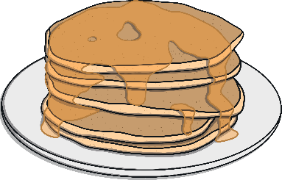
pancake
Start Timer
Start Timer
Use Timer
Show Answer
Next

Slide 6

inflate
Start Timer
Start Timer
Use Timer
Show Answer
Next

Slide 7
drame
Start Timer
Start Timer
Show Answer
Use Timer
Next

Slide 8

mistake
Start Timer
Start Timer
Use Timer
Show Answer
Next

Slide 9
flane
Start Timer
Start Timer
Show Answer
Use Timer
Next

Slide 10

invade
Start Timer
Start Timer
Use Timer
Show Answer
Next

Slide 11

shape
Start Timer
Start Timer
Use Timer
Show Answer
Next

