Slide 1
24th January 2021
Literacy Lesson: Tammy went to the Arctic: I can use adjectives to describe

Slide 2
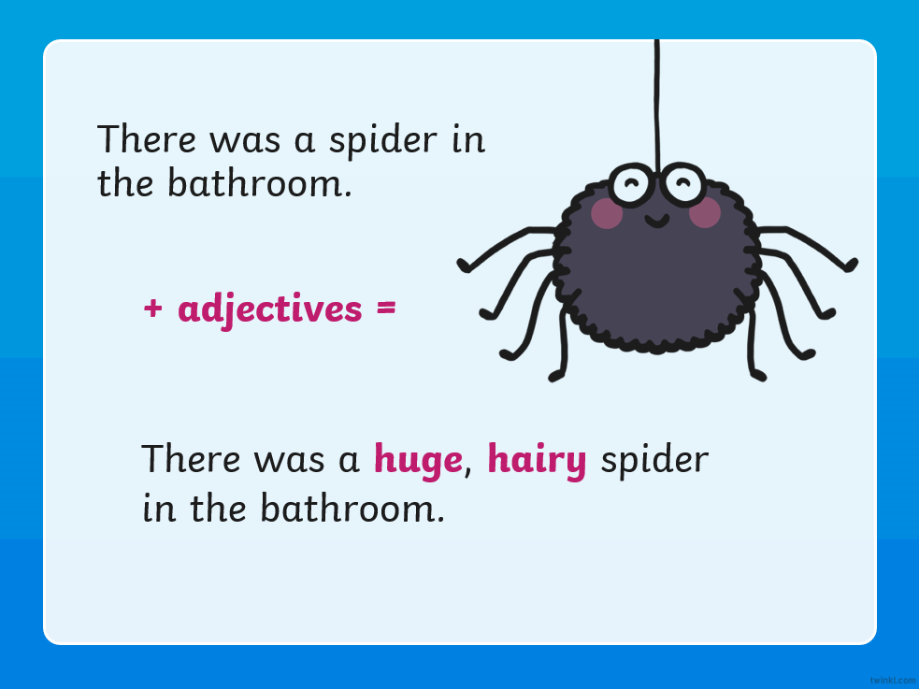
What is an adjective?
An adjective is a describing word

Slide 3
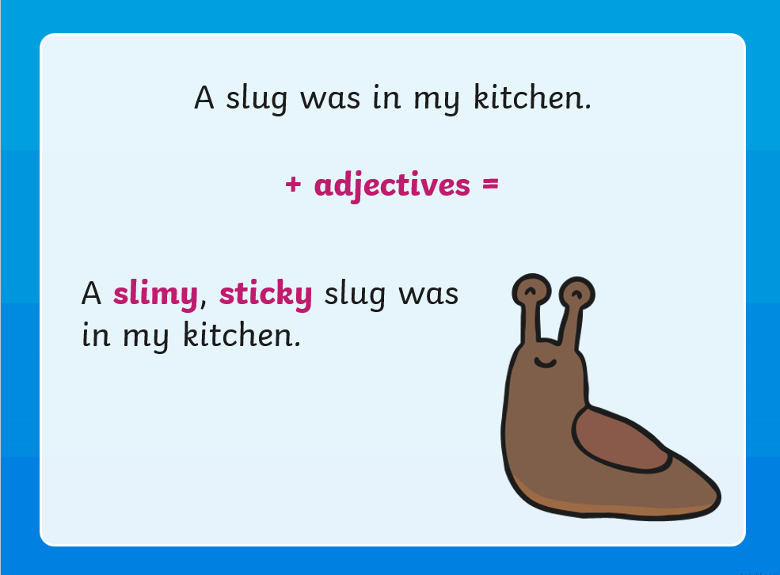

Slide 4
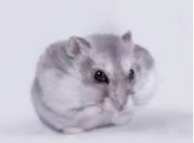
Anybody have a pet at home?
Can you tell me a sentence describing your pet using an adjective?
Eg I have a hamster called Pebbles… Pebbles is a grey and furry hamster.

Slide 5
We’re now going to watch the beginning part of Tammy went to the Arctic again….
I want you to focus on what Tammy is wearing. You might want to use your WB/pens to write down what you see her wearing.
https://www.twinkl.co.uk/go/resource/tg-a-07-the-girl-who-went-to-the-arctic-animation-1

Slide 6
Now… Lets have a go at describing what Tammy wears in the Arctic
Example:
Tammy wears gloves.
What kind of gloves does Tammy wear?
Tammy wears warm, black gloves.
Your go…
What else does Tammy wear in the Arctic? Try and describe it using an adjective.

Slide 7
Your task:
Is to describe what Tammy wears in the Arctic.
You need to have a read of the sentence and then in your literacy books re-write the sentences by putting adjectives in to describe what Tammy wears – Good Luck
Red and Yellow – fill in blanks
Blue and purple – re-write on books.

