Slide 1


Slide 3





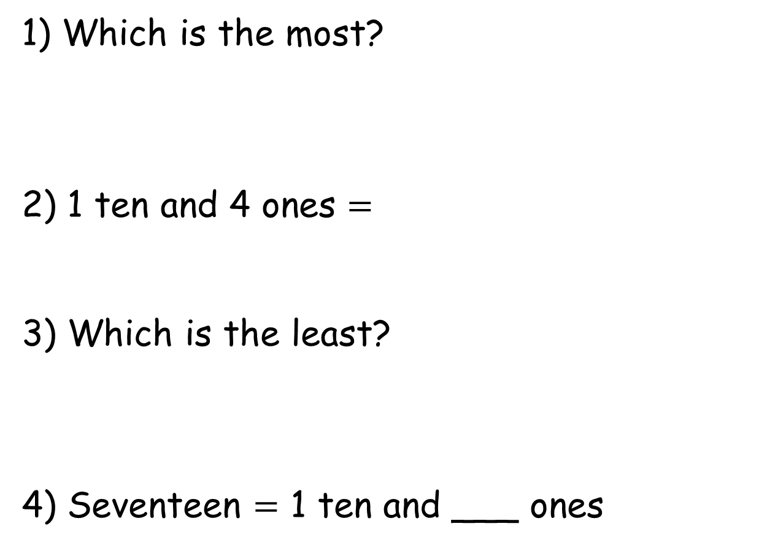
1) Which is the most?
2) 1 ten and 4 ones $=$
3) Which is the least?
4) Seventeen $=$ 1 ten and ___ ones

Slide 4
1) Which is the most?
2) 1 ten and 4 ones $=$
3) Which is the least?
4) Seventeen $=$ 1 ten and ___ ones
14
7

Slide 6

Which is the greatest?
sixteen
16
10
$$+$$
1
11
13
13
10 + 7
17
twelve
12

Slide 7

Which is the least?
sixteen
16
10
$$+$$
1
11
13
13
10 + 7
17
twelve
12

Slide 8

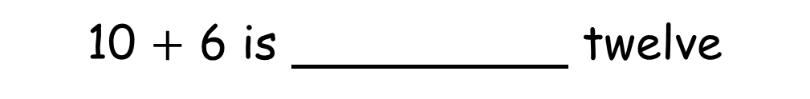
Have a think
11 | 12 | 13 | 14 | 15 | 16 | 17 | 18 | 19 | 20
greater than
less than
equal to
less than
16 is seventeen
equal to
nineteen is 1 ten and 9 ones
greater than
10 $+$ 6 is twelve

Slide 9
Have a go at questions 1 and 2 on the worksheet

Slide 10

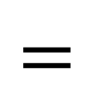




Let’s use symbols to compare!
11 | 12 | 13 | 14 | 15 | 16 | 17 | 18 | 19 | 20
$$<$$
$$=$$
$$<$$
$$<$$
18 20
$$<$$
16 12
$$<$$
13 18

Slide 11




Let’s use symbols to compare!
11 | 12 | 13 | 14 | 15 | 16 | 17 | 18 | 19 | 20
$$<$$
$$=$$
$$<$$
$$<$$
16 fifteen
$$<$$
eleven 1 ten and 9 ones
$$=$$
10 $+$ 10 twenty

Slide 12
Have a go at question 3 on the worksheet

Slide 13
Have a think
greater than
2
14 is 1 ten and ones
greater than
14 is 1 ten and ones
3

Slide 14
Have a think
greater than
2
14 is 1 ten and ones
greater than
14 is 1 ten and ones
3
14 is 1 ten and ones
less than
5
14 is 1 ten and ones
less than
7

Slide 15
Have a think
greater than
2
14 is 1 ten and ones
greater than
14 is 1 ten and ones
3
14 is 1 ten and ones
less than
5
14 is 1 ten and ones
less than
7
14 is 1 ten and ones
equal to
4
14 is 1 ten and ones
equal to
4

Slide 16

I think I will practise using words and symbols to compare numbers.
greater than
less than
equal to
is 1 ten and ones
is

Slide 17
Have a go at question 4 on the worksheet

