Slide 1


Slide 3



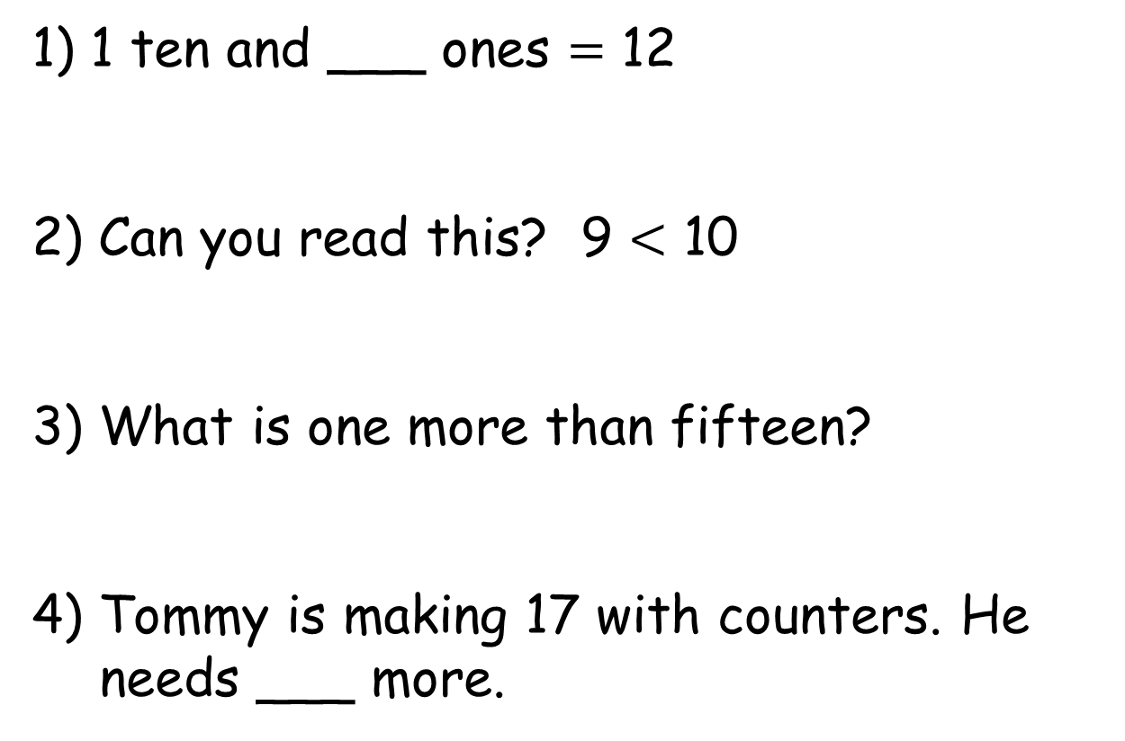
1) 1 ten and ___ ones $=$ 12
2) Can you read this? 9 $<$ 10
3) What is one more than fifteen?
4) Tommy is making 17 with counters. He needs ___ more.

Slide 4
2
1) 1 ten and ___ ones $=$ 12
2) Can you read this? 9 $<$ 10
3) What is one more than fifteen?
4) Tommy is making 17 with counters. He needs ___ more.
Nine is less than ten
16
1

Slide 6





Comparing
Have a think
Alex
Eva
Who is older?
Alex is 8
Eva is 10
Eva is older.
She has the most candles.

Slide 7


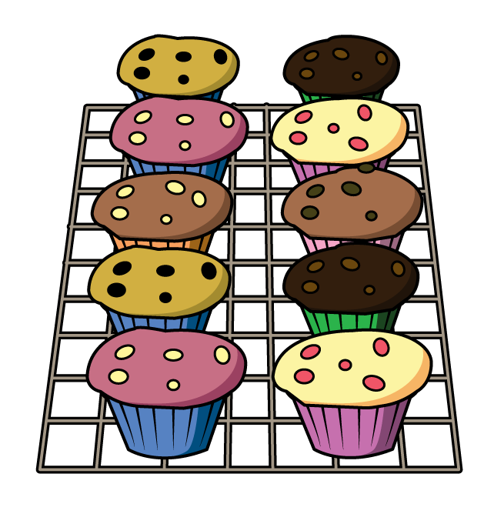
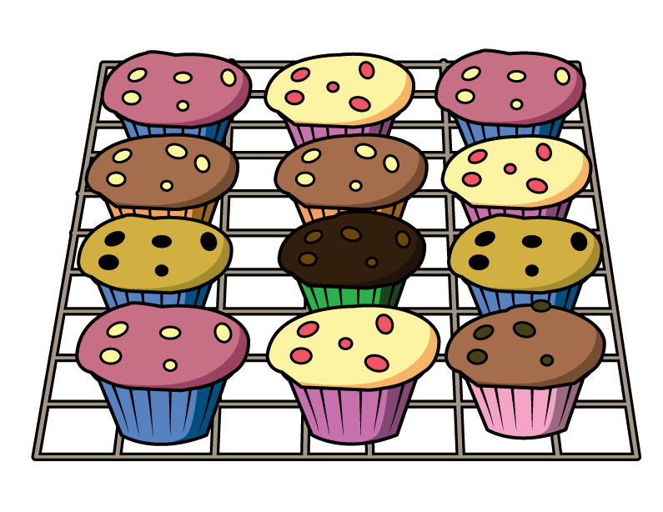
Comparing
Who baked the least?
10
is less than
12
Grandad baked the least.

Slide 8
Comparing
Who baked the most?
12
is more than
10
Nanny baked the most.

Slide 9



Let’s compare!
10
11, 12
10
11
I think the pink buttons are equal to the green buttons.

Slide 10
Let’s compare!
10
10
It’s easier when you line them up!
There are more pink than green.

Slide 11
Have a go at questions 1 and 2 on the worksheet

Slide 12







Greater than or less than
less than
is ___________
greater than
is ___________

Slide 13


Have a think
Greater than or less than
less than
is ___________
greater than
is ___________

Slide 14

Have a think
Greater than Less than Equal to
greater than
is ___________
equal to
is ___________

Slide 15
Have a go at question 3 on the worksheet

Slide 16

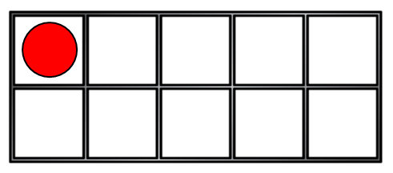





Pick a ten frame
Have a think
is greater than
?

Slide 17
Pick a ten frame
Have a think
is less than
?

Slide 18
Have a go at question 4 on the worksheet

