Slide 2
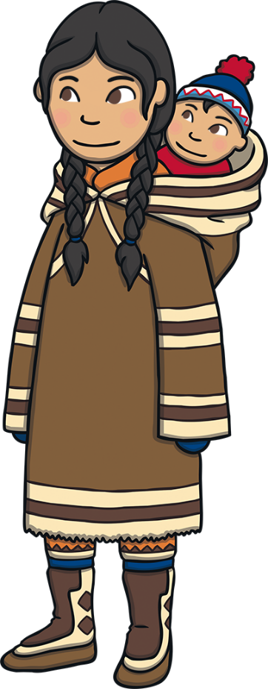
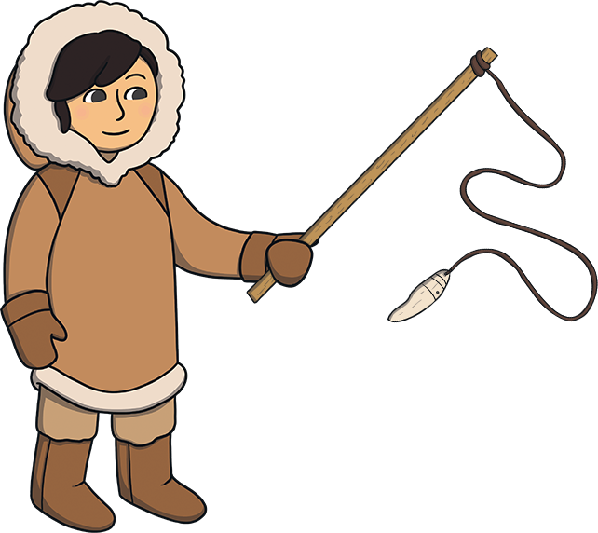
Inuit People
The Inuit people are a community of indigenous people.
A group are called ‘Inuit’ people and a single
person is called an ‘Inuk’.
‘Eskimo’ is the term used for the Yupik,
Iñupiat and Inuit peoples together,
but it is not thought to be a nice term
in some areas so we say ‘Inuit’
people instead.

Slide 3
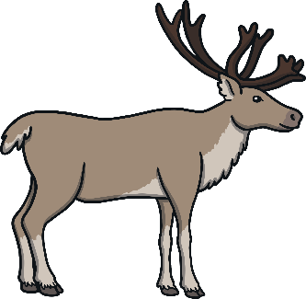
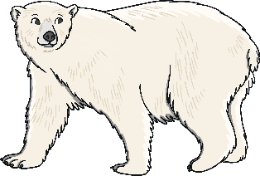
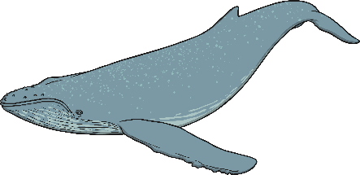
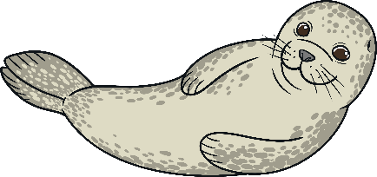
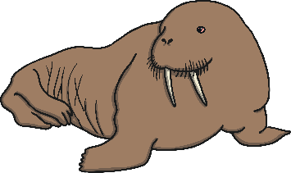
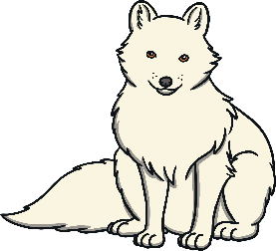
Diet
Inuit people hunt and fish, sometimes using harpoons.
Most of their diet is made up of meat, as not much can grow in such
a cold environment.
They eat fish, wild berries, edible seaweed called ‘kuanniq’, seal, caribou, walrus, polar bears, even whales and sometimes Arctic foxes!
Polar
bear
Whale
Caribou
Polar bear
Whale
Caribou
Seal
Walrus
Arctic fox
Seal
Walrus
Arctic fox

Slide 4
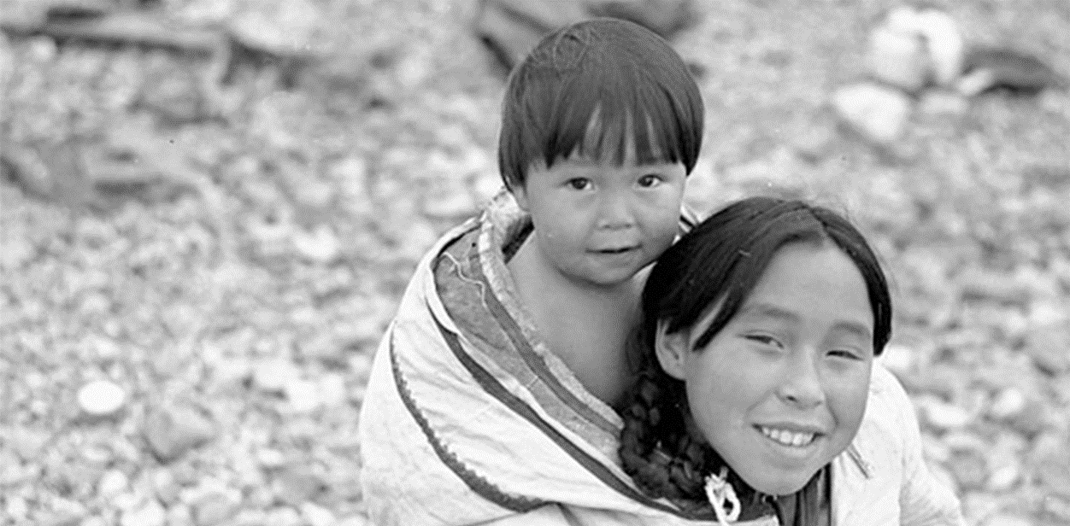
Where in the World
The Inuit people live in far northern Arctic areas. Populations of Inuit people are living in Greenland, Canada, Alaska, Russia and Denmark.
They used to live along the coast, but have travelled to new places.
They live in some of the harshest conditions on earth.
Photo courtesy of BiblioArchives / LibraryArchives (@flickr.com) - granted under creative commons licence – attribution

Slide 5
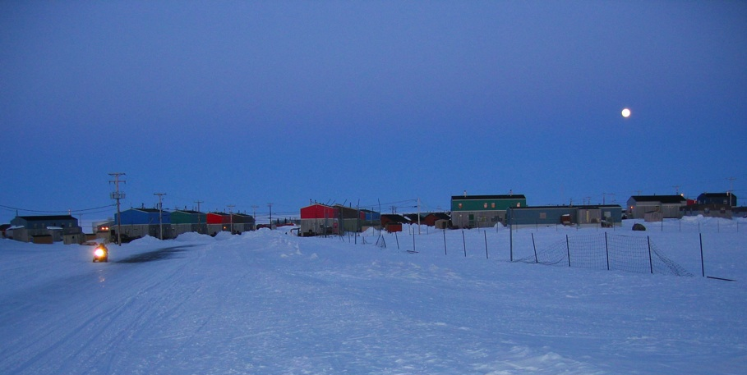
Inuit Towns
The Inuit live in houses, in small communities similar to villages. Each one has shops, churches and schools.
Photo courtesy of ezola (@flickr.com) - granted under creative commons licence – attribution

Slide 6
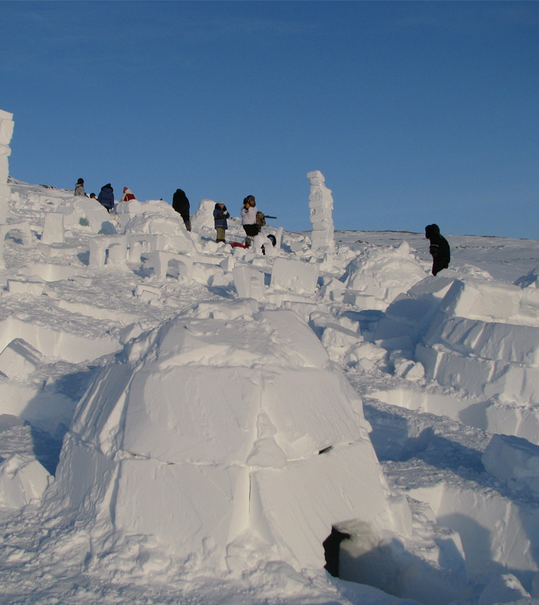
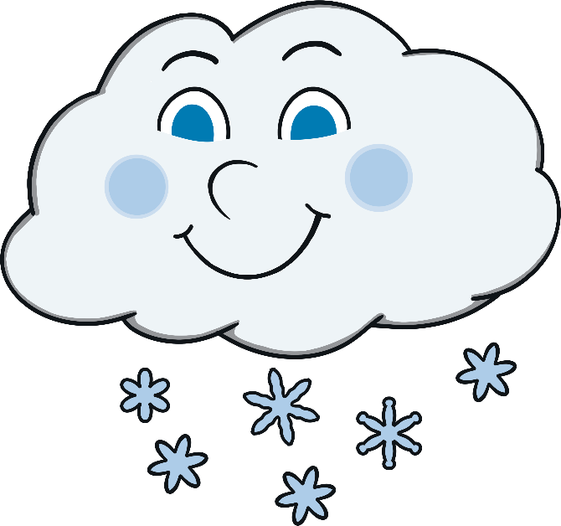
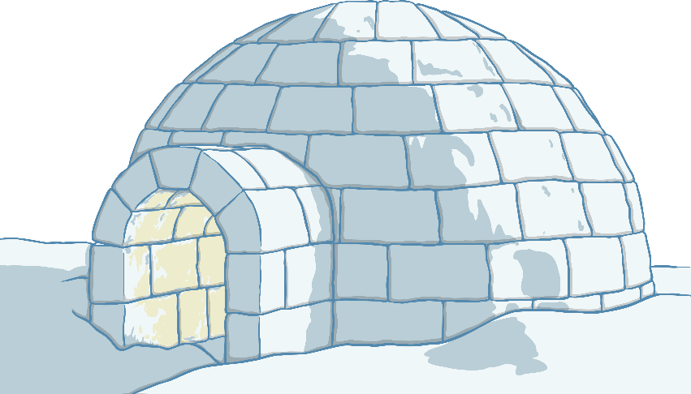
Homes - Igloo
A lot of Inuit people move around all year and don’t stay in one
single place.
They make igloos out of snow and ice, as a shelter when travelling.
These are perfect for them to stay in during the winter.
Photo courtesy of Steven Roberege (@flickr.com) - granted under creative commons licence – attribution

Slide 7
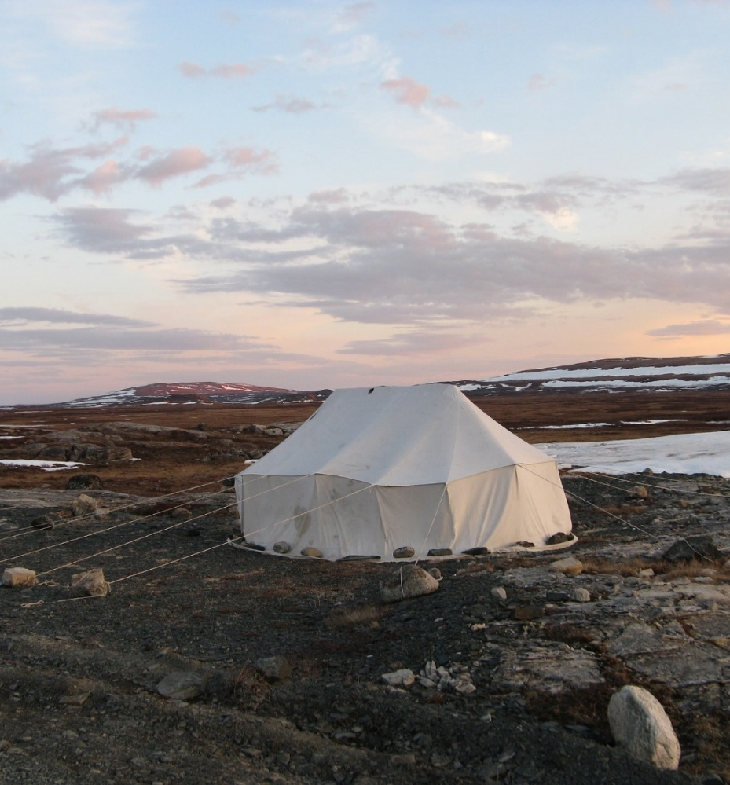
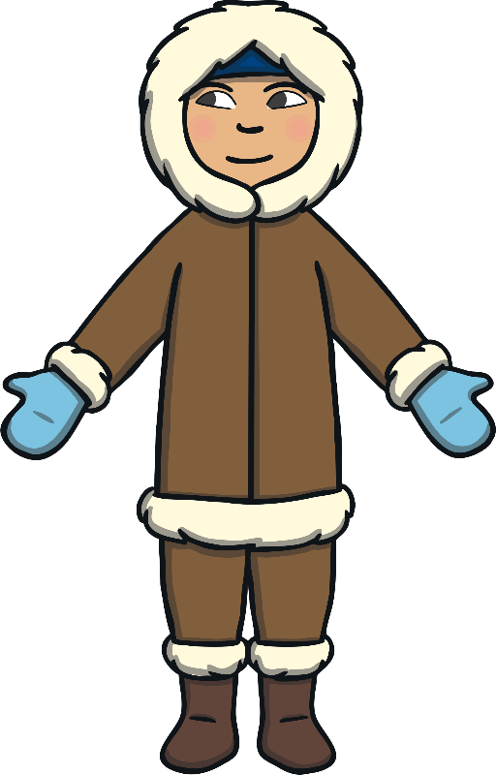
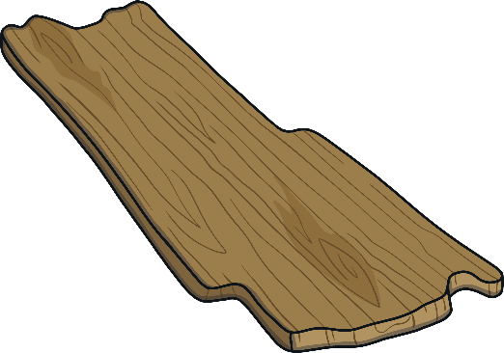
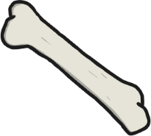
Homes - Tents
Tents are also used in the summer.
Some Inuit people make their own tents called ‘Tupiq’ from driftwood, whalebones and stretched animal skin.

Slide 8

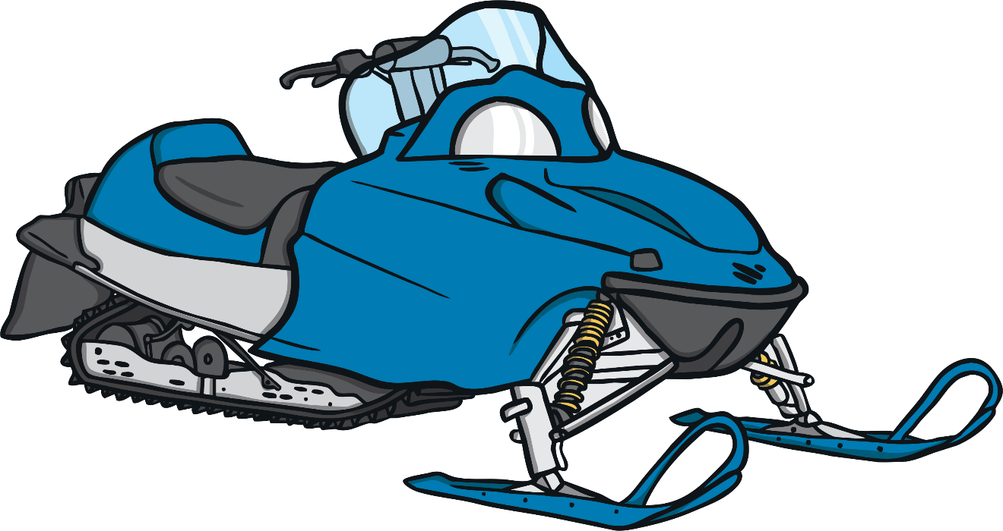
Travelling
The Inuit tend to travel, fish and hunt using snowmobiles...

Slide 9
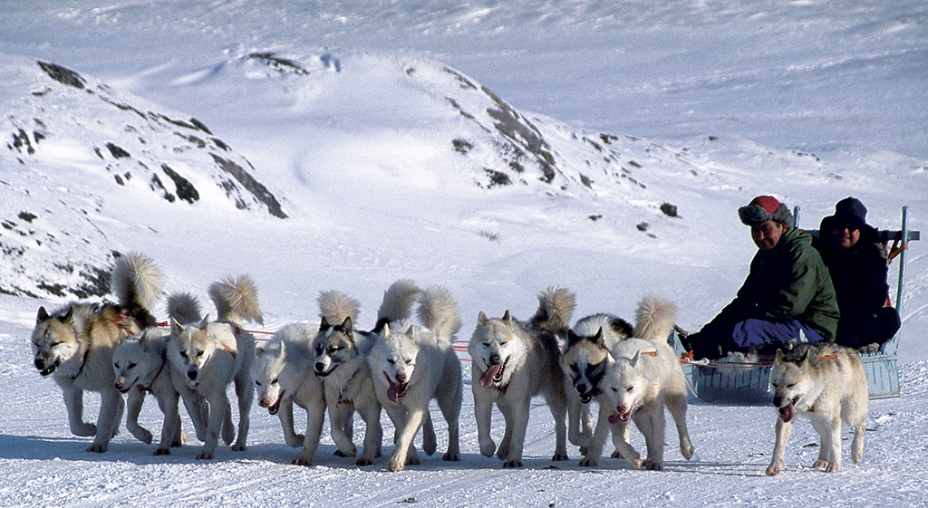
Travelling
...dog sleighs called ‘qamutik’...
Photo courtesy of Greenland Travel (@flickr.com) - granted under creative commons licence – attribution

Slide 10
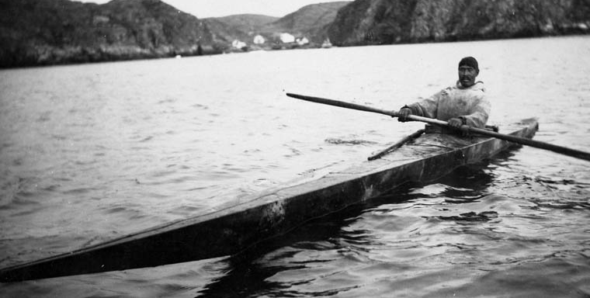
Travelling
...and kayaks (which is actually an Inuit word). They also build stronger boats called ‘umiaqs’.
Photo courtesy of BiblioArchives / LibraryArchives (@flickr.com) - granted under creative commons licence – attribution

Slide 11
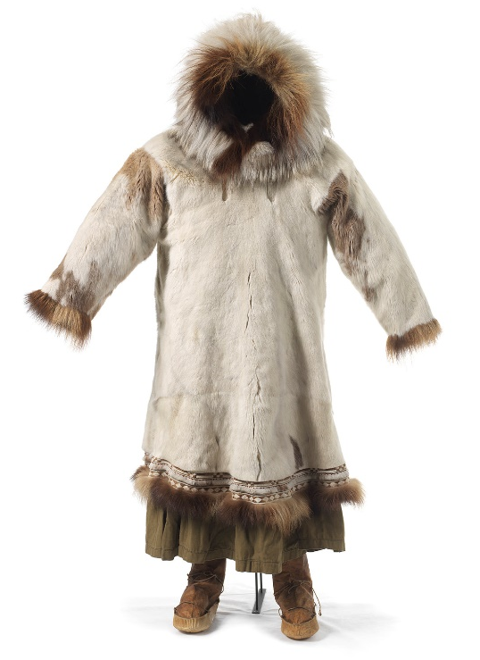
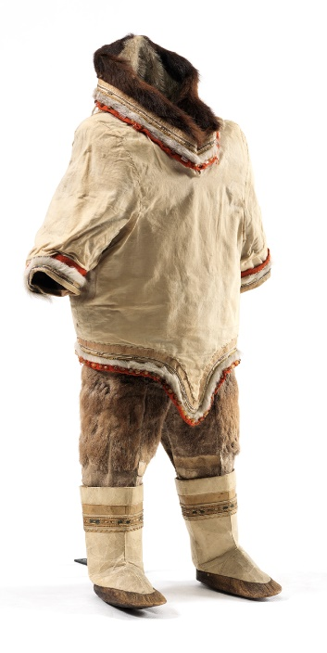
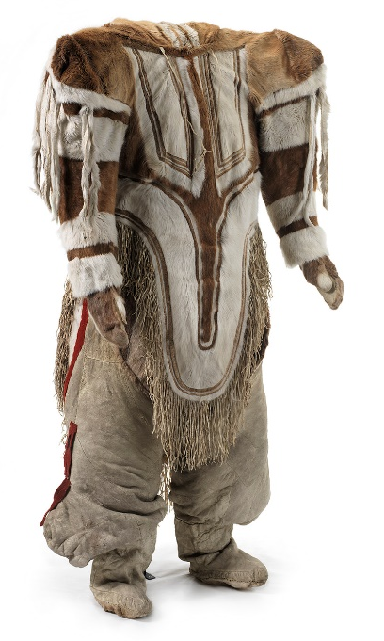
Clothes
Keeping warm is very important in such a cold climate so the Inuit people wear long parkas made from animal skins and furs.
They can buy their clothes from a shop, but some people still make their own. They wear tunics in summer.
Photo courtesy of Nationalmuseet (@flickr.com) - granted under creative commons licence – attribution

Slide 12
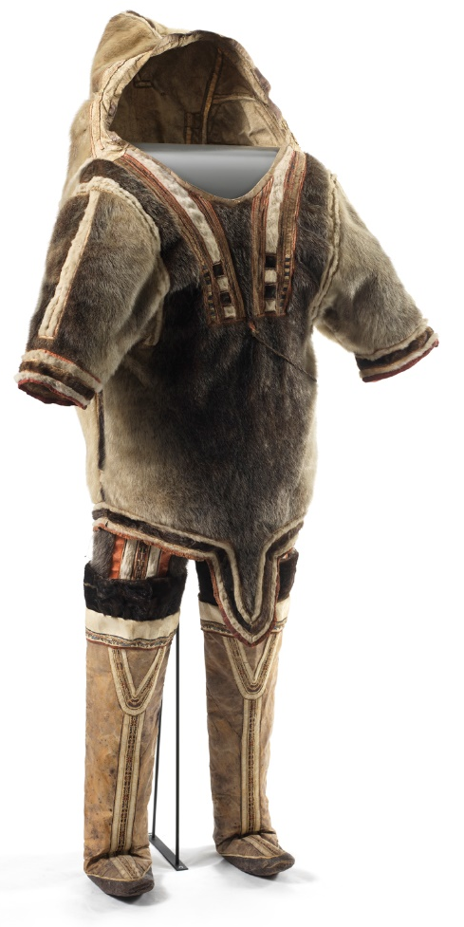

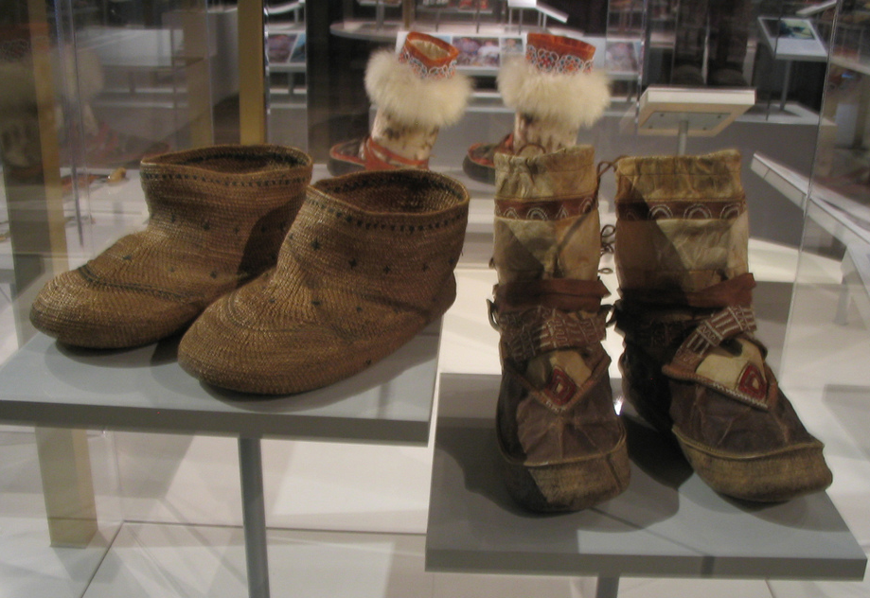
Clothes
Babies are sometimes kept in the hood of their mother’s parka.
They also wear warm, soft boots called ‘mukluks’.
Photo courtesy of Nationalmuseet (@flickr.com) - granted under creative commons licence – attribution

Slide 13
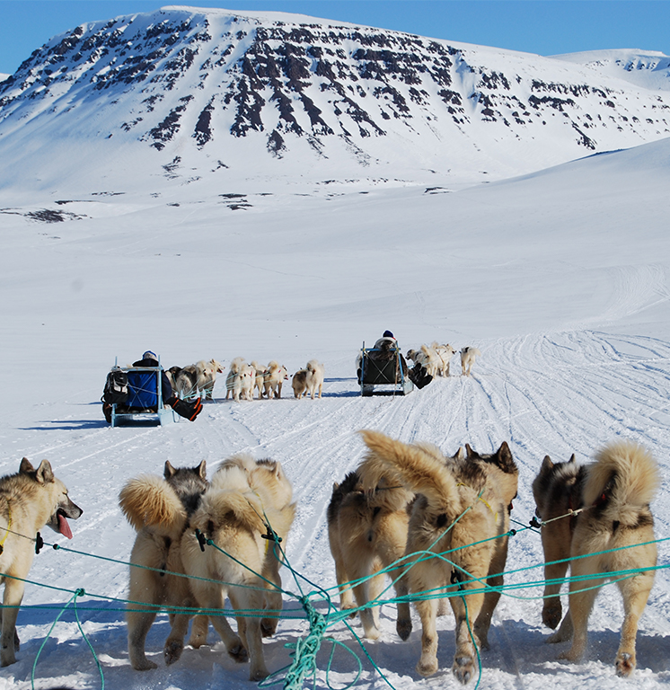
Hobbies
Their hobbies include:
snowboarding
playing hockey
skiing
ice fishing
playing video games
watching television
skating
art
throat singing
Photo courtesy of Greenland Travel (@flickr.com) - granted under creative commons licence – attribution

Slide 14


Throat Singing
The Inuit type of throat singing is often called ‘katajjaq’. It is an entertaining duet performed by two Inuit people, usually women.
They have a fun contest to see who can last the longest.
Karin and Kathy Kettler, the Canadian throat-singing sisters (who together are known as Nukariik), carry on the traditions of the elders from their mothers' village in Kangiqsualujjuaq, Nunavik, which is in northern Quebec, Canada.
Watch a clip of them performing.
Photo courtesy of Greenland Travel (@flickr.com) - granted under creative commons licence – attribution

Slide 15
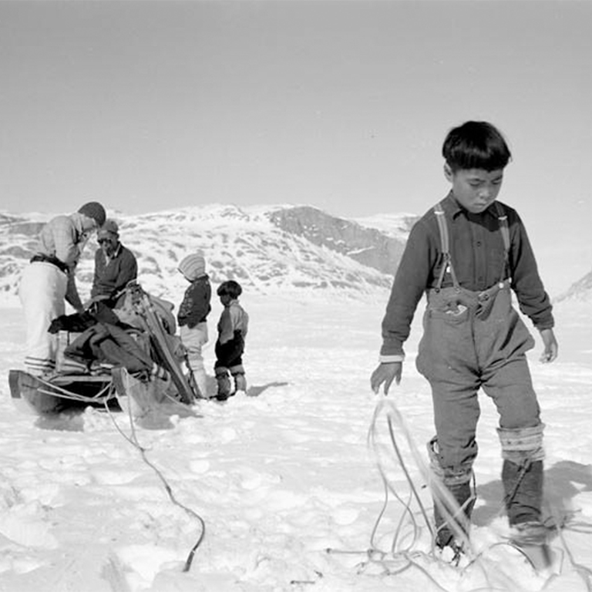
Language
The oral Inuit languages are part of the Eskimo-Aleut family.
Inuit speak a few different languages: Inuinnaqtun, Inuktitut, Inuvialuktun
and Greenlandic languages (Kalaallisut, Inuktun and Tunumiit).
The Inuit sign language
is called Inuiuuk.
It is now at risk of becoming extinct
because only about
50 people still speak it.
Photo courtesy of BiblioArchives / LibraryArchives (@flickr.com) - granted under creative commons licence – attribution

Slide 16
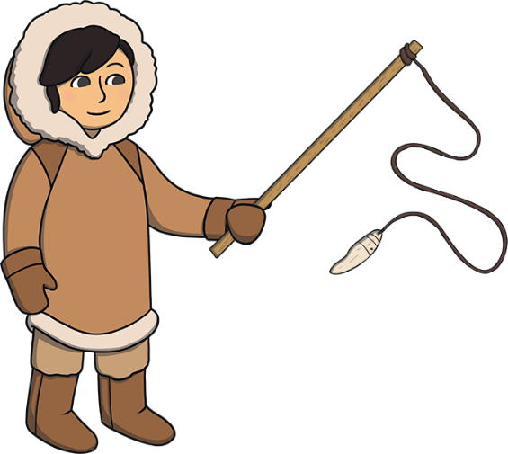
Language
Have a go at saying these Inuit words yourself!
katajjaq = Inuit throat singing
qamutik = dog sleighs
mukluks = warm, soft boots
umiaqs = strong boats they build
kuanniq = edible seaweed
Tupiq = their own homes made from driftwood,
whalebones and stretched animal skin

Slide 17

Did You Know...? Facts!
After hunting, the Inuit people often honour the animal’s spirit by singing songs and performing rituals.
Although the Inuit don’t eat many vegetables,
they are some of the healthiest people in the world.
This is fascinating to scientists!
After meeting Europeans in the 1800s,
nearly 90% of the Inuit people in
Western Alaska died.

