Slide 1
‘Meet the teacher’

Slide 2

Introduction
Just a little bit about myself…
I have 2 teenage girls. Eva my youngest is at Charters in year 10. She is about to start her GCSEs. My eldest Ella has just finished her A-levels and is taking a gap year before starting a graduate program. Before becoming a teacher, I worked as a learning support assistant for five years working with children with special needs. This is my second year at Cheapside and I absolutely love teaching year 1.
You will often find me covered in paint and glue as I will often literally speaking ‘get stuck in’ with the children’s learning. I feel so honoured to be given this class and your children to teach this year and I am excited about the journey we are all on.

Slide 3
Staffing
Mrs Lopez, Mr Ryker and Mrs Bailey are our teaching assistants this year.
Forest school – Mrs Ward and Mrs Miles
PE – Mrs Higgins.

Slide 4
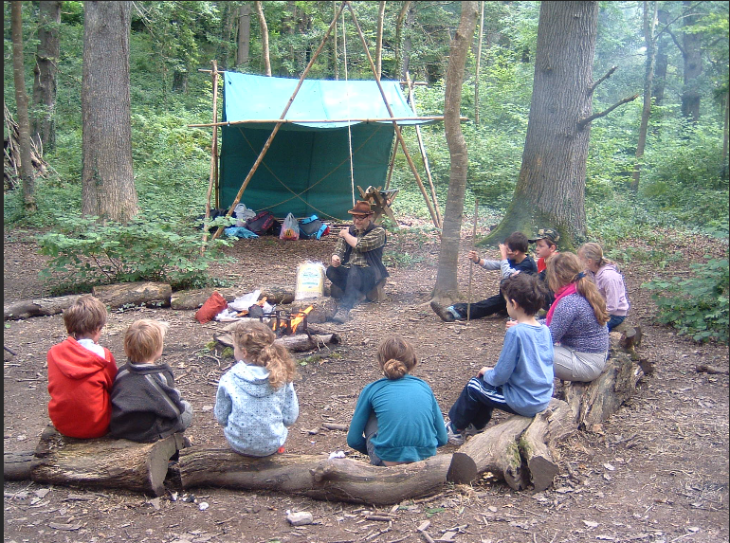
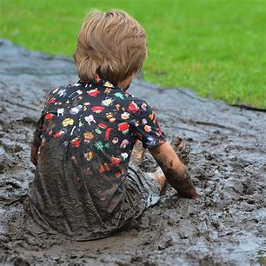
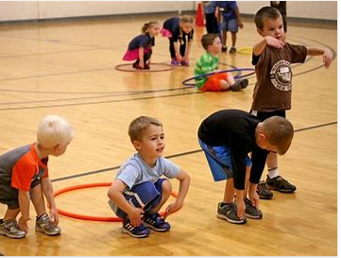
Information
FOREST SCHOOL – Monday afternoons
A pair of warm tracksuit bottoms or leggings, navy blue or black. The school PE tracksuit bottoms are ideal for this.
· The school PE jumper or zip up hoodie
· The school PE Tee-shirt
· A waterproof coat and waterproof trousers
· A pair of trainers and (a pair of wellington boots that will be kept in school.)
· Warm socks, gloves and a hat as the weather gets colder
PE –Tuesday mornings
Children to come in to school dressed in their PE kit. PLEASE make sure it is named.

Slide 5
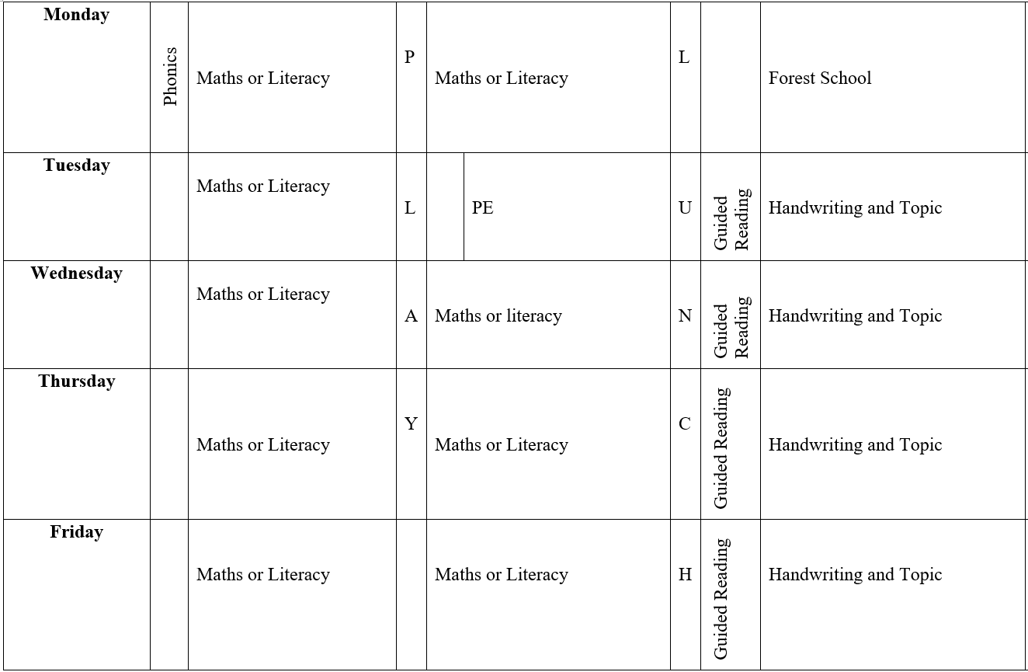
Timetable
Notes:
Talk about CP and assembly

Slide 6
Home work
On class pages I will post a copy of the year 1 and 2 common exception words. Please can you begin to go through these with your child.
Please read with you child every day. We will be sending out reading records and we can then track and read your comments. Make it fun… make a hot chocolate, read with a pet, read to different family members. Ten minutes of reading a day can support progression with you child in phonics and literacy.
I will also post the KIRFS onto class pages for the whole year. These are broken down into termly pages. Beginning with Autumn 1. These will support your child’s progression in mathematics.

Slide 7
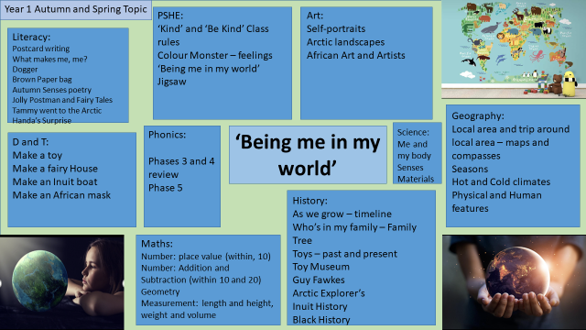

Slide 8

Reading
Please can you make sure your child brings their reading book in to school every day as we like to hear every child read individually once a week when we can.
All the children will have reading records and these will be coming out in the next week.
Just to reassure you I will move them onto the next stage when they are ready.

Slide 9
General
There is fruit available for the children at snack time.
Please do remember to send a water bottle in each day.
We have hand sanitiser in the class but your child may prefer to bring their own.

Slide 10
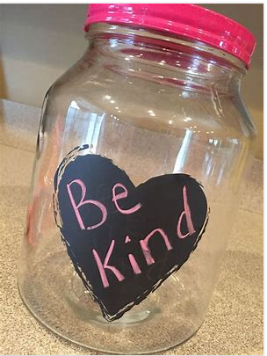
Finally…
There will always be an adult to greet you in the mornings from the year 1 team. Please feel free to communicate anything you feel we need to know that might be important. Especially if you feel your child might need extra emotional support that day for whatever reason and as long as we are aware we can adapt the day for them. I know and understand the challenges of being a parent and am also here for you if you ever need any support or a listening ear. If you are unable to speak to somebody please let the office know and they will pass the message on to me.
My core value as a teacher is nurture and therefore I set precedents to this as a foundation to good learning. My class rule is ‘kindness’ and the children have already spent the last two weeks learning how to be ‘kind’ when they play and learn. We have a class ‘kindness jar’ and the children are rewarded at the end of each week for filling this jar with acts of kindness.
Thank you
Laura Grigulis
Notes:
. I work a lot with the childre.n on emotional literacy and especially because of the challenges that have been posed due to the time the children have had away from each other and school I put a lot of emphasis in my class on teaching positive social and communication skills. We do a lot of work on sharing, learning to play and listening to learn.

