Slide 1
Turrets and Tiaras
Not forgetting the dragons
Year 1 Topic web Summer Term 1 and 2

Slide 2


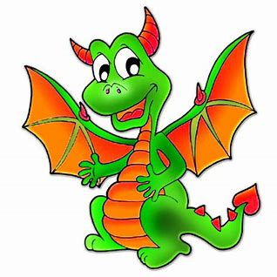

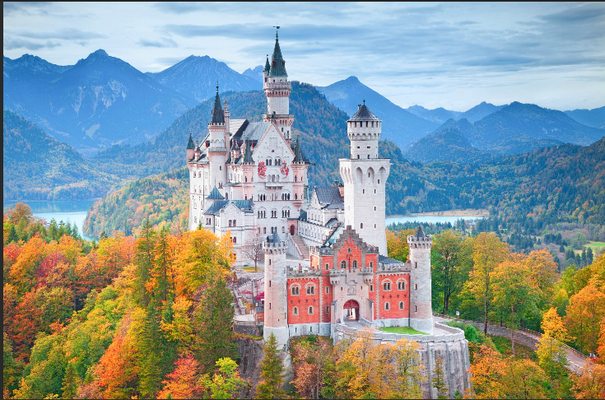

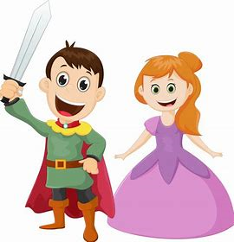
Year 1
Geography: Human/physical UK geography, name and locate places in the UK including their capital cities, all about British Castles.
Maths:
Counting ships and soldiers, repeating pattern towers, castle word problems, archery doubles, capacity of oil buckets, weight of catapult missiles
Turrets and Tiaras
DT: design and build a castle, design a crown, design and make a knights shield.
Science – TBC
History: Features of a castle, types of castles, life in a castle, why were castles built, timeline of kings and queens, castle defence and attack, William the Conquerer
Music: Sound effects – castle sensory story, Grand old Duke of York –Rhythm, horses, medieval
Literacy: William the Conqueror the story of Harold and William, cross-curricular history/literacy applying for a castle job and designing a medieval feast. Non-fiction Castle book.
Art: Portraits of Kings and Queens, Paul Klee ‘Castles and Sun’

