Slide 1

Kestrels
Teacher: Mr Searle
Teaching Assistant: Mrs Jain (a.m. only)

Slide 2
Timetable

Slide 3
Timetable

Slide 4
P.E.
Up to half term our sports are Tag Rugby – for which we are privileged to have an external coach - and Swimming.
After half term, our sports are Football and Circuits.
P.E. is on Tuesdays and Wednesdays.
Children should come to school in PE kit on these days and brings in their school shoes as well.
Long hair must be tied back and earrings should be removed (plastic retainers could be used to ensure newly pierced ears maintain their holes).
Lunchtime Football Club (Mon – Girls, Tues – Boys)

Slide 5
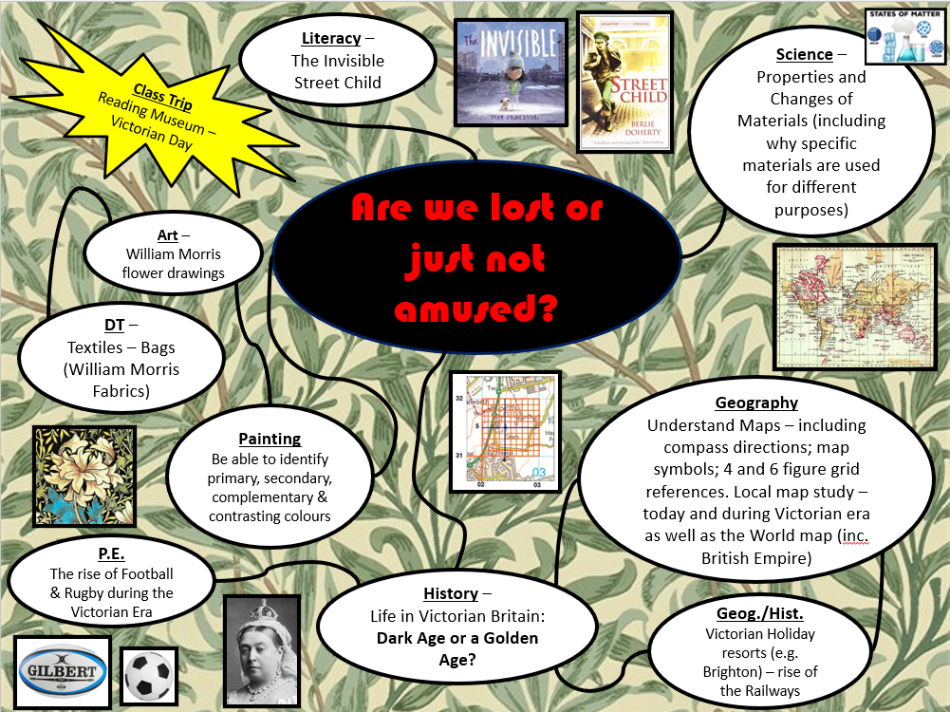
The Creative Curriculum

Slide 6
Our Topic
Are we lost or just not amused? is based around our Geography topic of Maps and our History topic of ‘Victorian Britain: Dark Age or Golden Age?’
The geographical skills of map reading, including the use of grid references, will be enhanced by looking at how the locality and the World has changed since Victorian times.
Lists of key vocabulary and a summary of what we will be covering can be found in the ‘Knowledge Organisers’ section on the class page.

Slide 7
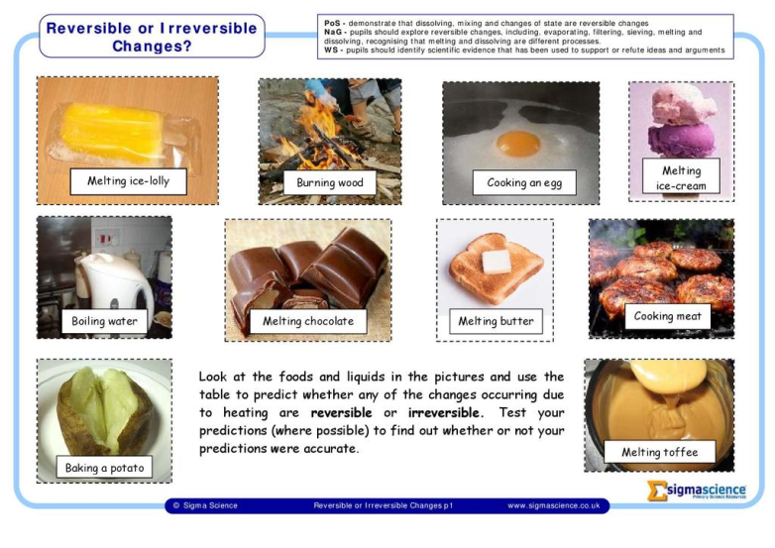
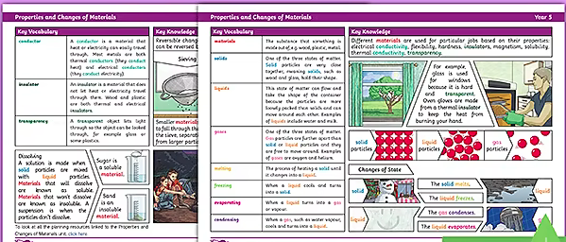
Science
This term we will be learning about all things related to the ‘Properties and Changes of Materials’.
A list of vocabulary and a summary of what we will be covering can be found in the ‘Knowledge Organisers’ section on the class page.

Slide 8
Reading
English will include ‘focused’ reading based on our topic linked class novels: Street Child. This is to build up their comprehension skills as well as encouraging reading for enjoyment.
It is essential that children read/are read to at home daily. Reading is a great way of understanding the world and reading to your child is as important as listening to your child read.
Children in Year 5 can choose a book from our class library, with guidance if required, or may bring in a book from home which they should also be reading with you.

Slide 9
Writing
Writing will also be based around our Topic linked class readers and will include:
  Narrative and descriptive writing
    Play scripts
    Graphic Novels
  Poetry
  Non-fiction writing
    Information (Non-chronological Reports) texts
    Recount texts
    Explanation texts
    Instruction texts
    Persuasive texts
    Discussion texts

Slide 10
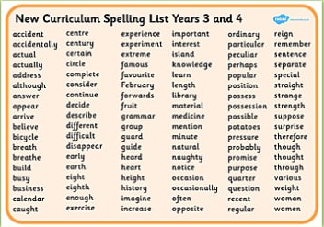
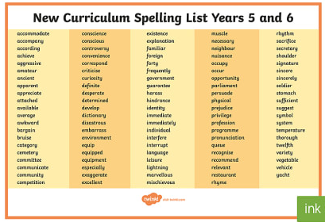
Spelling
Every Monday the children will bring home a spelling list with 10 spellings for them to learn. These spellings will consist of words based on the week’s spelling pattern or rule or words from the class writing or the statutory word lists (see website). Sometimes additional spellings may also be given.
The children will be tested on these throughout the week in class with a formal spelling test on Friday.

Slide 11
Maths
An outline of what we will be covering in maths can be found on the class page, along with the Key Instant Recall Facts (KIRFs).
Focussing on the KIRFs will improve your child’s mental maths skills and their ability to recall facts quickly; enabling them to solve more complex mathematical problems they encounter.
In order to support their Times Tables, I would encourage children to spend at least 10 minutes per day on Times Table Rockstars. A set Homework on Tuesdays will also be TTRS. Your child has been provided with their login and password.

Slide 12
Homework
It is the intention is to give approximately 30 minutes Homework per night, including Literacy, Reading, Spelling, Topic work and Maths. Please check and sign your child’s homework diary, each week, if possible.
Ongoing – Daily Reading, Times tables and KIRFS.
Spellings – The children are given these on Monday for a test on Friday.
Maths – an extra piece of Maths Homework will be provided weekly.
Other Homework Tasks – sometimes, additional support pieces of Homework will be provided.

Slide 13
Expectations in upper KS2
Achieving our best - in thought, in word, in deed.
Role models to the younger children.
Uniform – neat and correct.
Homework on time where possible.
Sensible, helpful and polite around the school.
Hard work but lots of fun too!

Slide 14
Any Questions?
Having a quick chat at the gate or in the car park is not ideal so please contact the office and we can arrange an appointment.
Formal Parent consultations will be held later in the term as usual.
Our Class Page on the website is regularly updated and is a good source of information, so please do check it.
The website also has lots of other useful pages such as the Curriculum page under the Key Information tab and the Reading Zone under the Children tab.
Do you have any questions you wish to raise at this time?

