Slide 1

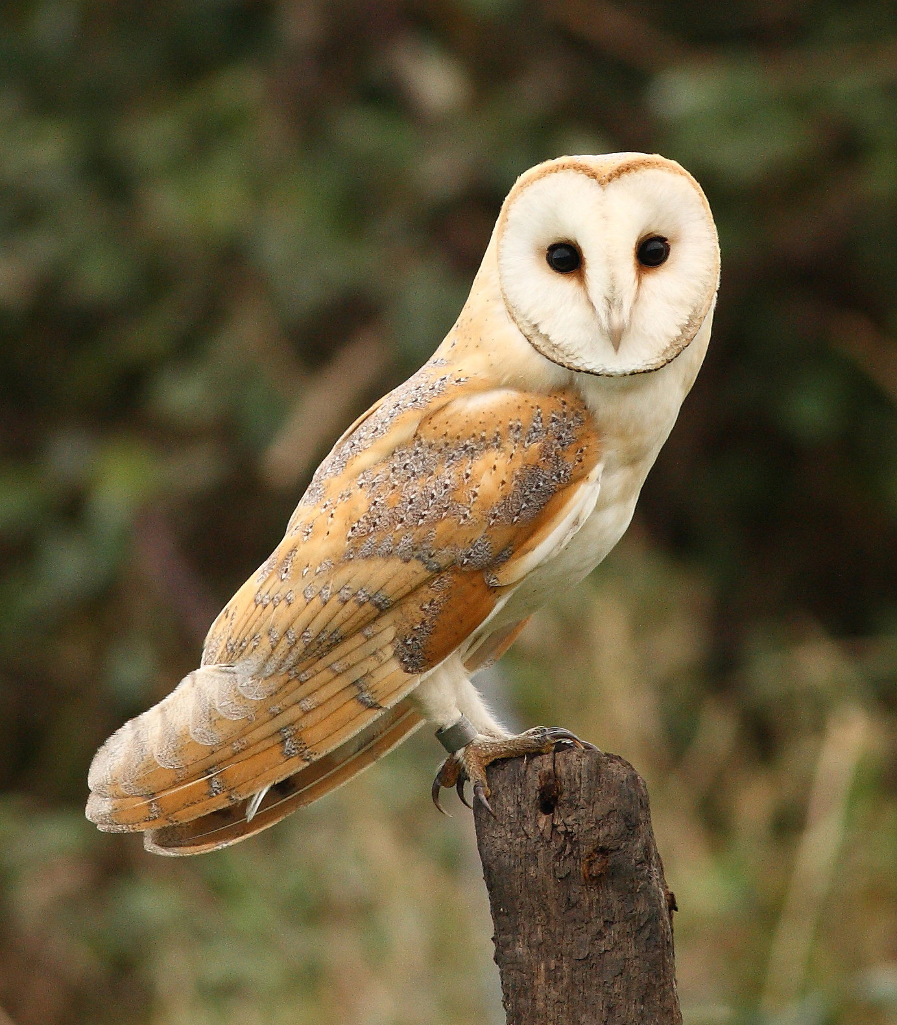

Owls
Teacher: Mrs M Rees

Slide 2
Year 6 weekly Timetable
MONDAY | TUESDAY | WEDNESDAY | THURSDAY | FRIDAY
Maths Fluency | Maths Fluency | Maths Fluency | Maths Fluency | Maths Fluency
Focused Reading | Focused Reading | Focused Reading | Focused Reading | Focused Reading
Maths | Maths | Maths | Maths | Maths
School Assembly | Values Assembly | School Assembly | Singing Assembly | Achievement Assembly
BREAK
English | English | English | English | English
LUNCH
Music/French | Topic | Science | R.E. | P.S.H.E
P.E. | Topic | Science | Art/D.T. | P.E.
Reading | Reading | Reading | Reading | Reading

Slide 3
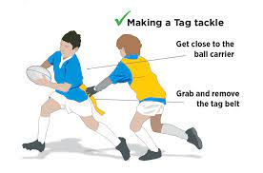
P.E
For the first half term, the children will be taking part in Tag Rugby activities – for which we are privileged to have an external coach - and Circuit Training.
• After half term, our sports are Football and Dance.
• P.E. is on Mondays and Fridays.
• Children should come to school in PE kit on these days and brings in their school shoes as well.
• Long hair must be tied back and earrings should be removed (plastic retainers could be used to ensure newly pierced ears maintain their holes).

Slide 4
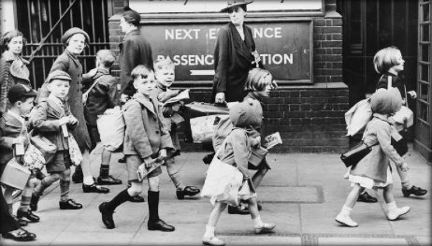

History – WWII
-Why did Britain have to go to war in 1939?
-Was it necessary for children to be evacuated?
-How did Britain stand firm against the German threat?
-What was life like on the Home Front?
-What was VE day really like?
WW2 Artists
- Henry Moore and L.S Lowry
- Propaganda posters
Science
Animals including humans
- Identify and name the main parts of the human circulatory system and describe the function of the heart, blood vessels and blood
Recognise the impact of exercise, drugs and lifestyle on the way their bodies function
Describe the ways in which nutrients and water are transported
Evolution and Adaptation
Recognise that living things produce offspring of the same kind
Identify how animals are different and adapt to their environment and that adaptation may lead to evolution
Worth Fighting For!
English
Class novel – Goodnight Mr Tom
Geography Country Comparison North American study
Name of countries, climate, cities, geographical features, time zones and similarities and differences between human and physical features within the UK and a North American region.
Music
- Recorders
PSHE -Healthy relationships -Celebrating differences
PSHE
-Healthy relationships
-Celebrating differences

Slide 5

Children who read well, write well!
Reading
This year, we will have a ‘focused reading’ slot several times per week. During this time, children will usually work on a book that we are reading as a class. I aim to increase their comprehension skills and promote reading for enjoyment!
The children should also be reading a book of their choice that they should bring into school every day and read at home every evening. It would be wonderful if you could listen to your child read and discuss what they have read.
Reading is a great way of understanding the world and reading to your child is as important as listening to your child read.

Slide 6

Writing!
Key areas being covered:
• Spelling, grammar and punctuation
• Story writing
• Non- chronological reports
• Recount texts
• Non- fiction writing
• Instruction texts
• Biographies
• Poetry
In year 6 there is a heavy focus on children editing their own work in order to encourage independence and improvement within their writing.

