Slide 2



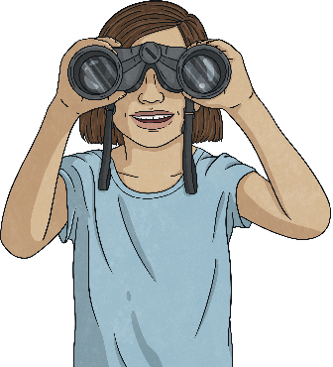
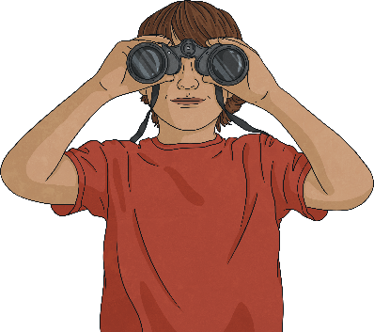
Pick Your Quiz
I want to do a quiz that contains nouns, verbs, adjectives and adverbs.
I want to do a quiz that contains nouns, verbs, adjectives, adverbs, pronouns, prepositions and determiners.
Start
Start
Finish

Slide 3

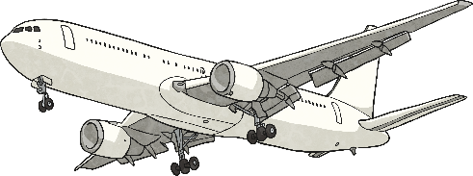
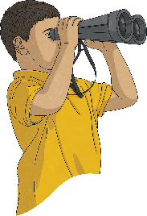
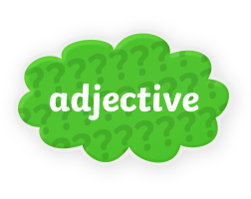
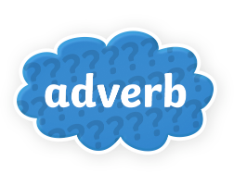
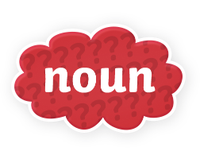
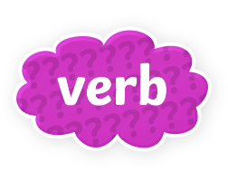
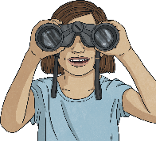
Which word class does the blue word belong to?
1
There was an old cabin next to the lake.
?
Next
Correct! Well done!
Incorrect. Try again!
adjective

Slide 4
Which word class does the blue word belong to?
2
I had to run for the bus.
?
Next
Correct! Well done!
Incorrect. Try again!
verb

Slide 5
Which word class does the blue word belong to?
3
I am going to visit Spain in the summer.
?
Next
Correct! Well done!
Incorrect. Try again!
noun

Slide 6
Which word class does the blue word belong to?
4
I quietly crept down the stairs.
?
Next
Correct! Well done!
Incorrect. Try again!
adverb

Slide 7
Which word class does the blue word belong to?
5
Fionn placed the book back on the shelf.
?
Next
Correct! Well done!
Incorrect. Try again!
noun

Slide 8
Which word class does the blue word belong to?
6
We swam in the ocean all afternoon.
?
Next
Correct! Well done!
Incorrect. Try again!
verb

Slide 9
Which word class does the blue word belong to?
7
Did you ask for a red bike for your birthday?
?
Next
Correct! Well done!
Incorrect. Try again!
adjective

Slide 10
Which word class does the blue word belong to?
8
Our teacher has gone home as they don’t feel well.
?
Next
Correct! Well done!
Incorrect. Try again!
noun

Slide 11
Which word class does the blue word belong to?
9
Slowly, the snail made its way up the garden path.
?
Next
Correct! Well done!
Incorrect. Try again!
adverb

Slide 12
Which word class does the blue word belong to?
10
The dogs on the beach raced towards the sea.
?
Next
Correct! Well done!
Incorrect. Try again!
verb

Slide 13
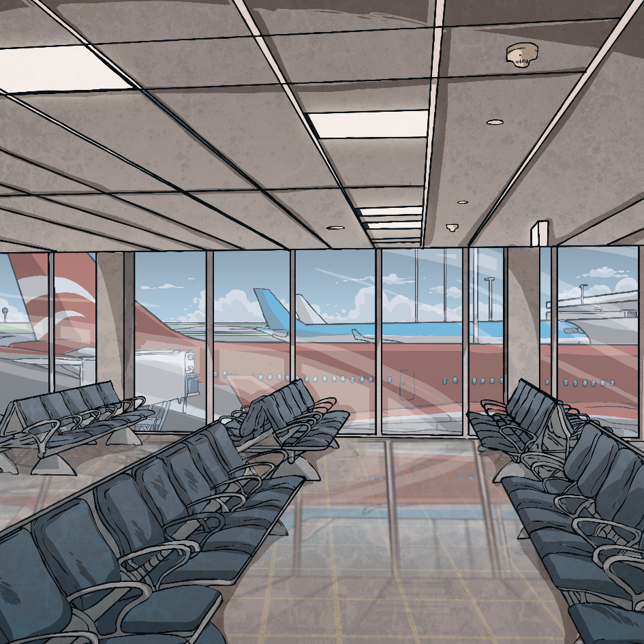



Congratulations!
Back to the quiz selection

Slide 14

Which word class does the yellow word belong to?
1
There was an old cabin next to the lake.
?
noun
verb
adjective
adverb
Next
Correct! Well done!
Incorrect. Try again!
pronoun
preposition
determiner
preposition

Slide 15
Which word class does the yellow word belong to?
2
Following a successful performance,
the cast members bowed.
?
noun
verb
adjective
adverb
Next
Correct! Well done!
Incorrect. Try again!
pronoun
preposition
determiner
verb

Slide 16
Which word class does the yellow word belong to?
3
Do you think that she is really going to eat that?
?
noun
verb
adjective
adverb
Next
Correct! Well done!
Incorrect. Try again!
pronoun
preposition
determiner
pronoun

Slide 17
Which word class does the yellow word belong to?
4
The artist smiled; happy that
the painting was finally finished.
?
noun
verb
adjective
adverb
Next
Correct! Well done!
Incorrect. Try again!
pronoun
preposition
determiner
adverb

Slide 18
Which word class does the yellow word belong to?
5
This strange cat has been following me all week!
?
noun
verb
adjective
adverb
Next
Correct! Well done!
Incorrect. Try again!
pronoun
preposition
determiner
determiner

Slide 19
Which word class does the yellow word belong to?
6
I can’t believe that the
concert is happening this week!
?
noun
verb
adjective
adverb
Next
Correct! Well done!
Incorrect. Try again!
pronoun
preposition
determiner
determiner

Slide 20
Which word class does the yellow word belong to?
7
The gargantuan sign reading ‘Warning! Trolls sighted in this area!’ was enough to put anyone off.
?
noun
verb
adjective
adverb
Next
Correct! Well done!
Incorrect. Try again!
pronoun
preposition
determiner
adjective

Slide 21
Which word class does the yellow word belong to?
8
The zookeeper slowly crept
towards the opened cage.
?
noun
verb
adjective
adverb
Next
Correct! Well done!
Incorrect. Try again!
pronoun
preposition
determiner
verb

Slide 22
Which word class does the yellow word belong to?
9
Class 6’s window had been ‘decorated’
by the local seagulls.
?
noun
verb
adjective
adverb
Next
Correct! Well done!
Incorrect. Try again!
pronoun
preposition
determiner
noun

Slide 23
Which word class does the yellow word belong to?
10
The cupboard beneath the stairs was the best hiding place in the whole house.
?
noun
verb
adjective
adverb
Finish
Correct! Well done!
Incorrect. Try again!
pronoun
preposition
determiner
preposition

Slide 24
Congratulations!
Back to the quiz selection

