Slide 1

Lesson 3:
Computing Scheme of Work
Spreadsheets Crash Course for Year 3
Creating Pie Charts and Bar Graphs
Notes:
Unless otherwise stated, all resources can be found on the main unit 3.3 page. From here, click on the icon to set a resource as a 2do for your class.
*You need to have collected data already or decide what data to use with the class and how you organise data collection. Below are the resources required for the challenges – set these as a 2DO (refer to PDF lesson plan).
Bird Data file (challenge activity 1): Set this as a 2Do.
Card Data files (challenge activity 2): Set this as a 2Do.

Slide 2


Aims
Slide 2
To add and edit data in a table layout.
To find out how spreadsheet programs can automatically create graphs from data.
Need more support? Contact us:
Tel: +44(0)208 203 1781 | Email: support@2simple.com | Twitter: @2simplesoftware
Notes:
Display slide 2 and outline the lesson aims.

Slide 3
Success Criteria
Slide 3
Children can create a table of data on a spreadsheet.
Children can use a spreadsheet program to automatically create charts and graphs from data.
Need more support? Contact us:
Tel: +44(0)208 203 1781 | Email: support@2simple.com | Twitter: @2simplesoftware
Notes:
Display slide 3 and outline the success criteria.

Slide 4
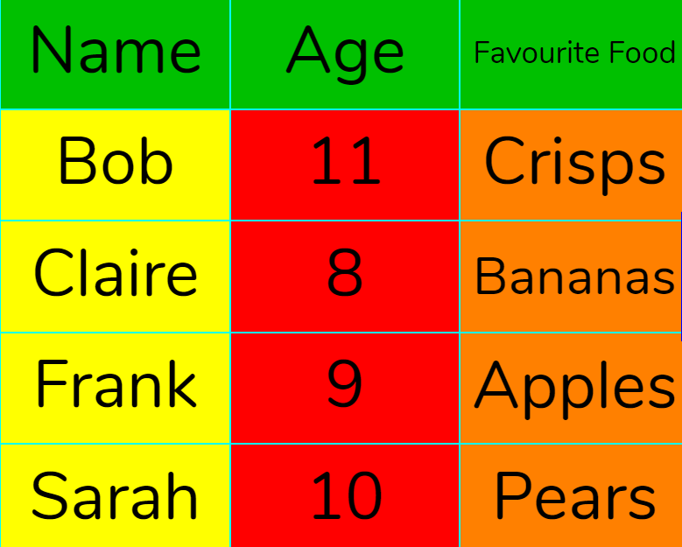
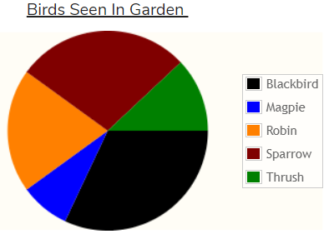
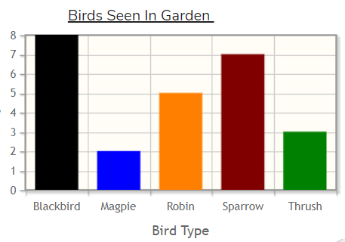
Vocabulary
Slide 4
Here is some vocabulary that you will be using this lesson. You might be familiar with some of the words from your Mathematics work. Can you give a definition? Click to see the answers and examples.
Word | Definition | Example
Data | A collection of information, collected by observation, questions or measurement. | Collecting information about how everyone travels to school.
Table | An organised display of information laid out in rows and columns.
Pie Chart | A circular chart divided into segments which each represent an amount.
Bar Graph | A chart that uses bars to show quantities or numbers, so they can be easily compared.
?
?
?
?
?
?
?
?
Need more support? Contact us:
Tel: +44(0)208 203 1781 | Email: support@2simple.com | Twitter: @2simplesoftware
Notes:
Use slide 4 to introduce key vocabulary for the session. Click to reveal the information.

Slide 5
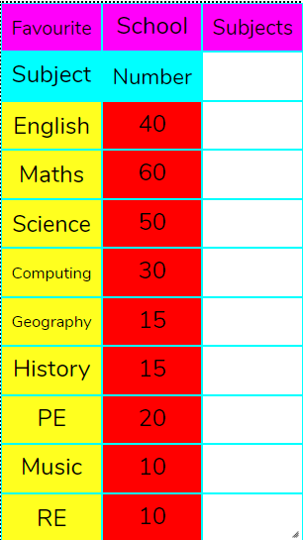
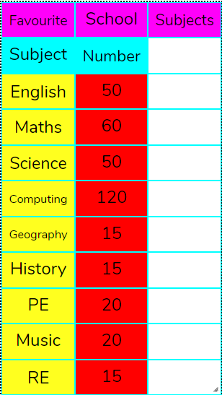
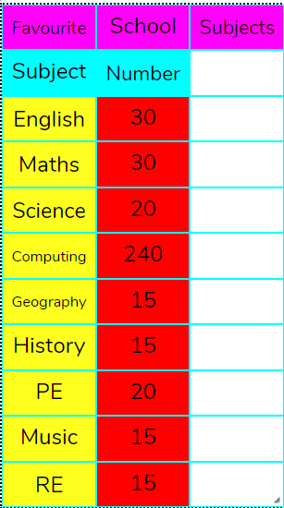
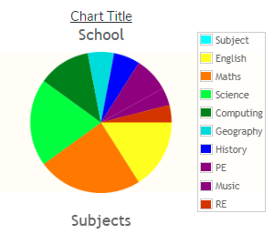
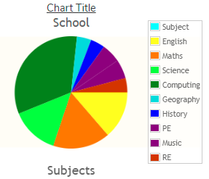
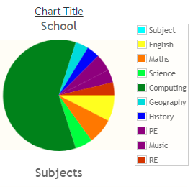
Using Spreadsheets to create charts and Graphs
Slide 5
Can you think of any advantages to using a computer to create charts rather than drawing them by hand?
Speed?
Neatness?
Accuracy?
The main advantage is, if the data changes, the chart automatically updates.
Need more support? Contact us:
Tel: +44(0)208 203 1781 | Email: support@2simple.com | Twitter: @2simplesoftware
Notes:
Use slide 5, click for further information.

Slide 6
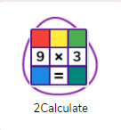
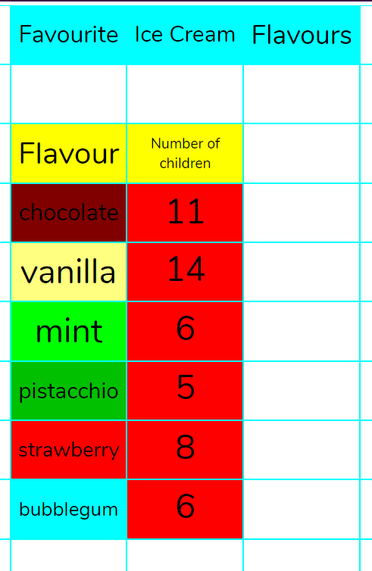



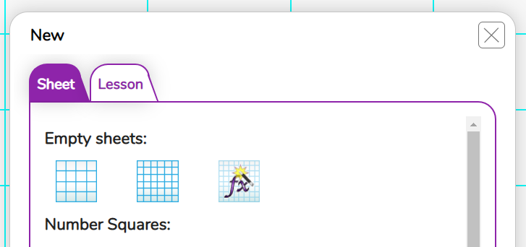
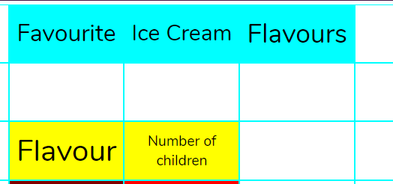
Activity 1: Collecting Data into a Table
Slide 6
As a class decide upon some data to collect. Click for some ideas.
How children get to school? Favourite pets? Ice cream flavours?
Once you have decided, follow the steps:
Open 2Calculate and a blank spreadsheet – select small squares.
Type a header and heading for the columns.
Collect data.
You need to have a format similar to this image (2 Columns).
Need more support? Contact us:
Tel: +44(0)208 203 1781 | Email: support@2simple.com | Twitter: @2simplesoftware
Notes:
Use slide 6 to guide children in entering the data for the theme you have decided upon into a 2-column table on their devices.

Slide 7

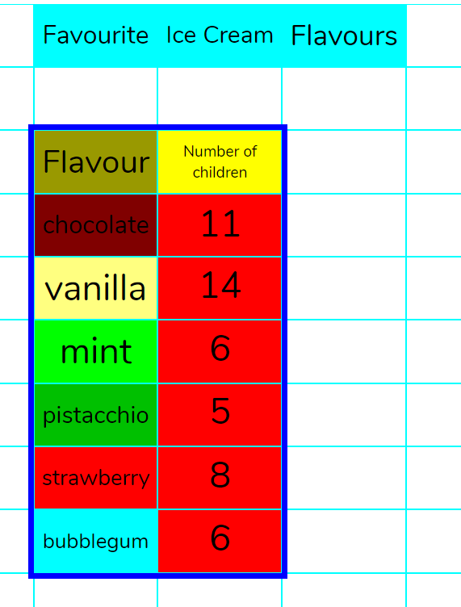
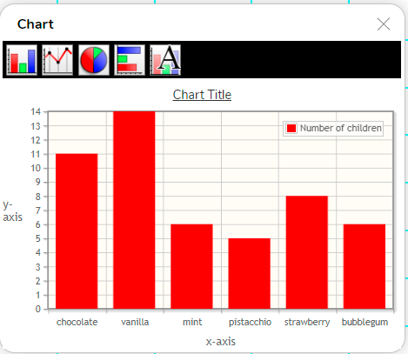

Activity 2: Creating Charts
Slide 7
Once you have collected the data, you can create a chart.
Select all of the data. Do this by dragging over it with the mouse or your finger.
Locate the chart button and press. Your chart will automatically be created.
Can you see how to add a title?
Can you label the axis?
What happens when you change chart type?
What is the most suitable chart type? Pie or Bar Chart? Why?
Need more support? Contact us:
Tel: +44(0)208 203 1781 | Email: support@2simple.com | Twitter: @2simplesoftware
Notes:
Display slide 7. Demonstrate creating a chart. Children should create their own charts and answer questions revealed on the slide through clicking.

Slide 8
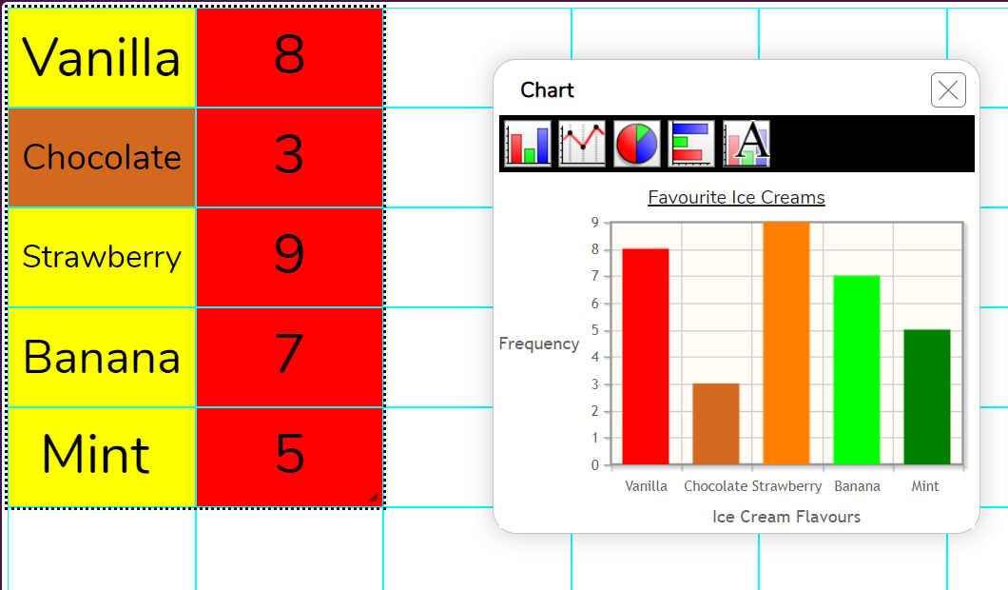
Activity 3: Changing Data
Slide 8
Can you experiment with the data?
What happens to the chart if you change a number/text in the table?
Can you try adding more rows to your table e.g. another flavour? *Drag the selection to include new row.
Need more support? Contact us:
Tel: +44(0)208 203 1781 | Email: support@2simple.com | Twitter: @2simplesoftware
Notes:
Display slide 8. Go through the questions as they are revealed, prompting the children to observe what happens to the chart when data in the table is changed and increasing chart range by adding further rows.

Slide 9
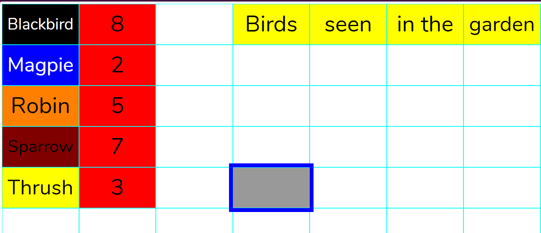
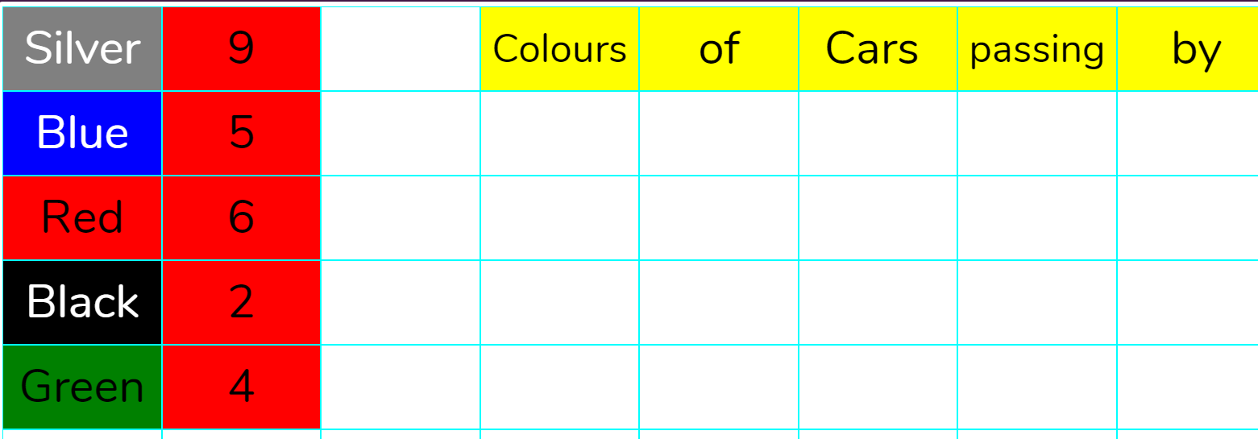
Activity 4: Extension
Slide 9
Can you turn these tables into suitable charts? What observations can you make about the data?
Challenge 1 – Birds
Challenge 2 - Cars
Need more support? Contact us:
Tel: +44(0)208 203 1781 | Email: support@2simple.com | Twitter: @2simplesoftware
Notes:
Display slide 9. Children should turn the given tables into charts and make observations on the data. *Clicking the icons will launch the files to demonstrate. Children should have these set as a 2Do.

Slide 10
Review Success Criteria
Slide 10
I can create a table of data on a spreadsheet.
I can use a spreadsheet program to automatically create charts and graphs from data.
Need more support? Contact us:
Tel: +44(0)208 203 1781 | Email: support@2simple.com | Twitter: @2simplesoftware
Notes:
Display slide 10. Review the success criteria from slide 3. Children could rate how well they achieved this using a show of hands.

