Slide 1

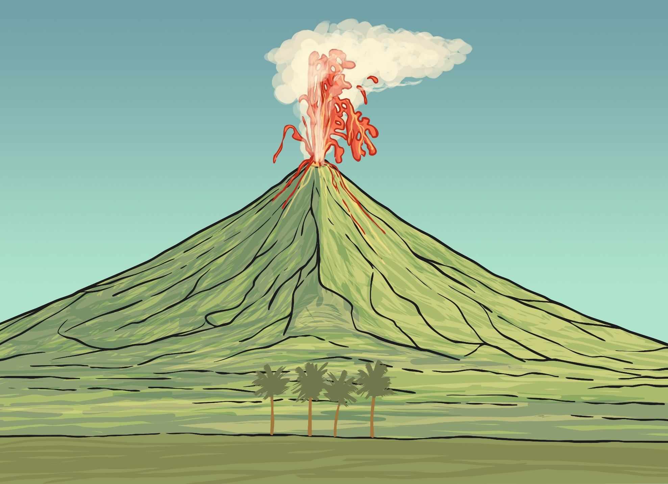

More Volcanoes

Slide 2

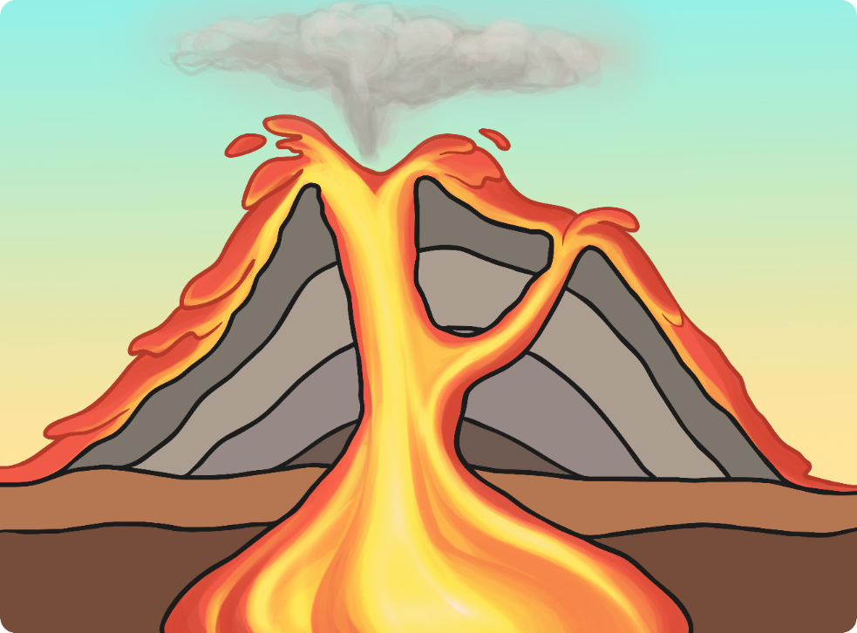
What’s it all called?
eruption cloud
crater
lava
main vent
magma
chamber
Can you name the main parts of this volcano?
Can you explain how the grey layers were made?

Slide 3
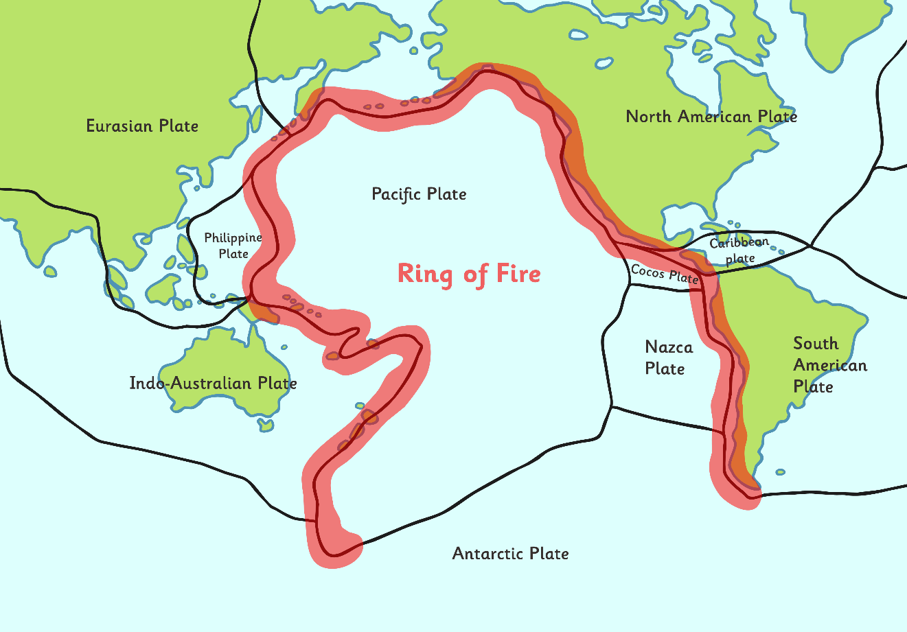
Where are most volcanoes located?
Look at this map.
Most of the word’s volcanoes are located in the area labelled “Ring of Fire”.
Why do you think it is called that?

Slide 4
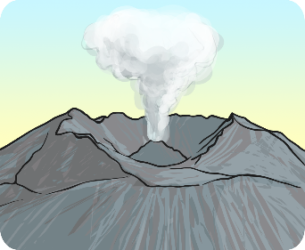
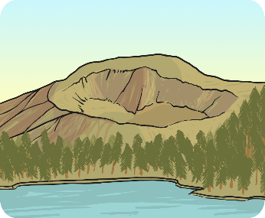
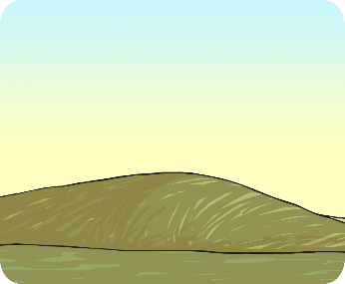
What do they mean?
active
A volcano that has erupted in the last 10 000 years.
dormant
A volcano that hasn't erupted in the last 10 000 years, but may erupt again.
extinct
A volcano that hasn't erupted in the last 10 000 years, and isn't expected to erupt again.

Slide 5
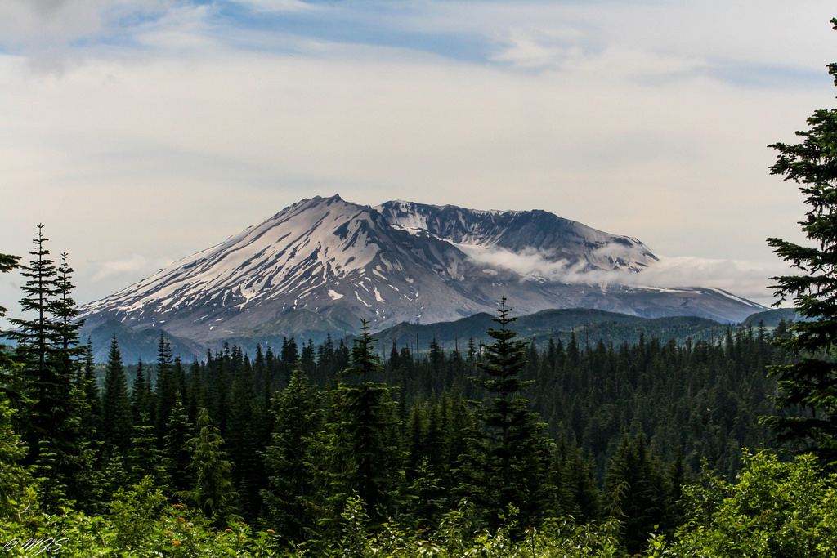

Would you like to live near these volcanoes?
Photo courtesy of mjsmith01 @flickr.com) - granted under creative commons licence - attribution

Slide 6
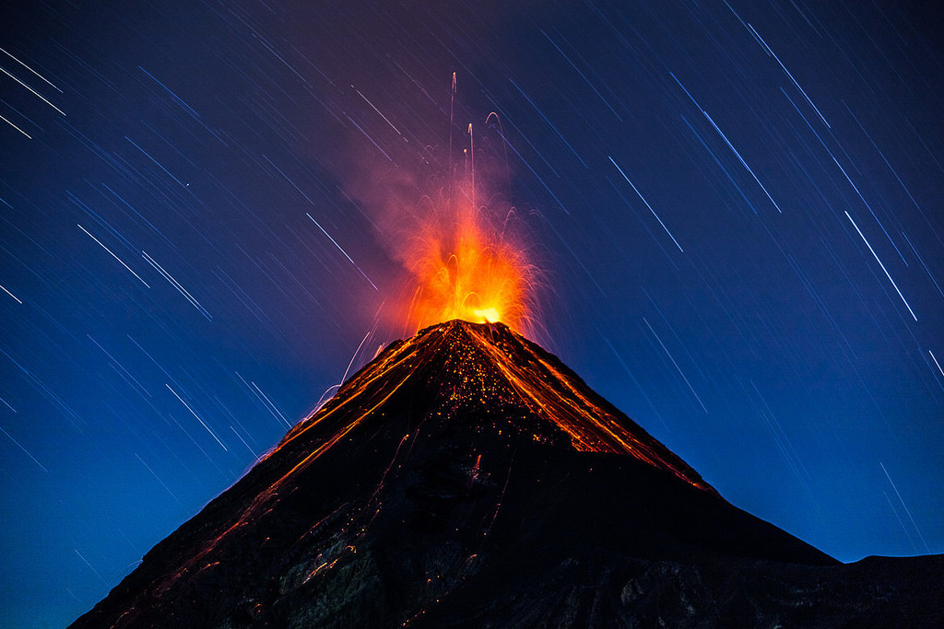
Would you like to live near these volcanoes?
Photo courtesy of ierdnall @flickr.com) - granted under creative commons licence - attribution

Slide 7
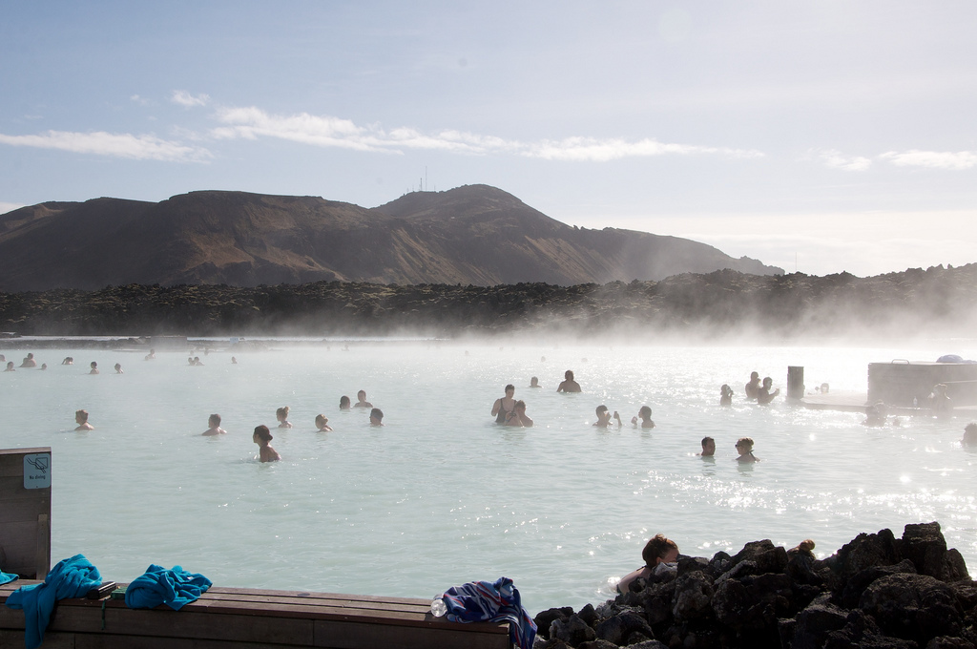
Would you like to live near these volcanoes?
Photo courtesy of Cait_Stewart @flickr.com) - granted under creative commons licence - attribution

Slide 8
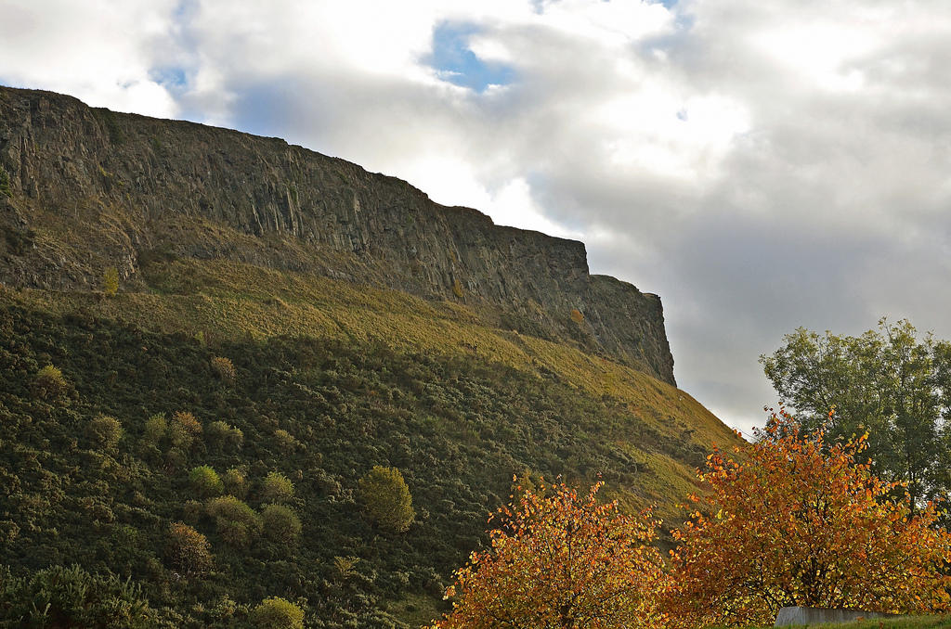

Are there any volcanoes in the UK?
Photo courtesy of [Duncan] @flickr.com) - granted under creative commons licence - attribution
Arthur’s Seat, Edinburgh, Scotland

Slide 9
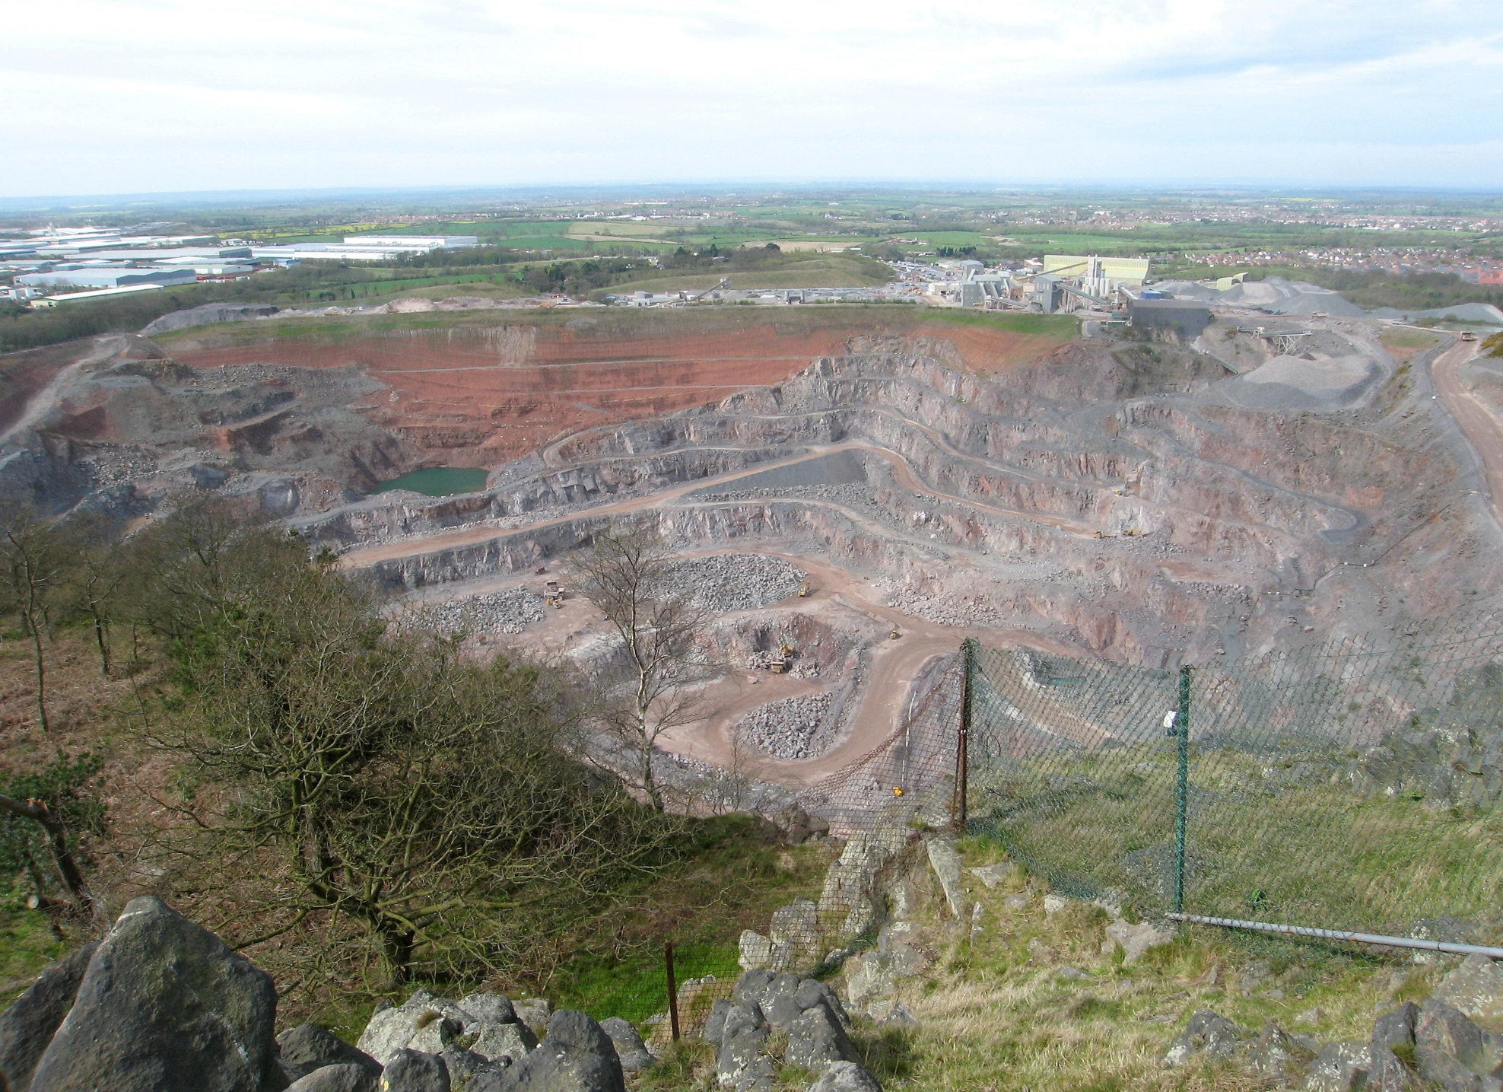
Are there any volcanoes in the UK?
Photo courtesy of MaltaGC (Own work) [CC BY-SA 3.0 (http://creativecommons.org/licenses/by-sa/3.0) via Wikimedia Commons
Bardon Hill Quarry, Leicestershire, England

Slide 10
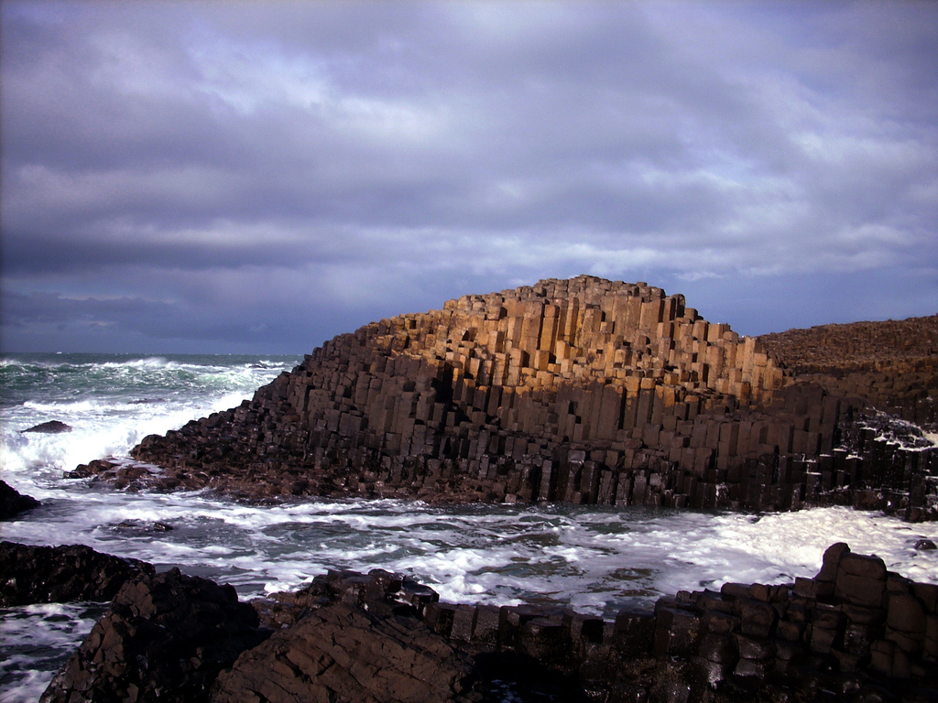
Are there any volcanoes in the UK?
Photo courtesy of TS Drown (@flickr.com) - granted under creative commons licence - attribution
Giant’s Causeway, Northern Ireland

Slide 11
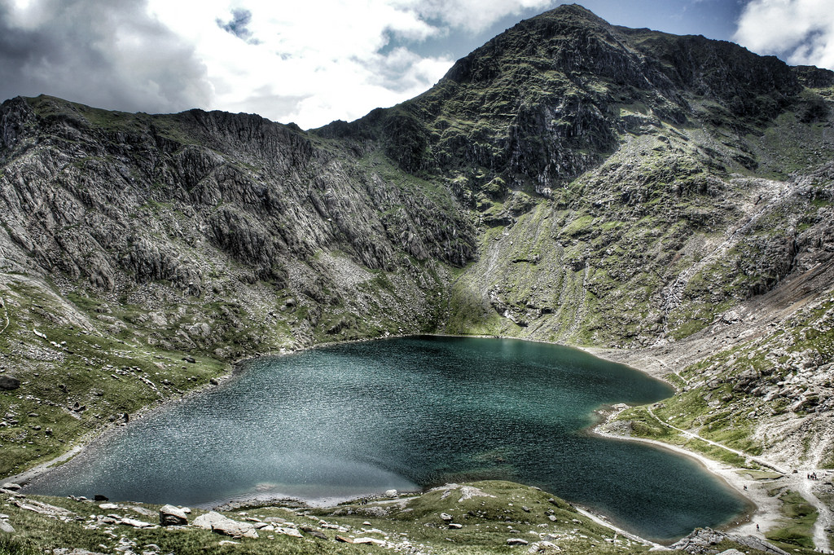
Are there any volcanoes in the UK?
Photo courtesy of ...Like Clockwork (@flickr.com) - granted under creative commons licence - attribution
Snowdon, Wales

Slide 12

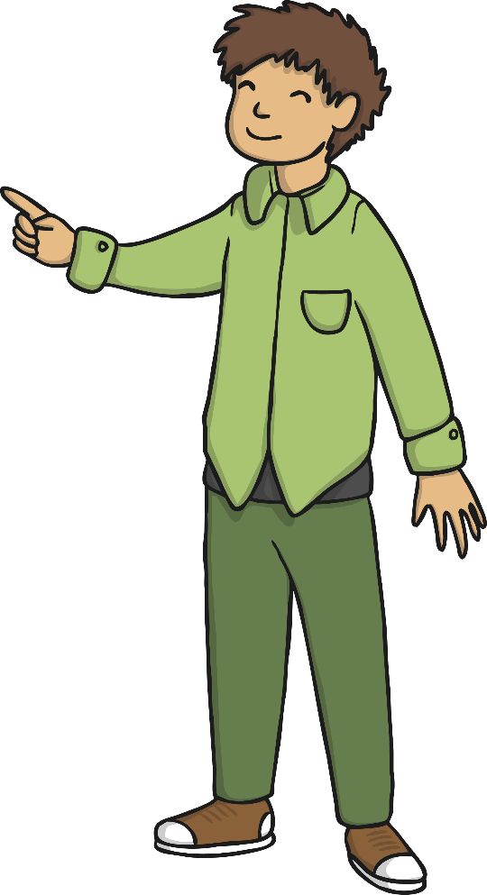
Are there any volcanoes in the UK?
Are these UK volcanoes active?
Watch this video to find out!
Photo courtesy of [Duncan] @flickr.com) - granted under creative commons licence - attribution

Slide 13
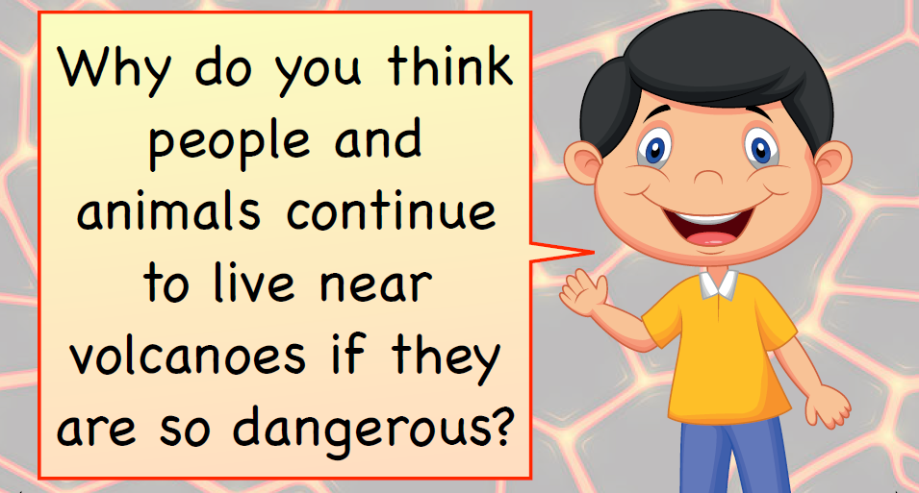

Slide 14
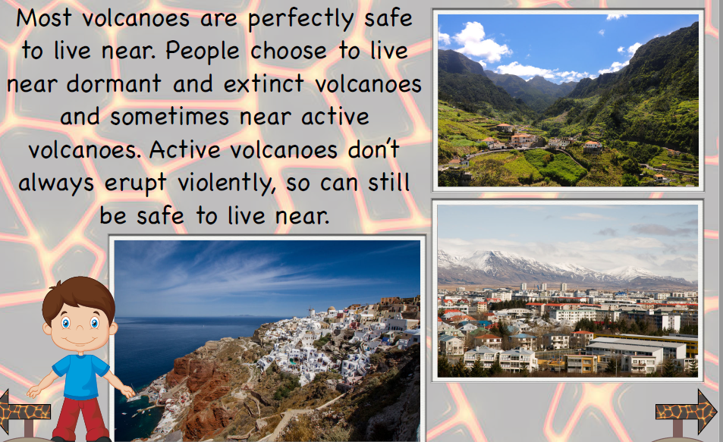

Slide 15
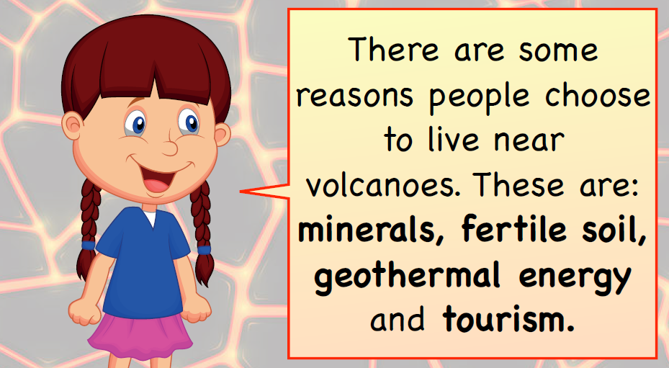

Slide 16
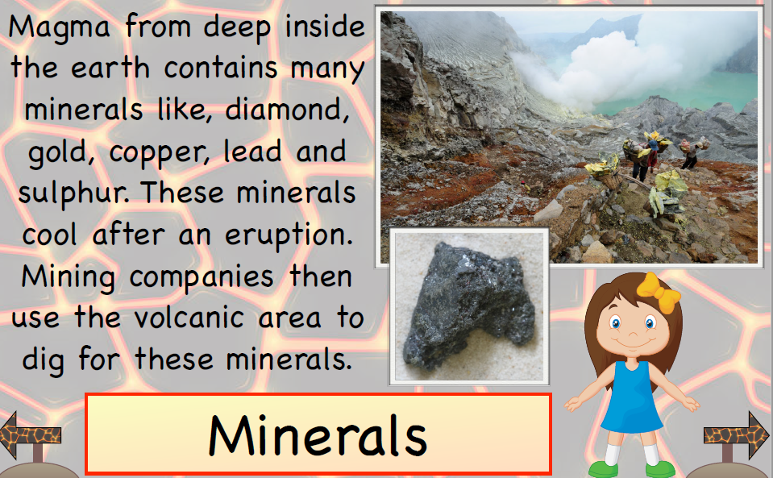

Slide 17
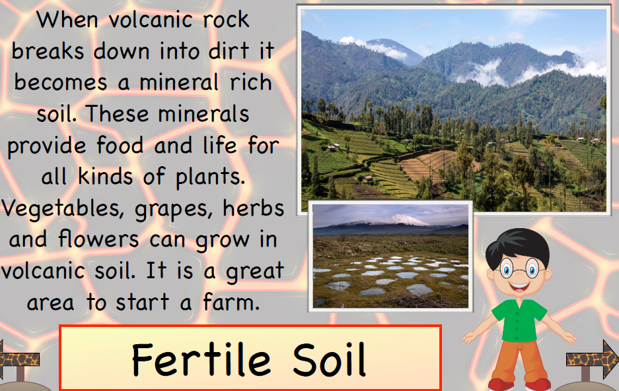

Slide 18
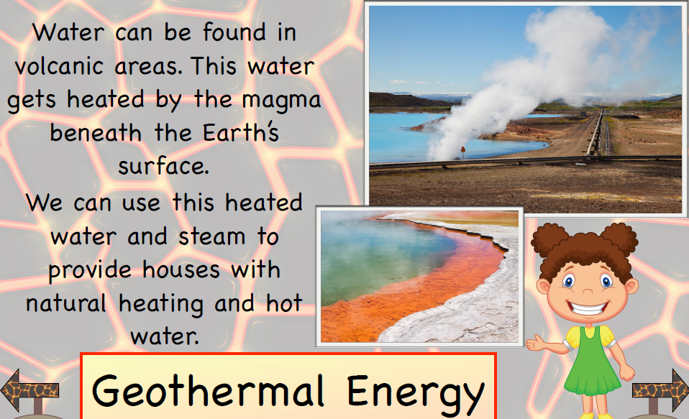

Slide 19
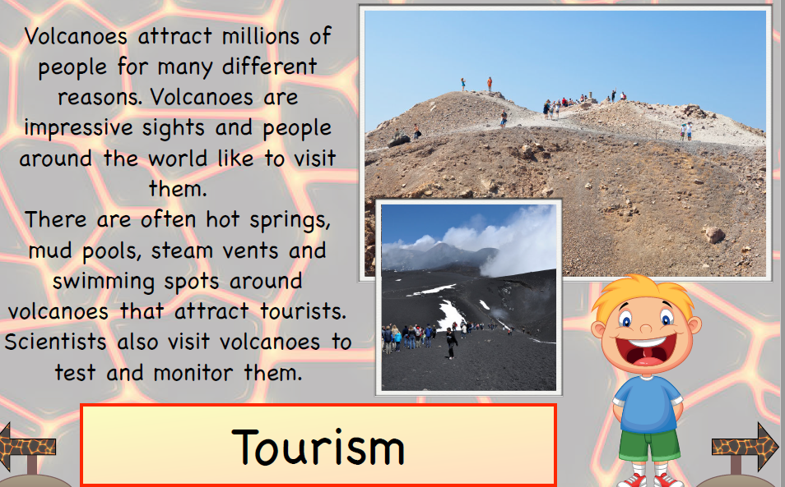

Slide 20
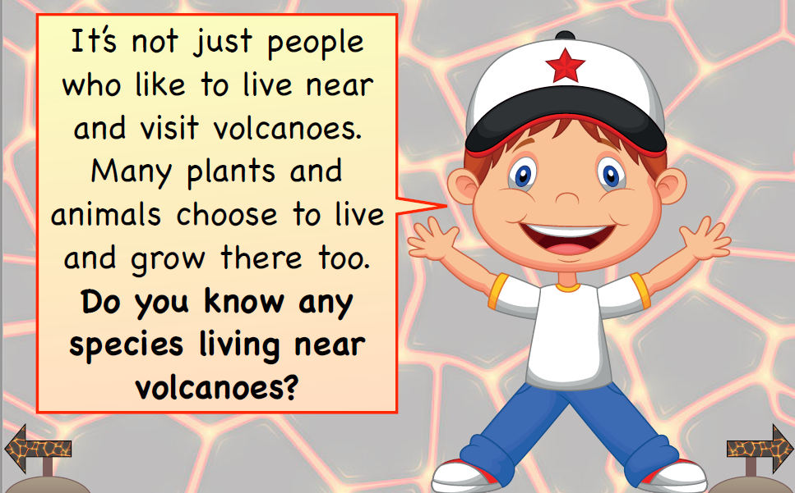

Slide 21
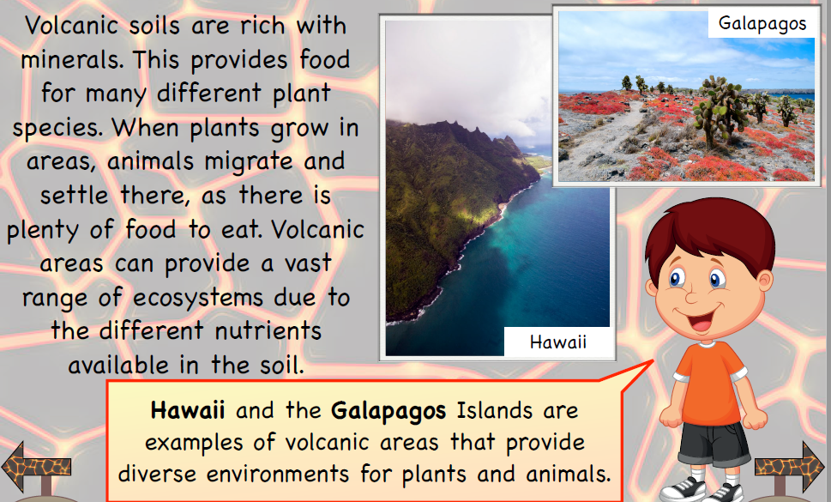

Slide 22
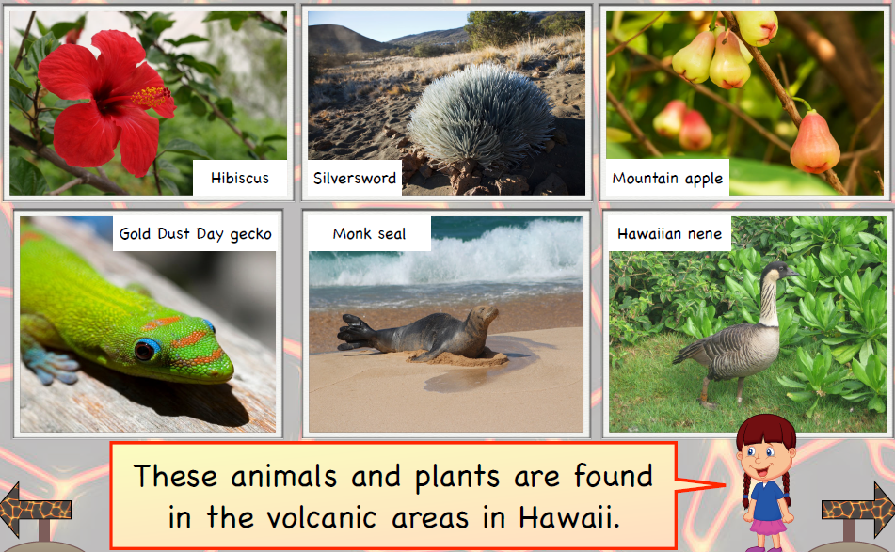

Slide 23
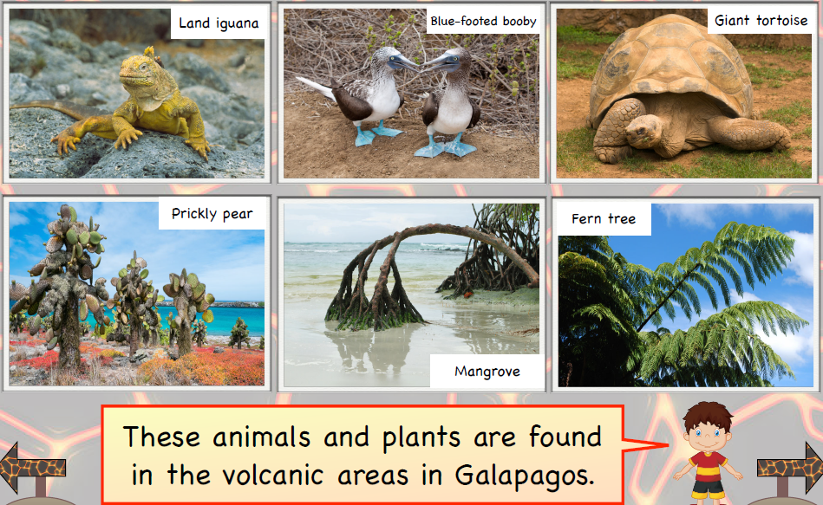

Slide 24
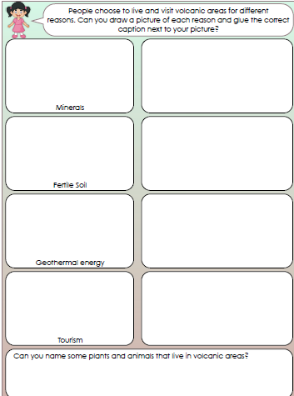

Slide 25
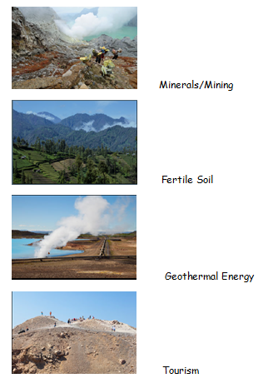

Slide 26


