Slide 1
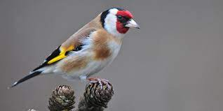
The Big Garden Birdwatch
Monday 24th January 2022

Slide 2
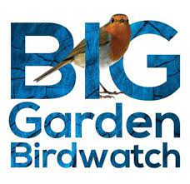
The Big Garden Birdwatch
28-30 January 2022
Have you heard of the annual birdwatch?
Have you done it before?
Do you know what you have to do?
Have they already signed up?

Slide 3

What is it?
Every year, people across the UK sit down for one hour over the course of a given weekend to count all the feathered visitors to their garden.
If you’ve participated in this before, can you remember any birds you’ve spotted, or perhaps where you sat to watch them?
Did you use any special equipment such as a pair of binoculars or a bird-spotting guide?

Slide 4
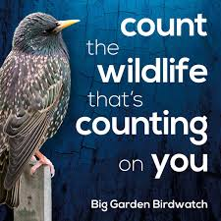
Which birds?
Which birds do you think were most commonly counted last year?
Write a list and then compare it with the last year’s results in the clip.
https://youtu.be/PJhrkow4xUY
How did you do?

Slide 5
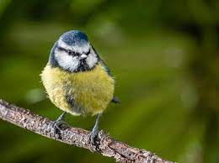
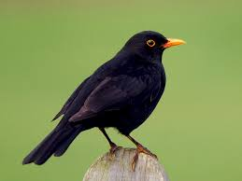
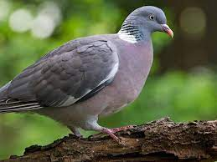
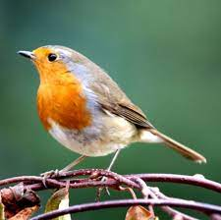
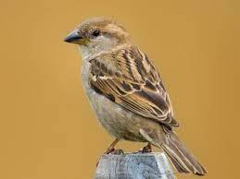
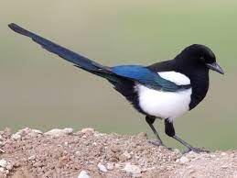
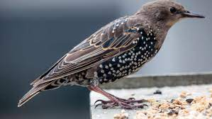
Can you name these birds from the Top 10?

Slide 6

The Big Garden Birdwatch
28-30 January 2022
This year’s big garden birdwatch is running next weekend
The RSPB will use the statistics that they gather to help discover more about the health and welfare of bird species in the country
In school, those who do Forest School will be doing some work towards the birdwatch
Don’t forget you can do this at home next weekend!
https://www.rspb.org.uk/get-involved/activities/birdwatch/

Slide 7
Prayer
Dear God
Thank you for the many different kinds of birds that visit our gardens.
Please help us to take the time to remember how beautiful they are.
Thank you that we are so precious to you.
Amen
Let’s join together to say The Lord’s Prayer.

Slide 8
Song – Three Little Birds
https://www.youtube.com/watch?v=F4sNi2PUiWM

