Slide 1
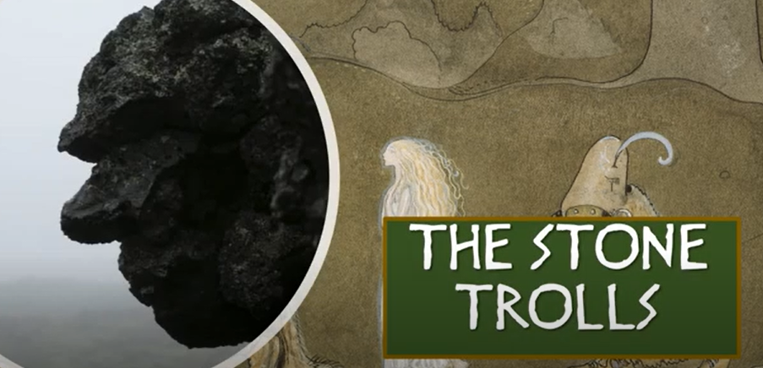

Slide 2
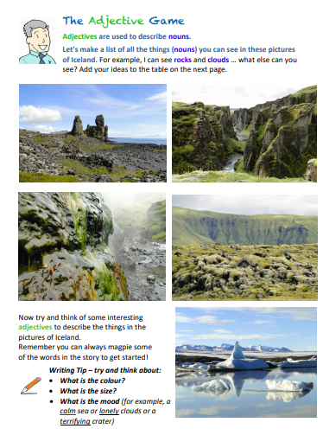

Slide 3
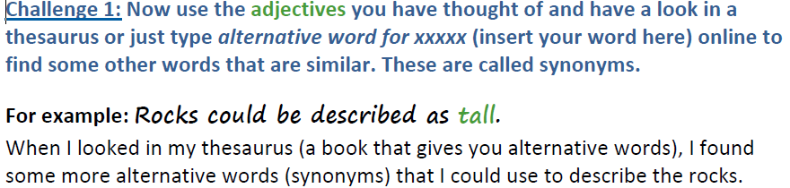

Slide 4
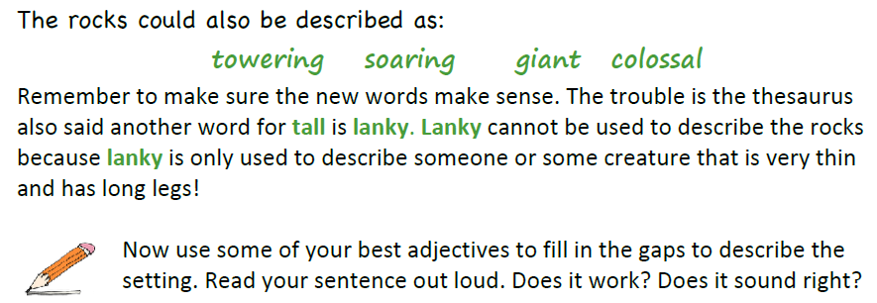
The rocks stood and stared down on the canyon.
The rocks steamed above the valley.

Slide 5
The , iceberg shimmered in the lake.
I stared towards the , crater across rocks carpeted in moss.

Slide 6
Challenge 3:
Now try writing your own sentences to describe the setting using your best adjectives. Remember to read your sentence out loud first. Also, use a capital letter, a full stop and, if you use 2 adjectives, remember the comma!

