Slide 1
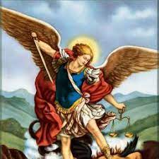
Who is St Michael?
Tuesday 18th January 2022

Slide 2
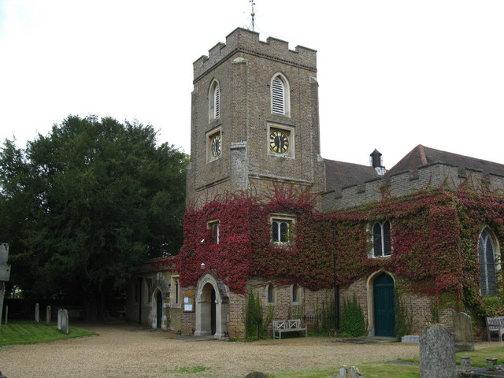
Do you recognise this building?
This is the church of St Michael and All Angels in Sunninghill.
It is the church connected to our school.

Slide 3

What is a saint?
Michael wasn’t exactly a saint. A saint is a human who lives a very, very good life and when they die the Christian church makes them a saint to show everyone how good they were when they were alive as an example to us.
Can you think of any famous saints?
Some saints are patron saints – this means that they represent certain things.
Can you think of any patron saints?

Slide 4
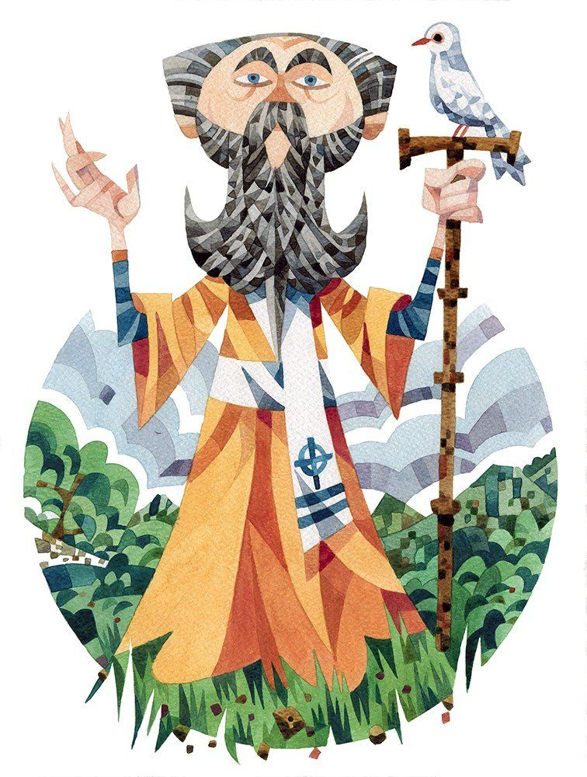
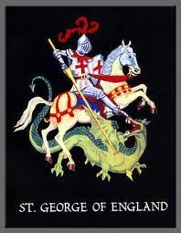
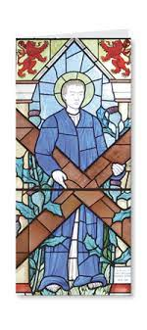

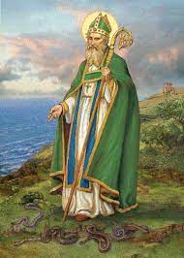
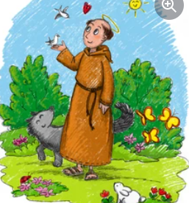
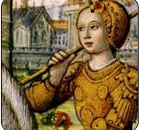
Patron saints you might know…
Saint Andrew – the patron saint of Scotland
St George – the patron saint of England
Saint David – the patron saint of Wales
Saint Patrick – the patron saint of Ireland
Saint Francis – the patron saint of animals
Saint Joan – a patron saint of France

Slide 5
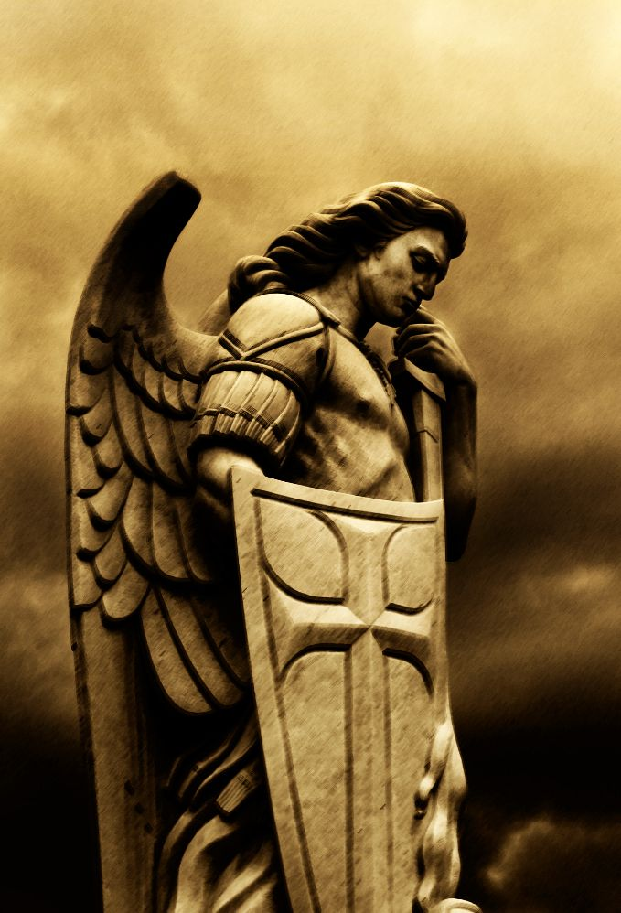
The story of Saint Michael
Saint Michael was not really a saint but an angel.
The story goes that after God created the angels, some of them decided not to follow Him. There was a big battle in heaven. Michael led all the good angels to fight on God’s side. In the Bible it says that Michael fought these bad angels off and won!
The name ‘Michael’ comes from the Hebrew meaning ‘who is like God’.

Slide 6
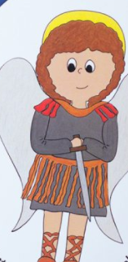
St Michael represents:
Good choices - one of St Michael’s jobs is to help make people good. He will help us when we have a hard decision or when we are tempted to do wrong.
Protection from harm – St Michael is a protector and defender of the Church. When we are in danger he will come to our side. He is patron saint of the police and soldiers.
Bravery – St Michael can help give us courage when we are afraid. Think of his story to give you courage.

Slide 7
Prayer
Dear Lord
We ask St Michael to help us make good choices, to help protect us from harm and to give us courage when we are afraid.
Amen.
Let us say together The Lord’s Prayer.

Slide 8
Song
KS1/EYFS:
https://www.youtube.com/watch?v=o-VhxoWTiss
KS2:
https://www.youtube.com/watch?v=yno7LNhiL_E
Change first verse to:
Give me hope in my heart keep me trusting,
Give me hope in my heart I pray,
Give me hope in my heart keep me trusting,
Keep me trusting ‘til the end of day.

