Slide 1
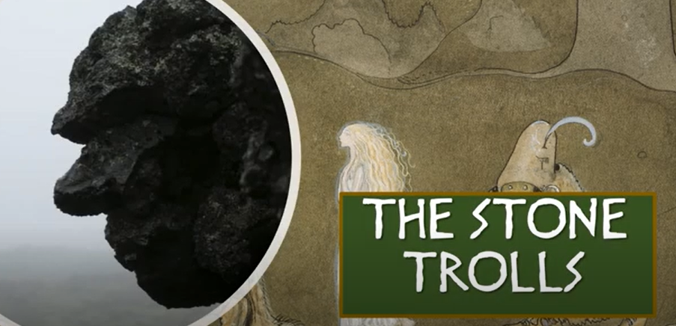

Slide 2
A Story inspired by a traditional Icelandic folktale……
The story explains how some amazing rocks called ‘sea stacks’ were created. This story has been told many, many times over the years….

Slide 3
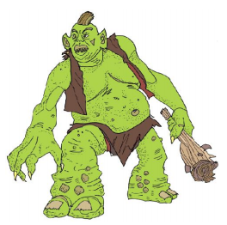
What is a troll?
There are many tales about the legendary troll that have been told and retold for centuries. Trolls are often thought to be very large, ugly creatures, like giants or ogres, that live in the mountains and are dangerous to human beings. But are all trolls like this? In a country called Iceland, there are some great stories about Icelandic trolls. There are some terrible trolls but there are also some that are peaceful, friendly and helpful.

Slide 4
Where is Iceland?
Iceland is an island in the very north of the Atlantic Ocean just below the Arctic Circle, between Canada and Norway. It has many large mountains, live volcanoes, amazing waterfalls and beaches made of black sand from volcanic lava. It also has lots and lots of glaciers and ice, plus masses of moss but very few trees!

Slide 5
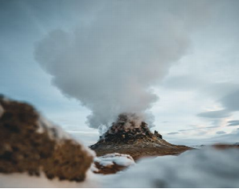
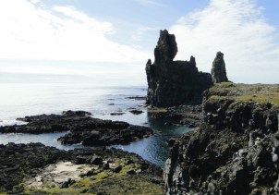
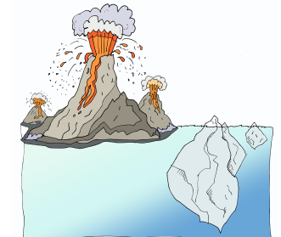
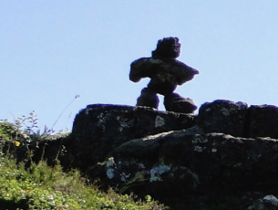

Slide 6
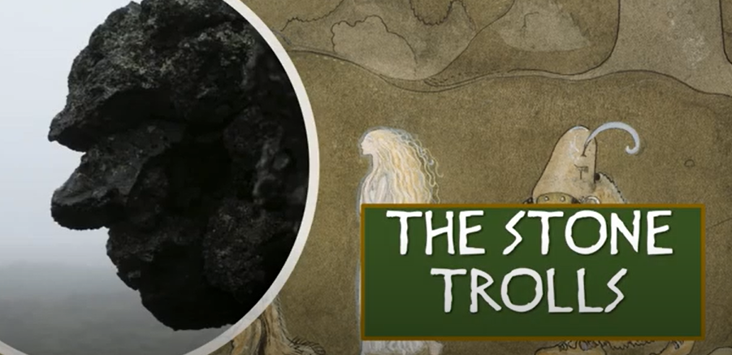
Let’s listen to the story!
https://www.youtube.com/watch?v=sVymgQJamuU

Slide 7
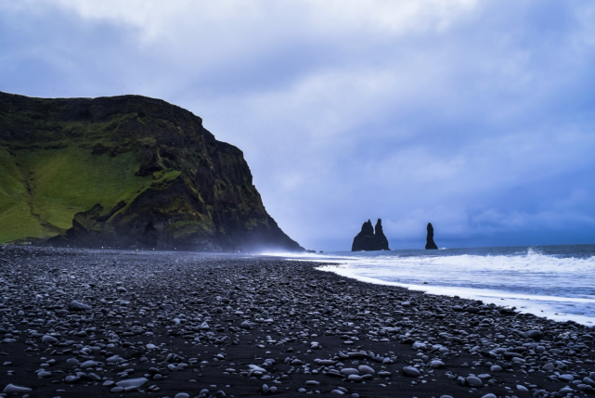

Slide 8
What did you think?
Do you think the sea stacks are really trolls and the ship turned to stone?
Those rocks are actually basalt sea stacks.
Basalt is a volcanic rock – here it is very dark in colour.
Sea stacks are pillars of rock, formed by the wind and the waves.
These rocks or sea stacks have real Icelandic names: Skess in the story is actually called Skessudrangur in Icelandic. Landra in the story is actually called Landdrangur in Icelandic.

Slide 9
What do these words mean?
Target Word Definition
cover of darkness -
venture -
mischievous -
ebony beach -
hoard -
Pitching -

