Slide 1

Lesson 2:
Computing Scheme of Work
Spreadsheets Crash Course for Year 3
Using Tools to Calculate Totals
Notes:
Resources
All resources can be set as 2Dos. The following resources are needed for this session, please refer to the PDF lesson plan:
2Calculate tool in Purple Mash
Ferret Walking Example file Set this as a 2Do for the class.

Slide 2


Aims
Slide 2
To use the totalling tools.
To use a spreadsheet to answer questions about data.
To collect and use data (extension).
Need more support? Contact us:
Tel: +44(0)208 203 1781 | Email: support@2simple.com | Twitter: @2simplesoftware
Notes:
Display slide 2 and outline the lesson aims.

Slide 3
Success Criteria
Slide 3
Children can use tools in a spreadsheet to automatically total rows and columns.
Children can use calculations to answer questions about data.
Children can collect some simple data and use a spreadsheet to interpret it (extension).
Need more support? Contact us:
Tel: +44(0)208 203 1781 | Email: support@2simple.com | Twitter: @2simplesoftware
Notes:
Display slide 3 and outline the success criteria

Slide 4
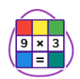
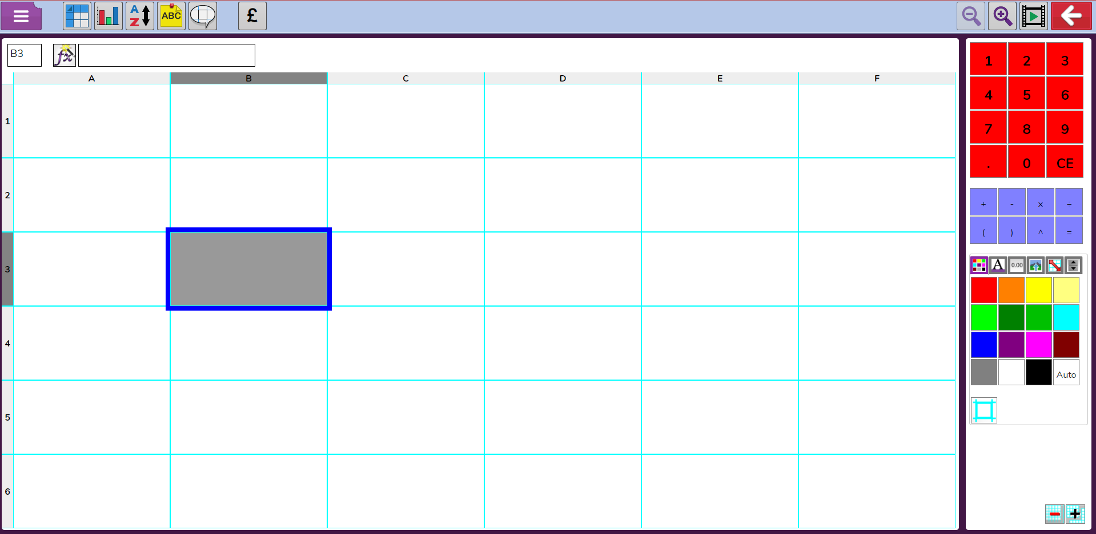
Review Spreadsheet Vocabulary
Slide 4
Look at the ? Click to reveal the names for the areas.
Columns
?
?
Numbers
Symbols
?
a cell
a column
?
?
?
Rows
?
Toolbox
a row
?
Need more support? Contact us:
Tel: +44(0)208 203 1781 | Email: support@2simple.com | Twitter: @2simplesoftware
Notes:
Display slide 5. Click the ? To reveal the words. Children will not have heard the term ‘toolbox’ yet.
Alternatively, demonstrate by clicking the icon to open 2Calculate and review the same vocabulary.

Slide 5

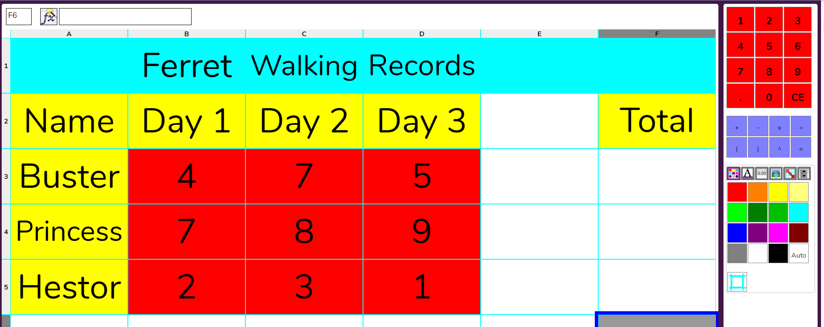
Calculating Totals
Slide 5
This example is similar to the one that you looked at last week. The ferrets need to get fit so their owners are recording how much walking they do each day.
They want to add up the total distance walked but they forgot to leave a space for the + and = symbols. Let’s see how to fix this…
Need more support? Contact us:
Tel: +44(0)208 203 1781 | Email: support@2simple.com | Twitter: @2simplesoftware
Notes:
Use slides 5-7 Talk about where children think the + and = symbols should go. Either use the slide or open the example from the icon. Do not fix it though.
Talk through the slides and demonstrate.

Slide 6
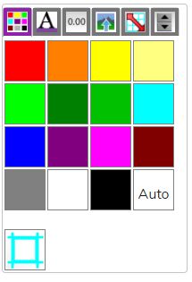


Calculating Totals
Slide 6
2Calculate can actually calculate totals without needing the + and = symbols.
On the right-hand side of the screen is the 2Calculate Toolbox. Can you see it?
Each of the small icons at the top are different tabs. Click on them to have a look.
Can you find the Totals tab? The icon looks like this:
These tools calculate totals for you. The arrow shows what cells it adds together.
Need more support? Contact us:
Tel: +44(0)208 203 1781 | Email: support@2simple.com | Twitter: @2simplesoftware
Notes:
Use slides 5-7 Talk about where children think the + and = symbols should go. Either use the slide or open the example from the icon. Do not fix it though.
Talk through the slides and demonstrate.

Slide 7
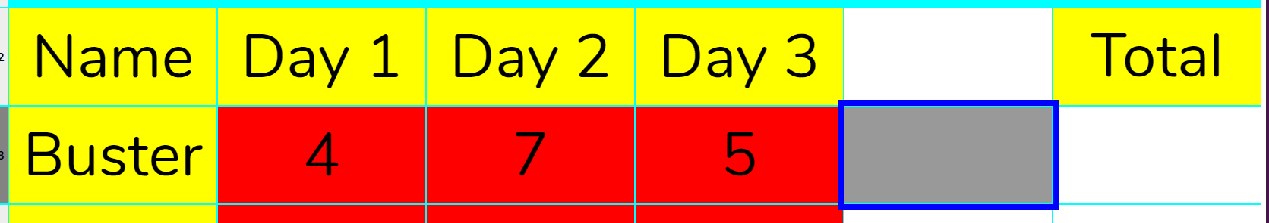

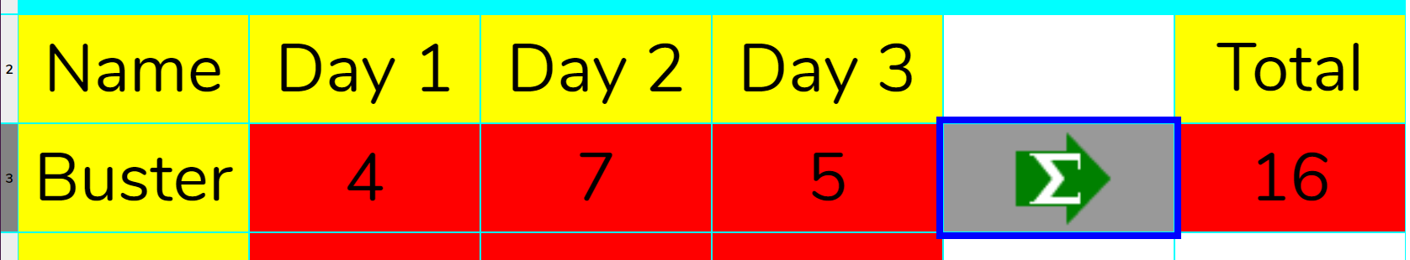
Calculating Totals
Slide 7
Find the cell where the total distance Buster has walked should go. Notice that there is an empty cell just before it. Click in this cell.
To find the total you want to add the cells in this row. To do this click on the icon in the totals tab.
The total gets calculated.
Who walked the most? Who needs to do a bit more to get fit?
Need more support? Contact us:
Tel: +44(0)208 203 1781 | Email: support@2simple.com | Twitter: @2simplesoftware
Notes:
Use slides 5-7 Talk about where children think the + and = symbols should go. Either use the slide, or open the example from the icon. Talk through the slides and demonstrate.

Slide 8
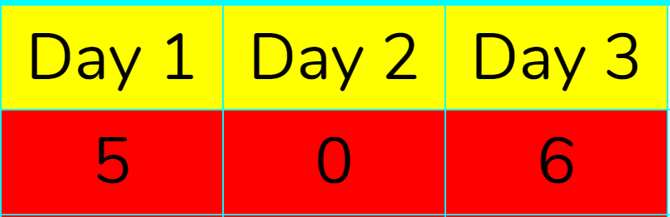


Activity: Calculating Totals
Slide 8
Open the Ferret Walking example from your 2Dos.
Complete the totals for the other ferrets.
Who walked the most? Who needs to do a bit more to get fit?
The owner of another ferret called Fee wants to add data. Fee walked these distances.
Add this data.
The owners want to compare each day using the symbol. But they don’t have enough cells.
You can use the button in the bottom right of the screen to increase the number of cells on the sheet.
See if you can calculate the day totals.
Which day was most walking done?
Remember to save your work.
Need more support? Contact us:
Tel: +44(0)208 203 1781 | Email: support@2simple.com | Twitter: @2simplesoftware
Notes:
Use slide 8 to direct the activity. Children might need help with the second stage where they add in daily totals. Stop the class and demonstrate if this is the case. Remind children to save.

Slide 9
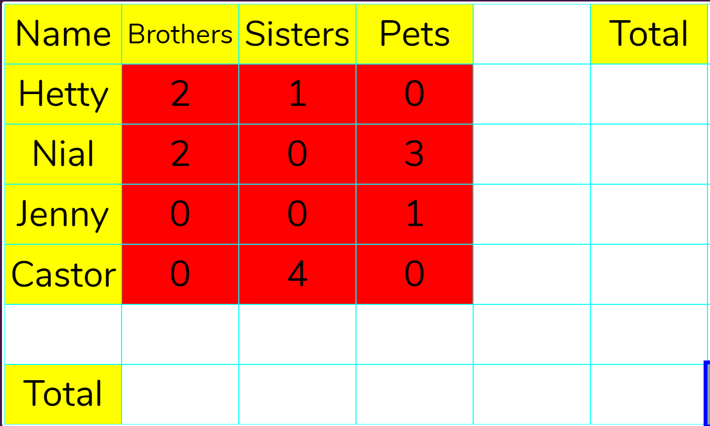
Extension: Calculating Totals
Slide 9
Use a new 2Calculate file.
Collect some data about you and three friends. How many brothers do they have and how many sisters? You could also include how many pets they have.
Create a spreadsheet like this for you and your friends.
Can you use the totalling tools to find out who has the most siblings (and pets)?
Is it more common to have a brother or a sister or a pet?
Need more support? Contact us:
Tel: +44(0)208 203 1781 | Email: support@2simple.com | Twitter: @2simplesoftware
Notes:
Use slide 9 to direct the activity. Children could work in small groups to complete this.

Slide 10
Review Success Criteria
Slide 10
I can use tools in a spreadsheet to automatically total rows and columns.
I can use calculations to answer questions about my data.
I can collect some simple data and use a spreadsheet to answer questions about it.
Need more support? Contact us:
Tel: +44(0)208 203 1781 | Email: support@2simple.com | Twitter: @2simplesoftware
Notes:
Use slide 10 to evaluate success of meeting success criteria and how well they felt they were able to achieve the 3 activities. Children could rate how well they achieved this using a show of hands.

