Slide 1


Hopes and dreams
Monday 17.1.22

Slide 2
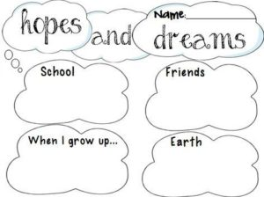
What are your hopes and dreams?
Is a hope different from a dream?

Slide 3
Are your hopes just for yourself?
Do your parents or grandparents, or aunties and uncles have hopes for you?
Do you have hopes for your siblings?
Do you have hopes for your friends?
Do you have hopes for the world and the environment?
Why do we have hopes for people and things other than ourselves?

Slide 4
Watch this film and think about what you are hoping whilst you watch it.
https://www.youtube.com/watch?v=6dZ7b7Bimrc
What were you hoping?
What do you think ‘Every dream is a journey’ means?

Slide 5

‘Put your hope in God.’
We put our hope in God, do you think He puts His hope in us?
What do you think God’s hopes for us all are?
What can we do to achieve God’s hopes for us?

Slide 6
Prayer
Dear Lord
Help us to put our trust, hope and faith in you.
Help us to work hard so that we can fulfil the hopes and dreams that our families and friends have for us.
Help us to recognise and support the hopes and dreams of those around us.
Amen
Let us join together to say the Lord’s Prayer.

Slide 7
Song
KS1/EYFS:
https://www.youtube.com/watch?v=o-VhxoWTiss
KS2:
https://www.youtube.com/watch?v=DShGTCZwAtw

