Slide 1
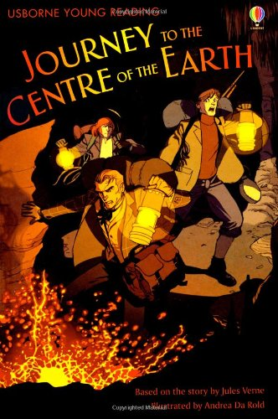
Journey to the Centre of the Earth
Based on the story by Jules Verne
Adapted by Sarah Courtauld
Illustrated by Andrea Da Rold
Published by Usborne

Slide 2

VIPERS
V is for Vocabulary in Chapter 7 (to the line Could they still live here? on p.40) :
cautiously
compass
eerie
mounds
struck dumb
(a) mummy
primitive
briskly
reluctantly

Slide 3
VIPERS
I is for Infer & E is for Explain in Chapter 7 (to the line Could they still live here? on p.40) :
Why does Axel think his uncle was “crazier than I thought”? (p.37/38)
Explain how they know they’ve ended up where they started? (p.38)
Why do you think the field of bones is “an eerie sight” to them? (p.39)
Axel asks “Could they live here still?” (p.40) Who or what does he mean by ‘they’? Do you think he’s right? Why/Why not?

Slide 4
Over to you…
Date and title your work.
Write your answers either directly onto the Word document or onto paper.
Write in full sentences.
Begin each sentence with a capital letter and finish it with a full stop.

