Slide 1
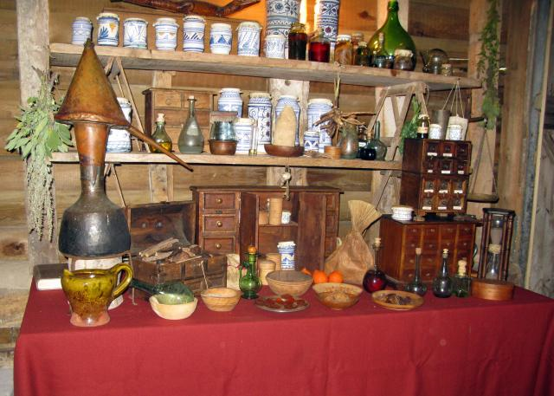
Health and Medicine
In Tudor Times (1485 – 1603)

Slide 2
Life in Tudor Britain was harsh
The average life expectancy was just 35-38 years. 30% of children died before their 10th birthday.

Slide 3
Diseases
Scurvy
Plague
Gout
Smallpox
Influenza
Scrofula
Sweating sickness
Notes:
Scurvy was due to lack of Vitamin C, but the Tudors didn’t know that. Sailors often got this. Sometimes some herbs helped, especially when eaten fresh.
Plague would kill you within 3-5 days if untreated. If you survived that long you might survive the whole thing.
Gout is also known and king’s disease or rich man’s disease. It is often associated with excess alcohol, sugar and fat consumption. It usually on the feet.
Smallpox was highly contagious and a bit like chicken pox, except more likely to be fatal. It’s called small pox do differentiate from the Black Death, which gives you very large pox.
Scrofula is a type of tuberculosis. It can be cured by touching royalty or a coin that hs been touched by a monarch, apparently.

Slide 4
Balance your humours
Humours were the fluids in the human body:
  Blood hot and wet
  Phlegm cold and wet
  Black bile cold and dry
  Yellow bile hot and dry
If the Humours were unbalanced you were ill:
  A dry hacking cough with a fever: too much yellow bile
  Fever: too much blood
  Sadness and depression: too much black bile
  Colds: too much phlegm
Notes:
Show page 12 of the YWWtbIiTT book

Slide 5
Health Practitioners
There were 5 main types of people who could help you if you were sick:
Physicians
Barber/surgeons
Apothecaries
Monks
Herb-, house-, and midwives
Notes:
Physicians were for the rich and the royals. They had been to university for 7 years. Their studies included philosophy and astronomy.
Barber surgeons cut hair in peace time and cut off limbs in the war
Apothecaries made potions out of herbs and other things
Monks were the researchers of their time. They had gardens where they would grow herbs and study their effects. They also ran hospitals, where people had to pay their funeral costs on entry! Shame Henry VIII closed all the monasteries.
Herb wives were usually in the country. They often had their garden at the end of the village so they had some more space to grow things. They would pass herbs to the sick, but people were often suspicious of their knowledge and sometimes called them witches.

Slide 6
Poor Diets
Although there was a big difference between the diet of the rich and the poor, neither diet was healthy.
The rich diet lacked fibre and was high in fat and sugars. The poor diet was healthier as it included vegetables and low fat meats such as mutton and chicken, but there was never enough food, causing malnutrition.

Slide 7
Tudor Towns were dirty
There were no bins, no toilets and no street cleaners.
There were many animals in the streets
Rats carried diseases but the Tudors didn’t know that.

Slide 8
How to Cure Your Illnesses!
Magic
Superstition
Herbs
Leeches
Cover up bad smells
Smoke tobacco (!)
Notes:
Magic and Superstition are closely related.
In an age when so much could not be explained, superstition was still important. Most people could not afford doctors and relied on treatments from the apothecary or a village wise-woman. Folk-remedies were often bizarre.
If, for example, you had a headache, the advice was to drink a herbal cure made of lavender, sage, marjoram, roses and rue or to press a hangman’s rope to your head. The cure for smallpox was to wrap somebody in a red blanket.
Doctors also believed that illnesses, like the plague, were passed on through smells.
These smells, or poisonous 'vapours', were thought to be absorbed through the skin. Ginger or Chervil (a herb that smells of aniseed) was put in scented balls called pomanders that people carried with them to smell.
Plague doctors wore all-over leather protective clothes and put bergamot oil (thought to protect against boils) in the long beaks of their face masks. They sprinkled themselves with vinegar and chewed the sweet herb angelica to fight off infection before visiting their patients.

