Slide 1


History
Crime and Punishment
Year One
History | LKS2 | Crime and Punishment | The Roman Legacy | Lesson 1

Slide 2
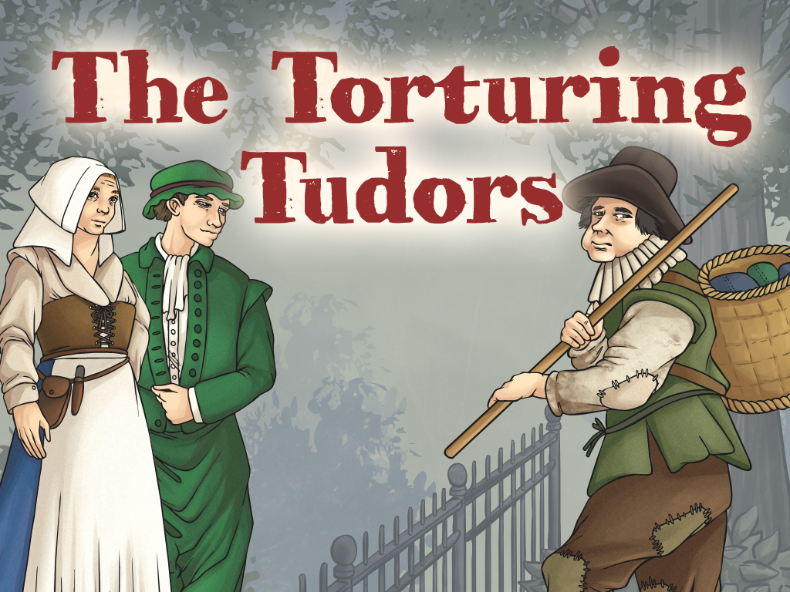


Slide 3
Aim
I can find out about different punishment methods that were popular during the Tudor period.
Success Criteria
I can ask questions about various historical sources of Tudor objects.
I can tell you some key facts about different types of punishments used in Tudor Britain.
I can explain which crimes were thought to be very serious in Tudor Britain.
I can compare and contrast the Tudor and Anglo-Saxon justice systems.

Slide 4
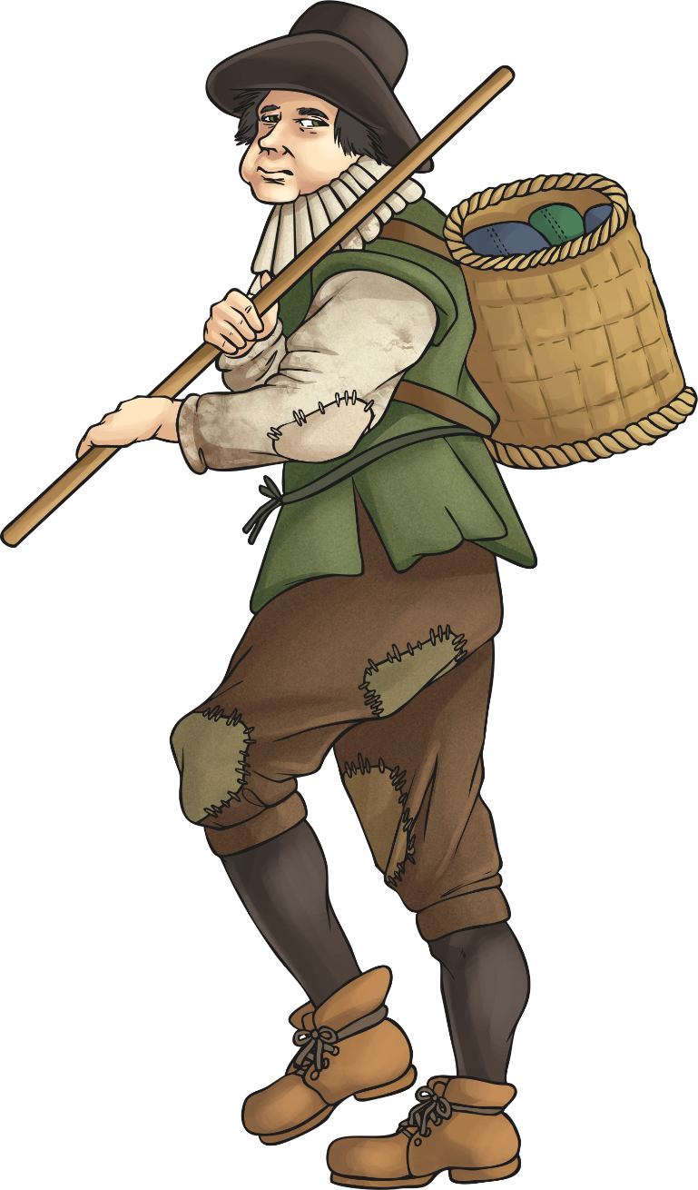
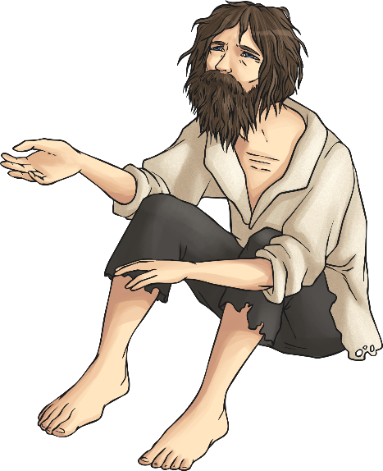
Tudor Crime and Punishment
In Tudor times, there were still no police. Crime – mainly stealing – was widespread, as many poor people could not afford to pay for increasingly expensive food. However, punishments were harsh, in the belief that it would stop others from committing the same crime. New punishments were created to be even more terrifying than before.
Because most people did not travel far in Tudor England, anyone who did was often treated with suspicion. Travelling actors had to have a license, otherwise they were breaking the law.
Tudor London experienced some of the worst crime. It attracted many vagrants (people without a home) and people looking for work. The Tudor rich and Tudor poor lived apart, and a poor person in a wealthy area was often thought to be a criminal.

Slide 5
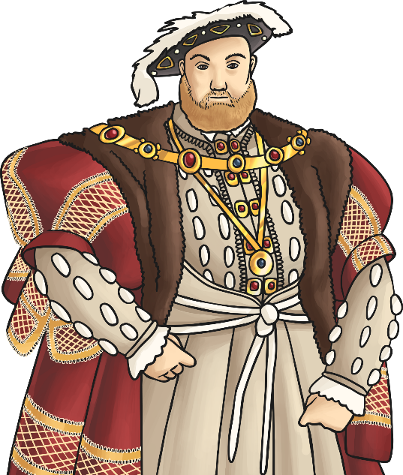
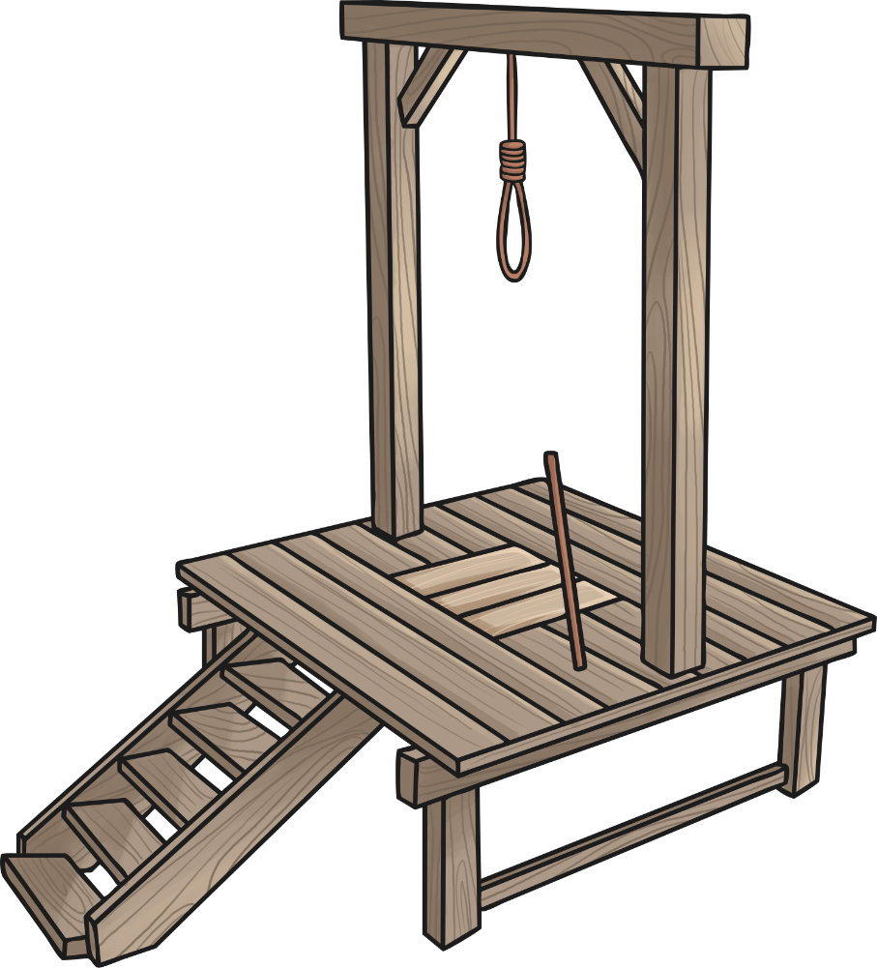
Tudor Crime and Punishment
Public executions were extremely popular and people would wait for hours to watch them, often taking their children with them!
Some historians have estimated that about 70,000 people were executed during the reign of Henry VIII.
Vagrancy (being homeless) was a crime and punished by being whipped, or even hanged. Many people were afraid that all vagrants were criminals and murderers.
Stealing was considered a serious Tudor crime, and people could be punished for just stealing a bird’s egg. Stealing even a small amount of money could mean the death penalty.

Slide 6

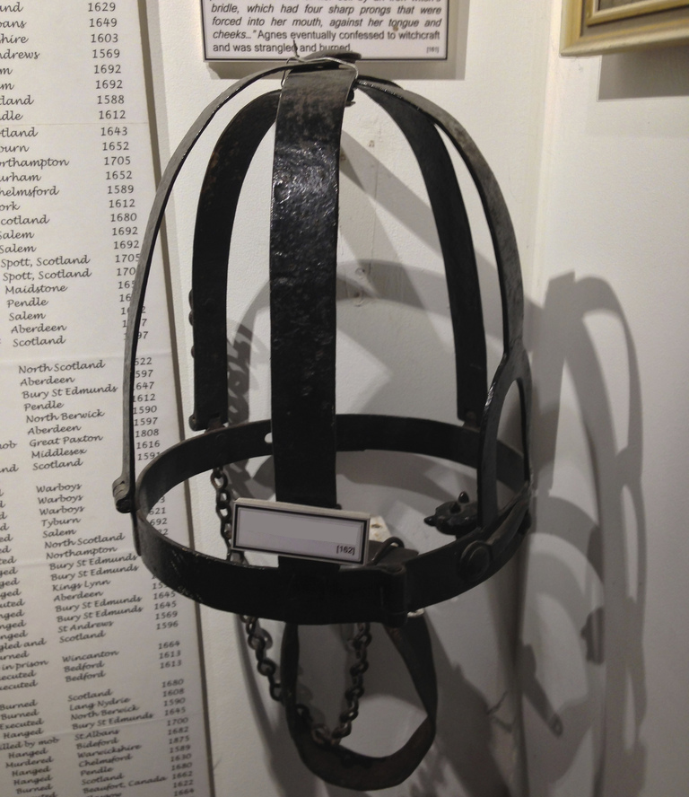
Guess the Tudor Object!
Look at the picture of Source 1 on your Activity Sheet.
What questions do you have about this?
What do you think it was used for?
Photo courtesy of Glen Bowman (@flickr.com) - granted under creative commons licence - attribution

Slide 7
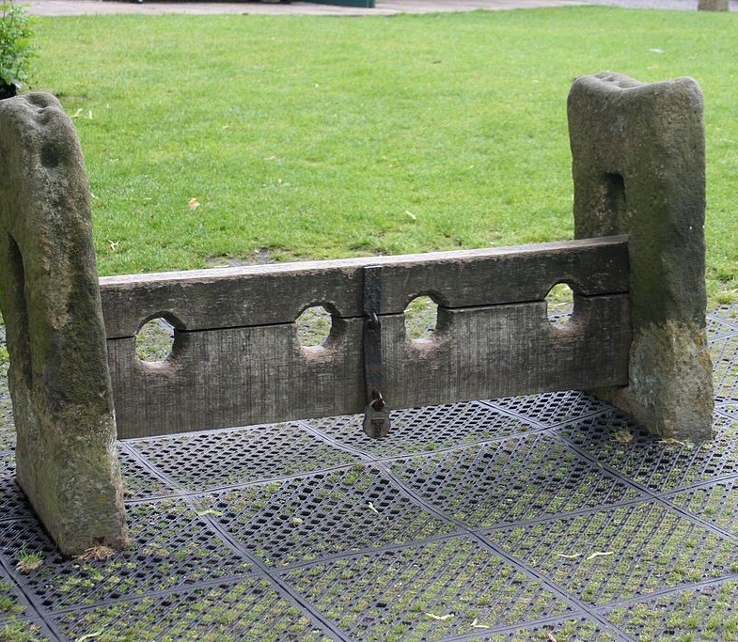
Guess the Tudor Object!
Look at the picture of Source 2 on your Activity Sheet.
What questions do you have about this?
What do you think a person would have done to be given this punishment?

Slide 8
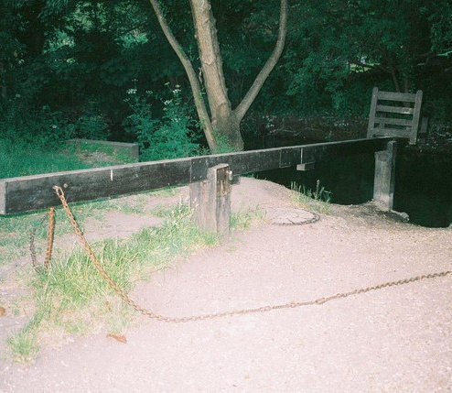
Guess the Tudor Object!
Look at the picture of Source 3 on your Activity Sheet.
What is this for?
What do you think a person would have done to be given this punishment?
Photo courtesy of Chris Downer (@flickr.com) - granted under creative commons licence - attribution

Slide 9
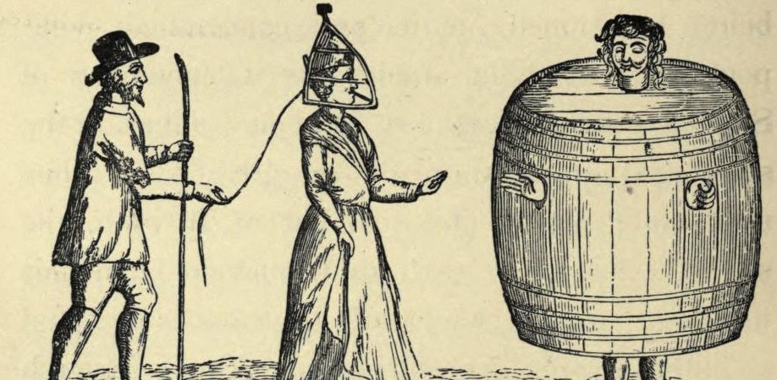
Guess the Tudor Object!
Look at the picture of Source 5 on your Activity Sheet.
What do you think these objects were used for?
Do you recognise the object what the lady has on her head from another picture you have?

Slide 10

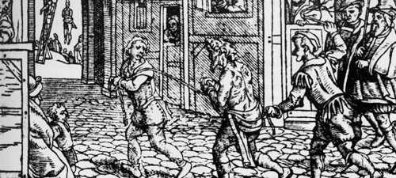
Tudor Crimes: Vagrancy
This is a woodcut from around 1536 depicting a vagrant being punished in the streets in Tudor England.
What can you see happening in this picture?
Why do you think the rich Tudor people wanted to punish people who were begging?

Slide 11
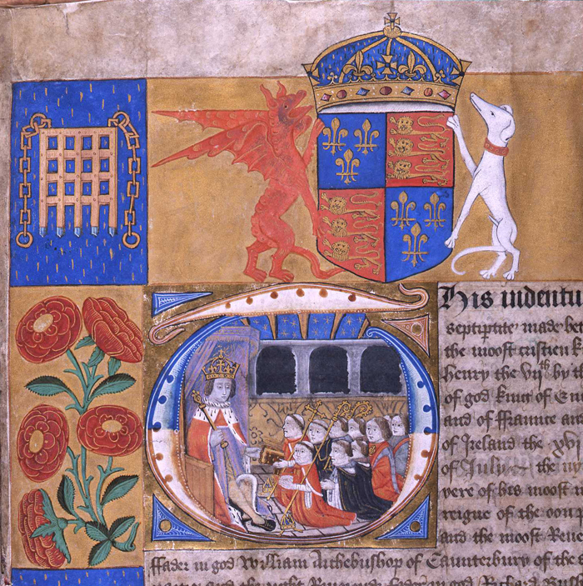
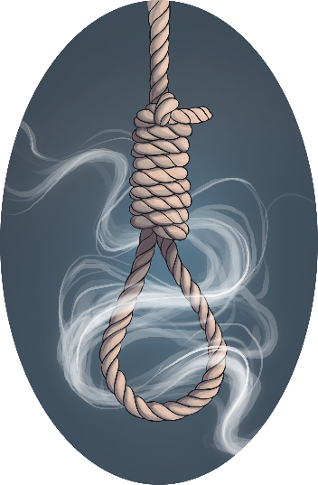
Tudor Crimes: Treason
The Tudor monarchs were very worried about people trying to take the crown from them. The act of attempting to otherthrow or kill the king or government in charge is called treason.
The Star Chamber (a type of court) was set up to hear cases of treason. It became feared, as being on trial here meant no jury, witnesses or possibility of appealing.
The punishment for treason would be death, usually by a very gruesome method to scare anyone else from thinking about it!
Fascinating Fact!
By the late 18th century, punishment for treason became very rare, but the official punishment for treason remained death until 1998!
Photo courtesy of The National Archives UK (@flickr.com) - granted under creative commons licence - attribution

Slide 12

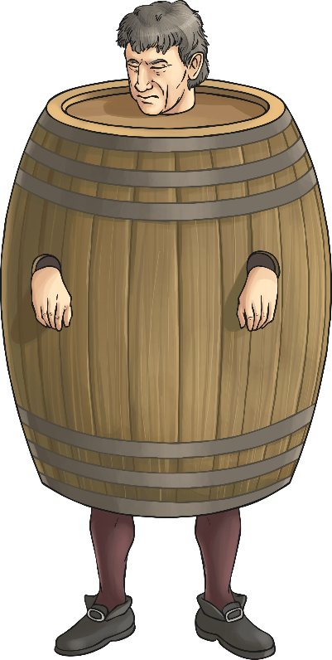
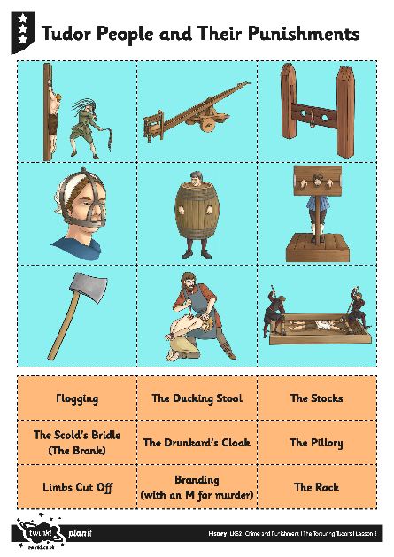
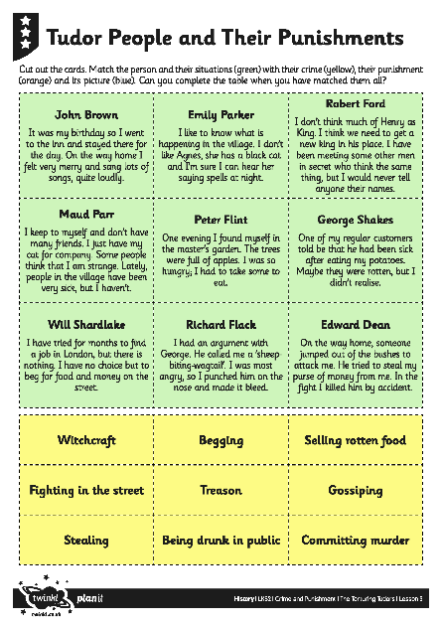
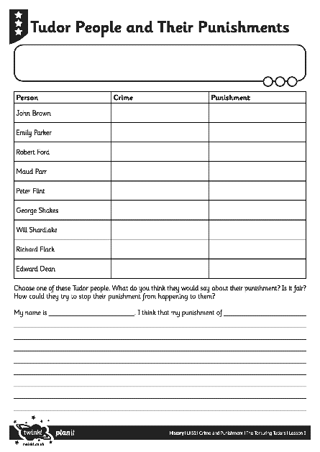
Tudor People and
Their Punishments
Activity
Read through the information about each person. Can you match them with their crime, the punishment and the picture of it?

Slide 13

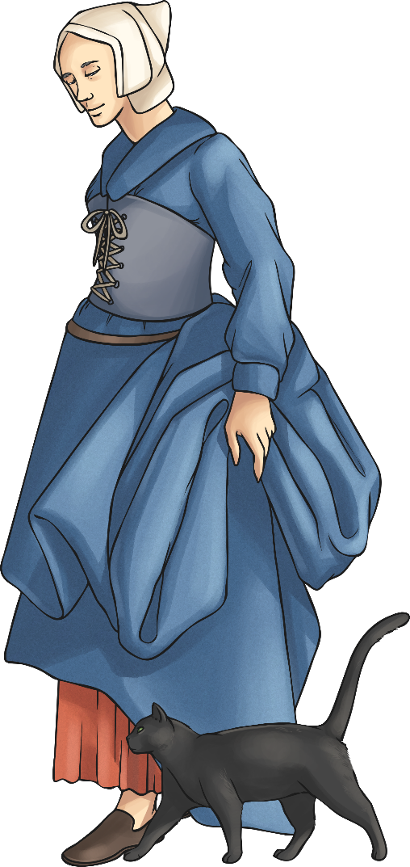

Comparing the Tudor
Justice System
Questions
Why was torture such a big part of the justice system in the Tudor period?
What did the Tudors (mainly the rich and wealthy people) see as the most worrying crimes?
Are there some punishments the Tudors use that haven’t changed since the Anglo-Saxon period?
Is the Tudor justice system fair? Can you explain why you think this?

Slide 14

Aim
I can find out about different punishment methods that were popular during the Tudor period.
Success Criteria
I can ask questions about various historical sources of Tudor objects.
I can tell you some key facts about different types of punishments used in Tudor Britain.
I can explain which crimes were thought to be very serious in Tudor Britain.
I can compare and contrast the Tudor and Anglo-Saxon justice systems.

