Slide 1

Lesson 3:
Computing Scheme of Work
Unit 3.2 – Online Safety
Appropriate Content and Ratings
Notes:
Unless otherwise stated, all resources can be found on the unit main page. From here, they can be set as 2Dos by clicking on the icon.
Ensure that children have access to shared folders: See your school administrator to check this. They will need to use the Manage Users tool.
Ensure that children’s safety settings are set to allow collaborative working: Click on the admin drop-down next to your name on the home page of Purple Mash. Click ‘Admin settings’ → ‘E-Safety settings.
Upsetting video writing frame ; you will be watching the video starter for this as a class.
Appropriate Content Quiz to be set as a 2do.
Create a collaborative 2Write file: See the PDF lesson plan for details of how to set up the collaborative file if you need guidance.
Ensure that children have access to shared folders and their safety settings are set to allow collaborative working, see Appendix 2 of the pdf lesson plan for details of how to do this.
Read the notes on slide 10 and ensure that you understand what to do.
On separate slips of paper write out the following sentences:
I am 12 years old
I am a boy
I live in a penthouse flat with a swimming pool
I think I go to your school, where is your school?
My mum asked me to get your address to send you something.
NOTE: There is an example of how schools track user content to this might not be the case in your school so use whichever safeguarding measure you put in place for this situation.

Slide 2


Aims
Slide 2
To learn about the meaning of age restrictions symbols on digital media and devices.
To discuss why PEGI restrictions exist.
To know where to turn for help if they see inappropriate content or have inappropriate contact from others.
Need more support? Contact us:
Tel: +44(0)208 203 1781 | Email: support@2simple.com | Twitter: @2simplesoftware
Notes:
Display slide 2 and outline the lesson aims.

Slide 3
Success Criteria
Slide 3
Children can identify some physical and emotional effects of playing/watching inappropriate content/games.
Children relate cyberbullying to bullying in the real-world and have strategies for dealing with online bullying including screenshot and reporting.
Need more support? Contact us:
Tel: +44(0)208 203 1781 | Email: support@2simple.com | Twitter: @2simplesoftware
Notes:
Display slide 3 and outline the success criteria.

Slide 4
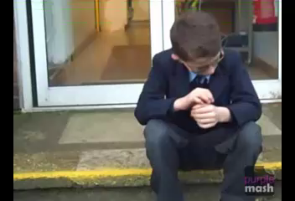
Internet Use
Slide 4
Watch this video from Inappropriate video writing frame as a class.
Has anything like this happened to anyone that you know? What about when playing games online?
Need more support? Contact us:
Tel: +44(0)208 203 1781 | Email: support@2simple.com | Twitter: @2simplesoftware
Notes:
Use the embedded video in slide 4.
Briefly discuss. Children will be returning to this later in the lesson.

Slide 5
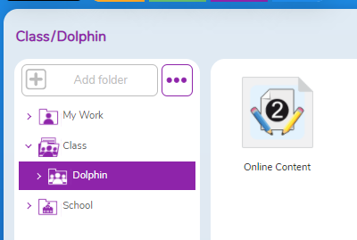
Activity 1: Collaborative 2Write
Slide 5
Each child should open the collaborative 2Write file. To do this:
Go to your Work tab in Purple Mash.
Click on the little arrow to the left of the word ‘Class’.
Click on your class name.
You will see the Online Content file in the main screen area.
Double-click to open this file.
Need more support? Contact us:
Tel: +44(0)208 203 1781 | Email: support@2simple.com | Twitter: @2simplesoftware
Notes:
See the PDF lesson plan for details of how to set up the collaborative file if you need guidance.
Use slides 5-6 to direct the activity.
Look at children’s ideas.
Note: Once children click onto a different line or exit the 2Write document, the ‘tags’ are lost.

Slide 6
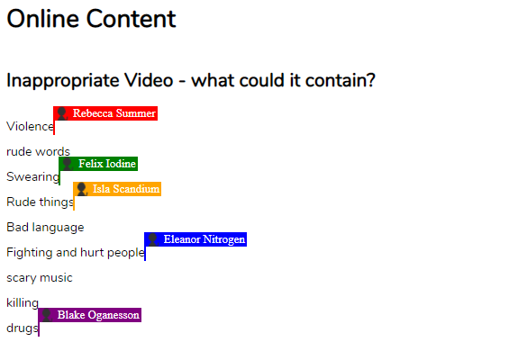
Activity 1: Collaborative 2Write
Slide 6
Contribute your ideas to the ‘Inappropriate video - What could it contain?’ section.
Click on a free line or click the enter key to create a line to write on.
Do not click away from the text that you typed or close the document once you have contributed.
The contributions should appear in real-time on the whiteboard, each child’s location in the document will be tagged in a different colour. Show children that this demonstrates that their contribution is being tracked.
Need more support? Contact us:
Tel: +44(0)208 203 1781 | Email: support@2simple.com | Twitter: @2simplesoftware
Notes:
Use slides 5-6 to direct the activity.
Look at children’s ideas.
Note: Once children click onto a different line or exit the 2Write document, the ‘tags’ are lost.

Slide 7

British Board of Film Classification (BBFC) Ratings
Slide 7
Are these symbols familiar?
How might the language used change between media with the different ratings?
How might levels of violence change?
How will the types of storylines differ?
Which ratings should you look for when watching films or playing games?
Are there places that films do not appear with ratings first to inform you?
YouTube is one example and other online video sources.
You need to be extra careful with such sites because you do not know from the title what the film could contain, and you could see something that upsets you or scares you. If in doubt, do not watch it.
Need more support? Contact us:
Tel: +44(0)208 203 1781 | Email: support@2simple.com | Twitter: @2simplesoftware
Notes:
Slides 7-9 cover BBC file classifications for film and PEGI rating for games. Use the slides and discuss the questions that appear when clicked.

Slide 8





PEGI Ratings
Slide 8
PEGI provides age classifications for video games in 38 European countries. There are age ratings and separate content descriptors.
These are the PEGI age ratings.
Suitable for all ages,
No sounds or pictures that are likely to frighten young children.
Only cartoon/joke violence
No bad language.
Scenes that could frighten younger children. Very mild non-realistic violence.
Video games that show violence of a slightly more graphic nature towards fantasy characters or non-realistic violence towards human-like characters.
Mild bad language.
More grown-up themes.
Increasing levels of more realistic looking violence.
Grown-up themes.
Bad language.
Gambling.
Pan-European Game Information https://pegi.info/
Need more support? Contact us:
Tel: +44(0)208 203 1781 | Email: support@2simple.com | Twitter: @2simplesoftware
Notes:
Slides 7-9 cover BBC file classifications for film and PEGI rating for games. Use the slides and discuss the questions that appear when clicked.

Slide 9







PEGI Ratings
Slide 9
These are the PEGI content descriptors.
BAD LANGUAGE
GAMBLING
Illegal Activities
VIOLENCE
Grown-up themes
DISCRIMINATION
Do these symbols appear on any games that you play?
Pan-European Game Information https://pegi.info/
Need more support? Contact us:
Tel: +44(0)208 203 1781 | Email: support@2simple.com | Twitter: @2simplesoftware
Notes:
Slides 7-9 cover BBC file classifications for film and PEGI rating for games. Use the slides and discuss the questions that appear when clicked.

Slide 10
Activity 2: Effects of Inappropriate Content
Slide 10
Look at the ‘Effects …’ section of the 2Write file with both emotional and physical effects.
Think about your own experiences to help answer this.
Write in note form unless you are a fast typist.
Need more support? Contact us:
Tel: +44(0)208 203 1781 | Email: support@2simple.com | Twitter: @2simplesoftware
Notes:
Slides 10-13 lead you through this activity. You will need to prepare for slide 10 actions in advance.
The semi-anonymous nature of this collaboration might encourage more reluctant children to share their ideas. Encourage children to think about both the immediate emotional and physical effects (including using bad language, being violent to others, getting into trouble personally, nightmares, anxiety) and the knock-on effect behaviourally; NOT doing other things with your time, fear of going out to play, lack of exercise, lack of sleep, loss of appetite. You can add additional questions to get children thinking.
While most of the class is doing the activity on slide 10, ask 5 children to help you with a special job. Explain that you need them to write some ‘lies’ on the 2Write file. Show them how to scroll to the bottom of the file and add a few lines (You might want to switch off your projector, so the rest of the class don’t see). Then give each child a prepared sentence and ask them to type these sentences from their device. They should try not to draw attention to themselves, so the other children do not realise what they are doing.

Slide 11
Activity 2: Effects of Inappropriate Content
Slide 11
Look at the effects that you have all written about.
Think back to Ollie in the video.
What do you think he should do about his feelings?
One recommended action is that he talk to a trusted adult who can help him to sort out how he can feel better and can put an end to his brother showing him inappropriate things.
Need more support? Contact us:
Tel: +44(0)208 203 1781 | Email: support@2simple.com | Twitter: @2simplesoftware
Notes:
Slides 10-13 lead you through this activity. You will need to prepare for slide 10 actions in advance.
The semi-anonymous nature of this collaboration might encourage more reluctant children to share their ideas. Encourage children to think about both the immediate emotional and physical effects (including using bad language, being violent to others, getting into trouble personally, nightmares, anxiety) and the knock-on effect behaviourally; NOT doing other things with your time, fear of going out to play, lack of exercise, lack of sleep, loss of appetite. You can add additional questions to get children thinking.
While most of the class is doing the activity on slide 10, ask 5 children to help you with a special job. Explain that you need them to write some ‘lies’ on the 2Write file. Show them how to scroll to the bottom of the file and add a few lines (You might want to switch off your projector, so the rest of the class don’t see). Then give each child a prepared sentence and ask them to type these sentences from their device. They should try not to draw attention to themselves, so the other children do not realise what they are doing.

Slide 12

Activity 2: Effects of Inappropriate Content
Slide 12
Thinking of your own situation, can you think of five different people that you know who could help you.
A leader at a club or group you belong to?
A teacher?
School staff ?
An older brother or sister ?
A parent?
A babysitter?
A grandparent ?
If they don’t know what to do or don’t help you, you should ask someone else on your list.
Need more support? Contact us:
Tel: +44(0)208 203 1781 | Email: support@2simple.com | Twitter: @2simplesoftware
Notes:
Slide 12 gives children the opportunity to identify people in their lives that they go turn to for help.

Slide 13
Activity 2: Effects of Inappropriate Content
Slide 13
Finding inappropriate content.
Let’s look at your answers in the 2Write file again.
Often people with the technical skills will be able to find out who sent the messages. Purple Mash has the facility to track who has created content in any of the tools and which device was used. This information can be used by schools to identify the culprit; therefore many schools note who uses which device for sessions.
A teacher can contact 2Simple who would be able to pinpoint the machines in use at the time. We also have a flagging facility where any rude words or certain terms are flagged by the system and reported back to schools. If anyone uses another person’s login in or out of school to corrupt work, we can identify the ip address of the machine that was logged in and can help schools to identify the person who did this.
Need more support? Contact us:
Tel: +44(0)208 203 1781 | Email: support@2simple.com | Twitter: @2simplesoftware
Notes:
When up to Slide 13, scroll through the screen and pretend to notice the planted sentences at the end. HOW COULD THESE HAVE GOT HERE? Well, we can work out who wrote them can’t we? – read the sentences and ask the children who in the class is 12/is a boy/lives in a penthouse with a pool? We cannot really work it out, can we? It seems that they have not told the truth. Unfortunately, people do not always tell the truth online and because you cannot see them there is no way of knowing.
Clicking on the slide will give some information about using technology to find the people who post inappropriate content.
Let the class know that the people who wrote the extra sentences were ‘plants’ in this case and thank them for their help.

Slide 14

Online Gaming
Slide 14
Do any children play games where they are in the same game as other people online and can communicate with them. Perhaps you have older siblings who do this?
Do the people who you communicate with always tell the truth or are they like the people who have written on the 2Write file?
Have you ever been scared or upset by someone online? Maybe you have played Minecraft, and someone has broken your building? Perhaps you have been scammed when swapping items in an online game with other players who you thought were trustworthy?
Has anyone ever asked for personal information online?
Can you identify the two sentences in our 2Write file that were trying to get personal information?
Why might someone want this information?
Need more support? Contact us:
Tel: +44(0)208 203 1781 | Email: support@2simple.com | Twitter: @2simplesoftware
Notes:
Slides 14-15 relates inappropriate content to online gaming: The responses will depend upon the experiences of your own class. It is important to emphasise that if anything happens online that upsets them, even if they think they did something wrong, they can tell a trusted adult who will help them to resolve the situation.
Bullying online is called cyberbullying and it is just as upsetting as ‘real-life’ bullying and the adults who care for them want to help them to be protected from this just like with any form of bullying.
Use slide 15 to show children how to take a screenshot.

Slide 15

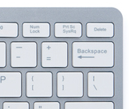

Online Gaming
Slide 15
Technology companies can use these skills to trace and deal with cyberbullies, you are never alone if you tell someone who can help you. You can also take a screenshot of anything inappropriate that a person says to you.
Taking a screenshot is a useful way to save evidence of inappropriate content. The method will depend upon your device:
You can also use a tool called the Snipping Tool (search for this on your computer), you can take a snip and then save it to your computer as an image.
On many Android devices, press the off button and volume down button at the same time.
On an iPad you need to press the home button and the off button at the same time to save an image to the gallery.
Conventional keyboards have a Print Screen button. This copies the screenshot to your computer clipboard and then you can paste it into a word processor file.
The save data will also record the time that the screenshot was taken, which might be useful.
Need more support? Contact us:
Tel: +44(0)208 203 1781 | Email: support@2simple.com | Twitter: @2simplesoftware
Notes:
Slides 14-15 relates inappropriate content to online gaming: The responses will depend upon the experiences of your own class. It is important to emphasise that if anything happens online that upsets them, even if they think they did something wrong, they can tell a trusted adult who will help them to resolve the situation.
Bullying online is called cyberbullying and it is just as upsetting as ‘real-life’ bullying and the adults who care for them want to help them to be protected from this just like with any form of bullying.
Use slide 15 to show children how to take a screenshot.

Slide 16
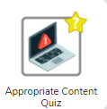
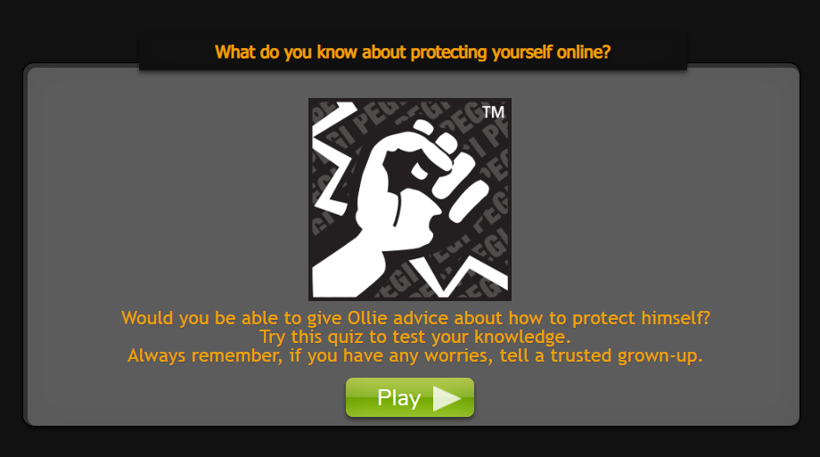
Activity 3: Quiz
Slide 11
Try the try the ‘How much do you know?’ quiz.
Discuss the correct answers as a class.
Need more support? Contact us:
Tel: +44(0)208 203 1781 | Email: support@2simple.com | Twitter: @2simplesoftware
Notes:
Slide 16 links to the quiz set as a 2do for children.

Slide 17
Review Success Criteria
Slide 17
I can identify some physical and emotional effects of playing/watching inappropriate content/games.
I know what cyberbullying is and how its effects are no different to bullying in the real-world. I have strategies for dealing with online bullying including screenshots and reporting.
Need more support? Contact us:
Tel: +44(0)208 203 1781 | Email: support@2simple.com | Twitter: @2simplesoftware
Notes:
Review the success criteria from slide 3. Children could rate how well they achieved this using a show of hands.

