Slide 1

Lesson 4:
Computing Scheme of Work
Spreadsheets Crash Course for Year 3
Advanced Mode and Cell Addresses
Notes:
Unless otherwise stated, all resources can be found on the main unit 3.3 page. From here, click on the icon to set a resource as a 2Do for your class. (See PDF Lesson plan).
Advanced Mode example 1
Advanced Mode example 2
Advanced Mode example 2 completed
Advanced Mode example 3
Set up a class Display Board – see the Display Boards User Guide if you need guidance with this.

Slide 2


Aims
Slide 2
To introduce the Advanced mode of 2Calculate.
To learn about describing cells using their addresses.
Need more support? Contact us:
Tel: +44(0)208 203 1781 | Email: support@2simple.com | Twitter: @2simplesoftware
Notes:
Display slide 2 and outline the lesson aims.

Slide 3
Success Criteria
Slide 3
Children can describe a cell location in a spreadsheet using the notation of a letter for the column followed by a number for the row.
Children can find specified locations in a spreadsheet.
Need more support? Contact us:
Tel: +44(0)208 203 1781 | Email: support@2simple.com | Twitter: @2simplesoftware
Notes:
Display slide 3 and outline the success criteria.

Slide 4
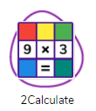

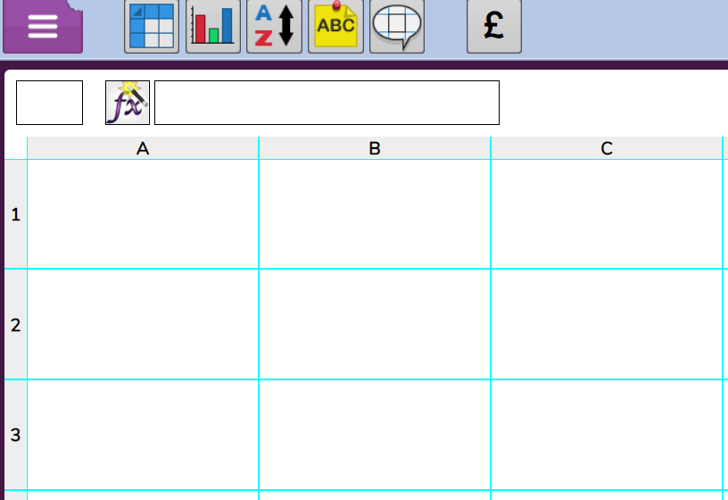
Advanced Mode
Slide 4
When you open a 2Calculate file, you can switch to ‘Advanced Mode’ using this button in the toolbar.
Look here
Switch between simple mode and advanced mode, what changes?
One change is that you can see the names for the columns and rows.
Each row is named with a number.
Each column is named with a letter
A cell address is worked out by reading the column then the row.
This cell is called B2.
Look at this row
Need more support? Contact us:
Tel: +44(0)208 203 1781 | Email: support@2simple.com | Twitter: @2simplesoftware
Notes:
Use slide 4. Use the icon to launch 2Calculate to demonstrate. Ask children to describe a few cells using their cell address.

Slide 5
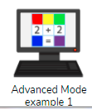
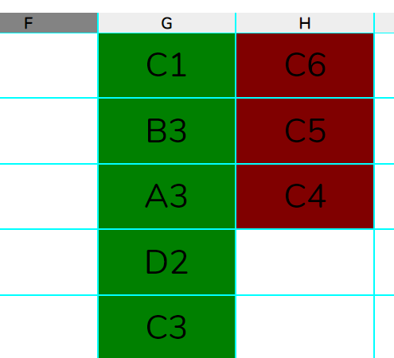
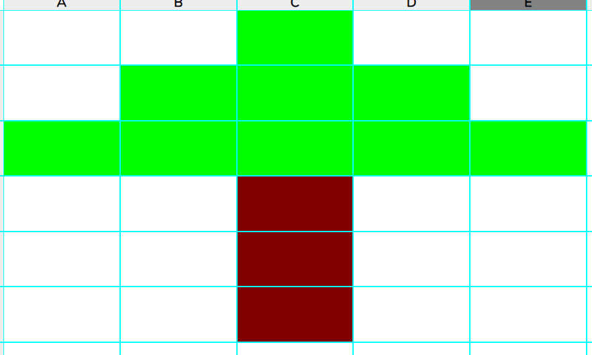
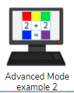
Activity 1: Creating a Picture
Slide 5
Launch Example 1 as a class using the icon:
This is a type of key describing which cells should be what colour.
Reveal answer
Colour in the cell addresses according to the key.
Click the button to reveal the answer.
Complete Example 2 from your 2Dos.
Then make your own example and save it to the class Display Board for others to try.
Need more support? Contact us:
Tel: +44(0)208 203 1781 | Email: support@2simple.com | Twitter: @2simplesoftware
Notes:
Use slide 5. Launch Example 1 from the icon. As a class, create a picture from cell addresses given on sheet.
Children should then complete Example 2 on their own. Explain to children how to save their own examples to the class Display Board, approve these so that children can try each other’s.

Slide 6
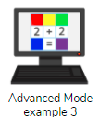
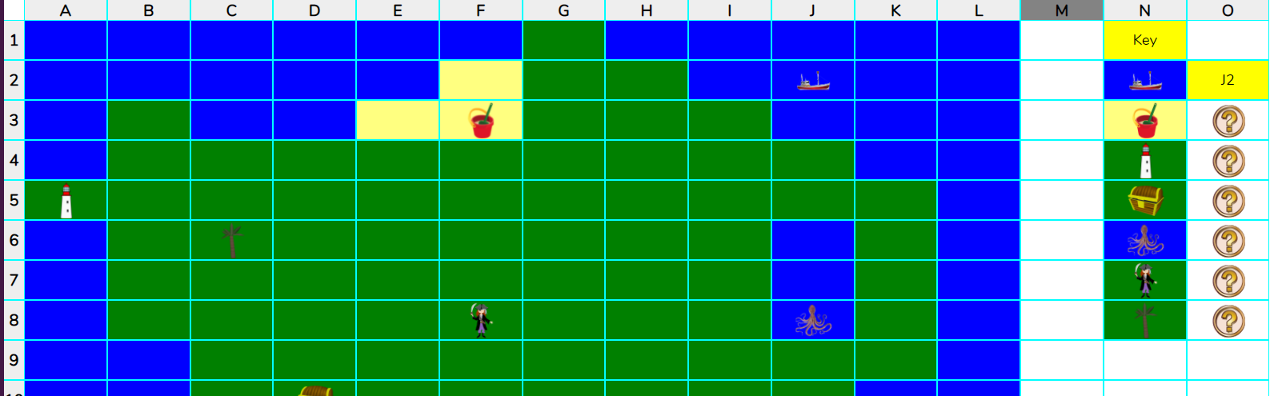
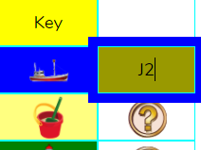
Activity 2: Treasure Maps
Slide 6
Example 3 is a treasure map.
You must enter the correct cell address for each item. If you get it correct, the Quiz Tool icon will disappear.
You must use a capital letter for cell address.
Need more support? Contact us:
Tel: +44(0)208 203 1781 | Email: support@2simple.com | Twitter: @2simplesoftware
Notes:
Display slide 6. Children should open and complete example 3 from their 2Dos.

Slide 7
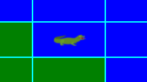
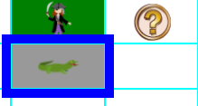
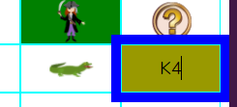

Extension
Slide 7
Can you add some more items to the map?
Add an image to a location and colour the cell correctly.
Copy the image to the key.
Type the cell address into the cell next to image.
Click on the
‘Quiz Tool’ in the Control Toolbox
Save your file to the class Display Board for other people to try.
Need more support? Contact us:
Tel: +44(0)208 203 1781 | Email: support@2simple.com | Twitter: @2simplesoftware
Notes:
Use slide 7 to display an extension activity. Explain to children how to save their own examples to the class Display Board, approve these so that children can try each other’s.
*Note it is possible to copy and paste on iPad by holding finger on cell until copy and paste option appears.

Slide 8
Review Success Criteria
Slide 8
I can describe a cell location in a spreadsheet using the notation of a letter for the column followed by a number for the row.
I can find specified locations in a spreadsheet.
Need more support? Contact us:
Tel: +44(0)208 203 1781 | Email: support@2simple.com | Twitter: @2simplesoftware
Notes:
Display slide 8. Review the success criteria from slide 3. Children could rate how well they achieved this using a show of hands.

