Slide 1
Toy Stories
Autumn 1 and 2

Slide 2
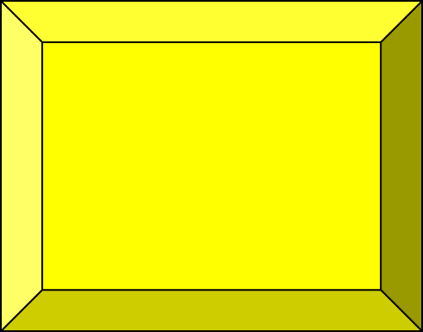
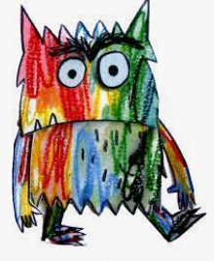

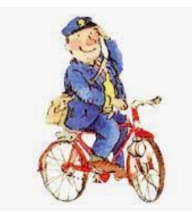
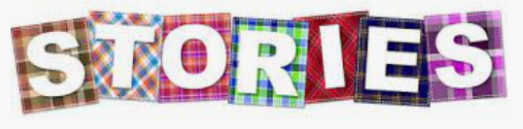
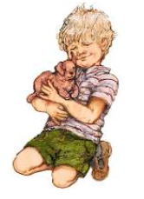
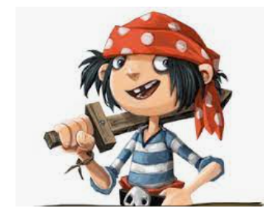
Literacy:
Colour Monster
Holiday Postcard writing
The pirate’s Next Door
Autumn Sensory Poetry
Jolly Postman
Jolly Christmas Postman
Fairy Tales
Art:
The Dot
Mermaid Collage
Firework Art
Geography:
Compass directions
Map reading
Aerial view of local area
Christmas local walk
History:
Toy Museum
Guy Fawkes
D and T:
Colour Monster Sensory Bottle
Pirate Ship
Fireworks
Fairy Tale character houses

