Slide 2
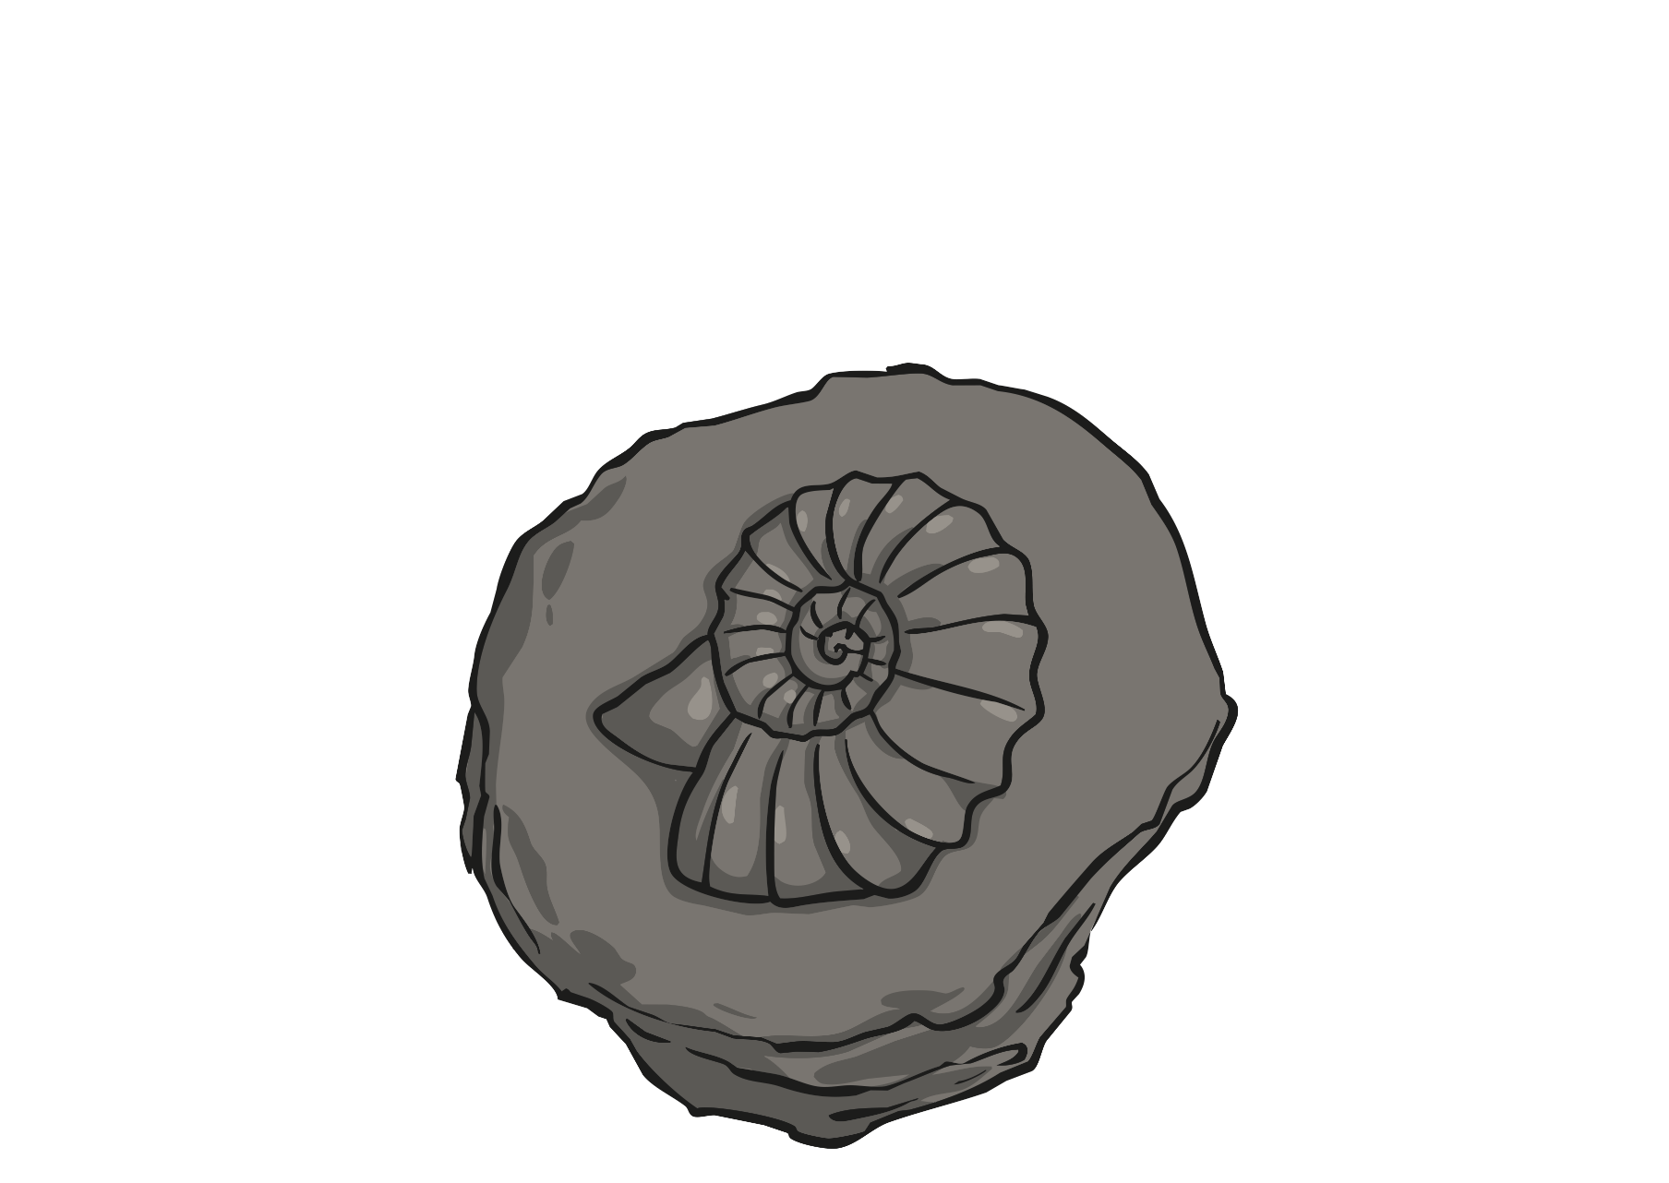
What is a Fossil?
A fossil is a special rock that holds the remains of creatures that lived millions of years ago.

Slide 3
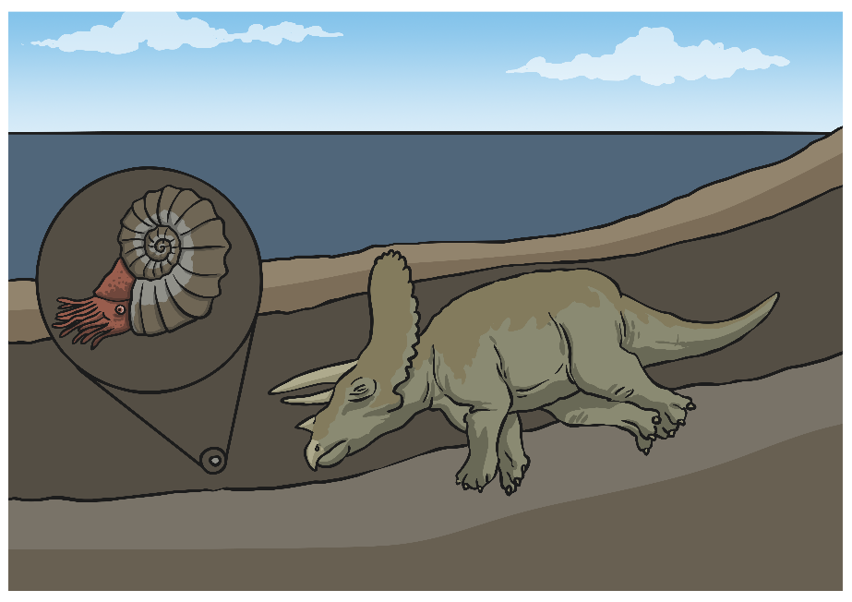
How Were Fossils Created From Sea Creatures?
When a sea creature died a long time ago its shell or body laid at the bottom of the sea. Over time it got covered in lots of layers of mud. This protected it and stopped it from crumbling into tiny pieces.

Slide 4
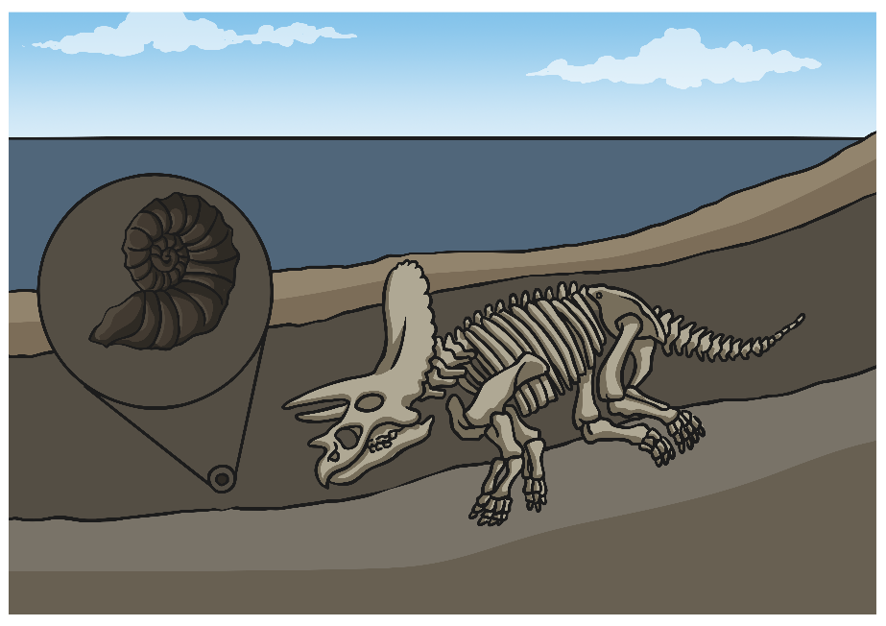
How Were Fossils Created From Sea Creatures?
After many years, the mud became hard and turned into rock. As this happened, the shell or body became a fossil. It is the harder parts of the animals which are now found fossilised, such as their shells, bones and teeth.

Slide 5

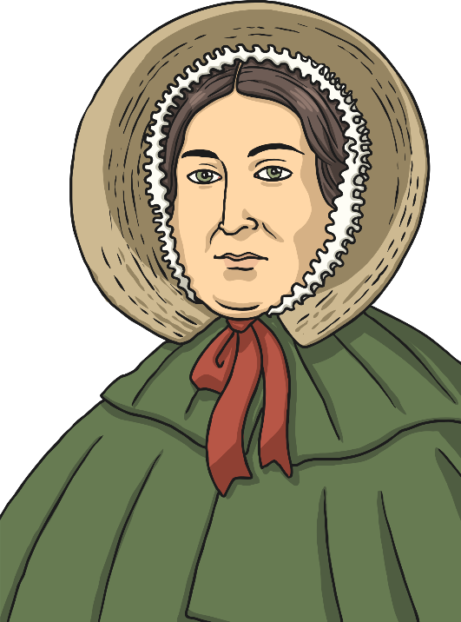
Mary Anning
So who was Mary Anning and what did she find that was so important?
While watching the video see if you can work out the types of fossils she found.
What have you learnt about Mary Anning?
What types of fossils did she find?
How did she learn about fossils?
Why were her finds so important?
Why do you think she was not credited with finding the fossils?
Click me to watch the video!
Notes:
If the BBC Bitesize link is unavailable, you can use this alternative: https://www.youtube.com/watch?v=qNOh-85_Dmc
Note - Please do not let the next video automatically play at the end of the clip. Twinkl accepts no responsibility for the content of third party websites.

Slide 6
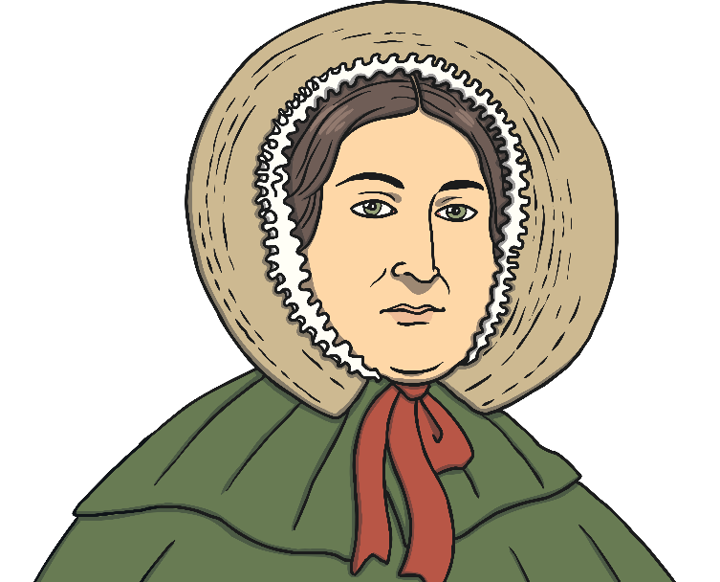
Who Was Mary Anning?
Mary Anning was a famous fossil hunter.
She was born in 1799 and lived in Lyme Regis by the sea. Her parents, Richard and Molly, had ten children. Mary and her brother Joseph were the only children to survive to adulthood.
Every day, her father took her and her brother to the beach, where they spent hours looking for fossils.
They didn’t actually know that the things they found were fossils or that they were sea creatures from millions of years ago.
However, Mary knew that there was something special about
the things she found lying in the rocks on the beach.

Slide 7
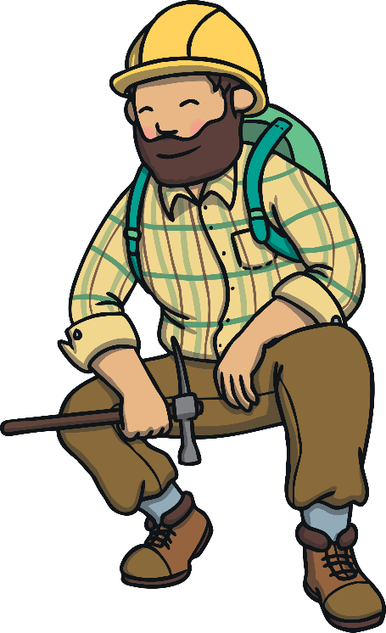
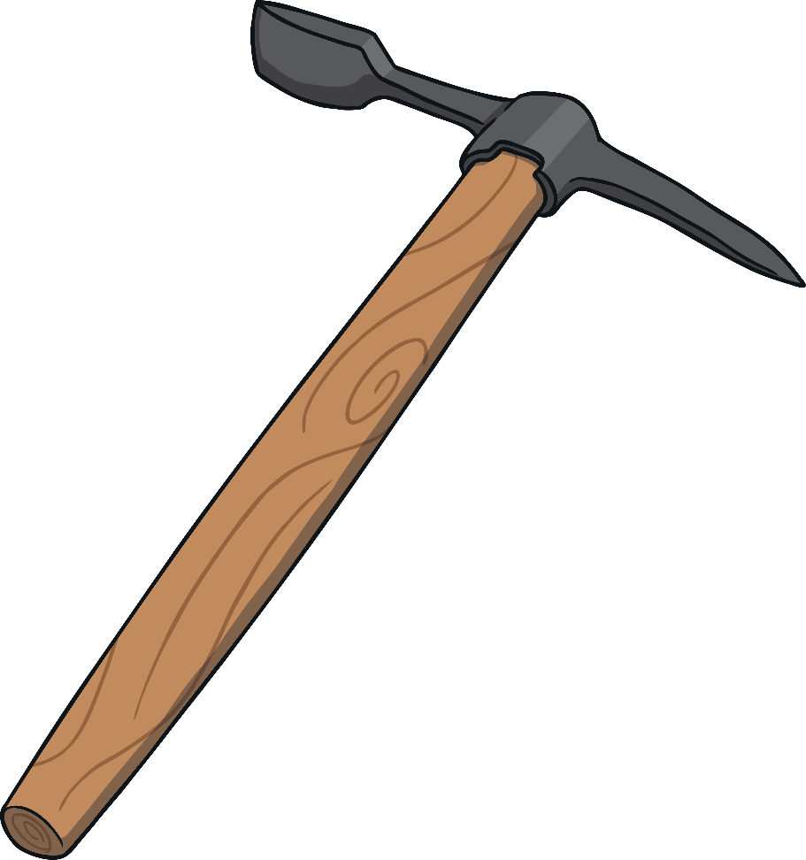
Who Was Mary Anning?
Mary was good at spotting fossils in rocks, and her father taught her how to get the fossils out of the rock by gently and carefully chipping the rock away from the fossil using a hammer and chisel. This took a very long time because if the fossil was hit with the chisel instead of the rock, it could be damaged.

Slide 8

Mary Anning’s Life
Mary and her family had little money, so Mary and her brother Joseph would take the fossils they had removed from the rocks and sell them for a penny each on a stall in the street near where they lived. People were amazed by the mysterious shapes of the fossils, thinking they were beautiful and from a mysterious world.

Slide 9

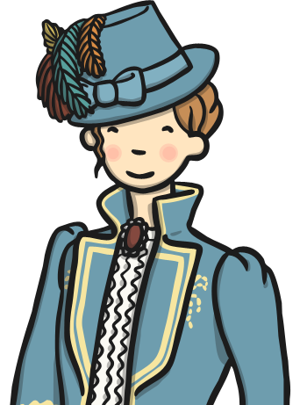
Mary Anning’s Life
One day a lady called Elizabeth Philpot, who was a fossil expert, saw Mary’s fossils and was very interested in them. She showed Mary some fossils she had collected and gave her books to read. The books taught Mary that scientists thought that the objects she had found were actually creatures that had lived a very long time ago.

Slide 10

Mary Anning’s Life
Mary’s father died of tuberculosis when she was just 11 years old. Her father was the only member of the family with a job so they now had to look at other ways to earn money to live.
Mary visited the beach every day, looking for fossils to sell. Knowing that the scientists thought these were creatures that had lived millions of years ago made Mary feel very excited. This meant that the world was millions of years old!

Slide 11
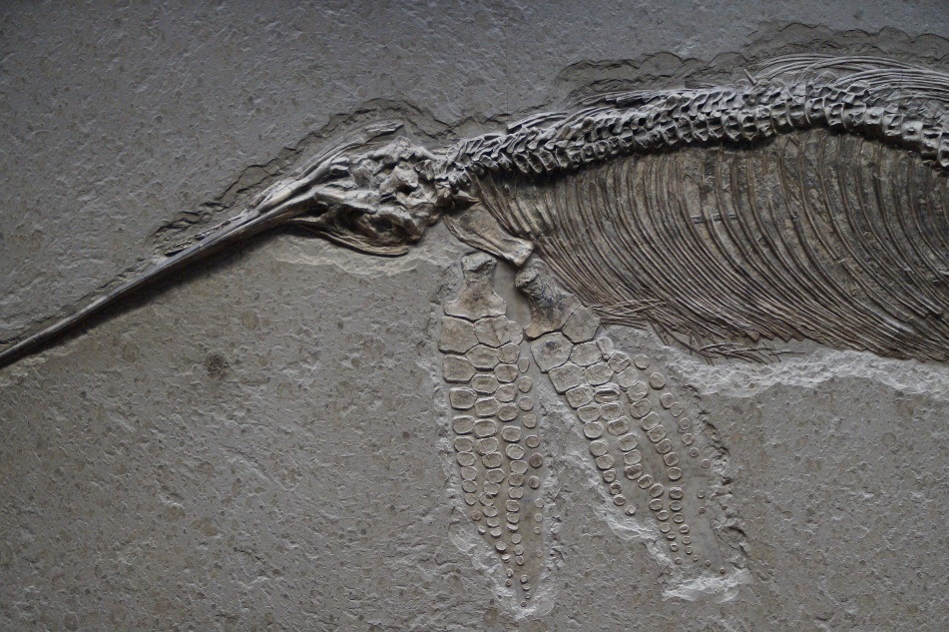
Mary Anning’s Life
Some years later, whilst walking along the beach one day, Mary made an amazing discovery. She had found a giant fossil that no one had ever seen before. It was the skull of a giant creature that looked like a crocodile. She had found the first complete fossil of an Ichthyosaurus or ‘fish-lizard’.
Scientists from London were amazed by the discovery. Mary was paid for the fossil and her family no longer needed to worry about money.

Slide 12

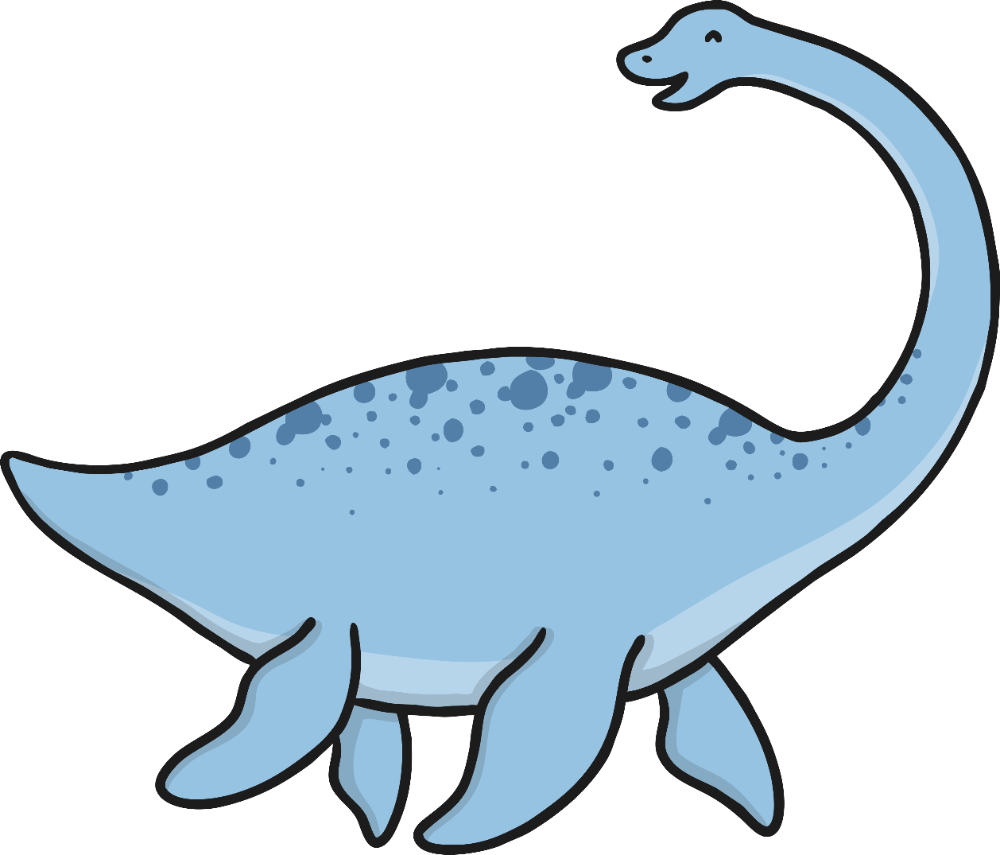
Mary Anning’s Life
Mary carried on finding more fossils that the world had never seen before. She found a ‘giant sea reptile’ or Plesiosaur, a flying reptile and a prehistoric fish. Many were taken to London and put on display in the British Museum. Mary opened a small shop where she sold fossils, stones and shells.
She died in 1847 after becoming ill, but is still remembered as one of the greatest fossil hunters ever to have lived.

Slide 13
Test Your Knowledge
Play Quiz
Back to Information

Slide 14

What is a fossil?
A special rock that holds the remains of creatures that lived millions of years ago.
A
B
A piece of metal.
C
Something found
in the sky.
D
A chair.
Next

Slide 15
Who was Mary Anning?
A
B
A cook.
A teacher.
A famous
fossil hunter.
C
D
A dentist.
Next

Slide 16
Which tools did Mary use to separate the fossil from the rock?
A
A hammer
and chisel.
B
A drill.
C
D
A saw.
A screwdriver.
Next

Slide 17
Which fossil did Mary find that no-one had ever seen before?
A
B
A cheetah.
A crab.
C
D
An elephant.
An ichthyosauraus.
Play Again
Finish

