Slide 1

Lesson 1:
Computing Scheme of Work
Spreadsheets Crash Course for Year 3
Introduction to Spreadsheets
Notes:
Resources
The following resources are needed for this session, please refer to the PDF lesson plan:
2Calculate tool in Purple Mash
Toy Data Spreadsheet: set this as a 2Do for children.

Slide 2


Aims
Slide 2
To understand what a spreadsheet looks like.
To be able to navigate around a spreadsheet and enter data.
To learn new vocabulary related to spreadsheets.
Need more support? Contact us:
Tel: +44(0)208 203 1781 | Email: support@2simple.com | Twitter: @2simplesoftware
Notes:
Display slide 2 and outline the lesson aims.

Slide 3
Success Criteria
Slide 3
Children can navigate around a spreadsheet.
Children can explain what rows and columns are.
Children can enter data into cells.
Children can create a table of data on a spreadsheet.
Need more support? Contact us:
Tel: +44(0)208 203 1781 | Email: support@2simple.com | Twitter: @2simplesoftware
Notes:
Display slide 3 and outline the success criteria

Slide 4



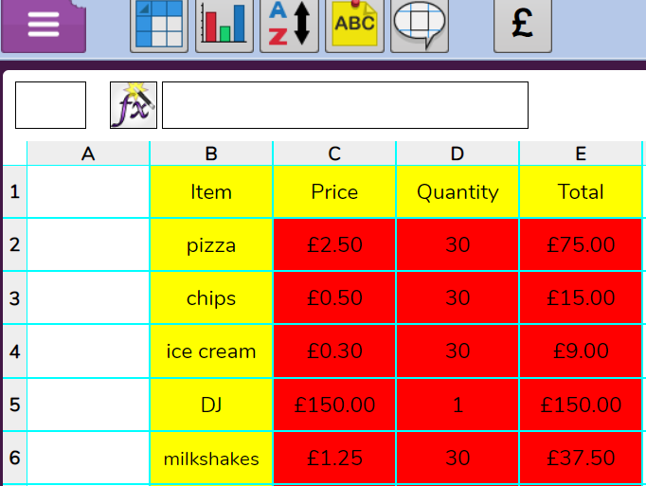

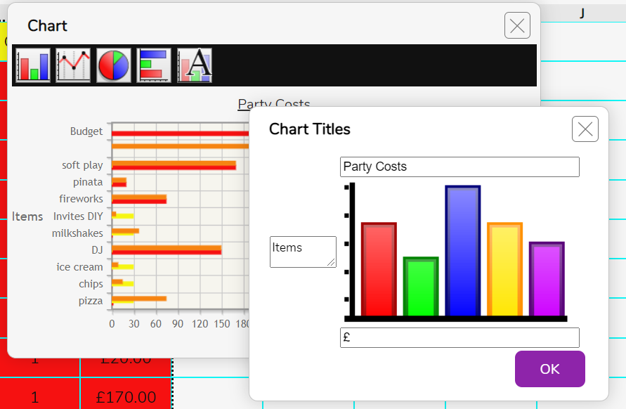
Introduction
Slide 4
What are spreadsheets?
School Records: Storing & organising children’s names, ages, class…
Spreadsheets
Spreadsheets are used for organising information.
Planning Parties: Calculating costs, making lists of food and amounts…
Displaying Charts: Spreadsheets can display information as tables and graphs.
Can you think of any other examples?
Need more support? Contact us:
Tel: +44(0)208 203 1781 | Email: support@2simple.com | Twitter: @2simplesoftware
Notes:
Display slide 4 clicking through it to reveal what spreadsheets are.

Slide 5
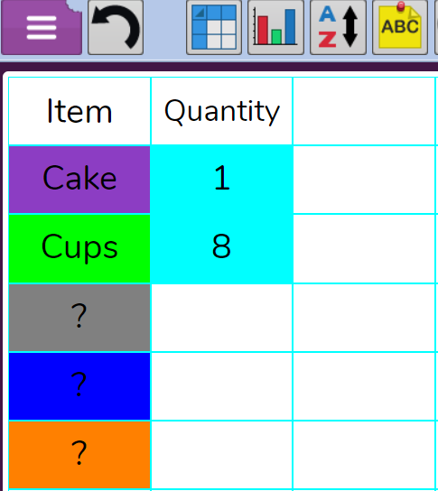

Introduction
Slide 5
If you were organising a party, you could use a spreadsheet to enter all the things you needed and who you were going to invite.
What else could you include on the spreadsheet for a party?
Did you know?
Spreadsheets are great for making lists for things like parties… they can even work out the cost of buying all the things you need.
Need more support? Contact us:
Tel: +44(0)208 203 1781 | Email: support@2simple.com | Twitter: @2simplesoftware
Notes:
Display slide 5. Ask the class - What could also be included on a spreadsheet for a party?

Slide 6

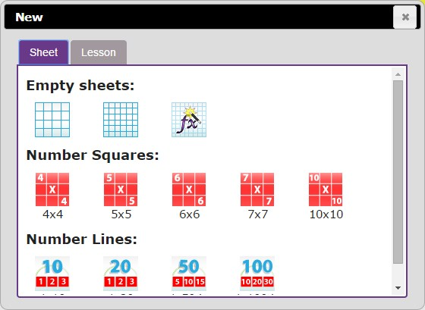
Getting to know 2Calculate
Slide 6
You will be using 2Calculate to learn how to enter information and do simple calculations.
First, click on the Sheet tab.
Then, click on the first type of Empty sheets.
Need more support? Contact us:
Tel: +44(0)208 203 1781 | Email: support@2simple.com | Twitter: @2simplesoftware
Notes:
Use slide 6. Show children how to open 2Calculate from the Tools area in Purple Mash or click on the icon on the slide. Use the prompts on the slide to help children familiarise themselves with 2Calculate when it is opened.

Slide 7
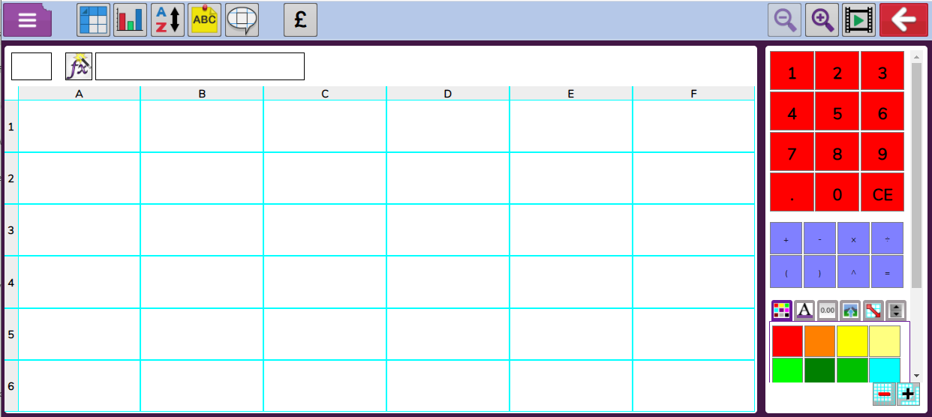
Key Vocabulary
Slide 7
Columns
Advanced mode
Cells
Cells can contain: words, numbers, colours or symbols (such as + - =)
Rows
Need more support? Contact us:
Tel: +44(0)208 203 1781 | Email: support@2simple.com | Twitter: @2simplesoftware
Notes:
Use slide 7 in conjunction with 2Calculate to show children the environment and go through key vocabulary (Click advanced mode on 2Calculate when demonstrating).

Slide 8
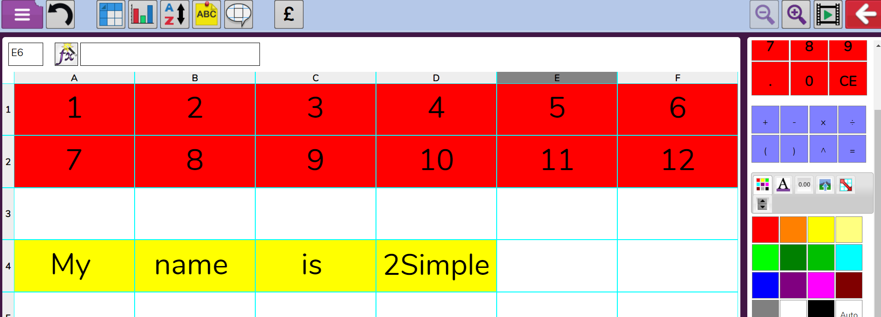
Activity 1: Writing Numbers & Name
Slide 8
Can you write the numbers 1 to 12 in different cells?
Can you write your name in a cell?
Moving from cell to cell: Use the arrow keys on your computer or tap on your tablet the cell you want to go to.
Delete: To delete contents of a cell, press backspace or delete key.
Can you save the file to your work folder?
Need more support? Contact us:
Tel: +44(0)208 203 1781 | Email: support@2simple.com | Twitter: @2simplesoftware
Notes:
Use slide 8. Show children how to launch 2Calculate from the tools area in Purple Mash. Use the slide to direct the activity. Ensure that children can save.

Slide 9
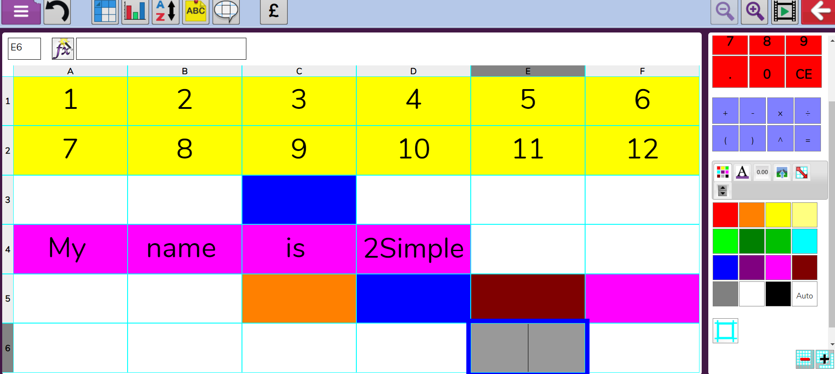
Activity 2: Colouring Cells
Slide 9
Experiment with colouring cells.
Try numbers in one colour and text in a different colour.
Hints
To colour cells: Click on the cell, then click on the colour you want in the toolbox.
To select more than one cell: Click and drag mouse or hold finger on cell on tablet and drag cells. Then click colour.
Save the file to your work folder with the same name as before.
Need more support? Contact us:
Tel: +44(0)208 203 1781 | Email: support@2simple.com | Twitter: @2simplesoftware
Notes:
Use slide 9 to explain how to colour cells in 2Calculate. Click the hints if necessary. When children save, encourage them to use the same file name, read the warning message together and discuss why this is okay because they are simply saving the latest version of their file.

Slide 10
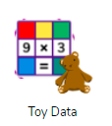
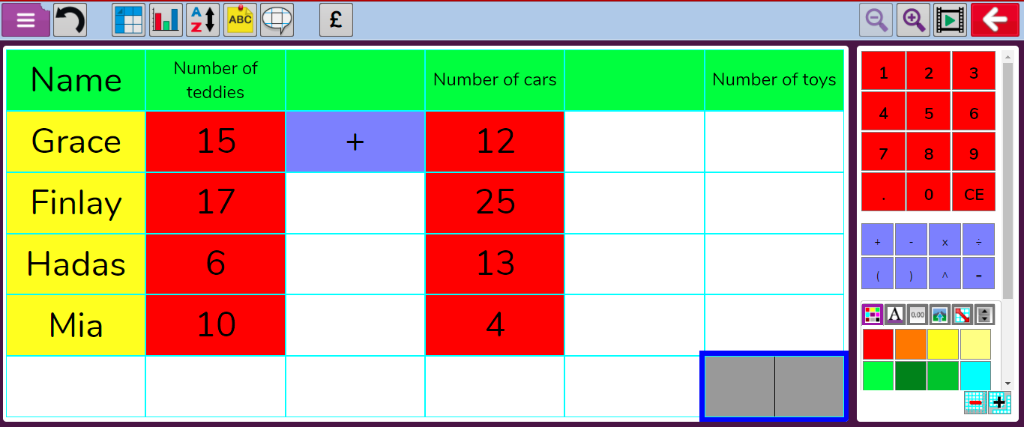
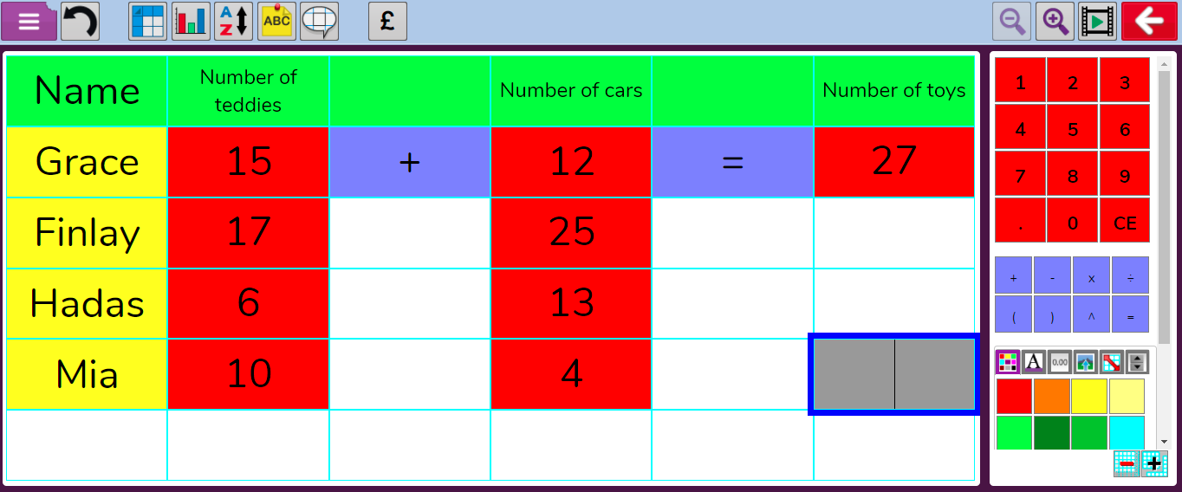
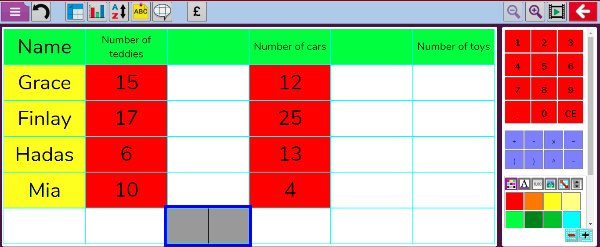
Activity 3: Toy Data
Slide 10
Grace and her friends were calculating how many toys they had, using a spreadsheet.
You can use a spreadsheet to do the calculations.
Look on the right-hand side of the screen, can you can see a + sign and an = sign?
The first calculation is to add up Grace’s teddies and cars. Click on the cell where a plus sign (+) should go.
Click on the + sign to insert a +.
Click on the cell where an = sign should go and click on the =.
The spreadsheet calculates the total.
Open the example file from your 2Dos.
Try to complete the calculations for all of the children.
What happens if you change the numbers of teddies or cars?
Need more support? Contact us:
Tel: +44(0)208 203 1781 | Email: support@2simple.com | Twitter: @2simplesoftware
Notes:
Use slide 10. Children might need help in interpreting the table of data. The icon on the slide is a link to the example for demonstration. Click to show children how to add calculations. Children should open the example from their 2Dos to complete and save.

Slide 11
Extension
Slide 11
Open a new 2Calculate file and explore calculations:
Put 3 separate numbers into a calculation:
Use different operations (+, -):
Remember to save your file.
Need more support? Contact us:
Tel: +44(0)208 203 1781 | Email: support@2simple.com | Twitter: @2simplesoftware
Notes:
Slide 11. Challenge children to explore the calculations that a spreadsheet can do.

Slide 12
Review Success Criteria
Slide 12
I can navigate around a spreadsheet.
I can explain what rows and columns are.
I can enter data into cells.
I can create a table of data on a spreadsheet.
Need more support? Contact us:
Tel: +44(0)208 203 1781 | Email: support@2simple.com | Twitter: @2simplesoftware
Notes:
Use slide 12 to evaluate success of meeting success criteria and how well they felt they were able to achieve the 3 activities. A show of hands could be used.

