Slide 1
‘Meet the teacher’
Miss Grigulis

Slide 2
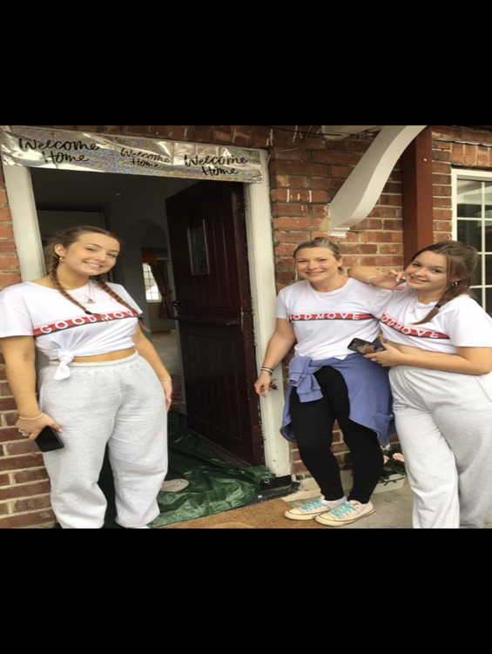
Introduction
Just a little bit about myself…
I have 2 girls. My eldest Ella works for British Airways. My youngest Eva is in her final year of A-levels at Farnborough College. Before becoming a teacher, I worked as a learning support assistant for five years working with children with special needs. This is my fifth year at Cheapside and I absolutely love teaching year 1. I have a very creative teaching style so get ready for immersive topic launches that will bring your children’s learning alive. I thank you in advance for your support with your children’s learning.

Slide 3
Staffing
Mr Ryker is our teaching assistant this year.
Forest school – Mrs Miles
PE – Mrs Higgins.

Slide 4
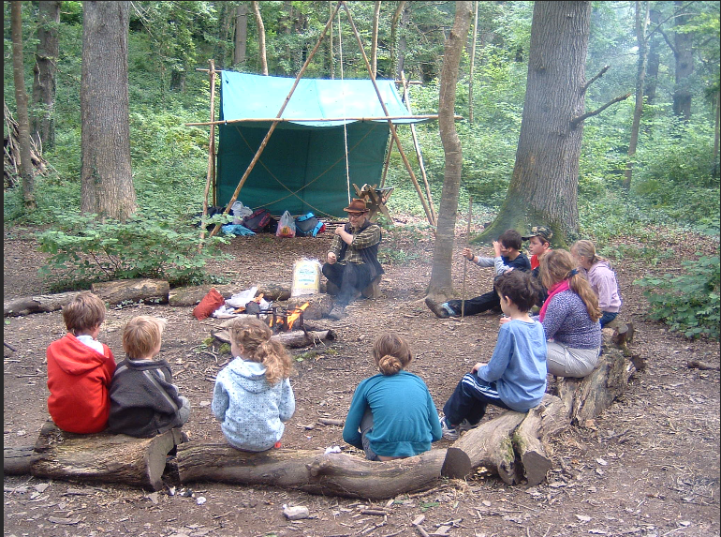
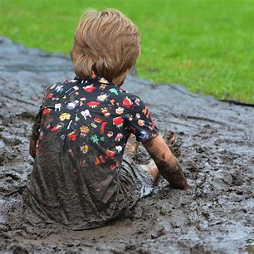
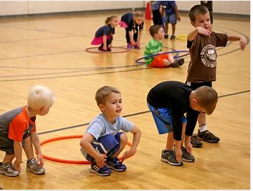
Information
FOREST SCHOOL – Thursday morning -
A pair of warm tracksuit bottoms or leggings, navy blue or black. The school PE tracksuit bottoms are ideal for this.
· The school PE jumper or zip up hoodie
· The school PE Tee-shirt
· A waterproof coat and waterproof trousers
· A pair of trainers and (a pair of wellington boots that will be kept in school.)
· Warm socks, gloves and a hat as the weather gets colder
PE – Monday mornings -
Children to come in to school dressed in their PE kit. PLEASE make sure it is named.

Slide 5
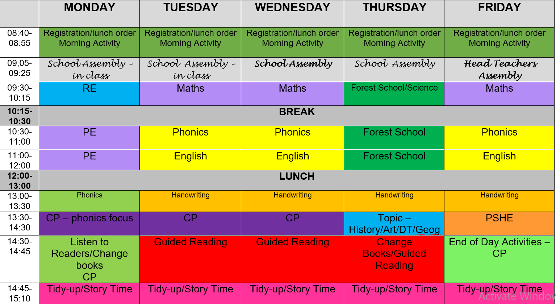

Slide 6
Home work – Reading Scrap Book -
Common Exception words – Half-termly test of review words. The list to learn will be under homework on the class pages. You can make this into a fun game with your child by printing off the words and putting them on a wall. You say the word the child has to slap the correct word on the wall. The test will be a written one so you could get your child to spell the word in mud, sand, make a pasta picture, chalk, paint. The main thing is to make it fun!
Please read with you child every day. We will be sending out reading records and we can then track and read your comments. Make it fun… make a hot chocolate, read with a pet, read to different family members. Ten minutes of reading a day can support progression for your child in phonics and literacy. There is marked difference in progress between the children who read with adults outside of school and those who only rely on the school to teach their child to read. If you would like any support with understanding the phonics sounds in your children’s books please speak to me.
I have also posted the KIRFS onto the class pages for the autumn term. These will support your child’s progression in mathematics.

Slide 7
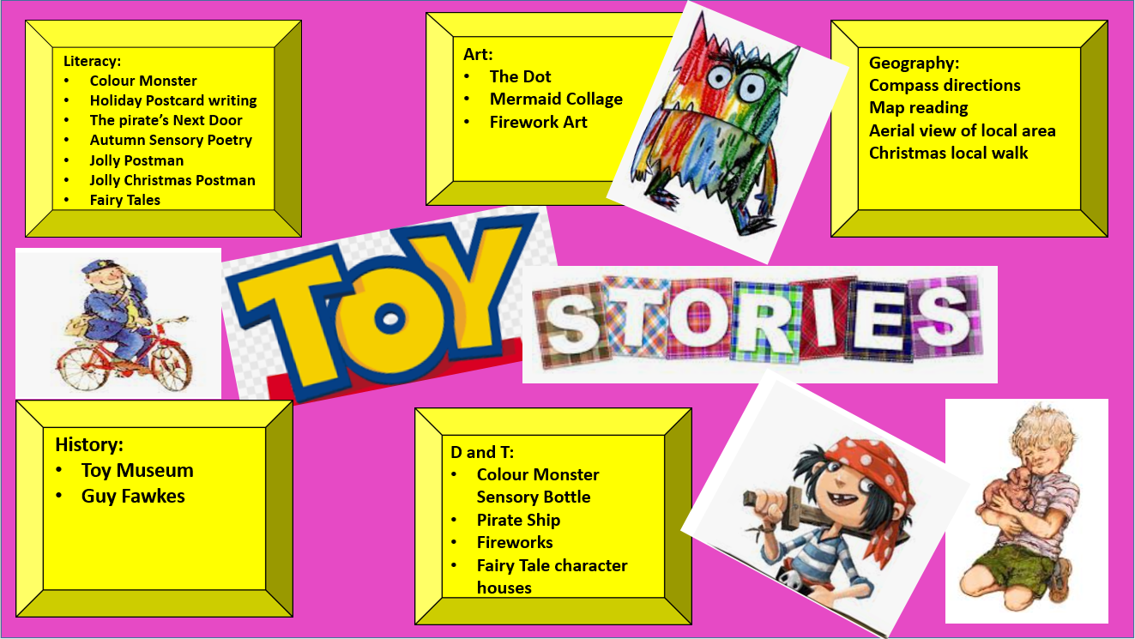

Slide 8

Reading
Please can you make sure your child brings their reading book in to school every day as we like to hear every child read individually once a week when we can. Please can the books be put into a zip lock plastic bag and put into the purple reading box. The box will be by the door.
Just to reassure you I will move them onto the next stage when they are ready.

Slide 9
General
There is fruit available for the children at snack time. If your child does not like fruit please provide and alternative savoury snack.
Please do remember to send a water bottle in each day.

Slide 10
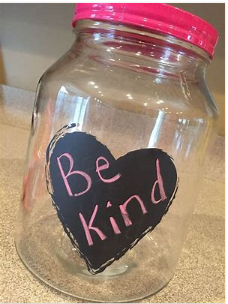
Finally…
There will always be an adult to greet you in the mornings from the year 1 team. Please feel free to communicate anything you feel we need to know that might be important. Especially if you feel your child might need extra emotional support that day for whatever reason and as long as we are aware we can adapt the day for them. I know and understand the challenges of being a parent and am also here for you if you ever need any support or a listening ear. If you are unable to speak to somebody please let the office know and they will pass the message on to me.
My core value as a teacher is nurture and therefore I set precedents to this as a foundation to good learning. My class rule is ‘kindness’ and the children have already spent the last two weeks learning how to be ‘kind’ when they play and learn. We have a class ‘kindness jar’ and the children are rewarded at the end of each week for filling this jar with acts of kindness. Please remind your child that if they need help on the playground they must go and speak to the adults in the yellow jackets. Children in year 1 are learning how to communicate with each other and what is appropriate behaviour and what is not. Every situation in class or on the playground is a learning opportunity both socially, emotionally and academically. In this class children will learn through understanding consequences of their actions. Please remind your children of our class rules. We incorporate these daily into our class routines. Kind hands! Kind feet! Kind words! And Kind Thoughts!
Thank you
Laura Grigulis
Notes:
. I work a lot with the childre.n on emotional literacy and especially because of the challenges that have been posed due to the time the children have had away from each other and school I put a lot of emphasis in my class on teaching positive social and communication skills. We do a lot of work on sharing, learning to play and listening to learn.

Slide 11


