Slide 2
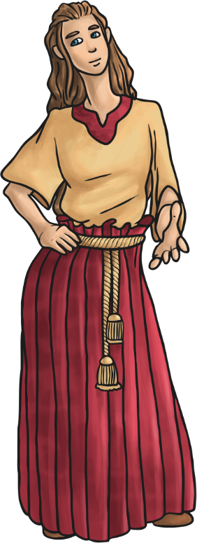
When Was the Bronze Age?
The Bronze Age in Britain began around 2100 BC and lasted for around 1500 years. It is part of a time we call prehistory because we have no written records. From evidence of the first early humans, the prehistoric era consists of three time periods:
The Stone Age – 800,000 BC
The Bronze Age – 2100 BC
The Iron Age – 750 BC
Because we don’t have any written records of life in the Bronze Age, archaeologists use artefacts to discover how people lived in the Bronze Age.
artefact - A human-made object from a historical time period.
archaeologist - Someone who studies the past by looking at artefacts.

Slide 3
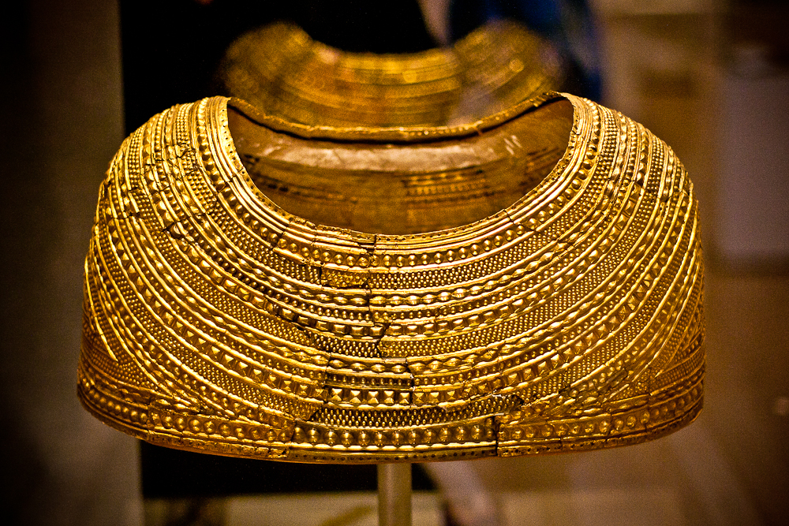
“Mold cape on display at the British Museum.” by Mark Ramsey is licensed under CC BY 2.0
What do you think this artefact is?
What do you think it is made of?
Who do you think might have owned it?
What do you think it might have been used for?

Slide 4
The Mold Cape
This very unusual cape was found in a burial site near Mold, Wales in 1833. It was discovered by workmen who were levelling a field. It was not found in one piece and has been reconstructed from the fragments that were found.
It was originally made from a single sheet of gold and is thought to be one of the finest examples of this type of prehistoric technique. Marks on the edges of the cape suggest that it was once attached to a lining (perhaps made of leather), which has since decayed.
It is believed that it may have been worn by a wealthy woman for ceremonial activities.
It is unlikely that it would have been very comfortable to wear. The cape would have made it difficult to move the upper arms and was likely not for everyday wear.

Slide 5
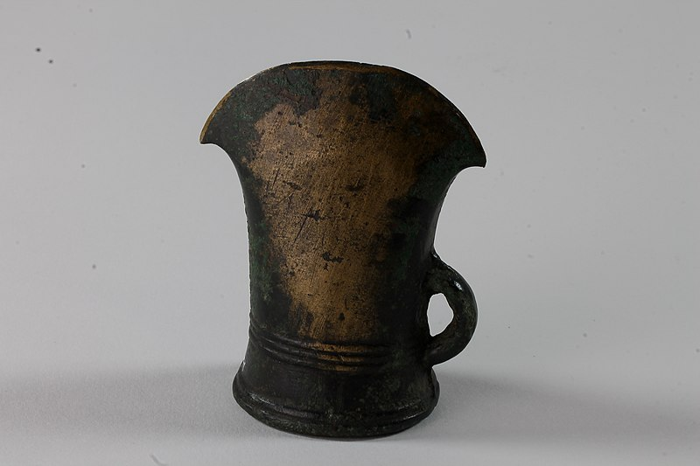
What could this artefact be?
What do you think it is made of?
How do you think it was made?
Do you think any parts of it are missing?

Slide 6
Bronze Age Flat Axe
This is an example of a Bronze Age flat axe head.
It was made from a bronze alloy.
People from the Bronze Age would have made it by pouring melted metal into a mould in a process called casting.
Originally, it would have been attached to a wooden handle probably by using pieces of leather to lash them together. The wooden handle has since decayed but the axe head itself has remained.

Slide 7
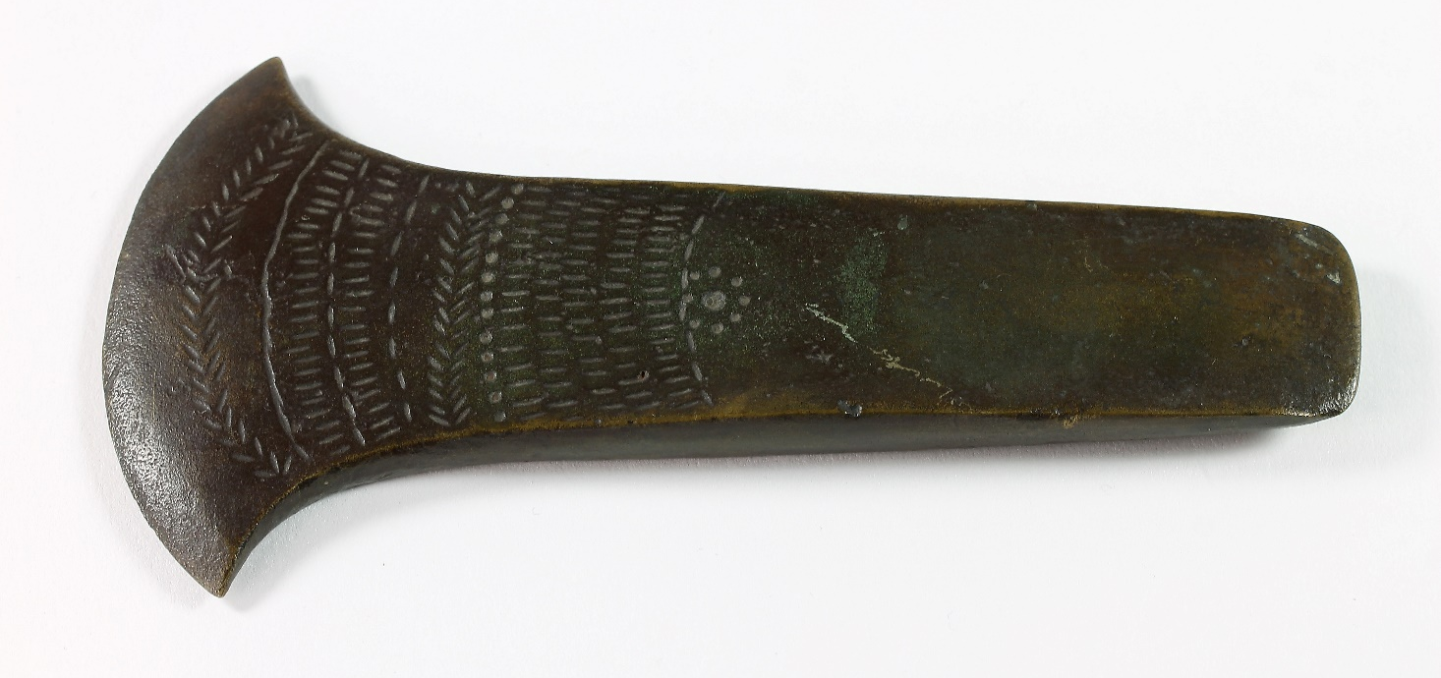
What do you think this artefact is?
How do you think it was made?
What do you think it might have been used for?
Do you think any parts of it are missing?

Slide 8
Bronze Age Socketed Axe
Axes became more sophisticated during the Bronze Age.
An axe head with a socket was developed so that the wooden handle would fit into it. A loop was also added so that they could be attached more securely and with more ease.
It is believed that this type of axe head was also made by casting bronze alloy materials.

Slide 9
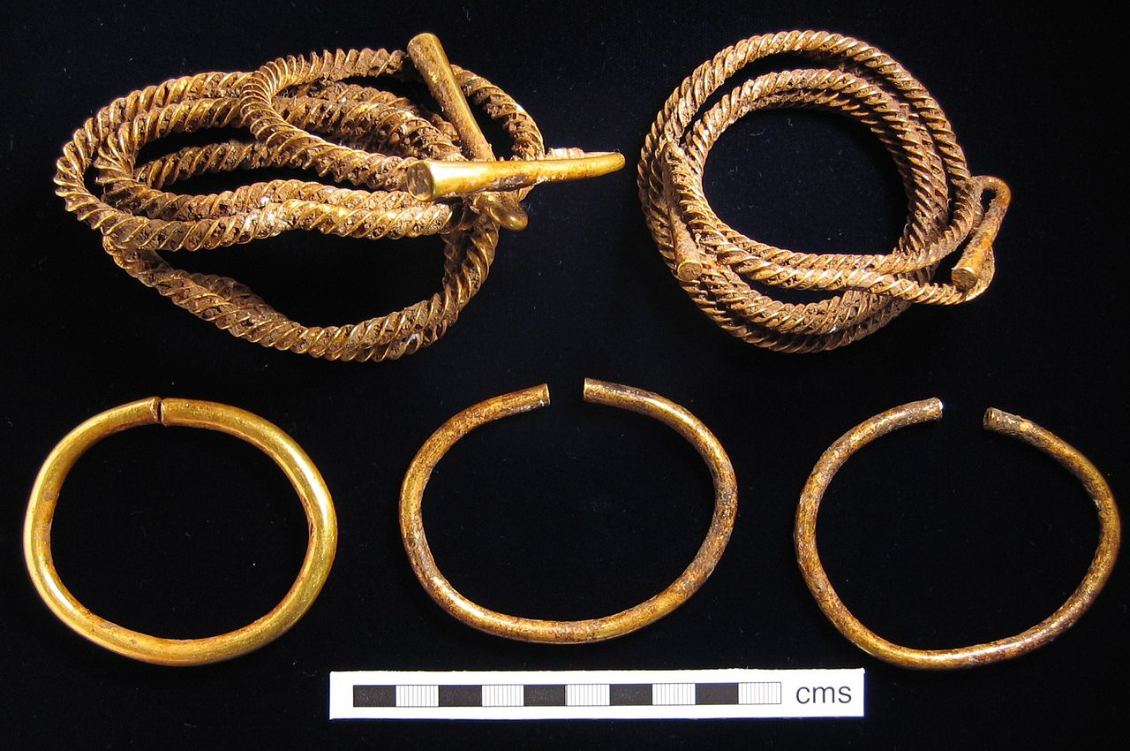
“Lambourne Hoard” by Portable Antiquities Scheme by is licensed under CC BY 2.0
What do you think these artefacts could be?
What do you think they are made of?
What do you think they were used for?
Who might have worn them?

Slide 10
Bronze Age Torc
These are examples of a type of jewellery known as a torc.
They came in different sizes so could be used as necklaces, bracelets or even belts.
Some torcs, such as those at the bottom of the picture, are quite plain but they can also be coiled, plaited or textured like the ones above.
“Lambourne Hoard” by Portable Antiquities Scheme by is licensed under CC BY 2.0

Slide 11
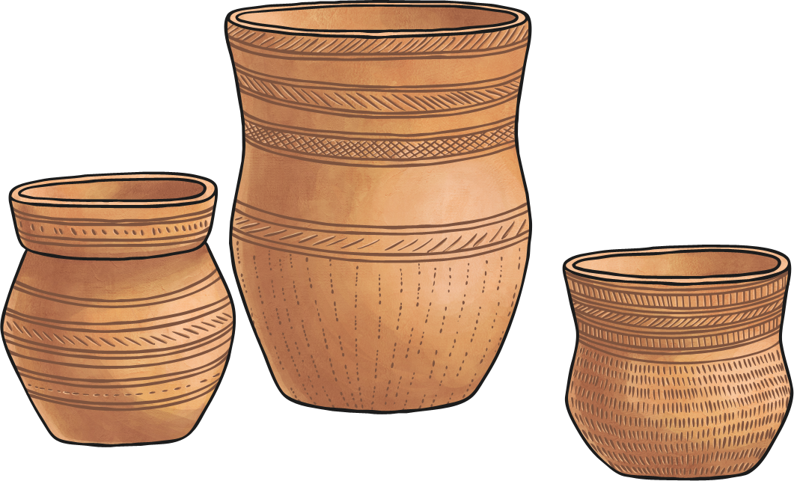
What material do you think these would have been made from?
How do you think the patterns on this were made?
What do you think it was used for?

Slide 12
Clay Beaker
This is an example of pottery made by the Bell Beaker people who are seen as an important link between the Stone Age and the Bronze Age.
Some people believe it was the Bell Beaker people who brought bronze to Britain.
The pots would have been used for cooking, drinking or storing food.
The marks in the clay would have been made using either wooden combs or rope and the more complicated the pattern, the wealthier the owner was.

Slide 13
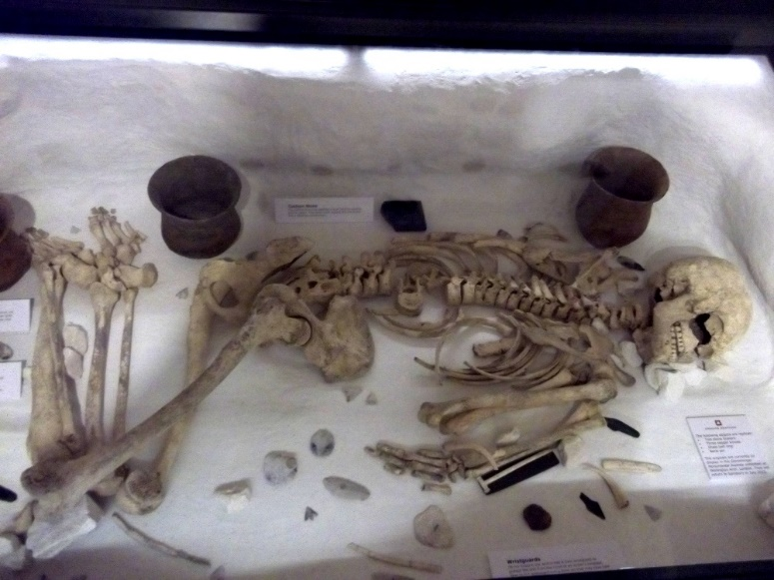
The Amesbury Archer
Many artefacts from the Bronze Age are examples of grave goods, which means that they were buried with people when they died. The grave of the Amesbury Archer was found near Stonehenge and is believed to be about 4000 years old. He was buried with many objects, including knives, tools, pottery and hair ornaments, along with archery and metal-working equipment. The metal objects buried with him are the oldest ever found in Britain.
Talk to Your Partner...
Why do you think the Amesbury Archer was such an important find?

Slide 14
Who Was the Amesbury Archer?
From studying his remains, archaeologists know that the Amesbury Archer was around 35-45 years old and had injured his knee, which meant he would have walked with a limp. By analysing his teeth, we know that he wasn’t from Britain but probably came from an area of Europe near the Alps, a mountain range which borders modern day countries such as Italy, France, Germany, Austria and Switzerland.
Did You Know…?
Archaeologists can tell lots from examining people’s teeth, including how old they were when they died, where they were from and what their diet was like.

