Slide 1
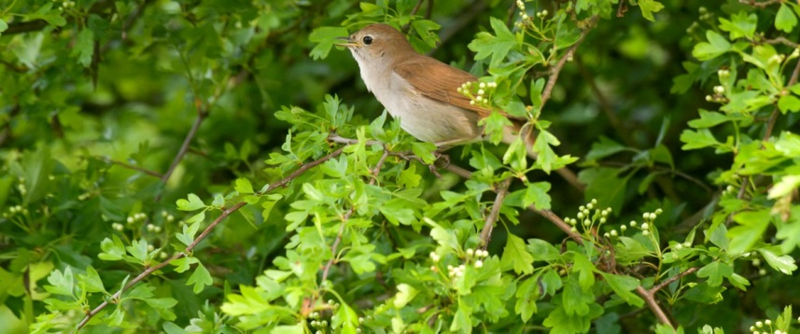
Welcome to Nightingale Class
September 2021
Mrs Ryker

Slide 2
General Information
The day for Year 3 runs from 8:55am until 3:10pm and lessons start and finish within these times. Obviously, we have some children starting earlier if they have younger siblings and leaving later if they have older siblings but we would ask that other than this, children are dropped off and picked up as promptly as possible (within the social distancing parameters on the school site).
If you would like to speak to me about your child please email or phone the office and I will then contact you.

Slide 3
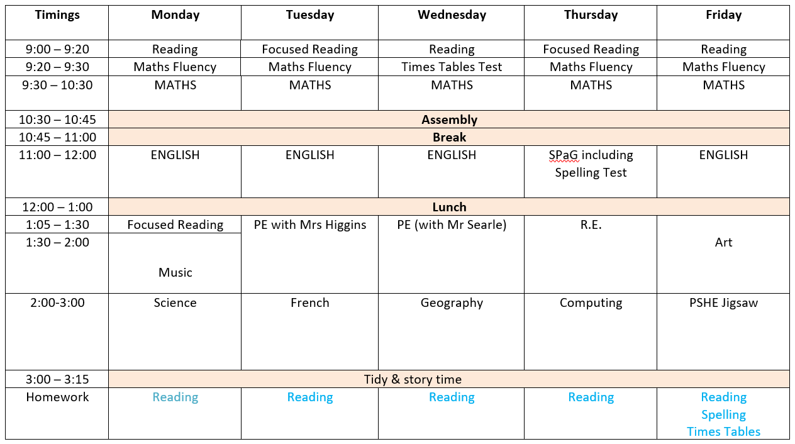

Slide 4
Reading
Each morning, as soon as the children get into class, they are expected to do independent reading or related tasks and the staff in the classroom listen to readers. They will be allocated a book from school according to their reading level. They can change these at school and we keep track of these. We would encourage children to read at home daily as part of the weekly homework – it can be you, a sibling, a grandparent, a childminder…
Twice a week, we have a ‘focused’ reading slot: during this time children will work on a whole class book. We aim to build up their comprehension skills and their skills as readers for enjoyment. Reading is a great way of understanding the world and reading to your child is as important as listening to your child read.

Slide 5
Writing
Key skills being covered:
  Spelling, grammar and punctuation
  Story writing and descriptive writing
  Poetry
  Non-fiction writing
    Non-chronological reports
    Recount texts
    Information texts
    Instruction texts

Slide 6
Maths
Building on all skills learnt in Key Stage 1 through White Rose Maths, with a focus on:
  Arithmetic and number fluency (including times tables)
  Problem solving & reasoning – proving their ideas in words
  Space, shape and measure (including telling the time)
Any practical reinforcement you can do at home is greatly appreciated e.g. finding opportunities to tell the time or work out how long until tea time; reciting times tables or counting in multiples of a given number when in the car. Use the KIRFs to support you in this.

Slide 7

The Creative Curriculum – providing a broad and balanced curriculum.
ENGLISH:
Exploring language and words focusing on key texts by Roald Dahl and also other texts linked to our History.
HISTORY:
Stone Age to Iron Age.
P.E.: Tag Rugby, Circuit Training, Dance linked to our History Topic.
SCIENCE:
Light and Darkness.
STONEs, BONES and GOBBLEFUNK!
COMPUTING:
Purple Mash:
Coding.
GEOGRAPHY:
Our European Neighbours. Human and physical features including culture and language.
Art:
Pencil skills/Primary Colours.
D.T.:
Design and make an instrument for an early Briton.
FRENCH:
Introduction to communicating in another language.
MUSIC:
The instruments of the orchestra; onomatopoeia for fireworks.

Slide 8
Homework
Ongoing – Reading, KIRFS and Year 3&4 Spellings
Daily Spellings – The children practise their spellings daily in class. The spellings are based on a combination of misspellings in their work and spellings they are learning in class.
Friday – Formal homework will comprise spellings for testing and a specific times table, tailored to your child.

Slide 9
What’s needed in school each day:
Water bottles, disposable lunch, small bags or rucksacks – these have to fit into the lockers!
PE kit to be worn into school on P.E days (Tuesdays and Wednesdays)
Wellies/outdoor shoes (these should be left on the rack outside the classroom) and a coat if required
Reading book – please do make sure that this comes in every day
Pencil case – this can stay in school throughout the week but when they are brought home please do keep an eye on the contents of your child’s pencil case as pencils/glue sticks etc. do need replacing from time to time. Also please encourage your child not to bring in anything too precious.
Fruit (fresh or dried) or fresh vegetable snack only.
NO NUTS OF ANY KIND PLEASE!

Slide 10
Expectations in Key Stage 2 (Years 3-6)
Role models to the younger children
Uniform – neat and correct. Labelled please!
Homework – prepared for weekly tests
Sensible, helpful and polite in class and around the school
Hard work but lots of fun too
Achieving our best – in thought, in word, in deed

Slide 11
Any questions?
At the moment it is sometimes possible to have a quick chat at the end of each day but if not, please do contact the office and I will make sure I get back to you as soon as possible.
Our Class Page on the website is regularly updated and is a good source of information, so please do check it as it has useful information on it:
www.cheapsideschool.org.uk/nightingales-year-3/
The website also has lots of other useful pages such as the Curriculum page under the Key Information tab and the Reading Zone under the Children tab.

