Slide 1

Lesson 3:
Computing Scheme of Work
Unit 2.3 - Spreadsheets
Using images and the ‘Speak’ and ‘Count’ Tools
Notes:
Resources
Unless otherwise stated, all resources can be found on the main unit 2.3 page. From here, click on the icon to set a resource as a 2Do for your class.
Finished counting machine spreadsheet: The children made these in year 1; this is to remind them what they have done before in 2Calculate. Set this as a 2Do for children to practice with.
Lesson 1 Example – Pencil Sharing

Slide 2


Aims
Slide 2
To insert clipart images to a spreadsheet.
To use the ‘move cell’ and ‘lock’ tools.
To use the ‘speak’ and ‘count’ tools in 2Calculate to count items.
Need more support? Contact us:
Tel: +44(0)208 203 1781 | Email: support@2simple.com | Twitter: @2simplesoftware
Notes:
Display slide 2 and outline the lesson aims.
*Children should be encouraged to open, save and edit files during this lesson.

Slide 3
Success Criteria
Slide 3
Children insert images and make them draggable.
Children can give images a value that the spreadsheet can use to count them.
Children can use the speak tool in conjunction with the count tool to count items.
Need more support? Contact us:
Tel: +44(0)208 203 1781 | Email: support@2simple.com | Twitter: @2simplesoftware
Notes:
Display slide 3 and outline the success criteria.

Slide 4
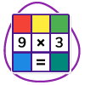
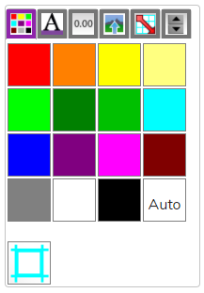
Introduction
Slide 4
Today you are going to use some of the 2Calculate tools to make a counting machine.
The first thing that you will need to know is how to colour cells.
Look at the toolbox, you can see the colours here in the first tab.
To colour cells, click on the cell or select a few cells in a block.
To select more than one cell click and drag mouse, or hold finger on a cell (on a tablet) and drag over the cells.
Then click on the colour you want in the toolbox.
Need more support? Contact us:
Tel: +44(0)208 203 1781 | Email: support@2simple.com | Twitter: @2simplesoftware
Notes:
Use slide 4 Use the icon to open 2Calculate to demonstrate.

Slide 5

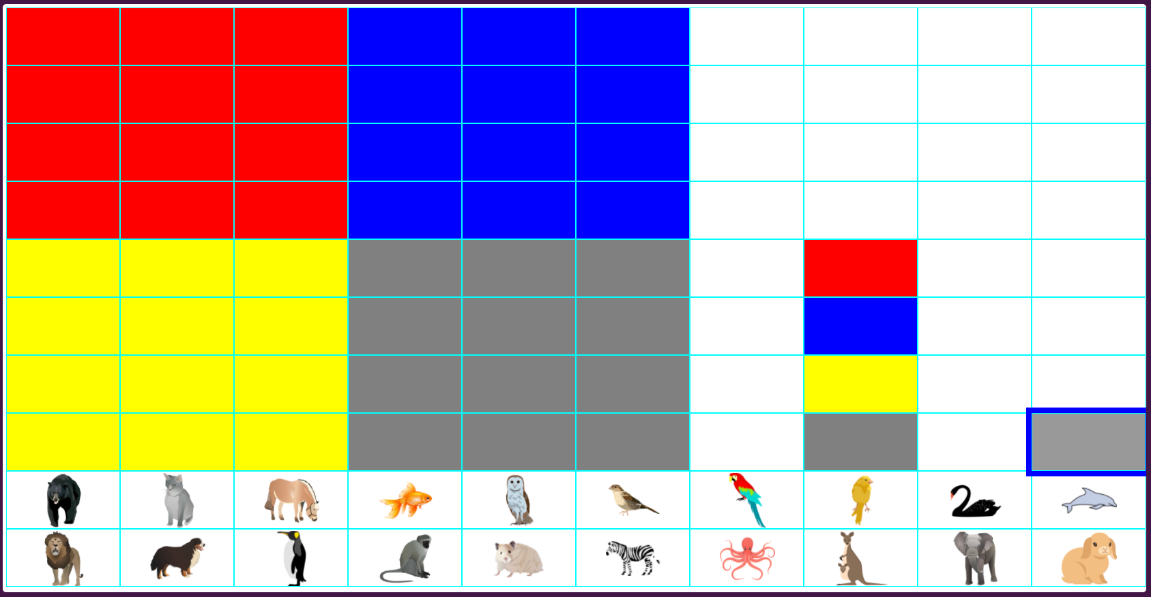
Activity 1 – Colour Cells
Slide 5
To begin your counting machine, open a new spreadsheet.
Use the button to add more cells so that there are ten columns in your spreadsheet.
Choose four colours that you can see the difference between.
Colour your spreadsheet like this example using your own choice of colours.
Save the spreadsheet once you have finished. A good name for it is Counting Machine.
Need more support? Contact us:
Tel: +44(0)208 203 1781 | Email: support@2simple.com | Twitter: @2simplesoftware
Notes:
Use slide 5 to explain the activity. Children should complete this stage. Alternatively, present all the stages and then ask children to complete them.

Slide 6

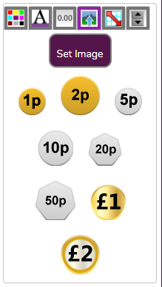

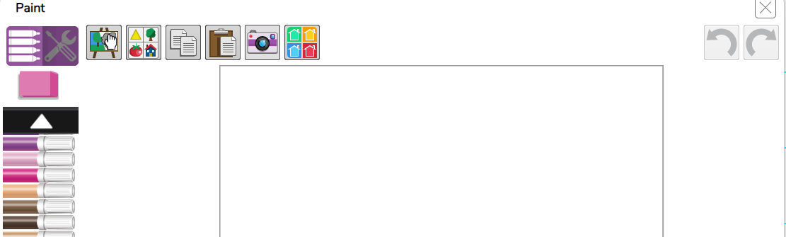
Adding Images
Slide 6
Look at the toolbox, can you see an icon for a tab that looks like this?
When you click on it, it opens a tab that looks like this
Click in a cell where you want an image.
To choose images, click on the button.
This opens the image picker where you can draw, or click this button for the clipart gallery.
Need more support? Contact us:
Tel: +44(0)208 203 1781 | Email: support@2simple.com | Twitter: @2simplesoftware
Notes:
Use slide 6 and demonstrate the process.

Slide 7
Activity 2 – Insert Images
Slide 7
Look at the example below. On the bottom two rows, animal images have been added.
Insert images into your spreadsheet in the same way.
Choose a mixture of birds, sea creatures, pets and wild animals.
Save the spreadsheet once you have finished, using the same name.
Need more support? Contact us:
Tel: +44(0)208 203 1781 | Email: support@2simple.com | Twitter: @2simplesoftware
Notes:
Use slide 7 to explain the activity. Children should complete this stage. Alternatively, present all the stages and then ask children to complete them.

Slide 8
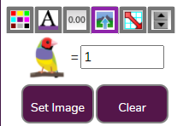
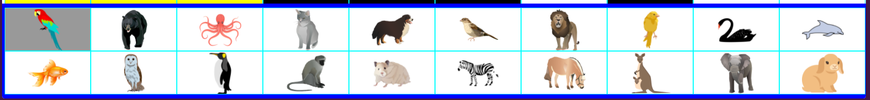
Giving Images a Value
Slide 8
To use these images in a counting machine, you need to give each image a value of 1.
This allows the program to count them.
Fortunately, they all need the same value so you can set the value for all images at once.
First, you have to select all of the images. To do this click (or press your finger) on the top left cell and then drag to the bottom right cell.
A blue border should show around them.
Now look in the toolbox and it should show one of your selected images. Where there is the = sign, type 1 in the box.
Need more support? Contact us:
Tel: +44(0)208 203 1781 | Email: support@2simple.com | Twitter: @2simplesoftware
Notes:
Use slide 8 and demonstrate the process. Children will need guidance and demonstration about how to select multiple cells.

Slide 9
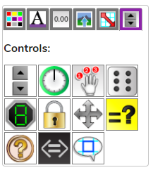

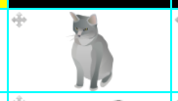
Draggable Images
Slide 8
To use these images in a counting machine, you need to make them draggable.
This means that you can drag the images around the screen.
If you try to drag them now, it will just select cells. Give this a go.
First, you have to select all of the images again.
A blue border should show around them like before.
Now look in the toolbox for the last tab and click on it. It opens the Control toolbox.
Click on this button to make the images draggable.
A symbol appears on each image to show that it is draggable. Try dragging them around now and you should be able to.
Need more support? Contact us:
Tel: +44(0)208 203 1781 | Email: support@2simple.com | Twitter: @2simplesoftware
Notes:
Use slide 9 and demonstrate the process. Children will need guidance and demonstration about how to select multiple cells and how to test that it works.

Slide 10
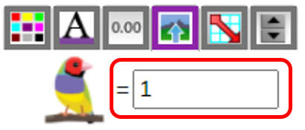
Activity 3 – Draggable images
Slide 10
Give your images a value of 1.
Make all of the images draggable
Save the spreadsheet once you have finished, using the same name.
Need more support? Contact us:
Tel: +44(0)208 203 1781 | Email: support@2simple.com | Twitter: @2simplesoftware
Notes:
Use slide 10 to explain the activity. Children should complete this stage. Alternatively, present all the stages and then ask children to complete them.

Slide 11
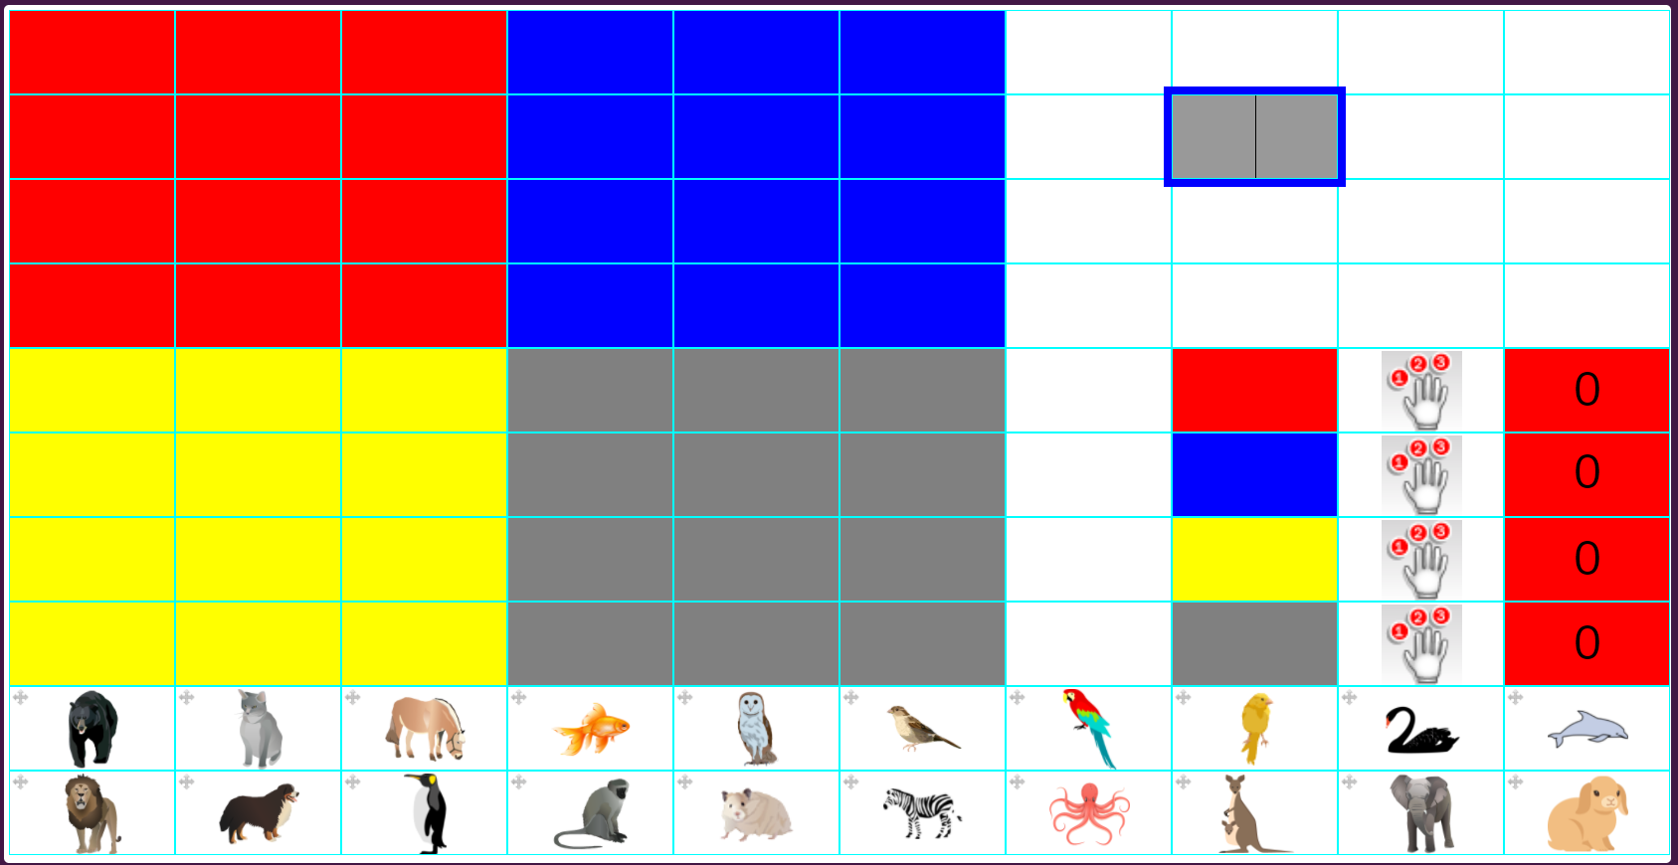
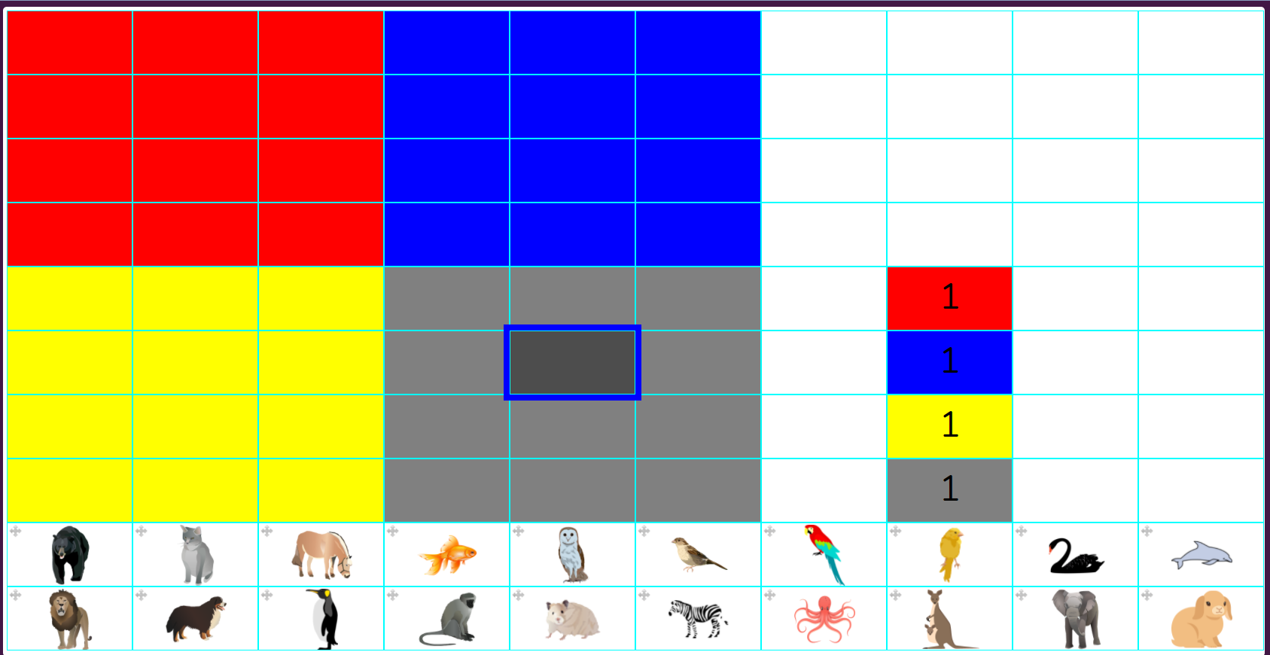


A Counting Machine
Slide 11
The counting machine is going to count the number of animals on each coloured background.
Here is how to make it:
Find where you have a copy of each of the colours on the spreadsheet. Type a number 1 into each of these cells, like this:
OPTIONAL
Use the text toolbox to recolour the text so that you can’t see the 1s.
Look in the Control toolbox for the Count tool. The icon looks like this:
This needs to be put in the cell next to these coloured cells like the picture above.
Need more support? Contact us:
Tel: +44(0)208 203 1781 | Email: support@2simple.com | Twitter: @2simplesoftware
Notes:
Use slides 11-12 and demonstrate the process. Hiding the visible numbers is optional.

Slide 12
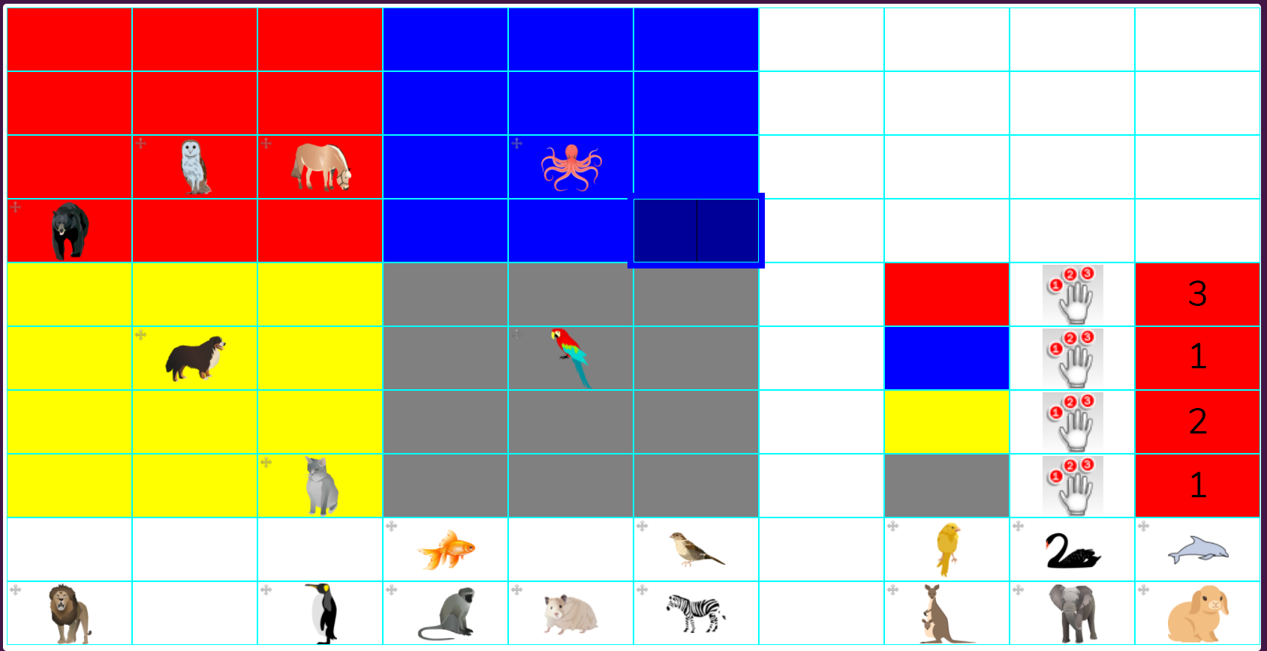
A Counting Machine
Slide 12
Drag an animal into one of the large coloured areas: The count tool should say 1 for that colour.
Try for a few more animals.
Need more support? Contact us:
Tel: +44(0)208 203 1781 | Email: support@2simple.com | Twitter: @2simplesoftware
Notes:
Use slides 11-12 and demonstrate the process. Hiding the visible numbers is optional.

Slide 13
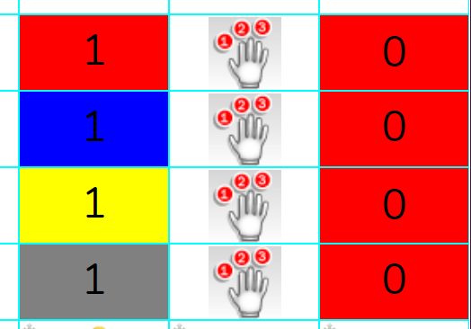
Activity 4 – Counting
Slide 13
Create the counting part of your file:
1) Type 1 into the cells.
2) Put a counting tool in the cells to the right.
3)Test by dragging some animals
4) Save
Need more support? Contact us:
Tel: +44(0)208 203 1781 | Email: support@2simple.com | Twitter: @2simplesoftware
Notes:
Use slide 13 to explain the activity. Children should complete this stage. Alternatively, present all the stages and then ask children to complete them.

Slide 14
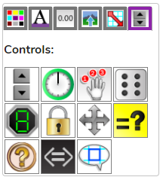

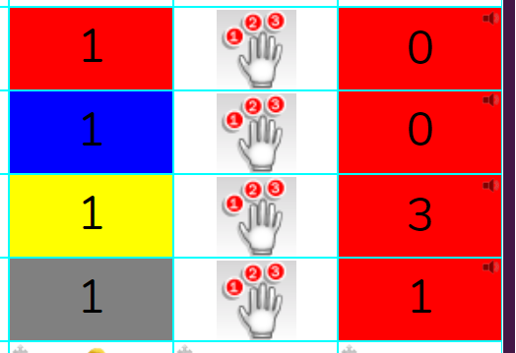
A Speaking Counting Machine
Slide 14
The counting machine can even speak*. Select the cells with the answers in them.
Open the Control Toolbox and look for the icon, click on this.
Now try your counting machine again.
You can click on the small speaker symbol to read the number.
*Your device must have its sound switched on.
Need more support? Contact us:
Tel: +44(0)208 203 1781 | Email: support@2simple.com | Twitter: @2simplesoftware
Notes:
Use slide 14 and demonstrate the process.

Slide 15
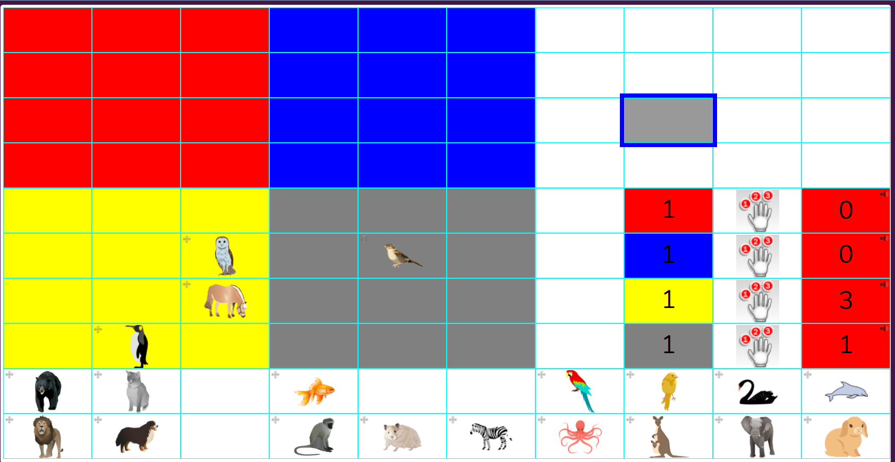
Activity 5 – Using your machine
Slide 15
Use your counting machine to sort the animals into groups.
One suggestion is:
Birds
Sea animals
Wild animals
Pets
Need more support? Contact us:
Tel: +44(0)208 203 1781 | Email: support@2simple.com | Twitter: @2simplesoftware
Notes:
Use slide 15 to explain the activity. Children should complete this stage. Alternatively, present all the stages and then ask children to complete them.

Slide 16
Review Success Criteria
Slide 16
I can insert images and make them draggable.
I can give images a value that the spreadsheet can use to count them.
I can use the speak tool and the count tool to count items.
Need more support? Contact us:
Tel: +44(0)208 203 1781 | Email: support@2simple.com | Twitter: @2simplesoftware
Notes:
Use slide 16 to evaluate success of meeting success criteria and how well they felt they were able to achieve the 3 activities.

