Slide 2
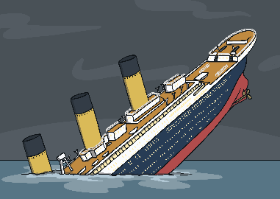
What year did the Titanic sink?
A
1923
B
1912
C
1900
Next

Slide 3
Which company owned the Titanic?
A
The White Star Line
B
The Blue Oval Express
C
The Red Hexagon Liners
Next

Slide 4
Where was the Titanic built?
A
Southampton
B
New York
C
Belfast
Next

Slide 5
Where was the
Titanic travelling from?
A
Southampton
B
New York
C
London
Next

Slide 6
Where was the Titanic travelling to?
A
Paris
B
New York
C
London
Next

Slide 7
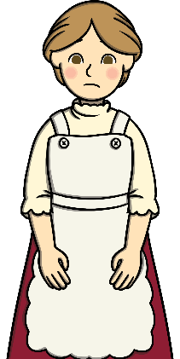
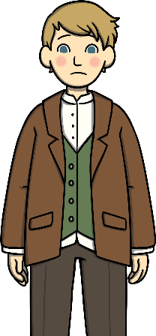
Third class passengers were also known as…
A
Underage passengers
B
Leverage passengers
C
Steerage passengers
Next

Slide 8
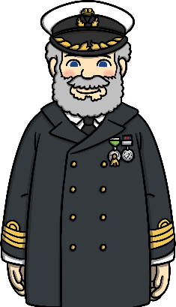
What was the name of the Titanic’s captain?
A
Captain Hawkins
B
Captain Smith
C
Captain Wright
Next

Slide 9
Who was the Captain of the Californian?
A
Captain Lord
B
Captain Turner
C
Captain Wright
Next

Slide 10
Captain Lord didn’t go to the assistance of the Titanic. Why?
A
He turned off his radio and ignored rockets in the sky
B
He didn’t like Captain Smith
C
His ship couldn’t carry anyone
Next

Slide 11

Why were the lifeboats an issue?
A
There were not enough lifeboats
to hold all the passengers and crew
B
The lifeboats had holes in them
C
There were no lifeboats
Next

Slide 12
Where is the Titanic today?
A
It was lifted from the ocean floor and put into a museum
B
It was never found
C
On the ocean floor
Next

