Slide 1

Lesson 4:
Computing Scheme of Work
Spreadsheets Crash Course for Year 2
Creating a Table and Block Graph
Notes:
Resources
Unless otherwise stated, all resources can be found on the main unit 2.3 page. From here, click on the icon to set a resource as a 2Do for your class.
Ice Cream Choice example file.
Challenge files 1 (School / TV).
Challenge files 2 (School/TV).

Slide 2


Aims
Slide 2
To add and edit data in a table layout.
To use the data to manually create a block graph.
Need more support? Contact us:
Tel: +44(0)208 203 1781 | Email: support@2simple.com | Twitter: @2simplesoftware
Notes:
Display slide 2 and outline the lesson aims.
*Children should be encouraged to open, save and edit files during this lesson.

Slide 3
Success Criteria
Slide 3
Children can create a table of data on a spreadsheet.
Children can use the data to create a block graph manually.
Need more support? Contact us:
Tel: +44(0)208 203 1781 | Email: support@2simple.com | Twitter: @2simplesoftware
Notes:
Display slide 3 and outline the success criteria.

Slide 4


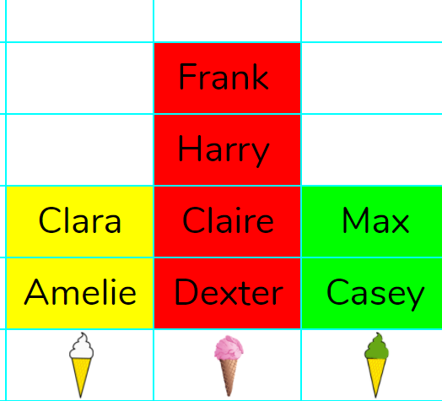
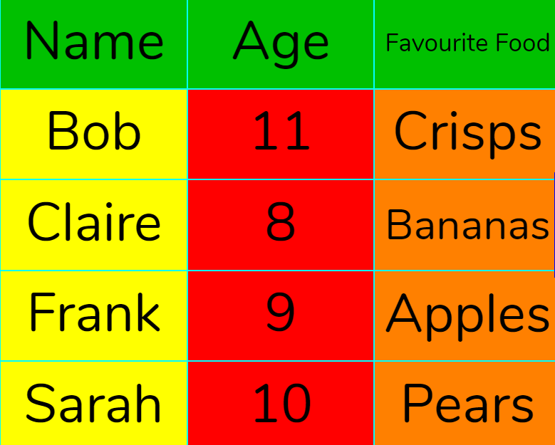
Introduction
Slide 4
You will have seen the word data used in previous lessons; can you explain what data is?
Data: A collection of information, collected by observation, questions or measurement.
Today, you will be collecting information (data) to put into a spreadsheet.
You will start with favourite ice cream flavours.
First, you will put the data into a table. In a spreadsheet, what is a table?
Then, you will use the table to create a block graph.
Block graph: A visual chart which displays data with blocks.
Table: An organised display of information laid out in rows and columns.
Need more support? Contact us:
Tel: +44(0)208 203 1781 | Email: support@2simple.com | Twitter: @2simplesoftware
Notes:
Use slide 4. Clicking reveals answers and introduces further vocabulary that children will be using today. Check that children have an understanding of the words.

Slide 5
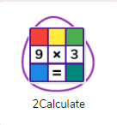
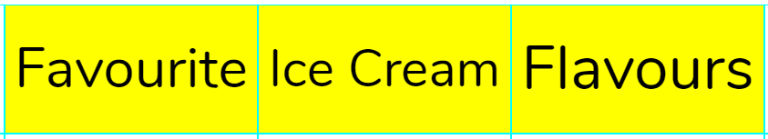
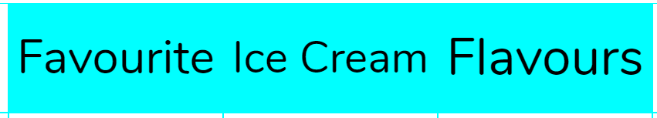


Activity 1: Give the Data a Title
Slide 5
Your title lets the person looking at the spreadsheet know what the data is about.
It is usually at the top of the sheet.
In 2Calculate, you might want to use a cell for each word to make the title big.
Use a suitable colour to make your title stand out.
The process for the next stage depends upon your device type so use the buttons below to go to the correct slide.
Tablet
Desktop or Laptop
Need more support? Contact us:
Tel: +44(0)208 203 1781 | Email: support@2simple.com | Twitter: @2simplesoftware
Notes:
Demonstrate using slides 5. Children could then complete this stage on their own devices. Clicking the icon on the slide will launch 2Calculate to demonstrate.
*The process is device dependent so select either desktop of iPad icon to go to the relevant next slides.

Slide 6
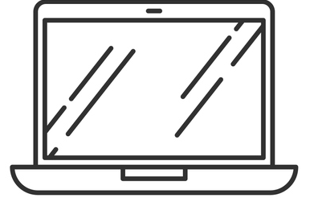
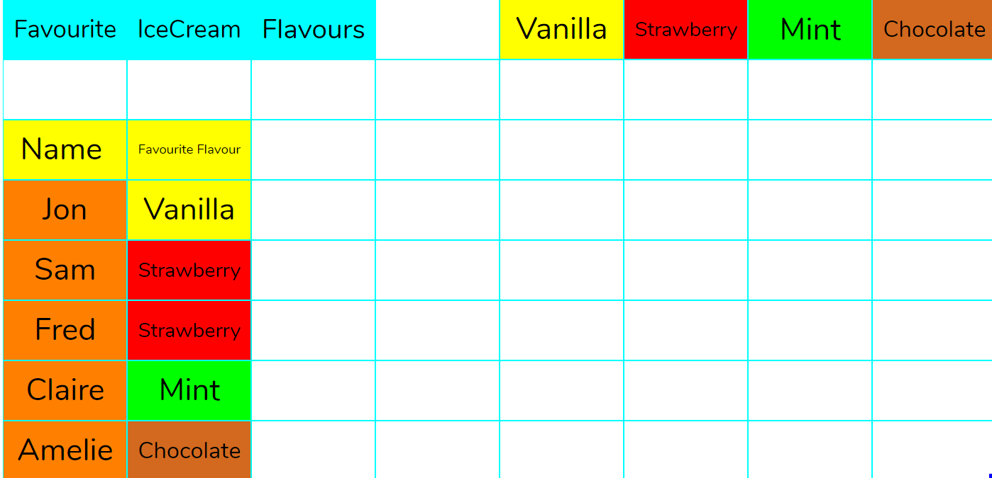
Activity 2: Creating Labelled Columns and Entering Data
Slide 6
Label the first column Name.
Label the second column Favourite Flavour.
Ask a few friends their favourite flavour and write it next to their name.
Need more support? Contact us:
Tel: +44(0)208 203 1781 | Email: support@2simple.com | Twitter: @2simplesoftware
Notes:
Use slide 6 (slide 8 iPads) to support children in creating labelled columns and entering data.

Slide 7

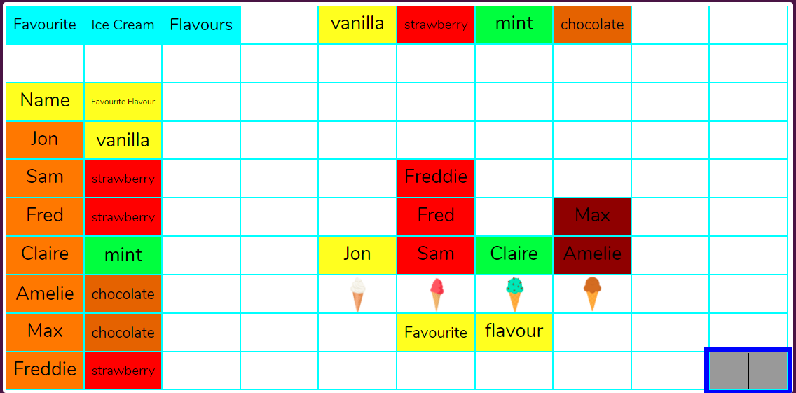
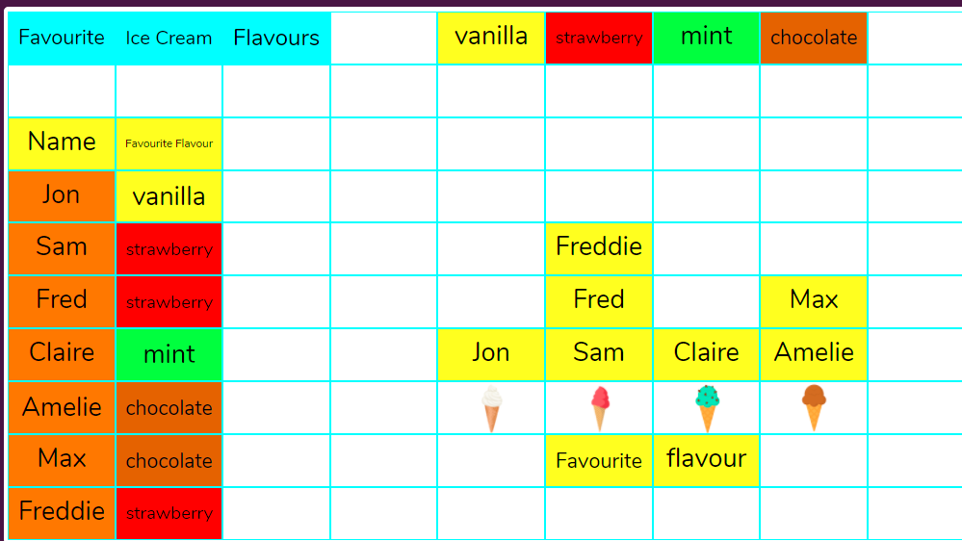
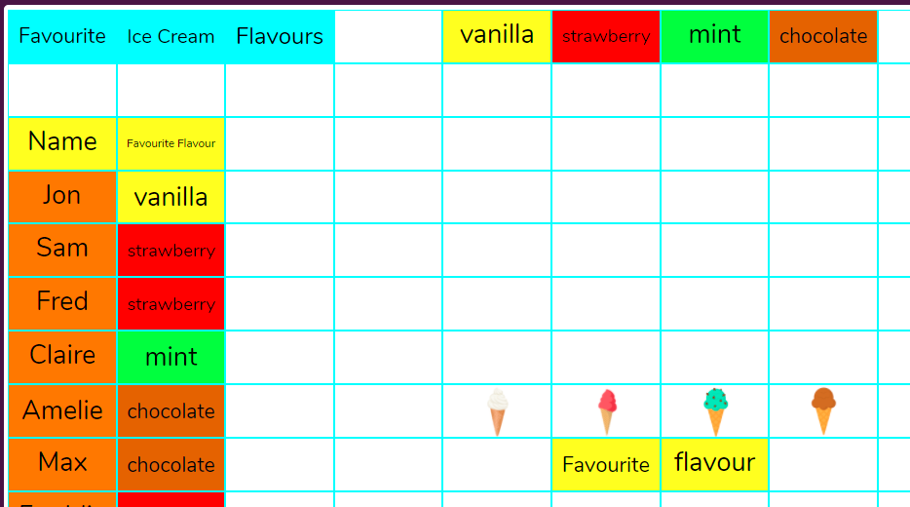
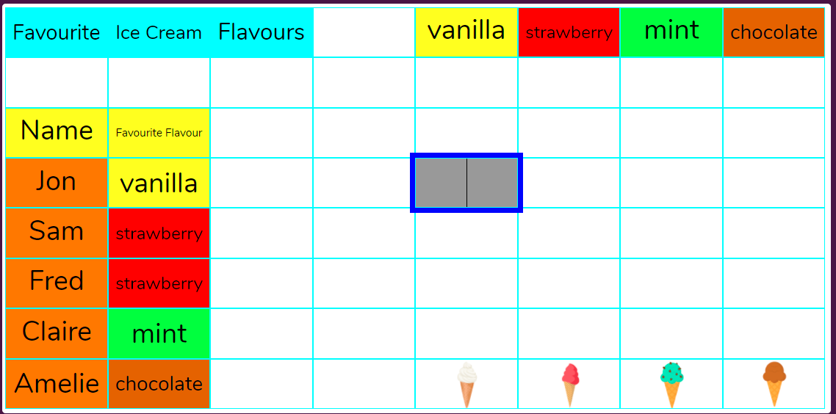
Activity 3: Making the Graph
Slide 7
Next slide
Create a few labels with the chosen ice cream flavours at the top e.g. vanilla, chocolate, strawberry, mint.
Insert ice cream images representing the appropriate flavour at the bottom of the sheet.
Remember, you can make more rows if you need to by using the button.
*You can find pictures of ice cream in the food clipart and then colour it to match the flavour.
Can you answer some questions about your graph?
What is the least/most popular flavour?
How many children like strawberry?
Add a label at the bottom.
Type the data (people’s names) in the cells above each flavour to make the graph.
Change cell colours to match the flavours.
Need more support? Contact us:
Tel: +44(0)208 203 1781 | Email: support@2simple.com | Twitter: @2simplesoftware
Notes:
Use slide 7 (slide 9 iPads) to show children how to add images and manipulate them in order to show different flavours. Children should add labels and colour code cells to match flavours on their devices.

Slide 8
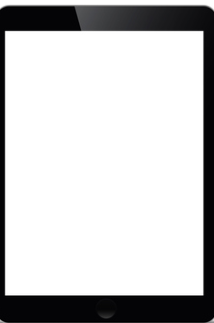
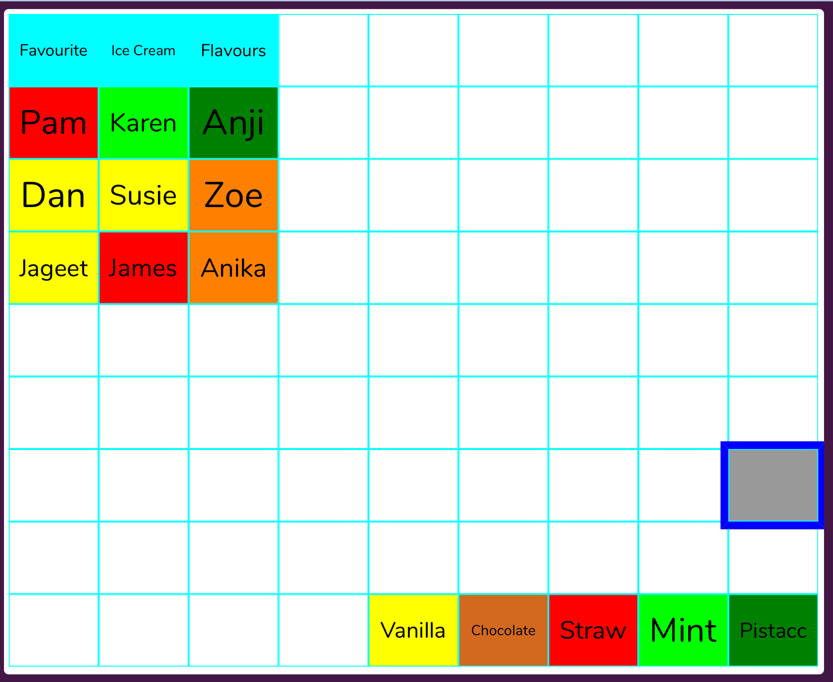
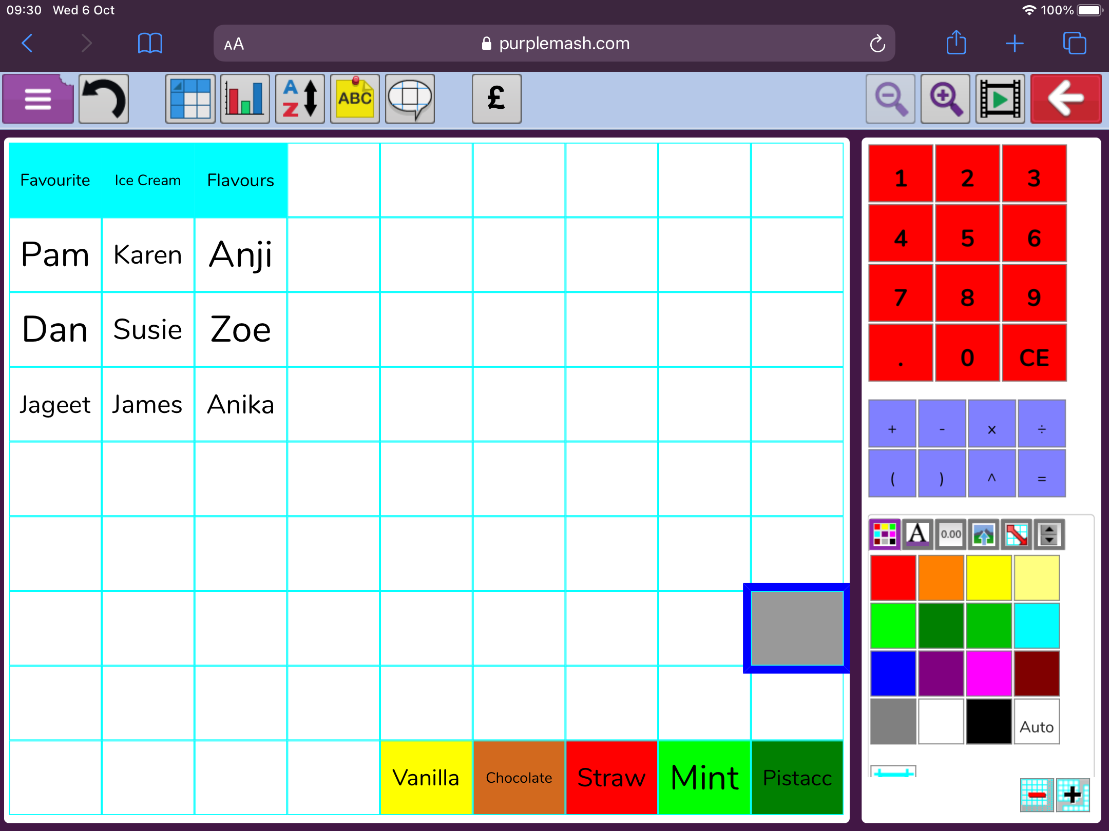
Activity 2: Creating Labelled Columns and Entering Data
Slide 8
Enter the names of children in your class.
Create a few labels with ice cream flavours into separate cells at the bottom right (9th row). The example shows vanilla, chocolate, strawberry, mint and pistachio.
Ask the children in your class their favourite flavour and colour the name cells to match the flavour.
Need more support? Contact us:
Tel: +44(0)208 203 1781 | Email: support@2simple.com | Twitter: @2simplesoftware
Notes:
Use slide 6 (slide 8 iPads) to support children in creating labelled columns and entering data.

Slide 9

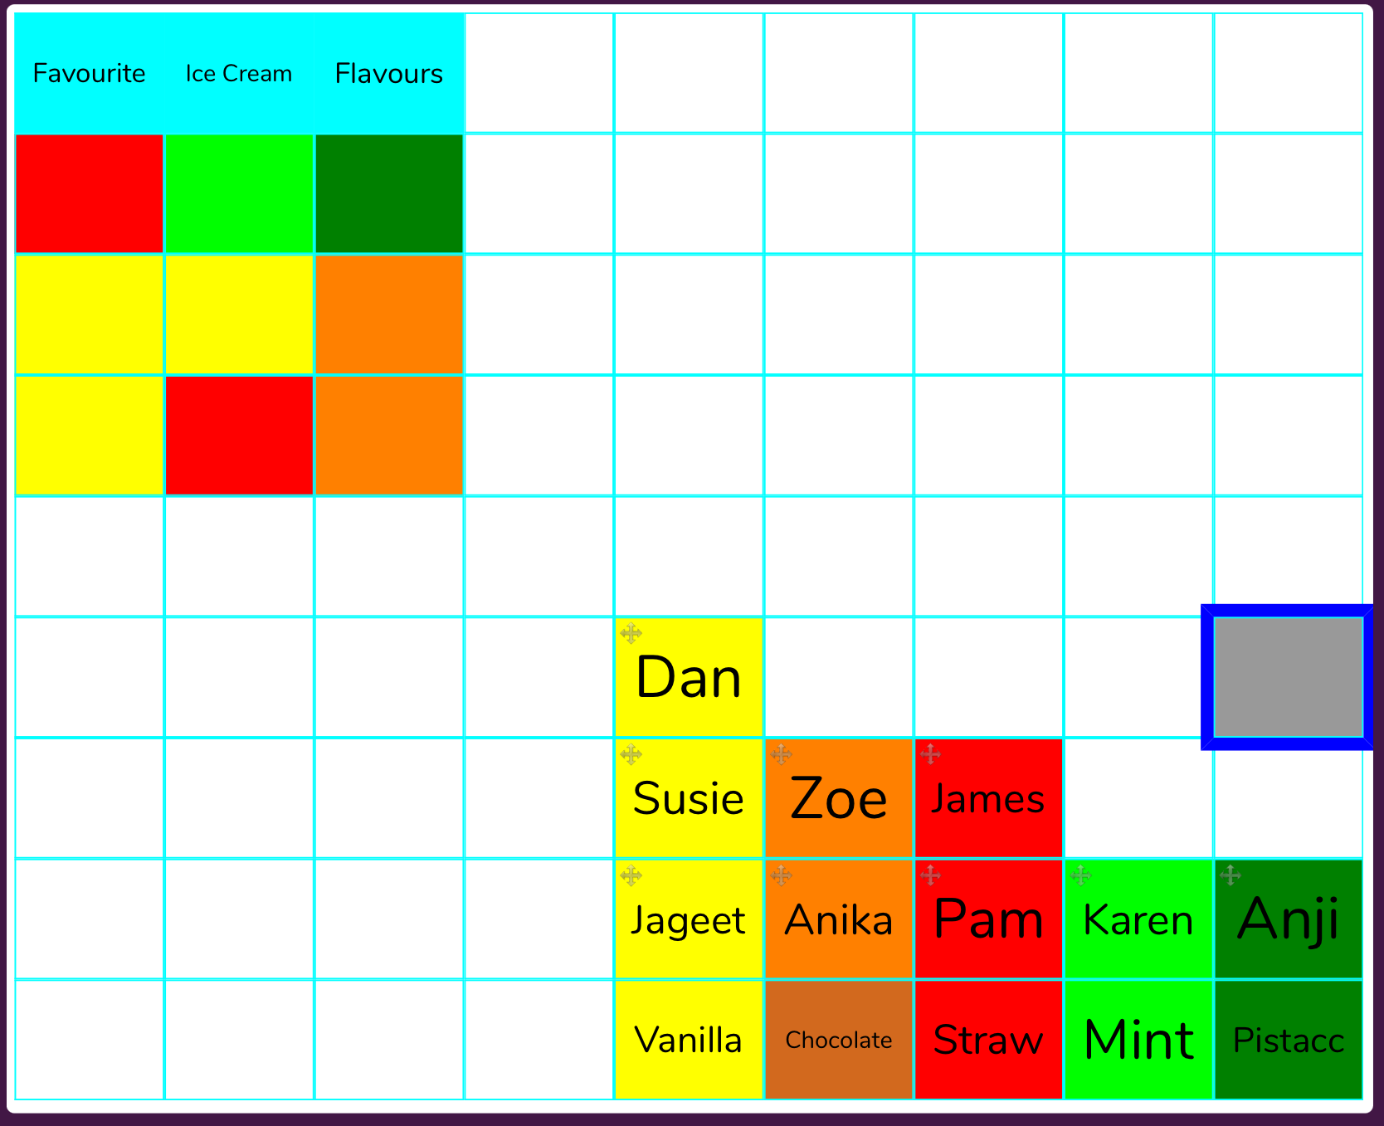
Activity 3: Making the Graph
Slide 9
To start making the block graph, you need make the children’s names moveable.
Select the children’s names by dragging your finger over the name cells.
In the Control Toolbox on the right, find the moveable tool and click it.
Drag the names to the correct flavours.
Can you answer some questions about your graph?
What is the least/most popular flavour?
How many children like strawberry?
Need more support? Contact us:
Tel: +44(0)208 203 1781 | Email: support@2simple.com | Twitter: @2simplesoftware
Notes:
Use slide 7 (slide 9 iPads) Demonstrate using the move tool to drag names to make a graph due to screen size limitations.

Slide 10
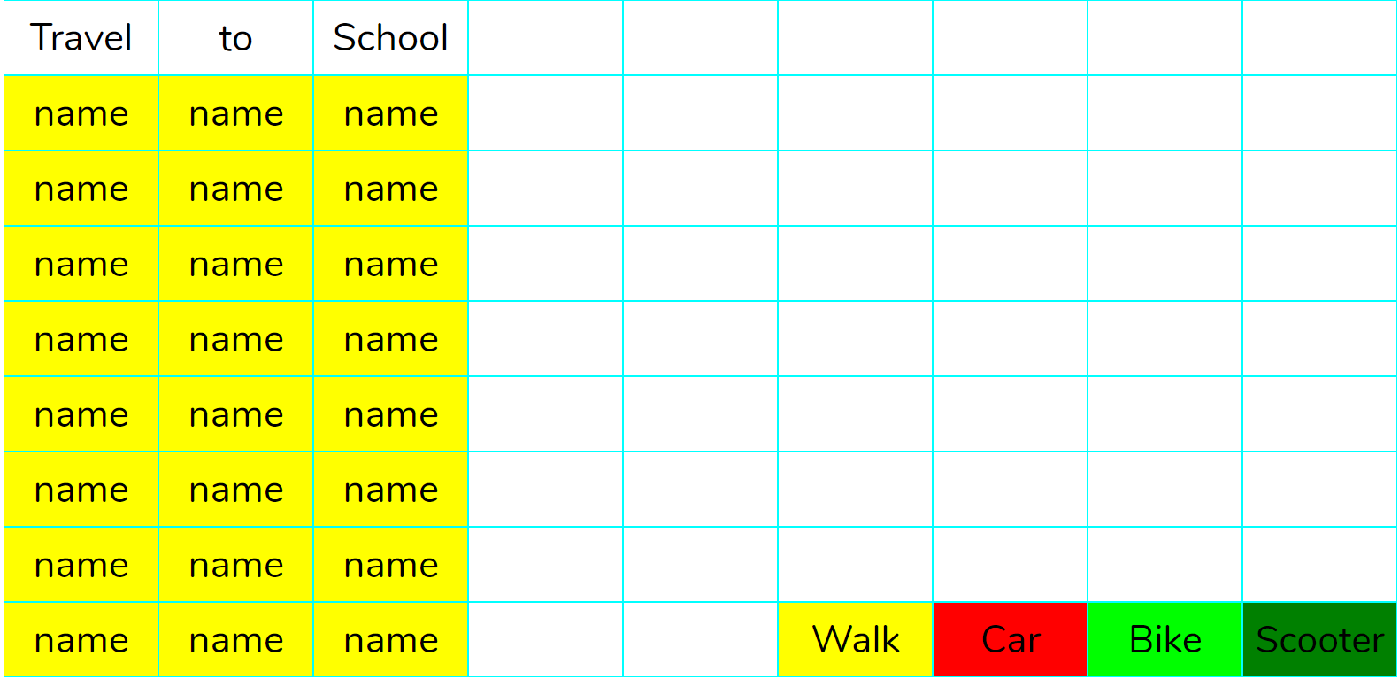
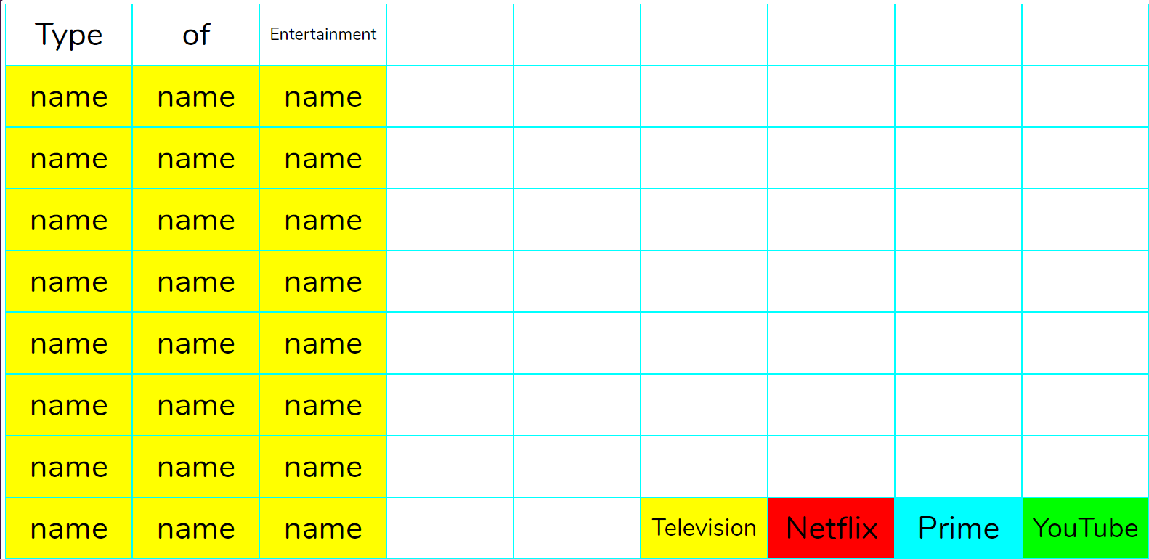
Extension
Slide 10
Can you create block graphs from these files by collecting data?
Need more support? Contact us:
Tel: +44(0)208 203 1781 | Email: support@2simple.com | Twitter: @2simplesoftware
Notes:
Display slide 10. Explain to children that they are to attempt to collect data using the two tables given and convert into block graph (Launch the example files on the slide).

Slide 11
Review Success Criteria
Slide 11
I can create a table of data on a spreadsheet.
I can use the data to create a block graph manually.
Need more support? Contact us:
Tel: +44(0)208 203 1781 | Email: support@2simple.com | Twitter: @2simplesoftware
Notes:
Use slide 11 to evaluate success of meeting success criteria and how well the children felt they were able to achieve the activities.

