Slide 1

Lesson 2:
Computing Scheme of Work
Unit 2.4 – Questioning
Asking Yes / No Questions
Notes:
RESOURCES
Unless otherwise stated, all resources can be found on the main unit 2.4 page. From here, click on the icon to set a resource as a 2do for your class. Use the links below to preview the resources; right-click on the link and ‘open in new tab’ so you do not lose this page.
Purple Mash Avatar Game(print for children).
Scissors

Slide 2


Aim
Slide 2
To use yes/no questions to separate information.
Need more support? Contact us:
Tel: +44(0)208 203 1781 | Email: support@2simple.com | Twitter: @2simplesoftware
Notes:
Display slide 2 and outline the lesson objectives.

Slide 3
Success Criteria
Slide 3
Children have used a range of yes/no questions to separate different items.
Need more support? Contact us:
Tel: +44(0)208 203 1781 | Email: support@2simple.com | Twitter: @2simplesoftware
Notes:
Display slide 3 and outline the success criteria.

Slide 4
Sorting Objects
Slide 4
Need more support? Contact us:
Tel: +44(0)208 203 1781 | Email: support@2simple.com | Twitter: @2simplesoftware
Notes:
Display Slide4. Show the children the different shapes on the slide. Show how we can use simple questions with a yes/no answer to separate them e.g.
Is the shape red?
Does the shape have 4 sides?

Slide 5
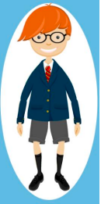
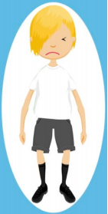


Sorting Characters
Slide 5
Need more support? Contact us:
Tel: +44(0)208 203 1781 | Email: support@2simple.com | Twitter: @2simplesoftware
Notes:
Display slide 5. Show the children four characters from the Purple Mash avatars. Choose one. Explain how we can use a range of yes/no questions to separate the avatars so we can select one. Discuss how we can ask questions relating to hair colour, hats, glasses etc

Slide 6
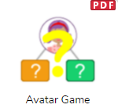












Activity 1: Which Character?
Slide 6
Need more support? Contact us:
Tel: +44(0)208 203 1781 | Email: support@2simple.com | Twitter: @2simplesoftware
Notes:
Display slide 6. Hand the children a copy of the Purple Mash Avatar Game. The children cut up the 12 images and then they play a game like Guess Who? Remind the children they can only use questions with a yes/no answer.
Clicking the icon will open the file on the board for demonstration.

Slide 7
Activity 2: Extension – Smarter Questions
Slide 7
Need more support? Contact us:
Tel: +44(0)208 203 1781 | Email: support@2simple.com | Twitter: @2simplesoftware
Notes:
Display slide 7. How many YES / NO questions needed to be asked before an answer was reached?
Can pupils improve on this by thinking about and improving the questions that they ask?
What type of questions work well?
Look at the need to split the pictures into two.
Repeat the game and find the fewest number of questions needed to find an answer.

Slide 8
Review Success Criteria
Slide 8
I have used a range of yes/no questions to separate different items.
Need more support? Contact us:
Tel: +44(0)208 203 1781 | Email: support@2simple.com | Twitter: @2simplesoftware
Notes:
Display slide 8. the success criteria from slide 3. Pupils could rate how well they achieved this using a show of hands.

