Slide 1
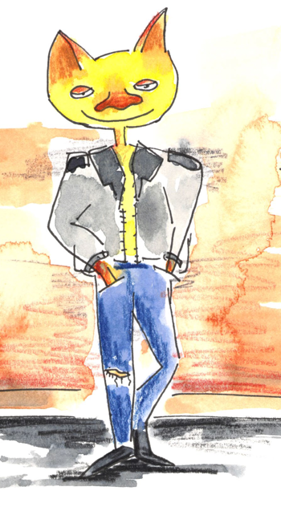
Punctuating Sentences
Learning how to start and end sentences of different types.

Slide 2
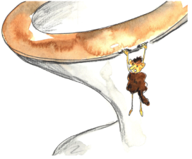
Punctuating Sentences
Statements
A statement tells us something.
A monster appeared beside the toilet.
A statement ends with a full stop.
It was hanging off the seat.
A statement starts with a capital letter.
The monster did not look scary.
Check out the capital letters and full stops in all three sentences here.

Slide 3
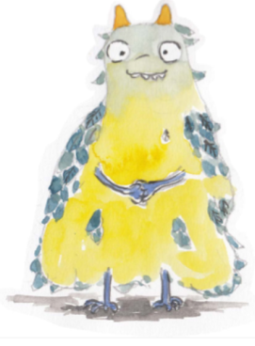
Punctuating Sentences
Add correct punctuation to each sentence.
Statements
we love yellow monsters
this monster has two horns
the monster smiled at me

Slide 4

Punctuating Sentences
Add correct punctuation to each sentence.
Statements
We love yellow monsters.
This monster has two horns.
The monster smiled at me.

Slide 5
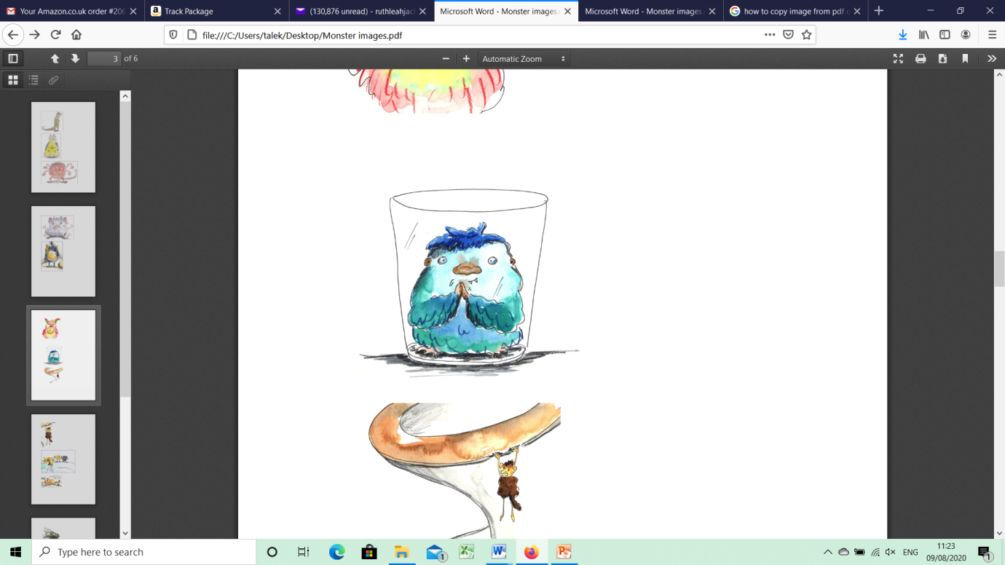
Punctuating Sentences
Questions
A question asks something.
Why is there a monster in my glass?
A question asks something.
Where has the water gone?
A question asks something.
Does this monster look happy?
Check out the capital letters and question marks in all three sentences here.

Slide 6
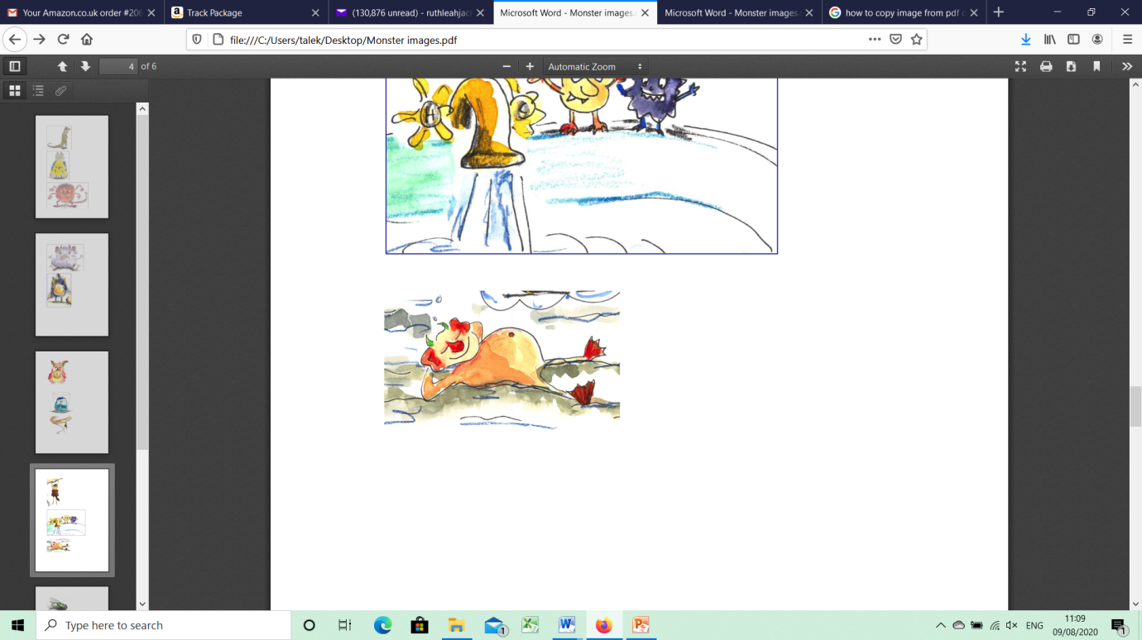
Punctuating Sentences
Add correct punctuation to each sentence.
Questions
is the monster asleep
what is he thinking about
why is he smiling

Slide 7
Punctuating Sentences
Add correct punctuation to each sentence.
Questions
Is the monster asleep?
What is he thinking about?
Why is he smiling?

Slide 8
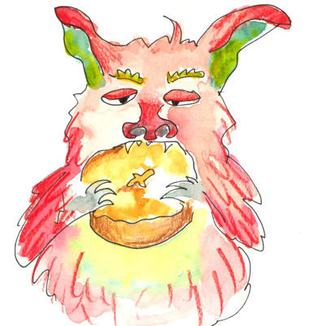
Punctuating Sentences
Exclamations
An exclamation begins ‘What’ or ‘How’
What a shame! How dreadful!
Exclamations end with an exclamation mark
What a pity the monster ate your bun!
Exclamations start with a capital letter
How annoying that monster is!
Check out the capital letters and exclamation marks in all three sentences here.

Slide 9
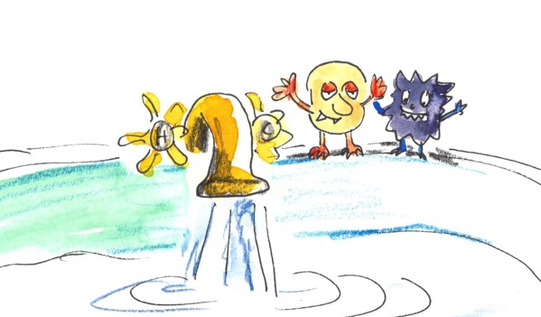
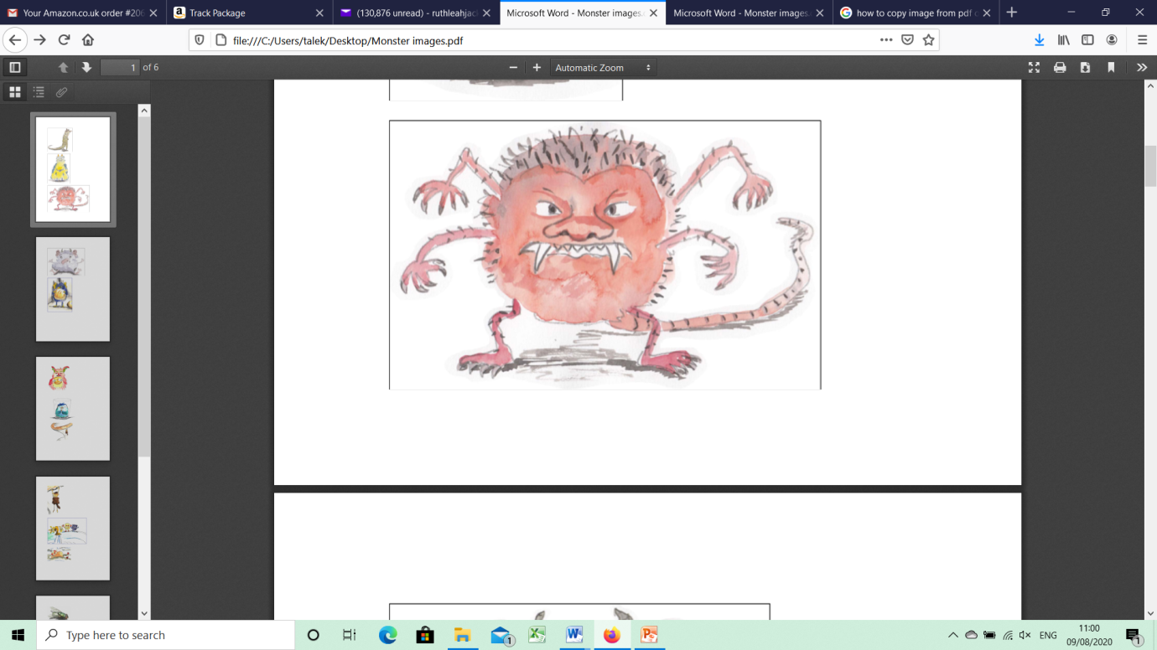
Punctuating Sentences
Exclamation marks
When we are exclaiming, we use an exclamation mark
The monster was furious!
Check out the capital letters and exclamation marks in all four sentences here.
You’ve eaten the bun!
You’re sticky!
You need a bath!

Slide 10
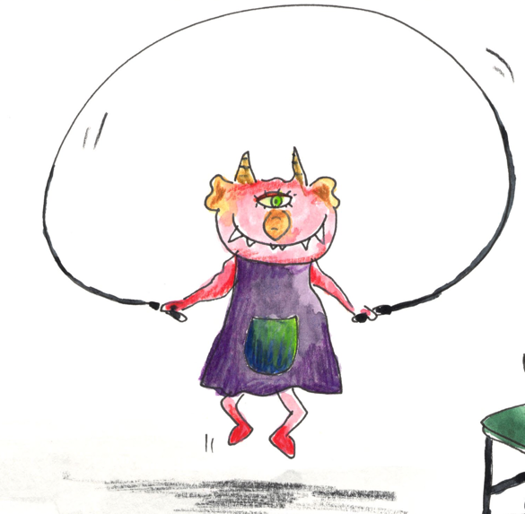
Punctuating Sentences
Add a full stop or a question mark or an exclamation mark to each sentence.
End-of-sentence punctuation
Add the correct end-of-sentence punctuation to each sentence.
How cool he is
How many skips have you done
I hate monsters
Why do monsters love tap water so much
The monster loved to sunbathe

Slide 11
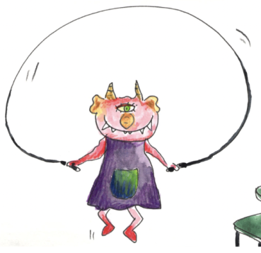
Punctuating Sentences
End-of-sentence punctuation
Add the correct end-of-sentence punctuation to each sentence.
How cool he is!
How many skips have you done?
I hate monsters!
Why do monsters love tap water so much?
The monster loved to sunbathe.

Slide 12


Explore more Hamilton Trust Learning Materials at https://wrht.org.uk/hamilton/ .

