Slide 1
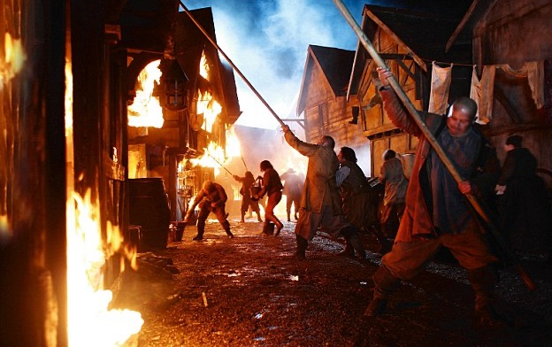
KQ4
Could more have been done to stop the spread of the Fire?

Slide 2
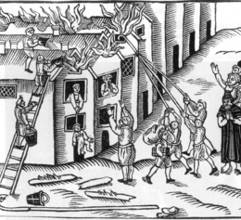
Fire hooks

Slide 3
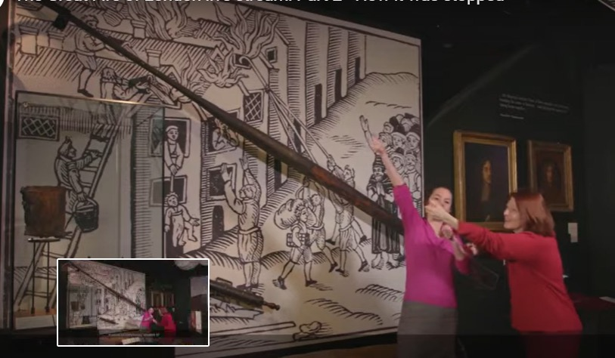

Slide 4
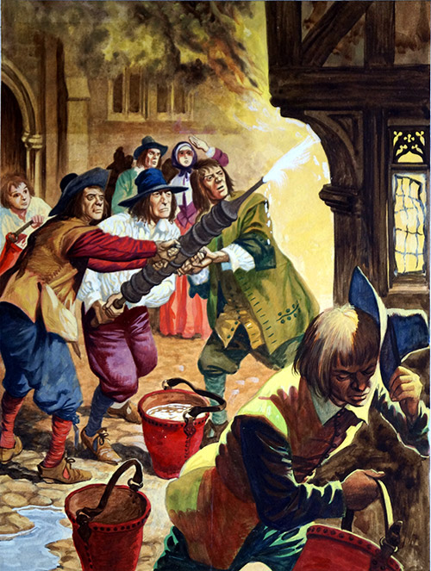
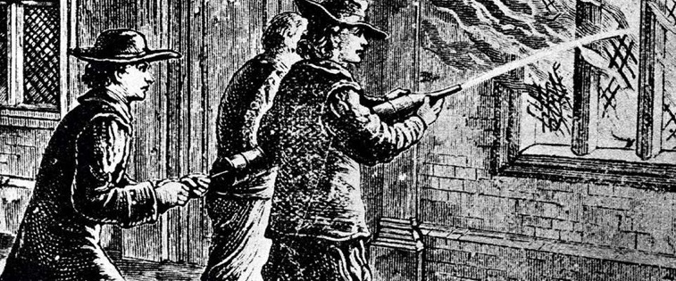
Fire squirts

Slide 5
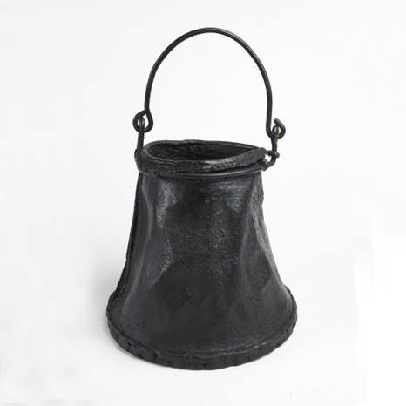
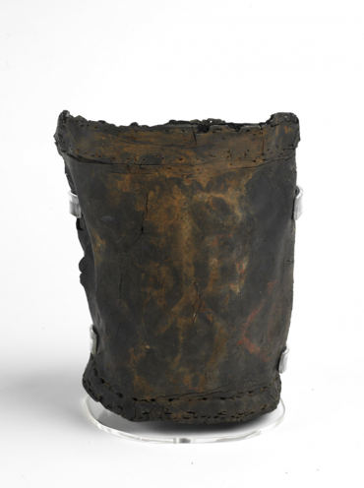
Leather water buckets

Slide 6
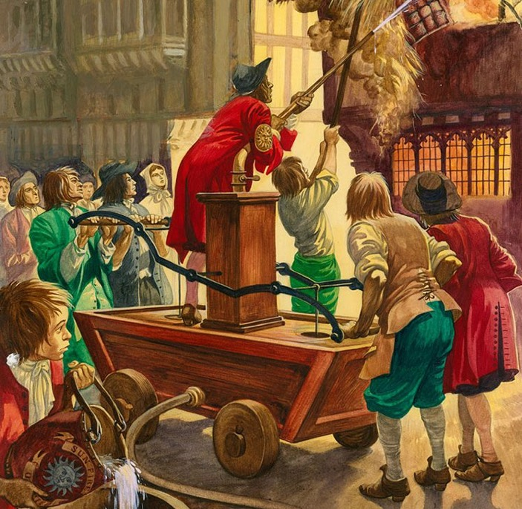
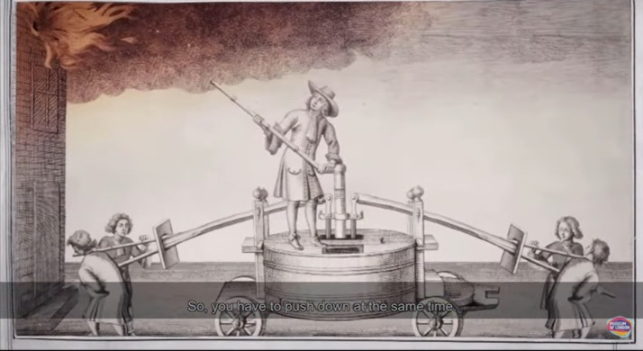
Fire engines

Slide 7
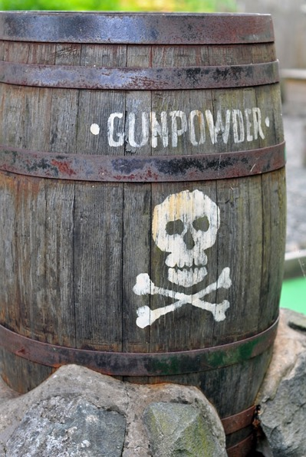
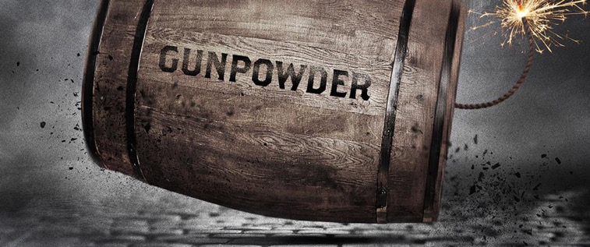
Gunpowder kegs
Gunpowder

Slide 8
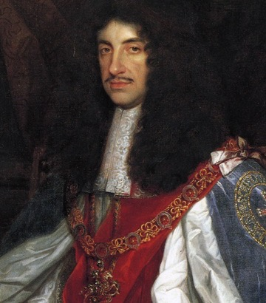
What WAS done?
King Charles

Slide 9
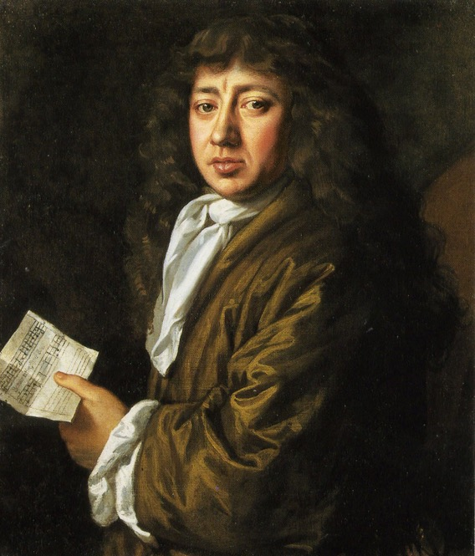
Samuel Pepys

Slide 10
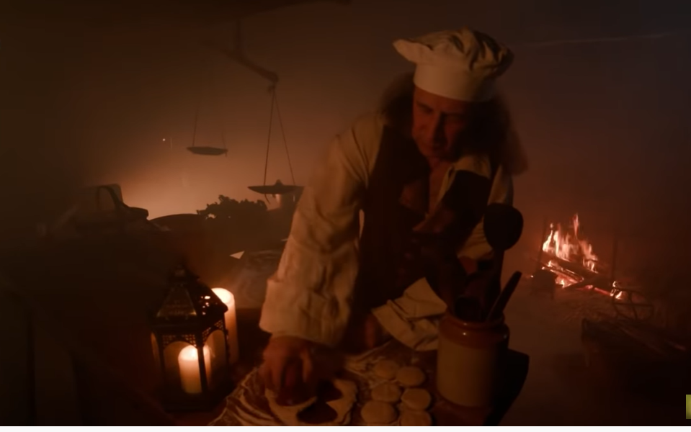
Thomas Farriner, the baker

Slide 11
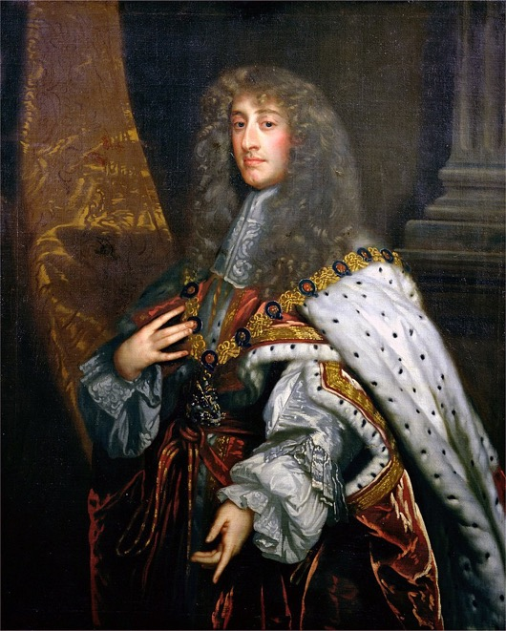
The Duke of York, the king’s brother

Slide 12
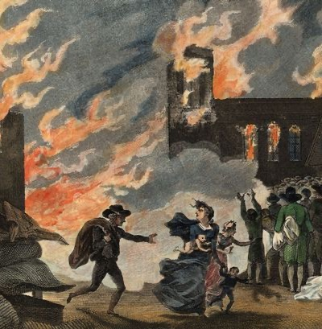
The people who left the city and didn’t stay to help fight the fire

Slide 13
1
2
The Mayor Thomas Bludworth was most to blame because he didn’t take it seriously at the start and then he didn’t order enough houses to be pulled down.
It was just a terrible accident. Nobody could have stopped it spreading so quickly
Who was to blame?
4
3
The baker for not putting out his fire properly and letting the spark from his ovens set light to the nearby wood.
The people themselves didn’t do enough to stop the fire. They were too worried about saving their own things.

Slide 14
In his diary Pepys wrote:
" People, all the world over cry out about the stupidity of my Lord Mayor, particularly in this business of the fire, laying all the blame upon him."

